Slide 1

DS-3002: Data Systems
An Overview of NoSQL Databases

Slide 2
NoSQL Databases
Understanding the Principles Behind NoSQL Databases

Slide 3

But Then… An Explosion of Data – “BIG Data”
A Rapid, Exponential Proliferation of New Devices: The Internet of Things (IoT)
olume (Size)
Explosion in social media, mobile apps, digital sensors, RFID, GPS, and more have caused exponential data growth.
ariety (Structure)
Traditionally BI has sourced structured data, but now insight must be extracted from unstructured or poly-schematic data like large text blobs, digital media, sensor data, etc.
eracity (Quality)
The anonymity of the WWW, incredible sources like social networking and duplicate systems bring into question the authenticity of the information being generated and collected.
elocity (Speed)
Sources like social networking and sensor signals create data at a tremendous rate; making it a challenge to capture, store, and analyze that data in a timely or economical manner.

Slide 4
NoSQL: Not Only SQL
Key-value stores
The simplest NoSQL database; based on “dictionaries” or “maps”.
Items are stored in associative arrays; pairing a name (or "key"), with a value.
Riak, FoundationDB, and Redis
Pairs keys with complex data structures (documents) using XML, JSON or BSON.
Documents may contain key-value pairs, key-array pairs, and nested documents.
MongoDB, MarkLogic, and Apache CouchDB
Graph stores
Stores interrelated networks of data such as social connections, or network topologies.
Optimized for interconnected data elements with an undetermined number of relations.
AllegroGraph, Neo4J and HyperGraphDB.
Column stores
Combines a key, value and timestamp for each item.
Optimized for large datasets by storing columns of data together, rather than in rows.
Cassandra, BigTable and HBase
Document databases
Often called "Not only SQL" because they may also support SQL-like queries. Many NoSQL stores compromise consistency in favor of availability & partition tolerance.

Slide 5

NoSQL Databases
NoSQL databases are defined by a collection of characteristics that they share rather than having a formal definition:
Non-relational
Scale-out
Schema-less
They were all born out of this desire to address new needs of the internet world.
Key–value databases
Column family databases
Document databases
Graph databases

Slide 6
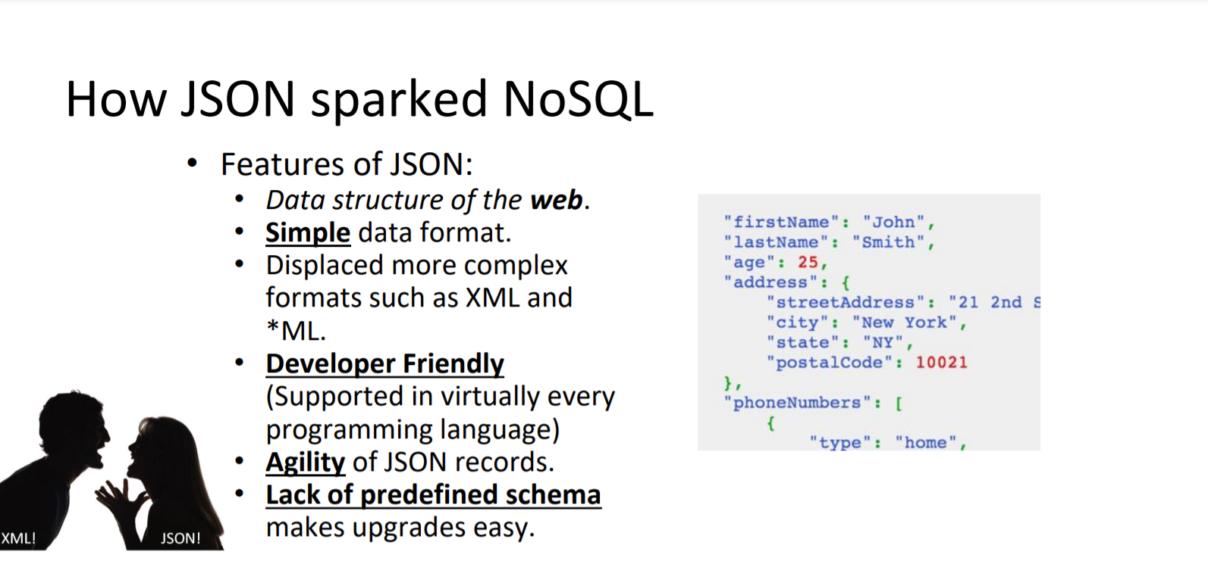
JSON in NoSQL

Slide 7
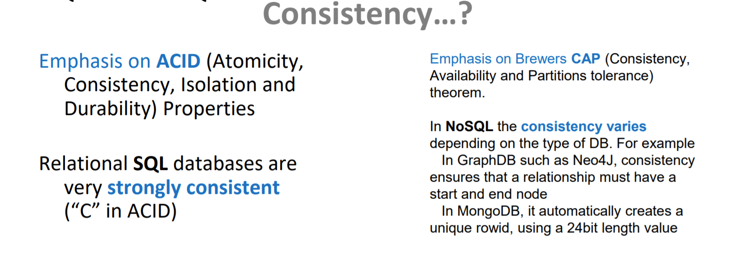
RDBMS vs NoSQL
RDBMS
NoSQL

Slide 8
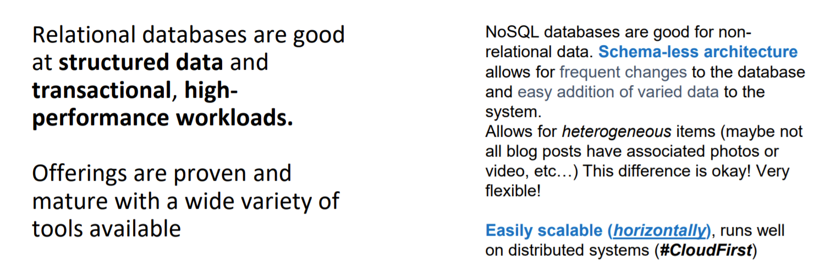
What are Relational DBs, NoSQL DBs good at?

Slide 9
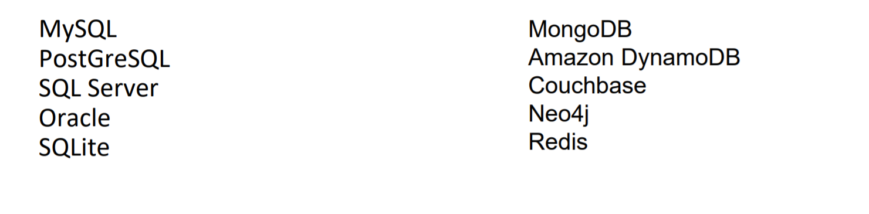
RDBMS and NoSQL Examples
RDBMS
NoSQL

Slide 10
SQL versus NoSQL Databases
 | SQL Databases | NoSQL Databases
Types | One: Relational Database | Many: Key-value, document, column, and graph databases
Data Storage | Records are stored as rows in tables that represent entities. Entity relationships are modeled by joining tables. | Records may be stored as “documents“ using XML or JSON. Entity relationships are modeled by nesting them hierarchically.
Schemas | Static: Structure & data types are fixed at design time. Adding new elements requires schema design changes. | Dynamic: New elements can be added at runtime. Poly-schematic: Dissimilar data can be stored together as necessary.
Scaling | Vertically: A single server must be made increasingly powerful to cope with increasing demand. | Horizontally: New commodity servers and storage are added to an array. Data is automatically distributed across all servers.
Transactions | Full transactional consistency (ACID) | Single element (document) only.
Manipulation | Using platform-specific languages (SQL) | Using OSS API’s, low-level lang., JavaScript
Consistency | Supports strong consistency | Per-product: Most are eventually consistent.

Slide 11
Resource Model: Account URI and Credentials
Account
********.virginia.edu
Database
IGeAvVUp …
Database
Database
Database
Database
Collection
Database
Database
Document

Slide 12
Resource Model: Database & Collection Resources
Database
Account
Database
Database
Collection
Collection
Database
Database
Database
Database
Document
Document

Slide 13
Document Collections versus Tables
JSON Documents
(Nested Hierarchies)
versus
RDBMS Tables
(Inter-tabular Relational Integrity)
{
“FirstName” : “Bob”,
“LastName” : “Smith”,
“BirthDate” : “03/11/1985”,
“PhoneNumbers” :
[ { “Home” : “571-555-1212” },
{ “Cell” : “703-525-1234” } ],
“Interests: [ “golf”, “movies” ]
}
Contacts
ContactID | 123
FirstName | Bob
LastName | Smith
BirthDate | 03/11/1985
Interests
InterestID | 3
ContactID | 123
Interest | Golf
PhoneNumbers
PhoneID | 1
ContactID | 123
Location | Home
Number | 571-555-1212

Slide 14
Interacting with Data: Relational vs Document
Relational Databases
(SQL: Sequential Query Language)
versus
Document Collections
(Documents: JSON Expressions)
SELECT * FROM [Table] WHERE…
INSERT INTO [Table] (Col1, Col1)
DELETE FROM [Table] WHERE…
UPDATE [Table] SET [Col1] = ‘value’
db.collection.find( { criteria }, { projection } )
db.collection.insert( { field : ‘value’ } )
db.collection.update( { criteria }, { action } )
db.collection.remove( { criteria } )
Filtering: the WHERE clause
WHERE LastName = ‘Smith’ AND InterestID IN (1,2)
Projection: the SELECT clause
SELECT FirstName, LastName… FROM
Filtering: More JSON Documents
{ “LastName” : “Smith”, “Interests” : {“Golf”, “Movies”} }
Projection: More JSON Documents
{ “FirstName” : 1, “BirthDate” : 0, “PhoneNumbers.Home” : 1 }

Slide 15
Architectural Models: How They’re Used
“Big Data” technologies aren’t necessarily intended to replace existing database technologies; rather they play a critical role in extending the capabilities of a data management ecosystem.
Standalone Data Analysis and Visualization
Experiment with data sources to discover if they provide useful information. Handle data that can’t be processed using existing systems.
Data Transfer, Cleansing or ETL
Extract and transform data before loading it into existing databases. Categorize, normalize, and extract summary results to remove duplication and redundancy.
Data Warehouse or Data Storage
Create robust data repositories that are reasonably inexpensive to maintain. Especially useful for storing and managing huge data volumes.
Integrate with Existing EDW and BI Systems
Integrate Big Data at different levels; EDW, OLAP, Excel PowerPivot. Also, APS enables querying Hadoop to integrate Big Data with existing dimension & fact data.

Slide 16
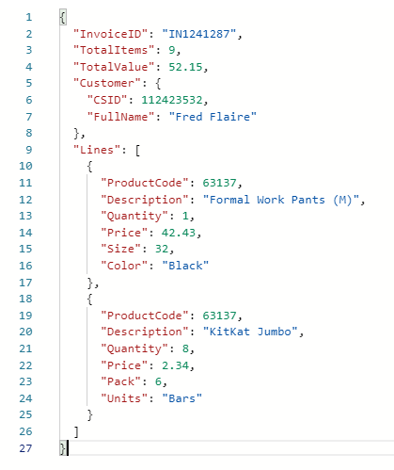
Document = BSON Document
BSON simply stands for “Binary JSON”
Based in Open JSON document format
Extended to add some optional non-JSON-native data types.
MongoDB stores data in BSON format both internally, and over the network

Slide 17
Document = BSON Document
Open JSON standard document format
Language-independent data format
Made up of attribute–value pairs
Supports recursive embedding
Supports embedded arrays
Flexible schema

Slide 18
Document = BSON Document
Open JSON standard document format
Language-independent data format
Made up of attribute–value pairs
Supports recursive embedding
Supports embedded arrays
Flexible schema

Slide 19
Items = JSON Document
Open standard document format
Language-independent data format
Made up of attribute–value pairs
Supports recursive embedding
Supports embedded arrays
Flexible schema

Slide 20
Document = BSON Document
Open JSON standard document format
Language-independent data format
Made up of attribute–value pairs
Supports recursive embedding
Supports embedded arrays
Flexible schema

Slide 21
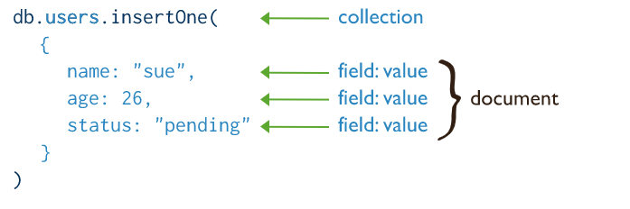
MongoDB API CRUD operations - Insert

Slide 22
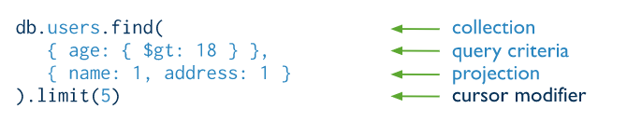
MongoDB API CRUD operations - Read
Notes:
db.runCommand({customAction: “getLastRequestStatistics", 1})

Slide 23
Features in MongoDB API – Indexing
Single Field Indexes: db.coll.createIndex({name:1})
Compound indexes: db.coll.createIndex({name:1,age:1})
Geospatial Indexes: db.coll.createIndex({ location : "2dsphere" })
Wildcard Indexes: db.coll.createIndex( { "$**" : 1 } )
Notes:
Unique indexes

Slide 24
Features in MongoDB API – Creating databases
db.runCommand({customAction: "CreateDatabase"});
db.runCommand({customAction: "CreateDatabase", offerThroughput: 1000 });
db.runCommand({customAction: "CreateDatabase",
autoScaleSettings: { maxThroughput: 20000 } });
db.runCommand({customAction: "UpdateDatabase", offerThroughput: 1200 });

Slide 25
Features in MongoDB API – Creating collections
db.runCommand({
customAction: "CreateCollection",
collection: "testCollection", offerThroughput: 400 });
db.runCommand({
customAction: "UpdateCollection",
collection: "testCollection", offerThroughput: 1200 });
Notes:
Removing the shard key will create an unsharded collection

Slide 27
Q & A
A Survey of Data Management Systems

Slide 28
The JSON Language
Understanding the Structured Query Language

