Slide 1

DS-3002: Data Systems
A Survey of Data Management Systems
Jason Williamson S2022

Slide 2
Class Mechanics
A Survey of Data Management Systems

Slide 3
Who am I?
Jason Williamson
VP, Oracle for Research and Oracle for Startups
MS Mgmt 2011, CommSchool Prof 2012-2017
Joined School of Data Science in 2020

Slide 4
Who am I?
Stuff about me, but mostly it just impresses my mom
Currently Global VP/Head of Oracle for Startups and Oracle for Research
See—>Oracle.com/startup and oracle.com/oracle-for-research/
Big Company Alum from: Amazon, GE Capital, Capital One
Small Stuff: Startup Founder, Faith Based NGO, boutique consulting
Academic: Current BoV at NCCU, Former Prof @McIntire & SEBTS, and UNC-CH Adam’s Fellowship Entrepreneurship Mentor
Former US Marine and Dual citizen of Raleigh, NC and C’Ville VA
4 Kids and 1 wife (Anna CAS ‘23, Patrick CAS ‘24, Lily, Jack and Susan COMM ‘95)
Can’t get enough basketball
Wrote some books on data, getting a job in big data, stuff like that... mostly just my mom buys them
I love helping students think about and navigate jobs, careers and life --> I’ve Hired 4 people from this program

Slide 5




Course Content
Lectures
Discussion
Person - First Class of the week (Monday)
Monday’s as a part of Lecture Day
Readings / Videos
Labs
Articles and posts Supporting tools/videos ~hours per week prep for Monday Class
Hands-On, Virtual and Wednesday. I’ll provide a Zoom

Slide 6
Course Content
Labs
Frequent hands-on labs
AWS, OCI, and GCP (Amazon, Oracle and Google)
1 per week (more available)
Begin on Wednesday’s and have complete by Friday

Slide 7

Grading
Data Projects
Concrete example of implementation - Two total - Released long before due - Detailed instructions will be in Collab - No time limits

Slide 8
Grading
Component | Weight | Frequency
Student Survey |  | First week
Lectures / Readings / Material |  | Weekly
Engaged Discussion | 5% | Weekly
Quiz | 15% | 3 or 4
Labs | 30% | Weekly
Data Projects | 50% | 2 projects x 25%

Slide 9
Things you need to know now
Everything will be updated on Git. https://jasonwnc.github.io/ds3002/
I’ll release quizzes and projects and grades on Collab
The schedule will update and I’ll be sure to let you know.
Still nailing down the TA
You can DM me on Discord with questions or to set up office hours
We will be IN PERSON Mondays and Wednesdays will be Zoom for hands on labs. We’ll do them in groups and sometimes alone.

Slide 10
Learning Objectives
Develop robust facility handling data
Acquire a strong understanding of SQL and NoSQL databases
Understand systems options in the public cloud
Gain fluency in tools, processes, and services, and how to choose among them.
Data retrieval
Data shipping
Data schemas
Data ingestion
Data processing
Data normalization
Data analysis

Slide 11
Overview of the Semester Topics
A Survey of Data Management Systems

Slide 12
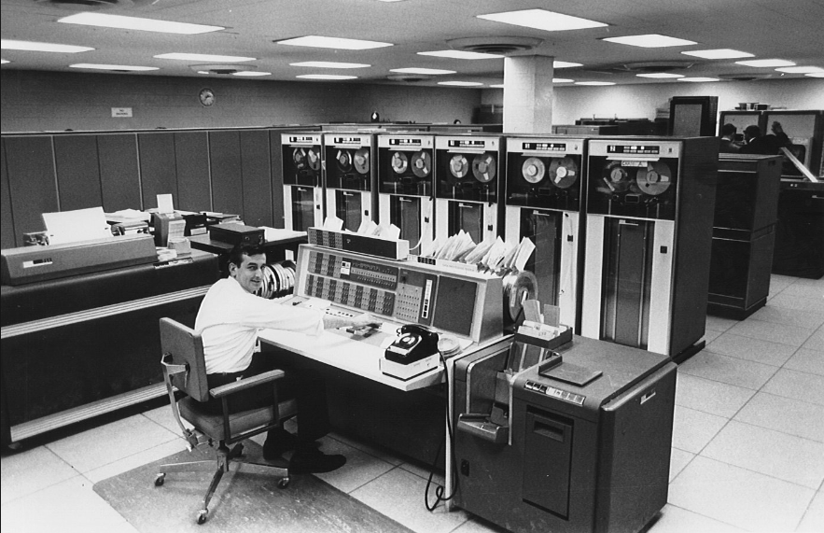
In the Beginning… There Was Mainframe
Data stored in ISAM files (indexed sequential access method)
Flat files having fixed-length fields
Centralized computing and storage resources
“Dumb” terminal clients
Only affordable to large, wealthy enterprises:
Governments
Large Banks

Slide 13
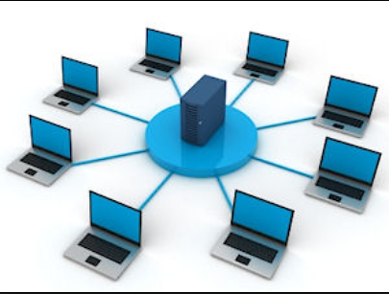
Then Came… Client/Server Networks
Data stored in Relational Database Management Systems (RDBMS):
Oracle
SQL Server
Enterprise Data Centers:
Company owned & managed
Based on commodity hardware
Some computation and storage resources shared by clients

Slide 14
And Today… Cloud-Hosted Systems & Services
Re-centralization of Servers ▪ Based on Commodity HW ▪ Resources Shared by Client
Essential Characteristics
On-Demand Self-Service
Broad Network Access
Resource Pooling
Rapid Elasticity
Measured Service
Service Models
Infrastructure as a Service (IaaS)
Platform as a Service (PaaS)
Software as a Service (SaaS)
Deployment Models
Public Cloud
Private Cloud
Community Cloud
Hybrid Cloud

Slide 15
Service Models: On-Premises vs Cloud-Hosted
Managed by Owner
Managed by Service Provider
On Premises
IaaS
PaaS
SaaS
Applications
Applications
Applications
Applications
Data
Data
Data
Data
Runtime
Runtime
Runtime
Runtime
Middleware
Middleware
Middleware
Middleware
OS
OS
OS
OS
Virtualization
Virtualization
Virtualization
Virtualization
Servers
Servers
Servers
Servers
Storage
Storage
Storage
Storage
Networking
Networking
Networking
Networking

Slide 16

The Internet of Things… An Explosion of Data
olume (Size)
Explosion in social media, mobile apps, digital sensors, RFID, GPS, and more have caused exponential data growth.
ariety (Structure)
Traditionally BI has sourced structured data, but now insight must be extracted from unstructured or poly-schematic data like large text blobs, digital media, sensor data, etc.
eracity (Quality)
The anonymity of the WWW, incredible sources like social networking and duplicate systems bring into question the authenticity of the information being generated and collected.
elocity (Speed)
Sources like social networking and sensor signals create data at a tremendous rate; making it a challenge to capture, store, and analyze that data in a timely or economical manner.

Slide 17
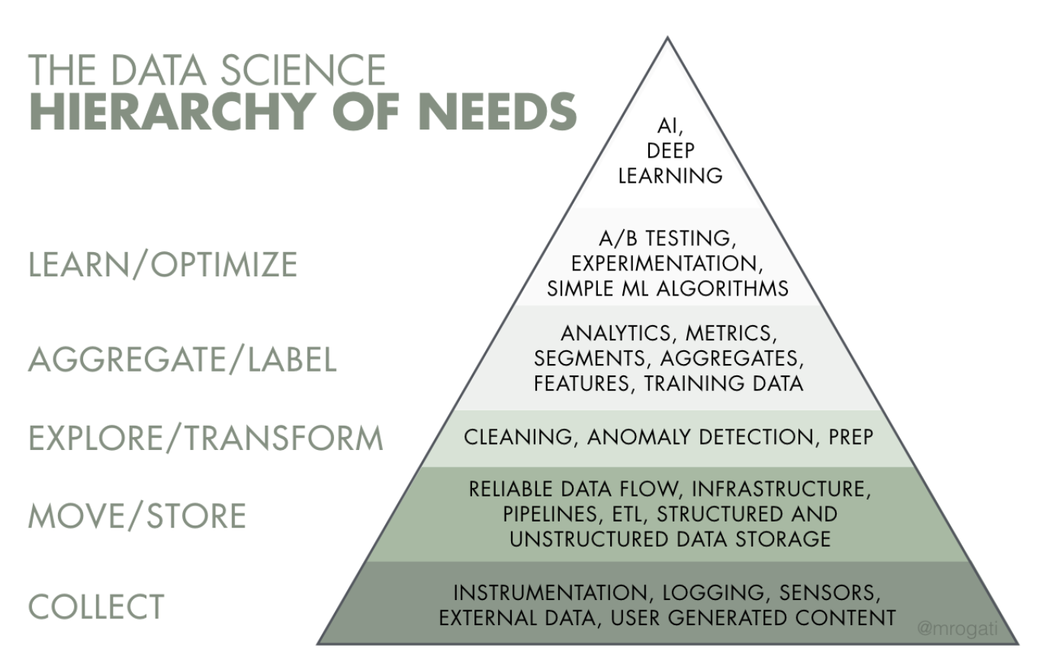
Notes:
Robert Chang, data scientist who used to work w/ Washington Post

Slide 18
Data Management Systems
Symmetric Multi-Processing (SMP) – Scale Up (Limited)
Massively Parallel Processing (MPP) – Scale Out (Practically Unlimited)
Schema on Write
Stores data in an organized structure (schema)
Schema on Read
Applies schema only when read, data stored in its original form-factor

Slide 19
Database Management Systems
File-based storage: Data Lakes
Relational Database Management Systems
Online Transaction Processing (OLTP) systems
Characterized by a large volume of transactions that affect a small number of rows
Online Analytical Processing (OLAP) systems
Characterized by a small volume of transactions that affect a large number of rows
NoSQL Database Management Systems
Massively Parallel Processing
Data partitioned and replicated across many server machines (nodes)
Data typically stored in file-based format (e.g., JavaScript Object Notation (JSON)

Slide 20
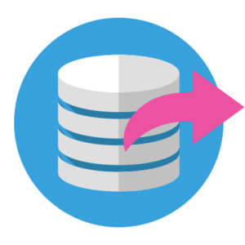


Data Engineering for Data Science
Extract - This is the step where sensors wait for upstream data sources to land. Once available, we transport the data from their source locations to further transformations.
Transform - The heart of any ETL job: apply business logic, perform actions such as filtering, grouping, and aggregation to translate raw data into analysis-ready datasets.
Load - Load the processed data and transport to a final destination. Can now be consumed directly by end-users or treated as yet another upstream dependency.

Slide 21
NoSQL: Not Only SQL
Key-value stores
The simplest NoSQL database; based on “dictionaries” or “maps”.
Items are stored in associative arrays; pairing a name (or "key"), with a value.
Riak, FoundationDB, and Redis
Pairs keys with complex data structures (documents) using XML, JSON or BSON.
Documents may contain key-value pairs, key-array pairs, and nested documents.
MongoDB, MarkLogic, and Apache CouchDB
Graph stores
Stores interrelated networks of data such as social connections, or network topologies.
Optimized for interconnected data elements with an undetermined number of relations.
AllegroGraph, Neo4J and HyperGraphDB.
Column stores
Combines a key, value and timestamp for each item.
Optimized for large datasets by storing columns of data together, rather than in rows.
Cassandra, BigTable and HBase
Document databases
Often called "Not only SQL" because they may also support SQL-like queries. Many NoSQL stores compromise consistency in favor of availability & partition tolerance.

