Slide 1
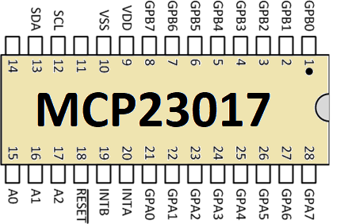
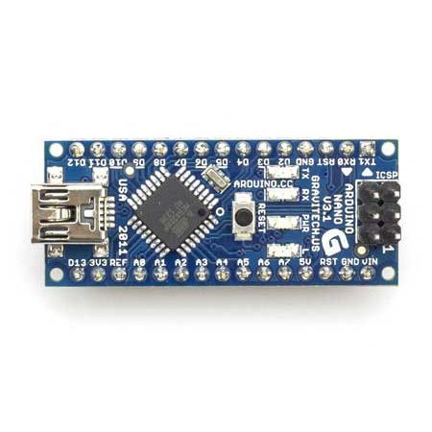
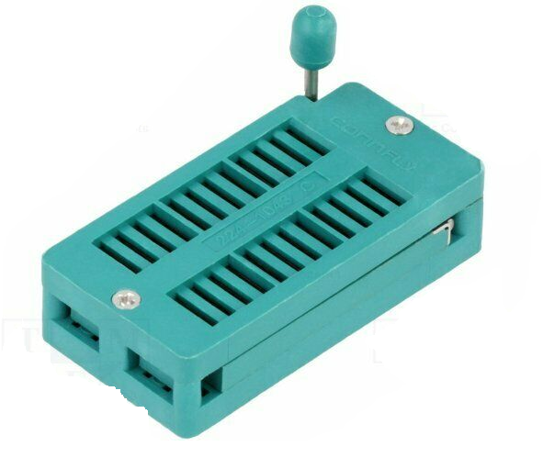

I²C
GPIO
GPIO
Serial
USB
48 pin ZIF socket
Serial
Monitor
GPIO
I²C

Slide 2
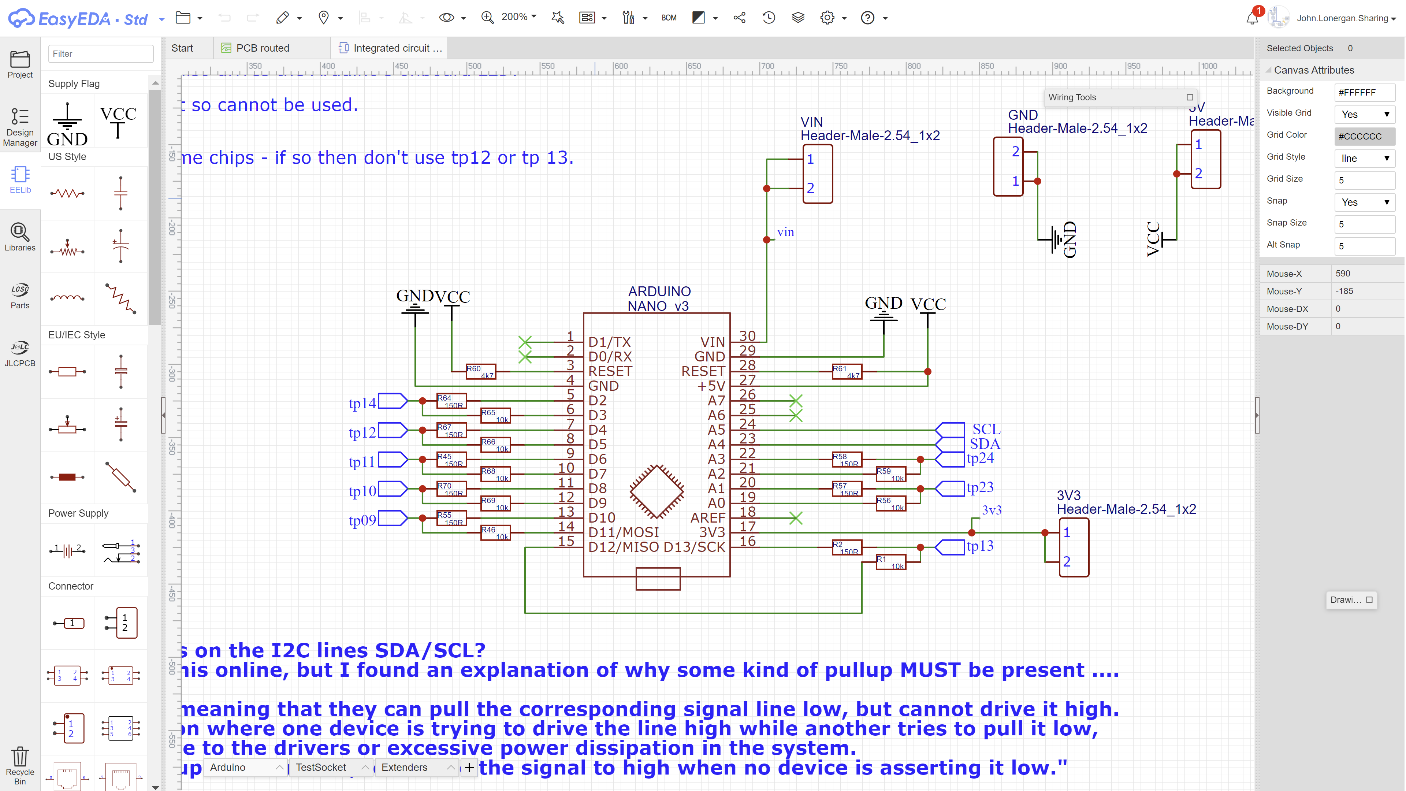

Slide 4
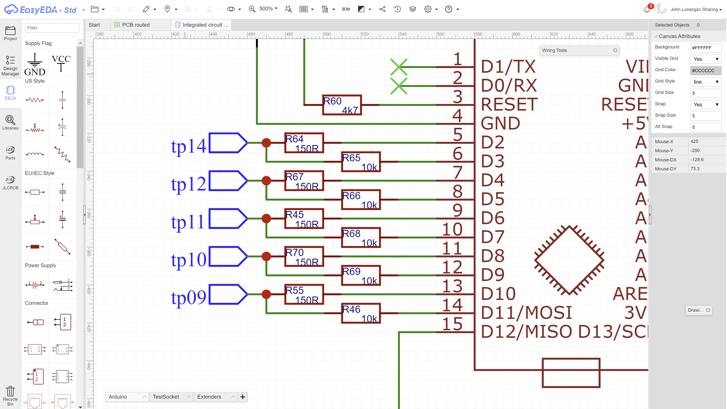

Slide 5
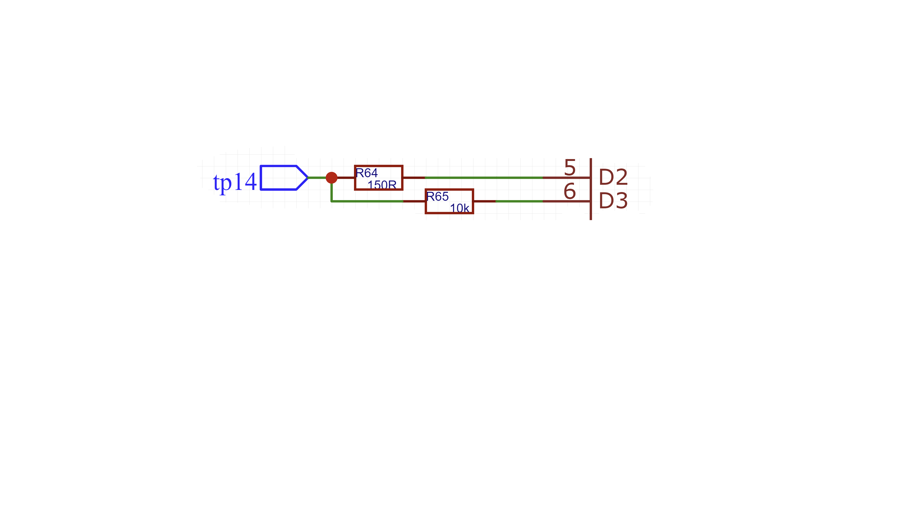

Slide 6
GPIO-L is activated as an output when tp14 is an input to the test chip is Vcc/Gnd.
Is activated as an input when sensing the value of tp14 when the test chip pin is an output.
GPIO-L
TEST PIN PAIR
D2 and D3 are dedicated to tp14, to drive a 1/0/Vcc/Gnd inputs or to sense 1/0/Z outputs of the test chip..
TEST PIN – tp14
Is connected directly to the ZIF socket
GPIO-H
GPIO-H is activated only ever as an output and is used to drive tp14 with a weak pull-up or weak-pull down. During sensing of tp14 this allows us to positively distinguish a 1 or 0 state from a high-Z output.
The ability to detect unoccupied ZIF socket pins makes this IC tester immune from spurious state readings that occur to capacitance and electrical noise.
Most other IC testers are unable to reliably detect vacant ZIF socket pins so my approach here thoroughly checks the state of all ZIF pins not just those that are occupied by the test chip.

Slide 7
GPIO-L
TEST PIN
GPIO-H
GPIO PIN PAIR

Slide 8
GPIO-L
TEST PIN
GPIO-H
GPIO PIN PAIR

