Slide 1
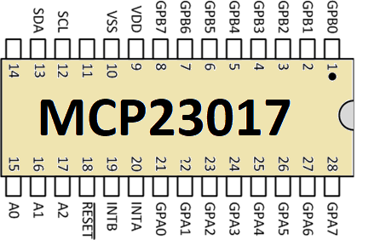
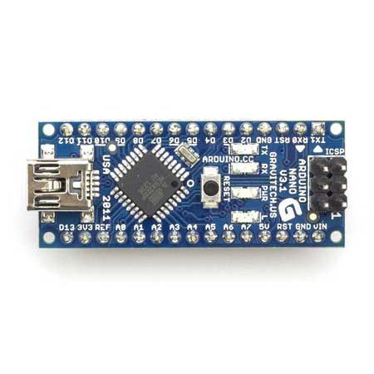
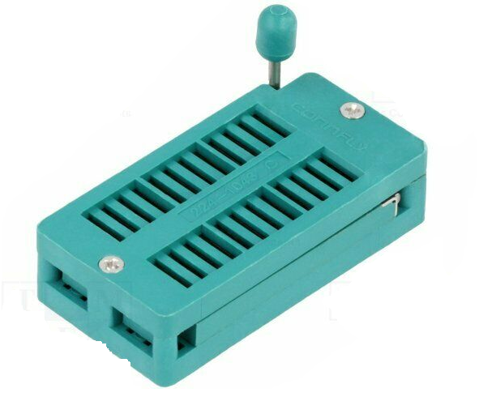

I²C
GPIO
GPIO
Serial
USB
48 pin ZIF socket
Serial
Monitor
GPIO
I²C

Slide 2
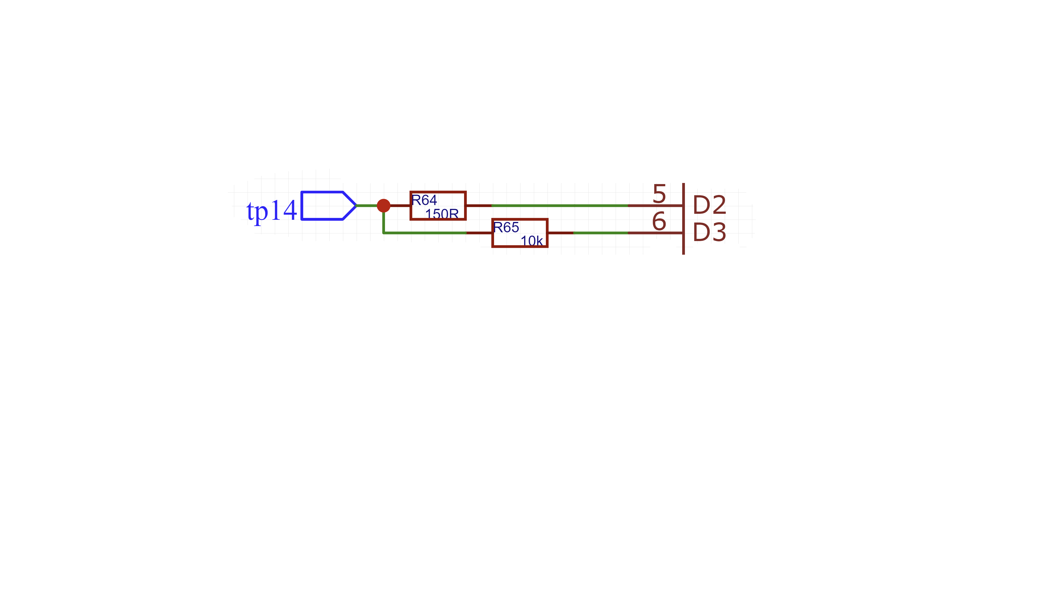
GPIO-L is pinMode(OUTPUT) when tp14 is a expected to be a logic input to the test chip or is expected to be Vcc/Gnd.
GPIO-L is pinMode(INPUT) when tp14 is expected to be a logic output of the test subject and we are sensing that output pin.
GPIO-L
GPIO “Pin Pair” D2 and D3 are dedicated to tp14. They either drive inputs of 1/0/Vcc/Gnd or sense 1/0/Z outputs of the test chip on tp14.
tp14 is connected to ZIF socket
test pin 14
GPIO-H
GPIO-H is pinMode(OUTPUT) while GPIO-L is sensing. The rest of the time it is a no-op and is set as pinMode(INPUT) and can be completely ignored.
GPIO-H’s sole purpose is to apply an optional weak pull-up or weak-pull down to tp14 during sensing and this allows us to positively distinguish a 1 or 0 logic output state from a high-Z (or vacant ZIF) output state.

Slide 3
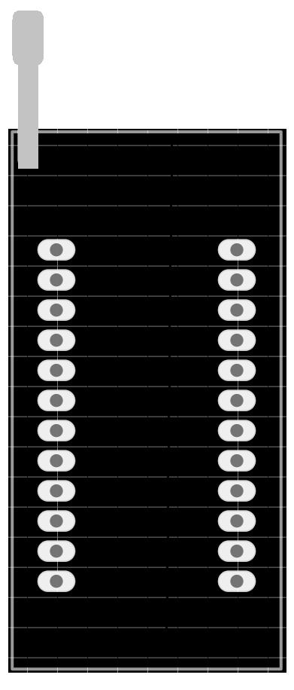
Empty ZIF Socket
??????????
?
??????????
?

Slide 4
Empty ZIF Socket
-ZZZZZZZZZZZ
-ZZZZZZZZZZZ
ZZZZZZZZZZZZZZZZZZZZZZ

Slide 5
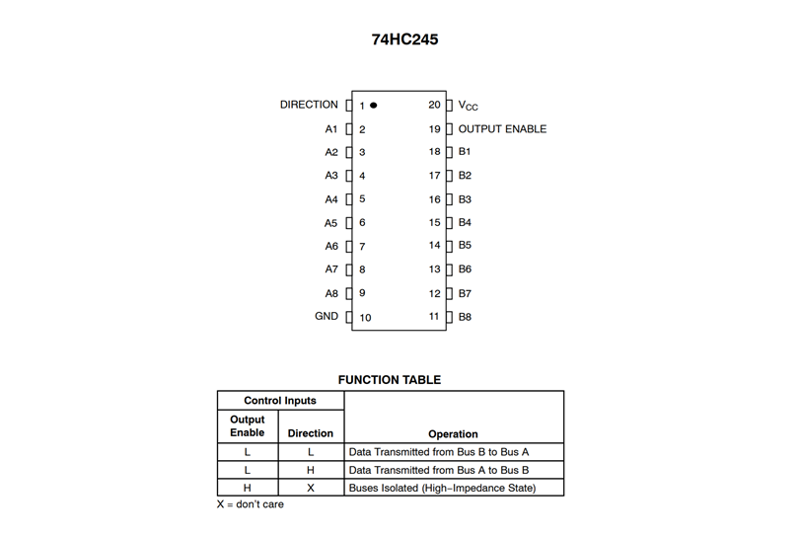

Slide 6

Test outputs disabled
??????????
??????????

Slide 7
Test outputs disabled

Slide 8
Test outputs disabled
V
G

Slide 9
Test outputs disabled
Don’t Care X
G
V
1 Active low so 1 = Disabled

Slide 10
Test outputs disabled
Don’t Care X
Z
Z
Z
Z
Z
Z
Z
Z
G
V
1 Active low so 1 = Disabled
Z
Z
Z
Z
Z
Z
Z
Z

Slide 11
Test outputs disabled
Don’t Care X
Z
Z
Z
Z
Z
Z
Z
Z
G
V
1 Active low so 1 = Disabled
Z
Z
Z
Z
Z
Z
Z
Z
XZZZZZZZZ0/ZZZZZZZZ11

Slide 12
Test outputs enabled
Data flowing from
B to A
G
V

Slide 13
Test outputs enabled
Data flowing from
B to A
G
V
0 Active low = Enable

Slide 14
Test outputs enabled
Data flowing from
B to A
B -> A = 0
G
V
0 Active low = Enable

Slide 15
Test outputs enabled
Data flowing from
B to A
B -> A = 0
G
V
0 Active low = Enable
1
1
1
1
0
0
0
0

Slide 16
Test outputs enabled
Data flowing from
B to A
B -> A = 0
H
H
H
H
L
L
L
L
G
V
0 Active low = Enable
1
1
1
1
0
0
0
0
0HHHHLLLLG000011110V

Slide 17
Test outputs enabled
Data flowing from
B to A
B -> A = 0
H
H
H
H
L
L
L
L
G
V
0 Active low = Enable
1
1
1
1
0
0
0
0
H and L for
output
expectations
i.e. tests
… and X for
don’t care
V/G/1/0 for
Input settings
0HHHHLLLLG/000011110V

Slide 18
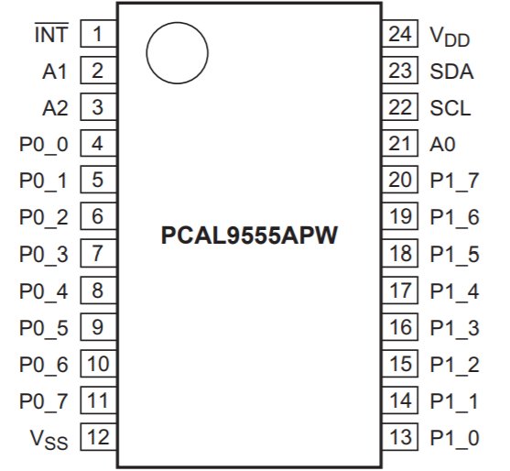
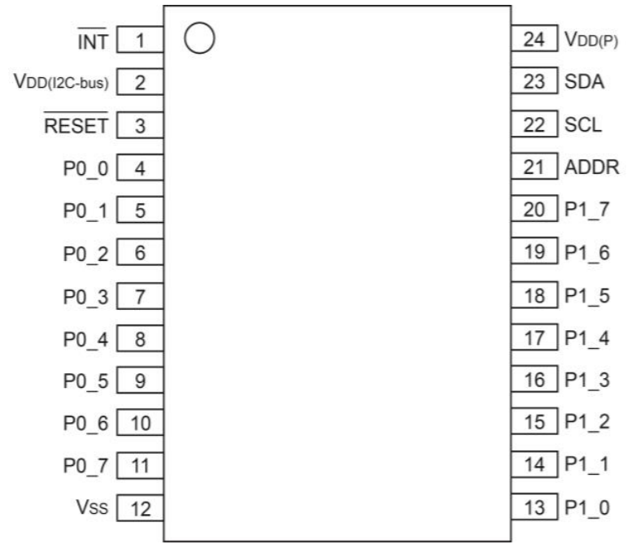
GPIO alternatives to Arduino & MCP23017
PCAL9555A
16 bit with internal pull-up and pull-down resistors (50KΩ-100KΩ) - eliminates need for GPIO-H
25mA high output current / 50mA low output current
No DIP variant so mounting more tricky for me (TSSOP24 / & tiny HWQFN24)
Cheap @ £1
PI4IOE5V6416
16 bit with internal pull-up & pull-down 100K (50KΩ -150KΩ) - eliminates need for GPIO-H
50mA current (data sheet is confusing and might be 10mA or 20mA)
No DIP (TSSOP 24 / TQFN 24)
I²C Addressing limited to 2 addresses (that’s ok if we want 32 bits)
Cheap @ £1
But not….
FLX6408
Only 8 pin but has pull-up and pull-down
Only a low 6mA drive
PI4IOE5V6416

Slide 19
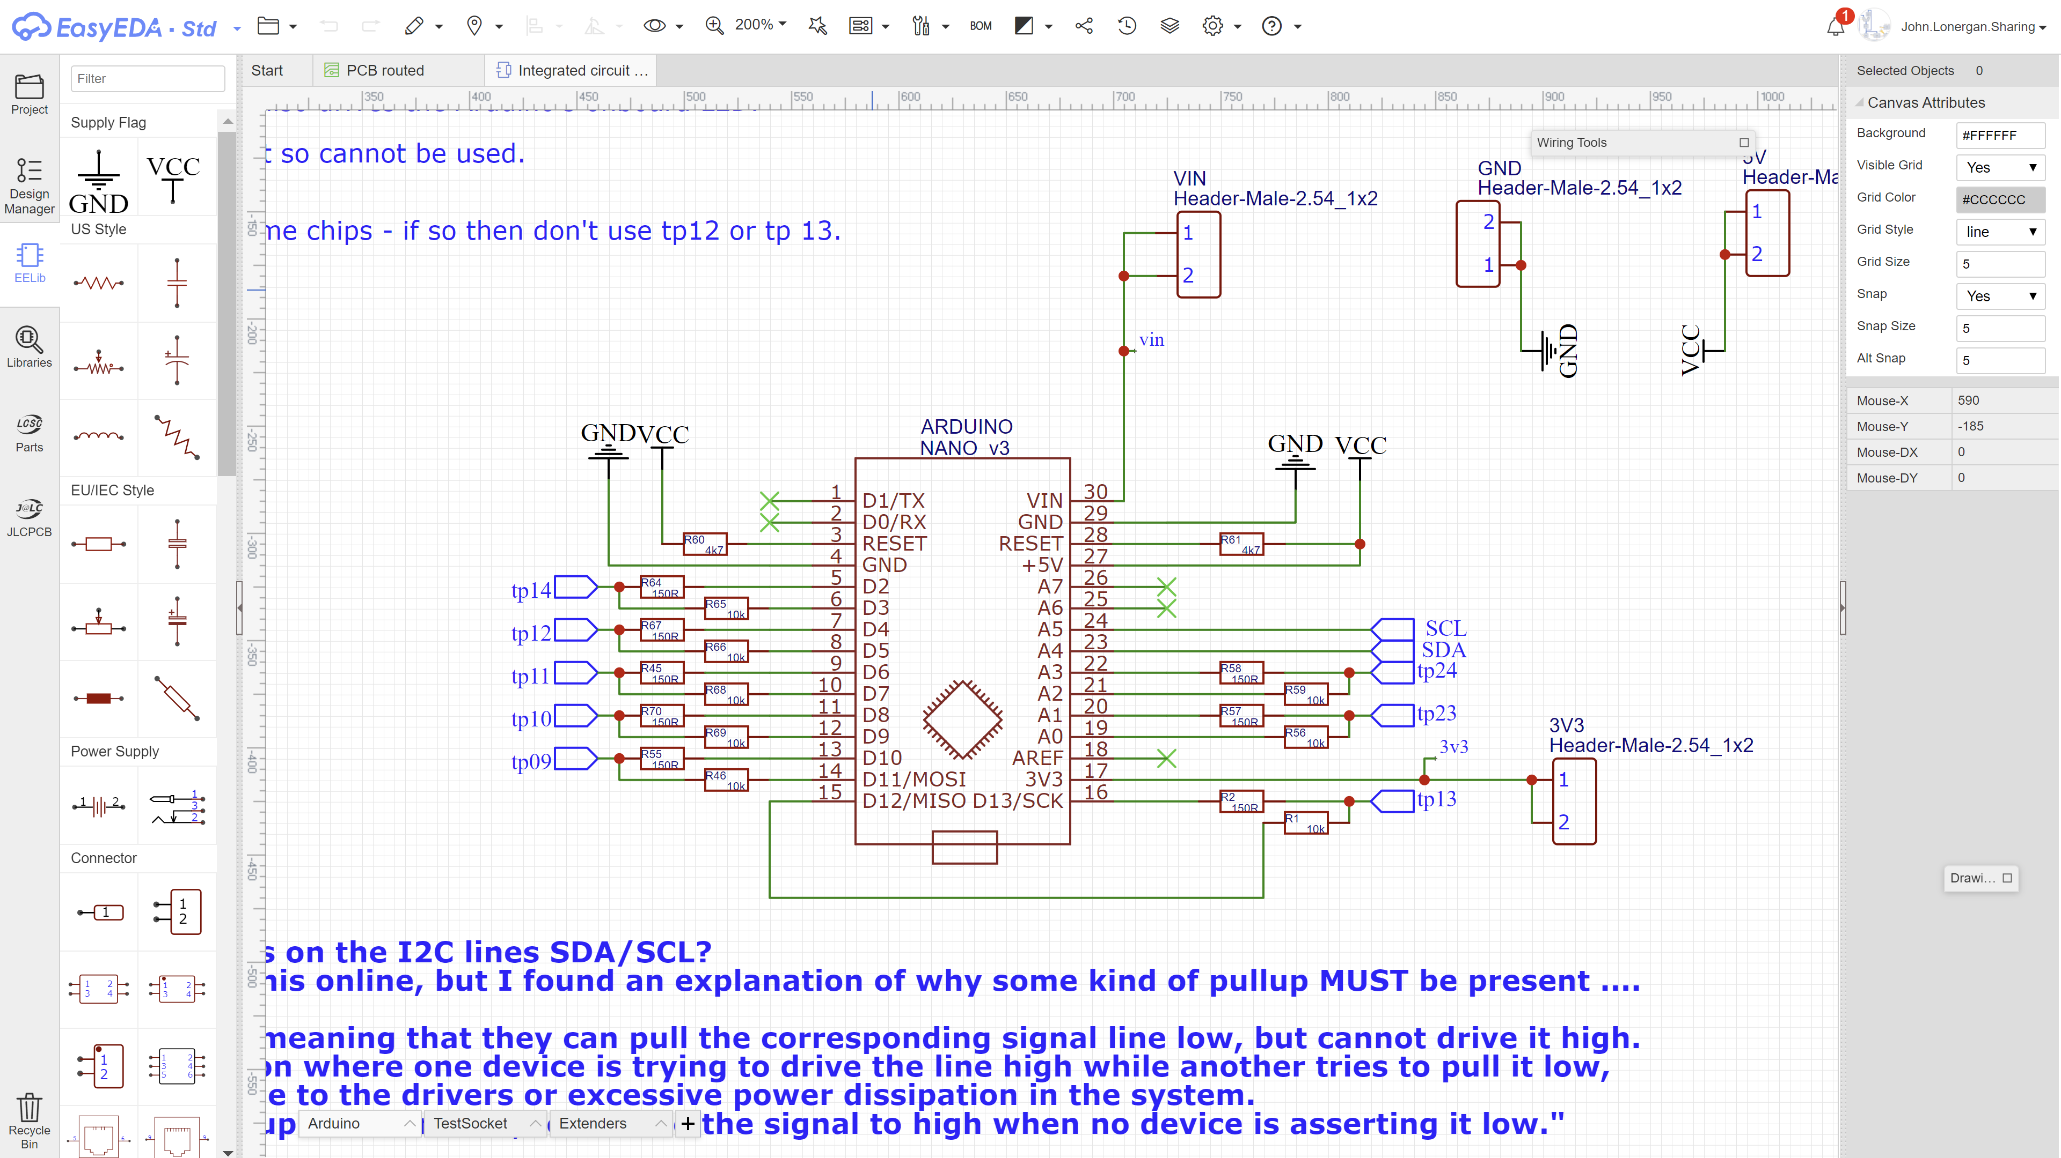

Slide 21
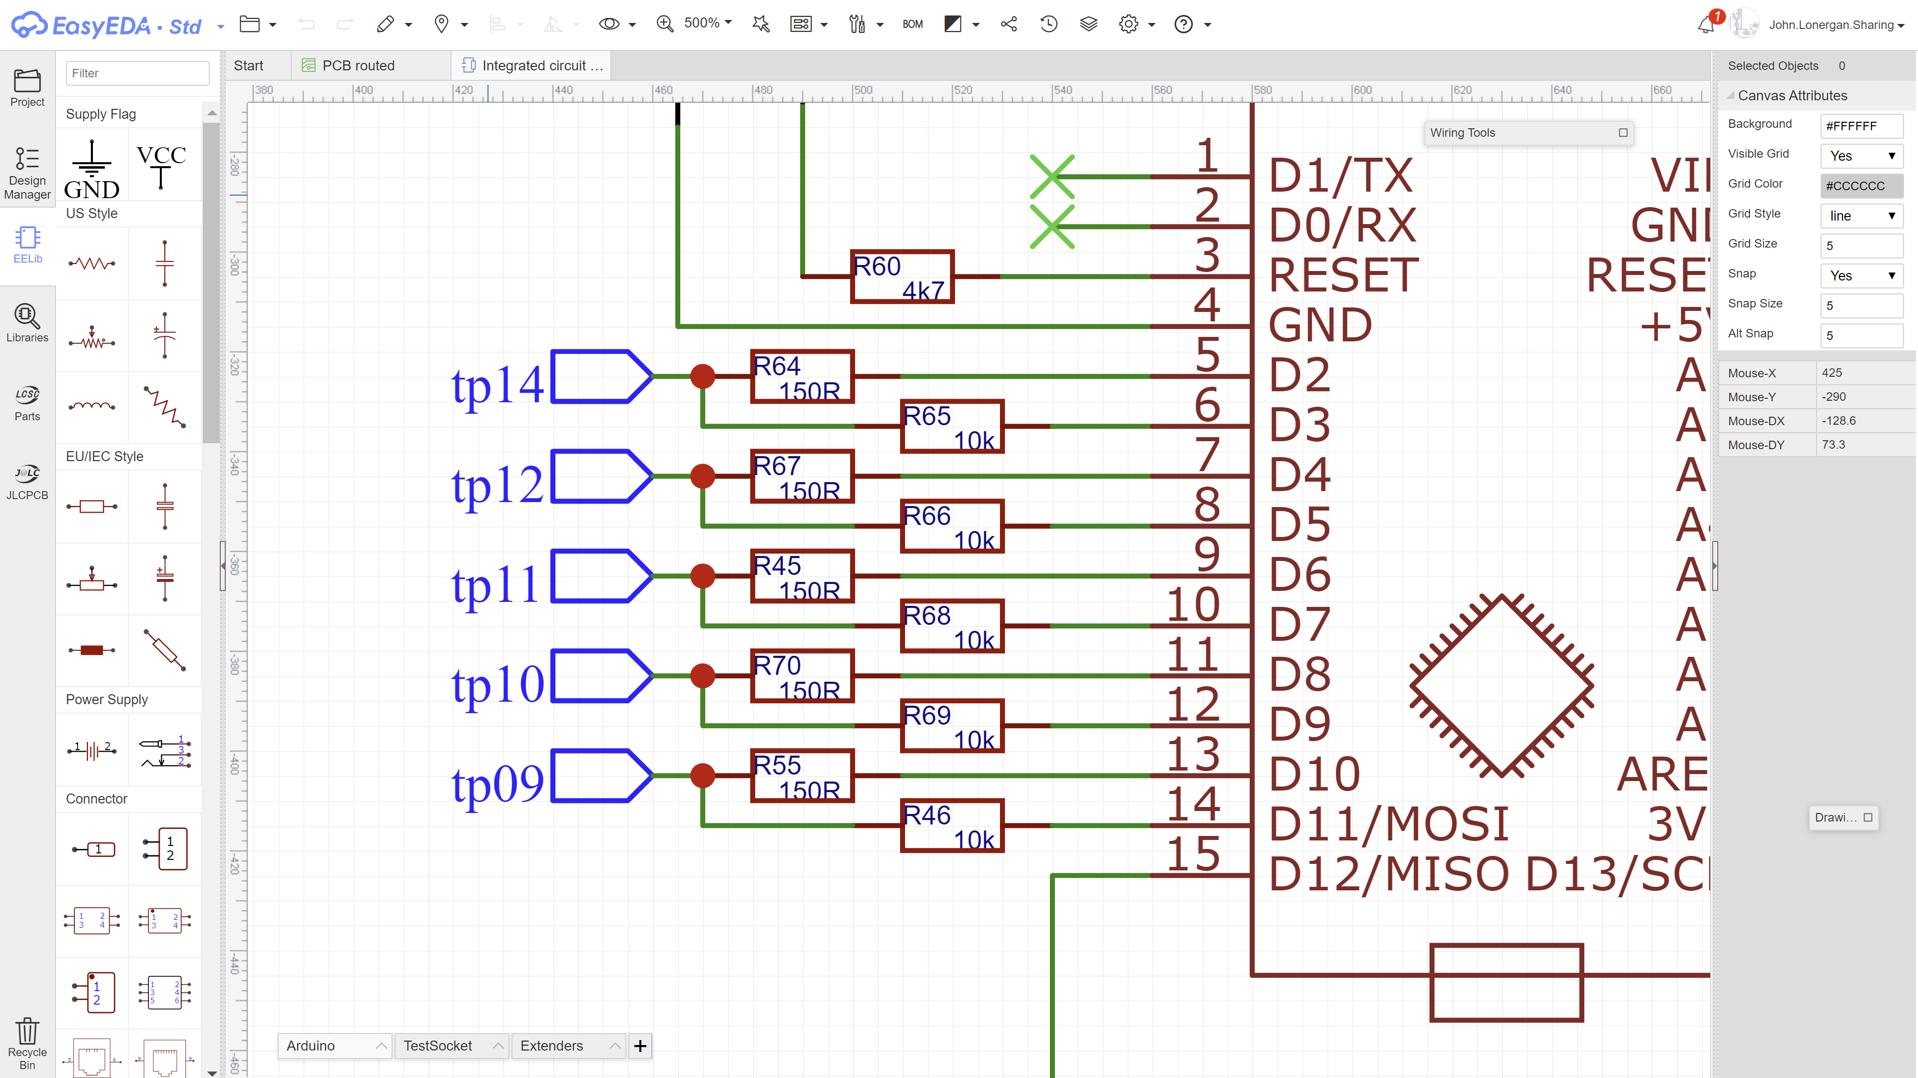

Slide 23
GPIO-L
TEST PIN
GPIO-H
GPIO PIN PAIR

Slide 24
GPIO-L
TEST PIN
GPIO-H
GPIO PIN PAIR

