Slide 1
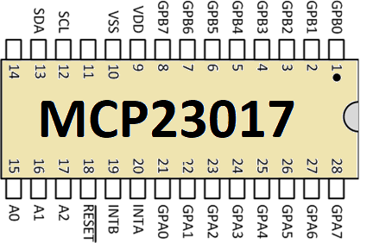
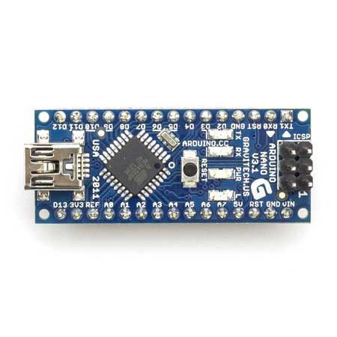
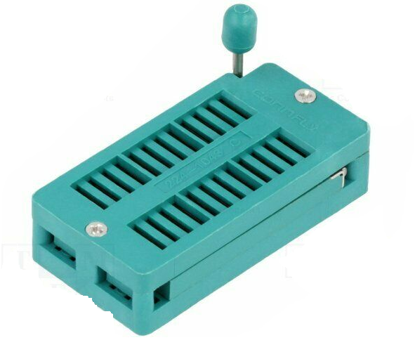

I²C
GPIO
GPIO
Serial
USB
48 pin ZIF socket
Serial
Monitor
GPIO
I²C

Slide 2
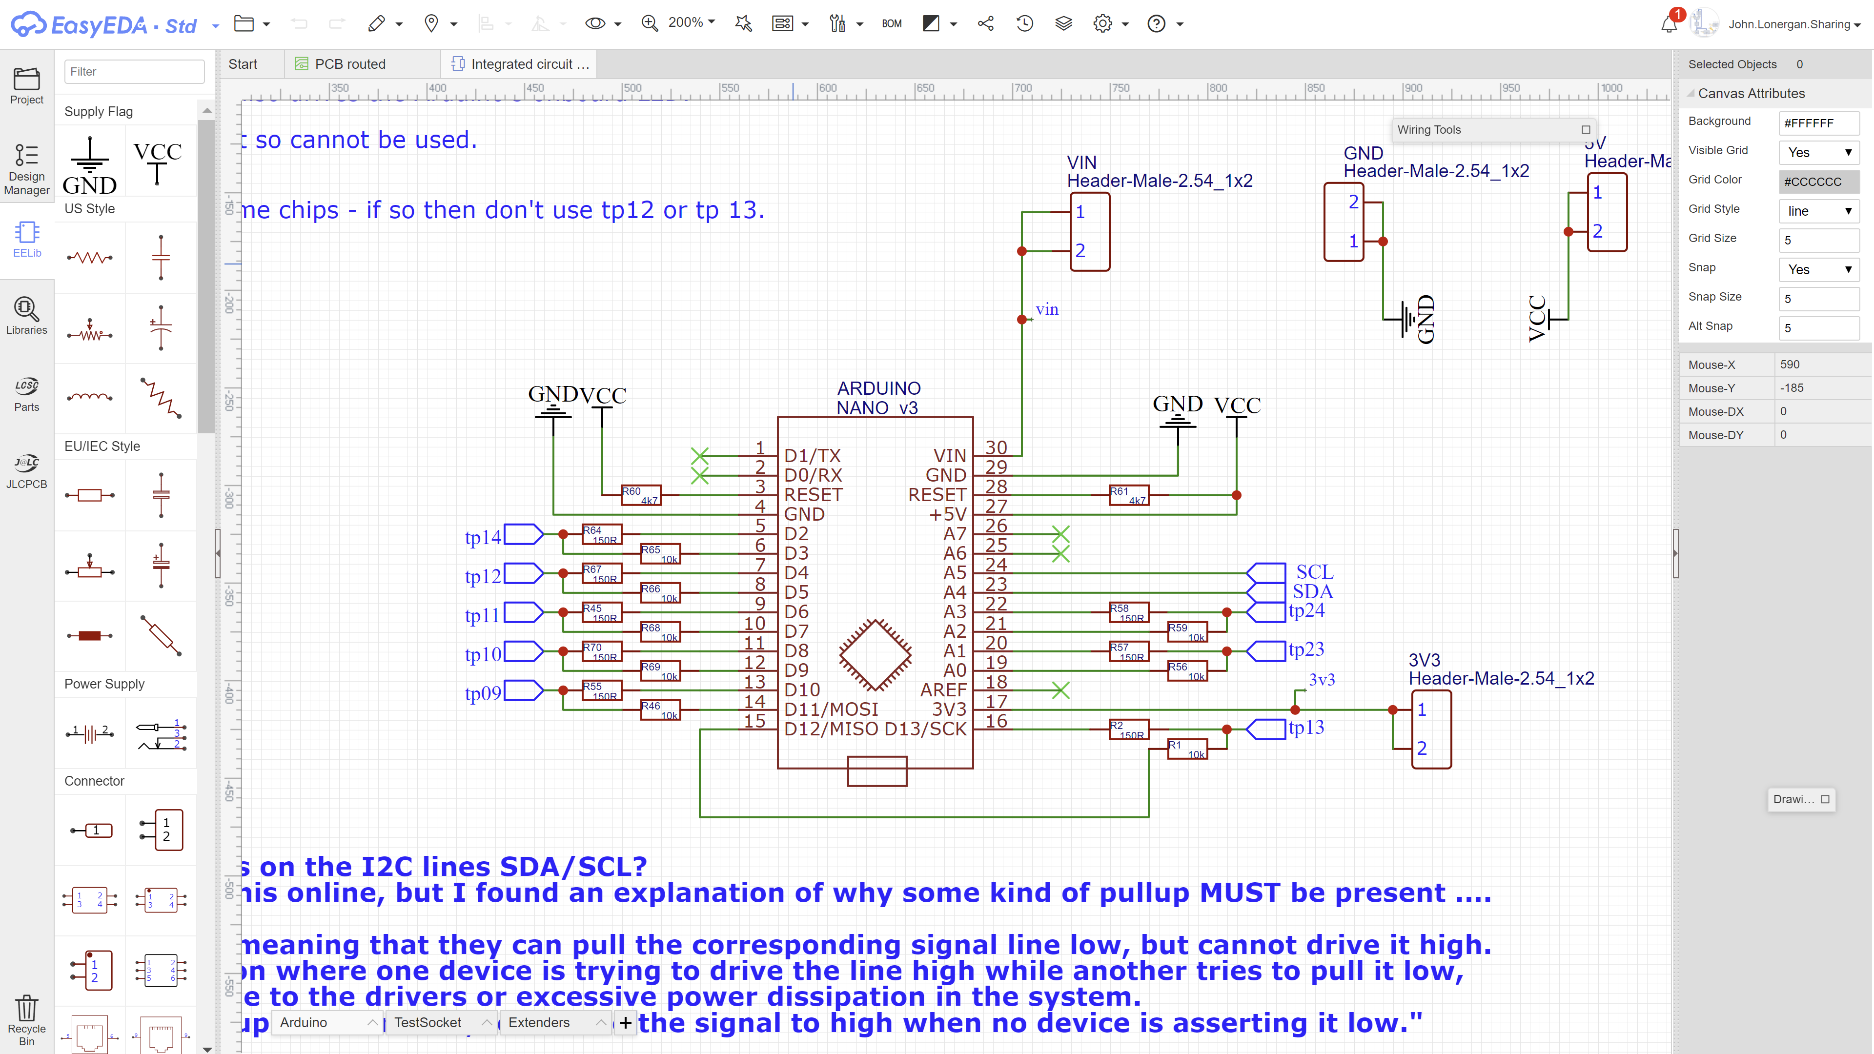

Slide 4
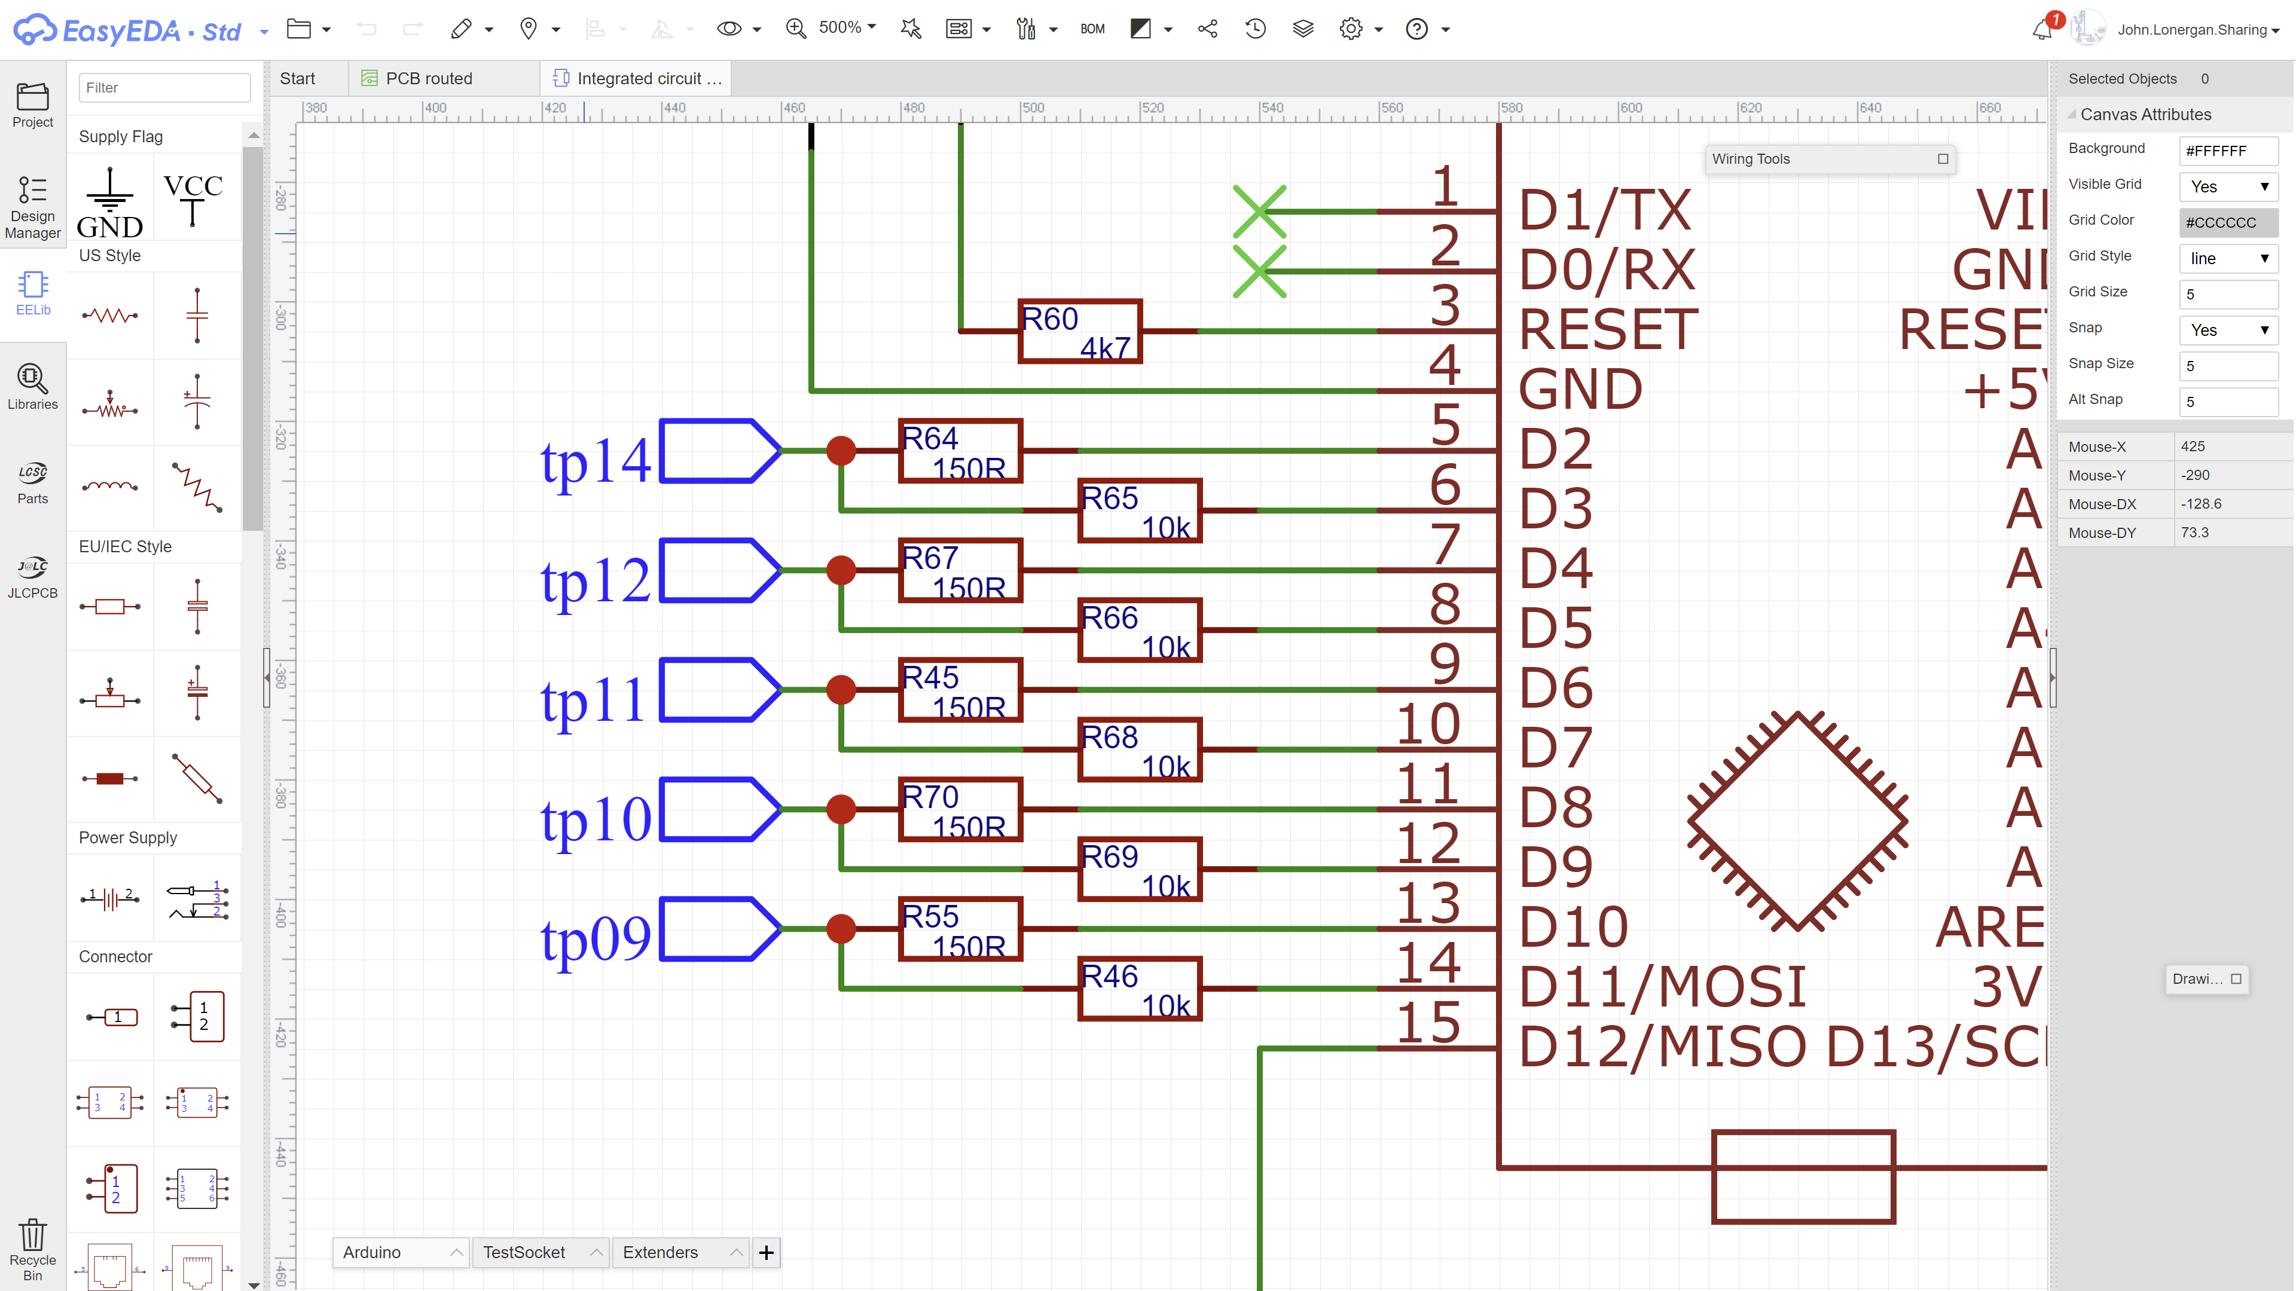

Slide 5
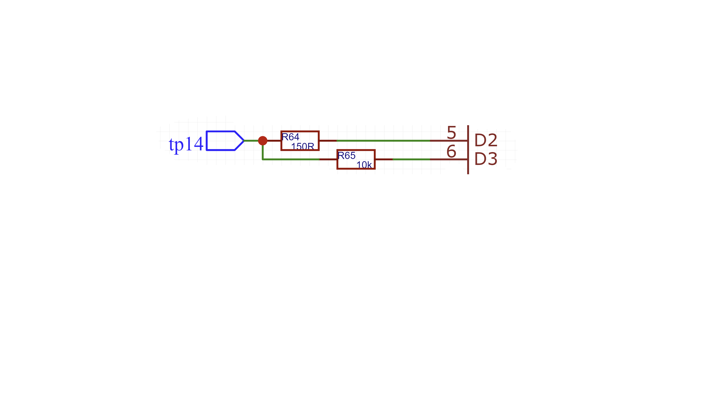

Slide 6
GPIO-L
TEST PIN
GPIO-H
GPIO PIN PAIR

Slide 7
GPIO-L
TEST PIN
GPIO-H
GPIO PIN PAIR

Slide 8
GPIO-L
TEST PIN
GPIO-H
GPIO PIN PAIR

