Slide 1
Address HI Path
PCHITMP
PCHI
ALU
/8
A
/8
/8
out
/16
Address Bus
/8
B
/8
PCLO
/8
Address Lo Path
PCHI
/8
/16
Address Bus
PCLO
/8

Slide 2
TRIPLE PORT REGISTER FILE 4 x 8 BIT
74HCT670
A : LO 4 Bits
R
D
W
RA_ADDR[1:0]
Q
D[3:0]
74HCT670
A : HI 4 Bits
QA[7:0]
W
D
R
W_ADDR[1:0]
Q
D[7:4]
D[7:0]
74HCT670
B : HI 4 Bits
R
D
W
Q
74HCT670
B : LO 4 Bits
QB[7:0]
W
D
R
D[3:0]
Q
RB_ADDR[1:0]

Slide 3
TRIPLE PORT REGISTER FILE
4 x 8 BIT
Register 0
Output Port A
Input Port
/8
Register 1
/8
Output Port B
Register 2
/8
/Write Enable
/1
Register 3
Write Register Select
/2
Output Port A Register Select
/2
Output Port B Register Select
/2
W_ADDR[1:0]
RB_ADDR[1:0]
RA_ADDR[1:0]
W_ADDR[1:0]
4 x 8 BIT TRIPLE PORT REGISTER FILE
QA[7:0]
D[7:0]
QB[7:0]

Slide 4
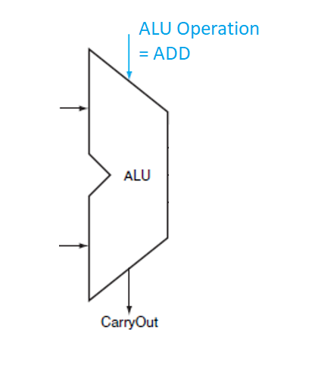
t0: VALUE = X
t1: VALUE = X +1
ASYNCHRONOUS
REGISTER
FILE
/WE
READ ADDR = 0
WRITE ADDR = 0
t0: VALUE = X + 1
t1: VALUE = X + 1 + 1
VALUE = 1

Slide 5
t0: VALUE = X
t1: VALUE = X +1
ASYNCHRONOUS
REGISTER
FILE
8 BIT
NEGATIVE EDGE TRIGGERED
D TYPE FLIP-FLOP
CLOCK
READ ADDR = 0
WRITE ADDR = 0
t0: VALUE = X + 1
t1: VALUE = X + 1 + 1
/WE
VALUE = 1

Slide 6
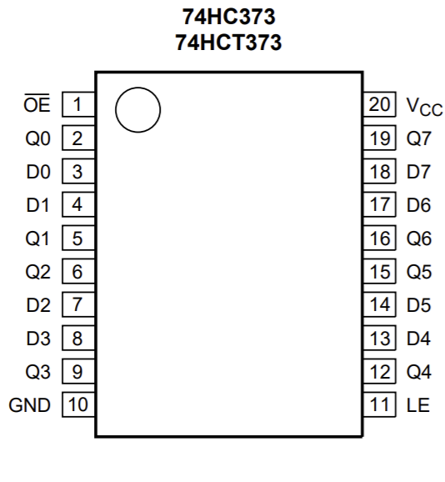
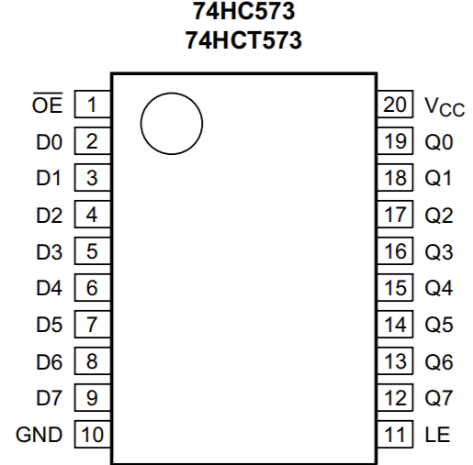
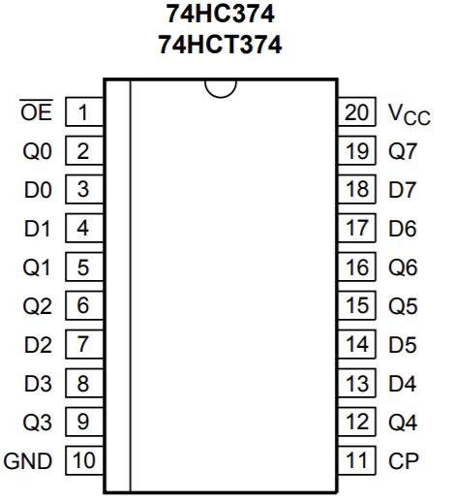
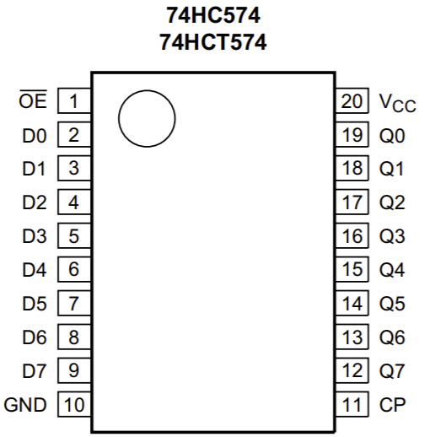
RA
/OE
Addr=1
write control?
CP or LE
Any 8 bit register with a tristate outputs can be directly multiplexed onto dual output busses.
Decoding is needed to select which register has it’s output enabled.
A 2 slot register file can decode using a invertor,
but for more registers use a 74139 or 74138.
74374/74574 are edge triggered and will need to gate a write control line with a clock signal to control which address gets written to.
74373/74573 are level sensitive latches and will need external logic to control which register gets updates, but may also need some extra help to work well in a synchronous circuit
QA
Addr=0
write control?
D
RB
Addr=1
write control?
QB
Addr=0
write control?

Slide 7
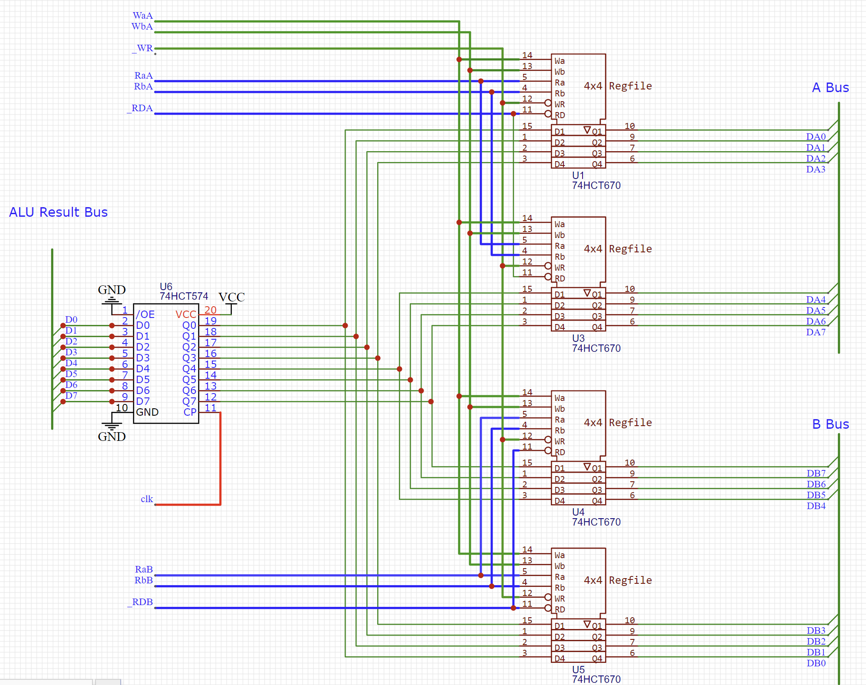
Triple Port Register Patterns Using Dual Port Components

Slide 8
Triple Port Register Patterns Using Dual Port Components
This pattern is useful where the register type doesn’t have tristate outputs…
A: register read select
Decode logic
/2
OE
Register write select
74245
Decode logic
/2
74245
A
CLK
/8
/8
74245
74273
74245
74273
Data In
/8
74273
74245
/8
74273
74245
/8
B
74377 has CLK and EN for decode
74273 has CLK and MR for initialization
74163 is a counter register
74245
74245
B: register read select
Decode logic
/2

Slide 9
Triple Port Register Patterns Using Dual Port Components
This pattern is useful where the register type doesn’t have tristate outputs…
Use this more direct approach if your device does have tristate outputs.
This approach combined with a decoder chip is more convenient
A: register read select
Decode logic
A: register read select
Decode logic
/2
/2
OE
OE
Register write select
74245
Register write select
Decode logic
74574
Decode logic
/2
/2
74245
A
74574
A
CLK
/8
CLK
/8
/8
74245
/8
74574
74273
74245
74574
74273
Data In
Data In
/8
/8
74273
74245
74574
/8
/8
74273
74245
74574
/8
B
Eg collection of 74574 with their CP input being driven by a 74138 decoder, where the 74138 enabled input is hooked up to the system clock is a more convenient approach
/8
B
74377 has CLK and EN for decode
74273 has CLK and MR for initialization
74163 is a counter register
74245
74574
74245
74574
OE
OE
B: register read select
B: register read select
Decode logic
Decode logic
/2
/2

Slide 10
Triple Port Register Patterns Using Dual Port Components
Using a single register with two buffers is less efficient….
OE
Buf A
QA
Reg
D
Buf B
QB

Slide 11
Triple Port Register Patterns Using Dual Port Components
Using a single register with two buffers is less efficient….
.. than using a pair of tristate capable registers
OE
OE
Buf A
Reg A
QA
QA
Reg
D
D
Buf B
Reg B
QB
QB
For example these devices …
74374
Flipflop
74574
Flipflop
Bus Pinout
74373
Latch
74573
Latch
Bus Pinout

Slide 12
OE
OE
Buf A
Reg A
QA
QA
Reg
D
D
Buf B
Reg B
QB
QB
Triple Port Register Patterns
OE
Buf A
LED
QA
Reg
D
Buf B
QB

Slide 13
Triple Port Register Patterns Using Dual Port Components
Using a single register with two buffers is less efficient….
.. than using a pair of tristate capable registers
OE
OE
Buf A
Reg A
QA
QA
Reg
D
D
Buf B
Reg B
QB
QB
For example these devices …
However, using buffers is certainly handy for isolating LED indicators so that we can see what’s in the register …
74374
Flipflop
74574
Flipflop
Bus Pinout
OE
Buf A
LED
QA
Reg
D
74373
Latch
74573
Latch
Bus Pinout
Buf B
… any latch or flipflop or parallel output device such as counters work in this context.
QB

Slide 14
Triple Port Register Patterns Using Dual Port Components
OE
Reg A
QA
D
Reg B
QB
OE

Slide 15
Triple Port Register Patterns Using Dual Port Components
OE
Reg A[3]
LE/CP
QA
LE/CP
OE
Reg A[2]
OE
LE/CP
OE
Reg A[1]
Reg A
QA
OE
Reg A[0]
D
LE/CP
D
Reg B
QB
LE/CP
Reg B[0]
OE
OE
Reg B[1]
LE/CP
OE
Reg B[1]
LE/CP
OE
Reg B[1]
LE/CP
QB
OE

Slide 16
Triple Port Register Patterns Using Dual Port Components
Something that might work for you …
74138
OE A
Reg A[3]
QA READ ADDR
A
OE A
LE/CP
QA
LE/CP
OE A
Reg A[2]
LE/CP
OE A
Reg A[1]
OE A
Reg A[0]
Data input and Write address must settle before the active clock transition (flip flops) or active clock phase (latches).
If you are using latches rather than flip flips then additionally be careful that the write address control lines and the data input lines don’t shift again during the active phase of the clock
LE/CP
WRITE ADDR
A
74138
LE/CP
CLK
EN
D
74574
LE/CP
Reg B[0]
OE B
Reg B[1]
LE/CP
OE B
Reg B[1]
LE/CP
QB READ ADDR
74138
OE B
A
OE B
Reg B[1]
LE/CP
QB
OE B
The above approach only pulses the selected 74138 output low during one half of the clock (use the appropriate 74138 “EN” input to choose the desired phase)
HAZARD: Do not rely on the address control lines alone to trigger the write signal of the registers. THAT APPROACH WILL LIKELY GLITCH!
Unless a device declares itself as glitch-free then you must assume that it will glitch during transitions.
ADVICE: assume that all switching devices will glitch during transitions and design to avoid the risk.

