Slide 1
ALU A
Bus
A
_oe
CONTROL LOGIC
BUFFER IN
_en
BUFFER A
_en
BUFFER A
_en
BUFFER IN
_en
BUFFER A
_en
D[48:8]
CP
L
ALU
A[15:0]
_wr
_oe
CP
CP
_MR
CP
_MR
CP
D
wr
_rd
CP
_MR
CP
_en
C
Z
O
GT
LT
EQ
NE
_cin
D[48:0]
D
Q
D
D
D
D
A[15:0]
_en
count_en
_pe
count_en
_pe
_en
_en
rdL_addr
rdR_addr
wr_addr
_rdL_en
_rdR_en
_wr_en
SYNC REG FILE
D
Q
Q
Q
Q
UART
D
Result
ROM
RAM
PCHITmp
PCHI
PCLO
MARHI
MARLO
_txe
_rxf
FLAGS
R
CONTROL
LOGIC
PC [15:0]
Address Bus [15:0]
CONTROL LOGIC
D[7:0]
BUFFER B
_en
BUFFER B
_en
C
Z
O
GT
LT
EQ
NE
IMMEDIATE
ADDRESSSING
BUFFER B
_en
BUFFER B
_en
ALU B
Bus
B
D[24:16]
D[15:8]
DIRECT
ADDRESS HI
BUFFER AH
_en
BUFFER AL
_en
DIRECT
ADDRESS LO
PC [15:0]
REGISTER ADDRESS HI
BUFFER AH
_en
BUFFER AL
_en
REGISTER ADDRESS LO
8 Bit CPU Design
Address Bus Hi [15:8]
Address Bus Lo [7:0]

Slide 2
ALU Result Bus
ALU A
Bus
ram_alubus_buf
marhi_abus_buf
marlo_abus_buf
uart_alubus_buf
uart_abus_buf
A
_oe
CONTROL LOGIC
BUFFER IN
_en
BUFFER A
_en
BUFFER A
_en
BUFFER IN
_en
BUFFER A
_en
D[48:8]
CP
CP
L
ALU
A[15:0]
_wr
_oe
CP
Q
CP
_MR
CP
_MR
CP
D
wr
_rd
D
_MR
CP
_en
C
Z
O
GT
LT
EQ
NE
_cin
D[48:0]
D
D
D
D
A[15:0]
_en
count_en
_pe
count_en
_pe
_en
_en
rdL_addr
rdR_addr
wr_addr
_rdL_en
_rdR_en
_wr_en
SYNC REG FILE
D
Q
Q
Q
Q
UART
D
Result
ROM
RAM
PCHITmp
PCHI
PCLO
MARHI
MARLO
_txe
_rxf
FLAGS
R
CONTROL
LOGIC
PC [15:0]
Address Bus [15:0]
CONTROL LOGIC
D[7:0]
BUFFER B
_en
BUFFER B
_en
C
Z
O
GT
LT
EQ
NE
IMMEDIATE
ADDRESSSING
BUFFER B
_en
BUFFER B
_en
ALU B
Bus
B
rom_bbus_buf
ram_bbus_buf
marhi_bbus_buf
marhi_bbus_buf
D[24:16]
D[15:8]
DIRECT
ADDRESS HI
BUFFER AH
_en
BUFFER AL
_en
DIRECT
ADDRESS LO
PC [15:0]
REGISTER ADDRESS HI
BUFFER AH
_en
BUFFER AL
_en
REGISTER ADDRESS LO
rom_addrbushi_buf
rom_addrbuslo_buf
marhi_addrbushi_buf
marlo_addrbuslo_buf
Optional extras: a presettable auto-counting MAR?
Or a settable address register that autoincrements after each read will save time on copy operations; otherwise multiple instructions required for increment, with carry to MARHI.
Basically a second program counter-like thing.
Dedicated stack pointer?.
Address Bus Hi [15:8]
Address Bus Lo [7:0]

Slide 3
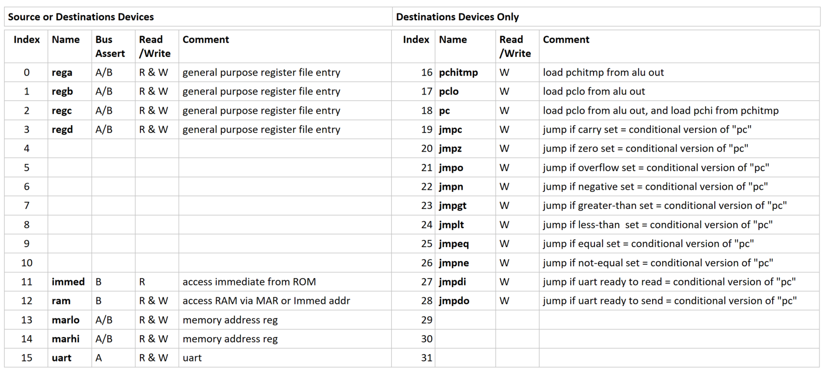

Slide 4
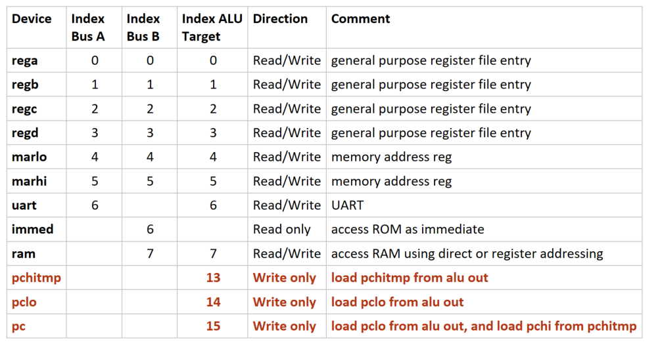

Slide 5
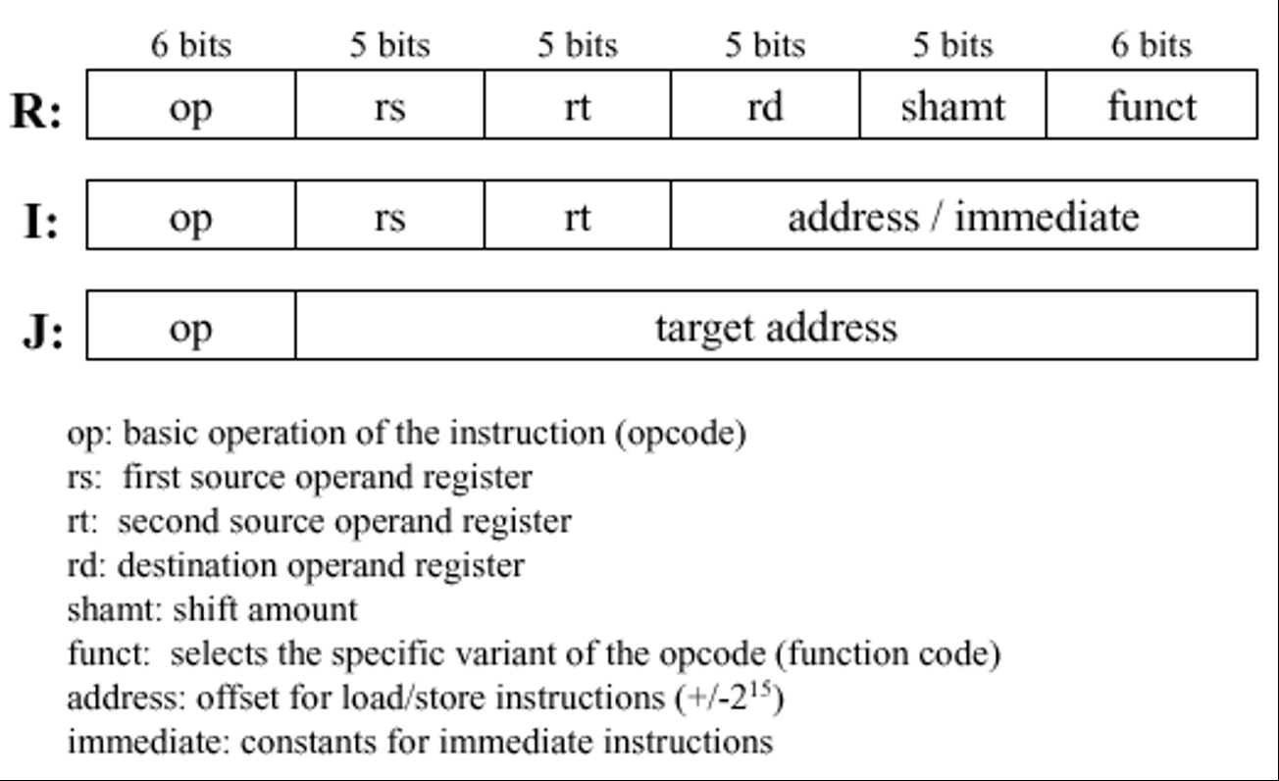

Slide 6
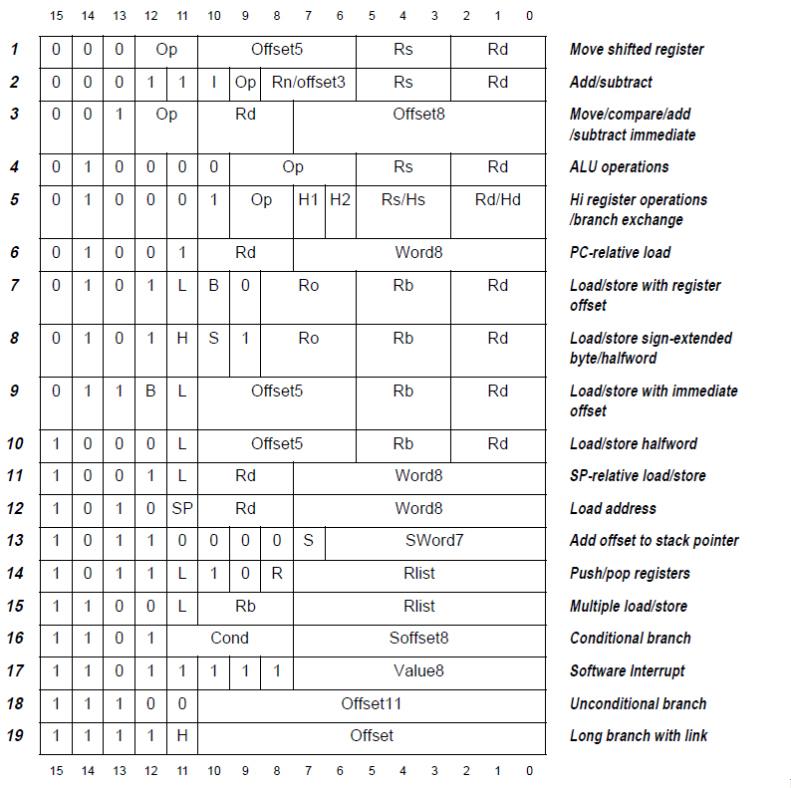

Slide 7
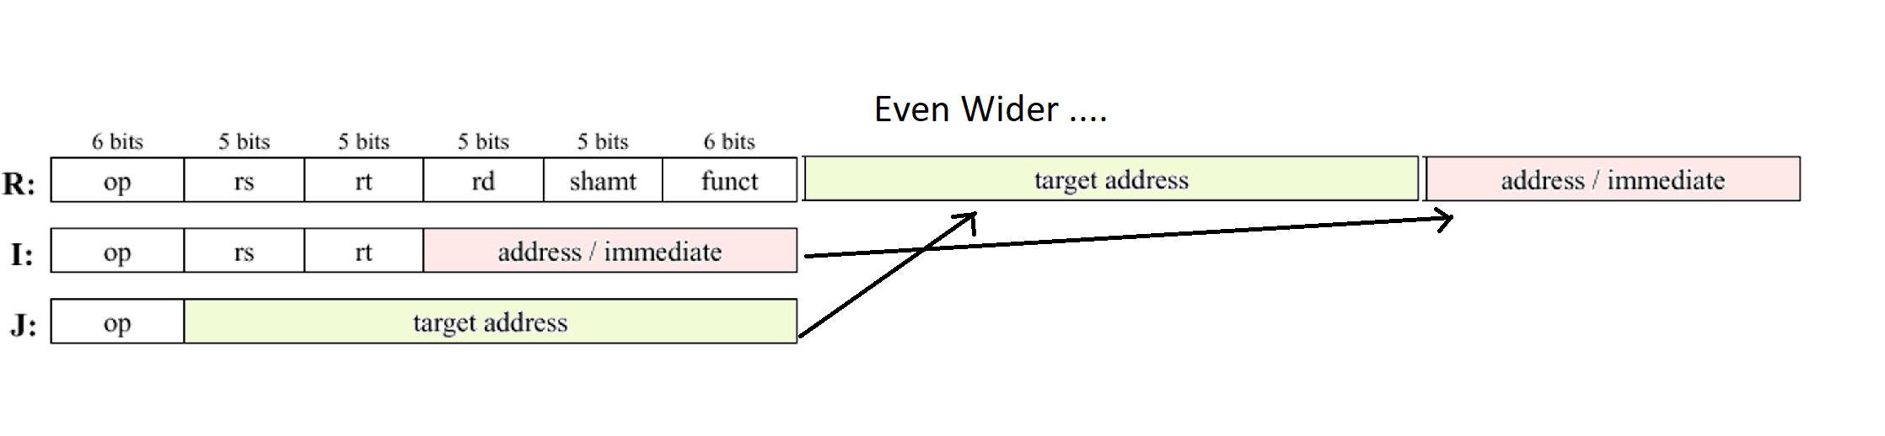
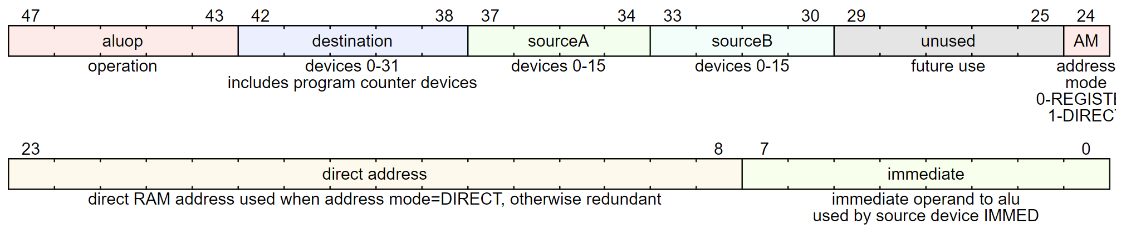

Slide 8
Useful?? 74als576 – inverting dtype – oe + clk + bus layout 74HC7292 clock divider 4> 2billion – good for clock speed control off a fast crystal or for a freq counter - https://uk.rs-online.com/web/p/clock-dividers/5400461/
Horizontal Encoded “WIDE ROM” Design
ALU Result Bus
Optional : Flags reg on A Bus means we can store it
to RAM or to another reg and do arbitrary bitwise comparisons on the result.
Optional: But if we also allow it to be restored from RAM or a REG or ROM then that
might be extra useful – eg to set or clear carry before arithmetic.
Or is Carry a special case? Perhaps on a sophisticated CPU
stashing the flags might be useful, but here?
RAM isolation from result bus to avoid read / write or RAM leaking between Result Bus and B Bus.
Buffer I _oe = _wr
Buffer B _oe = _RAM _oe
CAN NOT DO “RAM ALU IMMED” AS BOTH USE RBUS ONLY!
General conditional instruction?
Set flags control like ARM?
ram_alubus_buf
marhi_abus_buf
marlo_abus_buf
uart_alubus_buf
uart_abus_buf
ALU A Bus
A
_oe
CONTROL LOGIC
BUFFER IN
_en
BUFFER A
_en
BUFFER A
_en
BUFFER IN
_en
BUFFER A
_en
TBD: Flags Reg
write _en may only be enabled for specific ops
BUFFER A
_en`
D[48:8]
CP
CP
L
ALU
A[15:0]
_wr
_oe
CP
Q
CP
_MR
CP
_MR
CP
D
wr
_rd
D
_MR
CP
_en
C
Z
O
GT
LT
EQ
NE
_cin
D[48:0]
D
D
D
D
A[15:0]
_en
count_en
_pe
count_en
_pe
_en
_en
rdL_addr
rdR_addr
wr_addr
_rdL_en
_rdR_en
_wr_en
SYNC REG FILE
D
Q
Q
Q
Q
UART
D
Result
ROM
RAM
PCHITmp
PCHI
PCLO
MARHI
MARLO
_txe
_rxf
FLAGS
CONTROL LOGIC
MAR primary function is Address Bus index.
Optionally MAR can join either/both A Bus or B Bus depending
on flexibility desired.
So MAR also acts as a GP register on both ALUinput busses.
CONTROL LOGIC
R
PC [15:0]
Address Bus [15:0]
PCHI/LO Primary function is Address Bus index.
Optionally PC can join either/both A Bus or B Bus depending on whether I want to permit PC arithmetic.
Here PC is shown outputting to
A Bus.
UART Buffer isolation needed to prevent writes and reads from UART on one bus leaking over to the other bus.
Buffer IN _oe = wr Buffer A _oe = _rd (wr is +ve edge latch)
Register file is a general
purpose register set
D[7:0]
BUFFER B
_en
BUFFER B
_en
C
Z
O
GT
LT
EQ
NE
Immediate
addressing
buffer
BUFFER B
_en
BUFFER B
_en
ALU B Bus
B
rom_bbus_buf
ram_bbus_buf
marhi_bbus_buf
marhi_bbus_buf
Optional extras: a presettable auto-counting MAR?
Or a settable address register that autoincrements after each read will save time on copy operations; otherwise multiple instructions required for increment, with carry to MARHI. Basically a second program counter like thing.
And I have no dedicated stack pointer either.
D[24:16]
D[15:8]
Attach RAM /ROM to
R Bus so they can
participate in ALU
as other side from
the other registers
Or UART.
PC [15:0]
_oe=_addrmode_register
DIRECTHI
BUFFER AH
_en
BUFFER AL
_en
DIRECTLO
MARHI
BUFFER AH
_en
BUFFER AL
_en
MARLO
rom_addrbushi_buf
CANNOT READ PROGRAM COUNTER : NOT NEEDED IN STATIC PROGRAM
marhi_addrbushi_buf
marlo_addrbuslo_buf
rom_addrbuslo_buf
Address Bus Hi [15:8]
Address Bus Lo [7:0]
BUS RIBBON CONNECTOR https://uk.rs-online.com/web/p/products/0471389/
USE 40 pin ribbon and connector for busses?
20 pin for connector + 4x10 pin for chips = 60
Remaining 3 pins for caps? Or spacing?? Very tight.
So instead use the approach in the
GS100 bus stripx2 $3.45 https://www.globalspecialties.com/solderless-breadboards/breadboards-bus-strips/item/34-gs-100.html
£3.28 https://www.mouser.co.uk/ProductDetail/Global-Specialties/GS-100?qs=uv8bPZ39CeNa73a0uSX5Lw%3D%3D
BB100R is the busboard equiv
£2.70 https://www.digikey.co.uk/product-detail/en/global-specialties/GS-100/BKGS-100-ND/5231302

Slide 9
ALU Result Bus
Optional : Flags reg on A Bus means we can store it
to RAM or to another reg and do arbitrary bitwise comparisons on the result.
Optional: But if we also allow it to be restored from RAM or a REG or ROM then that
might be extra useful – eg to set or clear carry before arithmetic.
Or is Carry a special case? Perhaps on a sophisticated CPU
stashing the flags might be useful, but here?
RAM isolation from result bus to avoid read / write or RAM leaking between Result Bus and B Bus.
Buffer I _oe = _wr
Buffer B _oe = _RAM _oe
ram_alubus_buf
pchi_abus_buf
pclo_abus_buf
marhi_abus_buf
marlo_abus_buf
uart_alubus_buf
uart_abus_buf
ALU A Bus
A
_oe
CONTROL LOGIC
BUFFER IN
_en
BUFFER A
_en
BUFFER A
_en
BUFFER A
_en
BUFFER A
_en
BUFFER IN
_en
BUFFER A
_en
TBD: Flags Reg
write _en may only be enabled for specific ops
BUFFER A
_en`
D[48:8]
CP
CP
L
ALU
A[15:0]
_wr
_oe
CP
Q
CP
_MR
CP
_MR
CP
D
wr
_rd
D
_MR
CP
_en
C
Z
O
GT
LT
EQ
NE
_cin
D[48:0]
D
D
D
D
A[15:0]
_en
count_en
_pe
count_en
_pe
_en
_en
rdL_addr
rdR_addr
wr_addr
_rdL_en
_rdR_en
_wr_en
SYNC REG FILE
D
Q
Q
Q
Q
UART
D
Result
ROM
RAM
PCHITmp
PCHI
PCLO
MARHI
MARLO
_txe
_rxf
FLAGS
CONTROL LOGIC
MAR primary function is Address Bus index.
Optionally MAR can join either/both A Bus or B Bus depending
on flexibility desired.
So MAR also acts as a GP register on both ALUinput busses.
CONTROL LOGIC
R
PC [15:0]
Address Bus [15:0]
PCHI/LO Primary function is Address Bus index.
Optionally PC can join either/both A Bus or B Bus depending on whether I want to permit PC arithmetic.
Here PC is shown outputting to
A Bus.
UART Buffer isolation needed to prevent writes and reads from UART on one bus leaking over to the other bus.
Buffer IN _oe = wr Buffer A _oe = _rd (wr is +ve edge latch)
Register file is a general
purpose register set
D[7:0]
BUFFER B
_en
BUFFER B
_en
C
Z
O
GT
LT
EQ
NE
Immediate
addressing
buffer
BUFFER B
_en
BUFFER B
_en
ALU B Bus
B
rom_bbus_buf
ram_bbus_buf
marhi_bbus_buf
marhi_bbus_buf
Optional extras: a presettable auto-counting MAR?
Or a settable address register that autoincrements after each read will save time on copy operations; otherwise multiple instructions required for increment, with carry to MARHI. Basically a second program counter like thing.
And I have no dedicated stack pointer either.
D[24:16]
D[15:8]
Attach RAM /ROM to
R Bus so they can
participate in ALU
as other side from
the other registers
Or UART.
PC [15:0]
_oe=_addrmode_register
DIRECTHI
BUFFER AH
_en
BUFFER AL
_en
DIRECTLO
MARHI
BUFFER AH
_en
BUFFER AL
_en
MARLO
rom_addrbushi_buf
rom_addrbuslo_buf
marhi_addrbushi_buf
marlo_addrbuslo_buf
Address Bus Hi [15:8]
Address Bus Lo [7:0]

Slide 10
This design doesn’t permit
X=Y+KONST ☹ or worse perhaps
X = X logicialOp KONST FIXED
Use unused op 2 or 3 for that?
If not enough bit space then do X=X+5 so targ is fixed to src OR only permit lower 16 ALU ops HMM Bad for logic ops.
OR only allow 3 bits for src and/or targ so we can only do that with GP registers ??
Targ fixed to src is probably ok for many logical ops??
74als576 – inverting dtype – oe + clk + bus layout 74HC7292 clock divider 4> 2billion – good for clock speed control off a fast crystal or for a freq counter - https://uk.rs-online.com/web/p/clock-dividers/5400461/
Horizontal Encoded “WIDE ROM” Design
ALU Result Bus
Optional : Flags reg on A Bus means we can store it
to RAM or to another reg and do arbitrary bitwise comparisons on the result.
Optional: But if we also allow it to be restored from RAM or a REG or ROM then that
might be extra useful – eg to set or clear carry before arithmetic.
Or is Carry a special case? Perhaps on a sophisticated CPU
stashing the flags might be useful, but here?
RAM isolation from result bus to avoid read / write or RAM leaking between Result Bus and B Bus.
Buffer I _oe = _wr
Buffer B _oe = _RAM _oe
ram_alubus_buf
pchi_abus_buf
pclo_abus_buf
marhi_abus_buf
marlo_abus_buf
uart_alubus_buf
uart_abus_buf
ALU A Bus
A
_oe
CONTROL LOGIC
BUFFER IN
_en
BUFFER A
_en
BUFFER A
_en
BUFFER A
_en
BUFFER A
_en
BUFFER IN
_en
BUFFER A
_en
TBD: Flags Reg
write _en may only be enabled for specific ops
BUFFER A
_en`
Raw {PCHI, PCLO}
ALU
PC [15:0]
A[15:0]
_wr
_oe
CP
CP
_MR
CP
_MR
CP
CP
wr
_rd
CP
_MR
L
CP
_en
C
Z
O
GT
LT
EQ
NE
Address Bus
multiplexes {PCHI, PCLO}
{MARHI, MARLO}
{DIRECTHI, DIRECTLO}
D[48:8]
D[48:8]
D
Q
D
D
D
D
D
_cin
ROM
Address Bus
A[15:0]
_en
count_en
_pe
count_en
_pe
_en
_en
rdL_addr
rdR_addr
wr_addr
_rdL_en
_rdR_en
_wr_en
SYNC REG FILE
D
Q
Q
Q
Q
UART
D
Result
_oe
Instruction Reg
for low byte
RAM
PCHITmp
PCHI
PCLO
MARHI
MARLO
_txe
_rxf
FLAGS
A D[7:0]
D[7:0]
IReg Lo _en
R
CONTROL LOGIC
ROM
MAR primary function is Address Bus index.
Optionally MAR can join either/both A Bus or B Bus depending
on flexibility desired.
So MAR also acts as a GP register on both ALUinput busses.
+ve edge Registers but could be latches if the output of the ALU is a register
CONTROL LOGIC
PCHI/LO Primary function is Address Bus index.
Optionally PC can join either/both A Bus or B Bus depending on whether I want to permit PC arithmetic.
Here PC is shown outputting to
A Bus.
UART Buffer isolation needed to prevent writes and reads from UART on one bus leaking over to the other bus.
Buffer IN _oe = wr Buffer A _oe = _rd (wr is +ve edge latch)
Register file is a general
purpose register set
D[7:0]
BUFFER B
_en
BUFFER B
_en
C
Z
O
GT
LT
EQ
NE
Direct
addressing
buffer
BUFFER B
_en
BUFFER B
_en
Immediate
addressing
buffer
BUFFER B
_en
ALU B Bus
B
rom_bbus_buf
instreg_bbus_buf
ram_bbus_buf
marhi_bbus_buf
marhi_bbus_buf
Optional extras: a presettable auto-counting MAR?
Or a settable address register that autoincrements after each read will save time on copy operations; otherwise multiple instructions required for increment, with carry to MARHI. Basically a second program counter like thing.
And I have no dedicated stack pointer either.
D[24:16]
D[15:8]
Attach RAM /ROM to
R Bus so they can
participate in ALU
as other side from
the other registers
Or UART.
Address Bus [15:0]
_oe=_addrmode_immediate
_oe=_addrmode_pc
_oe=_addrmode_register
DIRECTHI
BUFFER AH
_en
BUFFER AL
_en
DIRECTLO
PCHI
BUFFER AH
_en
BUFFER AL
_en
PCLO
MARHI
BUFFER AH
_en
BUFFER AL
_en
MARLO
rom_addrbushi_buf
rom_addrbuslo_buf
pchi_addrbushi_buf
pclo_addrbuslo_buf
marhi_addrbushi_buf
marlo_addrbuslo_buf
Address Bus Hi [15:8]
Address Bus Lo [7:0]
GS100 bus stripx2 $3.45 https://www.globalspecialties.com/solderless-breadboards/breadboards-bus-strips/item/34-gs-100.html
£3.28 https://www.mouser.co.uk/ProductDetail/Global-Specialties/GS-100?qs=uv8bPZ39CeNa73a0uSX5Lw%3D%3D
BB100R is the busboard equiv
£2.70 https://www.digikey.co.uk/product-detail/en/global-specialties/GS-100/BKGS-100-ND/5231302

Slide 11
This design doesn’t permit
X=Y+KONST ☹ or worse perhaps
X = X logicialOp KONST FIXED
Use unused op 2 or 3 for that?
If not enough bit space then do X=X+5 so targ is fixed to src OR only permit lower 16 ALU ops HMM Bad for logic ops.
OR only allow 3 bits for src and/or targ so we can only do that with GP registers ??
Targ fixed to src is probably ok for many logical ops??
74als576 – inverting dtype – oe + clk + bus layout 74HC7292 clock divider 4> 2billion – good for clock speed control off a fast crystal or for a freq counter - https://uk.rs-online.com/web/p/clock-dividers/5400461/
FIX NAMES IMMEDIATE/DIRECT/REGISTER
CONTROL LOGIC EASIER IF ALL DEVICES CAN WRITE TO RBUS OR LBUS AS DON’T NEED TO FORCE L AND R JUST ONE OR THE OTHER
Horizontal Encoded “WIDE ROM” Design
Clock Circuit with Break - http://tinyurl.com/y3ygr5yr
ALU Result Bus
Optional : Flags reg on L Bus means we can store it
to RAM or to another reg and do arbitrary bitwise comparisons on the result.
Optional: But if we also allow it to be restored from RAM or a REG or ROM then that
might be extra useful – eg to set or clear carry before arithmetic.
Or is Carry a special case? Perhaps on a sophisticated CPU
stashing the flags might be useful, but here?
RAM isolation from result bus to avoid read / write or RAM leaking between Result Bus and R Bus.
Buffer I _oe = _wr
Buffer R _oe = _RAM _oe
CAN’T DO “RAM ALU IMMED” AS BOTH USE RBUS ONLY!
ram_alubus_buf
pchi_abus_buf
pclo_abus_buf
marhi_abus_buf
marlo_abus_buf
uart_alubus_buf
uart_abus_buf
ALU A Bus
A
_oe
CONTROL LOGIC
BUFFER I
_en
BUFFER A
_en
BUFFER A
_en
BUFFER A
_en
BUFFER A
_en
BUFFER I
_en
BUFFER A
_en
TBD: Flags Reg
write _en may only be enabled for specific ops
BUFFER A
_en`
Raw {PCHI, PCLO}
ALU
PC [15:0]
A[15:0]
_wr
_oe
CP
CP
_MR
CP
_MR
CP
CP
wr
_rd
CP
_MR
L
CP
_en
C
Z
O
GT
LT
EQ
NE
Address Bus
multiplexes {PCHI, PCLO}
{MARHI, MARLO}
{DIRECTHI, DIRECTLO}
D[48:8]
D[48:8]
D
Q
D
D
D
D
D
_cin
ROM
Address Bus
A[15:0]
_en
count_en
_pe
count_en
_pe
_en
_en
rdL_addr
rdR_addr
wr_addr
_rdL_en
_rdR_en
_wr_en
SYNC REG FILE
D
Q
Q
Q
Q
UART
D
Result
_oe
Instruction Reg
for low byte
RAM
PCHITmp
PCHI
PCLO
MARHI
MARLO
_txe
_rxf
FLAGS
A D[7:0]
D[7:0]
IReg Lo _en
R
CONTROL LOGIC
ROM
MAR primary function is Address Bus index.
Optionally MAR can join either/both L Bus or R Bus depending
on flexibility desired.
So MAR also acts as a GP register on both ALUinput busses.
+ve edge Registers but could be latches if the output of the ALU is a register
CONTROL LOGIC
PCHI/LO Primary function is Address Bus index.
Optionally PC can join either/both L Bus or R Bus depending on whether I want to permit PC arithmetic.
Here PC is shown outputting to
L Bus.
UART Buffer isolation needed to prevent writes and reads from UART on one bus leaking over to the other bus.
Buffer I _oe = wr Buffer L _oe = _rd (wr is +ve edge latch)
Register file is a general
purpose register set
D[7:0]
BUFFER B
_en
BUFFER B
_en
C
Z
O
GT
LT
EQ
NE
Direct
addressing
buffer
BUFFER B
_en
BUFFER B
_en
Immediate
addressing
buffer
BUFFER B
_en
ALU B Bus
B
rom_bbus_buf
instreg_bbus_buf
ram_bbus_buf
marhi_bbus_buf
marhi_bbus_buf
Optional extras: a presettable auto-counting MAR?
Or a settable address register that autoincrements after each read will save time on copy operations; otherwise multiple instructions required for increment, with carry to MARHI. Basically a second program counter like thing.
And I have no dedicated stack pointer either.
D[24:16]
D[15:8]
Attach RAM /ROM to
R Bus so they can
participate in ALU
as other side from
the other registers
Or UART.
Address Bus [15:0]
_oe=_addrmode_immediate
_oe=_addrmode_pc
_oe=_addrmode_register
DIRECTHI
BUFFER AH
_en
BUFFER AL
_en
DIRECTLO
PCHI
BUFFER AH
_en
BUFFER AL
_en
PCLO
MARHI
BUFFER AH
_en
BUFFER AL
_en
MARLO
rom_addrbushi_buf
rom_addrbuslo_buf
pchi_addrbushi_buf
pclo_addrbuslo_buf
marhi_addrbushi_buf
marlo_addrbuslo_buf
DONE!!
!!!! DON’T SET FLAGS WHEN OPERATION IS A JUMP (IE SETTING THOSE REG) AS IT MAKES
“IF NFLAG & CFLAG” logic impossible
!!! CANT WORK UNLESS FIX BECAUSE SETTING PCHITMP CLEARS THE CONDITION SO WE NEVER CONDITIONALLY JUMP
Address Bus Hi [15:8]
Address Bus Lo [7:0]
USE 40 pin ribbon and connector for busses?
20 pin for connector + 4x10 pin for chips = 60
Remaining 3 pins for caps? Or spacing?? Very tight.
So instead use the approach in the
GS100 bus stripx2 $3.45 https://www.globalspecialties.com/solderless-breadboards/breadboards-bus-strips/item/34-gs-100.html
£3.28 https://www.mouser.co.uk/ProductDetail/Global-Specialties/GS-100?qs=uv8bPZ39CeNa73a0uSX5Lw%3D%3D
BB100R is the busboard equiv
£2.70 https://www.digikey.co.uk/product-detail/en/global-specialties/GS-100/BKGS-100-ND/5231302

Slide 12
This design doesn’t permit
X=Y+KONST ☹ or worse perhaps
X = X logicialOp KONST FIXED
Use unused op 2 or 3 for that?
If not enough bit space then do X=X+5 so targ is fixed to src OR only permit lower 16 ALU ops HMM Bad for logic ops.
OR only allow 3 bits for src and/or targ so we can only do that with GP registers ??
Targ fixed to src is probably ok for many logical ops??
74als576 – inverting dtype – oe + clk + bus layout 74HC7292 clock divider 4> 2billion – good for clock speed control off a fast crystal or for a freq counter - https://uk.rs-online.com/web/p/clock-dividers/5400461/
FIX NAMES IMMEDIATE/DIRECT/REGISTER
CONTROL LOGIC EASIER IF ALL DEVICES CAN WRITE TO RBUS OR LBUS AS DON’T NEED TO FORCE L AND R JUST ONE OR THE OTHER
If I postpone being able to write
to more than one bus then I don’t
need to wire in the Buffer L/R devices.
Eg if the reg’s write to L and ROM/RAM to R
Then I think that’s a simplification especially
If PC and MAR can’t be read via ALU
ALU Result Bus
Optional : Flags reg on L Bus means we can store it
to RAM or to another reg and do arbitrary bitwise comparisons on the result.
Optional: But if we also allow it to be restored from RAM or a REG or ROM then that
might be extra useful – eg to set or clear carry before arithmetic.
Or is Carry a special case? Perhaps on a sophisticated CPU
stashing the flags might be useful, but here?
RAM isolation from result bus to avoid read / write or RAM leaking between Result Bus and R Bus.
Buffer I _oe = _wr
Buffer R _oe = _RAM _oe
ram_alubus_buf
pchi_abus_buf
pclo_abus_buf
marhi_abus_buf
marlo_abus_buf
uart_alubus_buf
uart_abus_buf
ALU L Bus
L
Attach RAM /ROM to
R Bus so they can
participate in ALU
as other side from
the other registers
Or UART.
CONTROL LOGIC
BUFFER I
_en
BUFFER A
_en
BUFFER A
_en
BUFFER A
_en
BUFFER A
_en
BUFFER I
_en
BUFFER A
_en
TBD: Flags Reg
write _en may only be enabled for specific ops
BUFFER A
_en`
Latches
CP
CP
L
ALU
_oe
D[23:16]
_wr
_oe
CP
Q
CP
_MR
CP
_MR
CP
D
wr
_rd
D
_MR
CP
_en
C
Z
O
GT
LT
EQ
NE
_cin
D[23:16]
IReg Hi
_en
D
D
D
D
A/16
A[15:0]
A/16
A[15:0]
_en
count_en
_pe
count_en
_pe
_en
_en
rdL_addr
rdR_addr
wr_addr
_rdL_en
_rdR_en
_wr_en
SYNC REG FILE
D[15:0]
D[15:8]
IReg Mid
_en
D
Q
Q
Q
Q
D
Result
UART
ROM
D[7:0]
IReg Lo _en
RAM
PCHITmp
PCHI
PCLO
MARHI
MARLO
_txe
_rxf
FLAGS
CONTROL LOGIC
MAR primary function is Address Bus index.
Optionally MAR can join either/both L Bus or R Bus depending
on flexibility desired.
So MAR also acts as a GP register on both ALUinput busses.
+ve edge Registers but could be latches if the output of the ALU is a register
CONTROL LOGIC
R
PCHI/LO Primary function is Address Bus index.
Optionally PC can join either/both L Bus or R Bus depending on whether I want to permit PC arithmetic.
Here PC is shown outputting to
L Bus.
UART Buffer isolation needed to prevent writes and reads from UART on one bus leaking over to the other bus.
Buffer I _oe = wr Buffer L _oe = _rd (wr is +ve edge latch)
Register file is a general
purpose register set
D[7:0]
BUFFER B
_en
BUFFER B
_en
C
Z
O
GT
LT
EQ
NE
BUFFER B
_en
BUFFER B
_en
BUFFER B
_en
ALU R Bus
R
rom_bbus_buf
instreg_bbus_buf
ram_bbus_buf
marhi_bbus_buf
marhi_bbus_buf
D[15:8]
D[7:0]
_oe=_addrmode_immediate
_oe=_addrmode_pc
_oe=_addrmode_register
BUFFER AH
_en
BUFFER AL
_en
BUFFER AH
_en
BUFFER AL
_en
BUFFER AH
_en
BUFFER AL
_en
Optional extras: a presettable auto-counting MAR?
rom_addrbushi_buf
rom_addrbuslo_buf
pchi_addrbushi_buf
pclo_addrbuslo_buf
marhi_addrbushi_buf
marlo_addrbuslo_buf
!!!! DON’T SET FLAGS WHEN OPERATION IS A JUMP (IE SETTING THOSE REG) AS IT MAKES
“IF NFLAG & CFLAG” logic impossible
!!! CANT WORK UNLESS FIX BECAUSE SETTING PCHITMP CLEARS THE CONDITION SO WE NEVER CONDITIONALLY JUMP
Address Bus (A/16)
Address Bus Hi / 8
Address Bus Lo / 8
USE 40 pin ribbon and connector for busses?
20 pin for connector + 4x10 pin for chips = 60
Remaining 3 pins for caps? Or spacing?? Very tight.
So instead use the approach in the
GS100 bus stripx2 $3.45 https://www.globalspecialties.com/solderless-breadboards/breadboards-bus-strips/item/34-gs-100.html
£3.28 https://www.mouser.co.uk/ProductDetail/Global-Specialties/GS-100?qs=uv8bPZ39CeNa73a0uSX5Lw%3D%3D
BB100R is the busboard equiv
£2.70 https://www.digikey.co.uk/product-detail/en/global-specialties/GS-100/BKGS-100-ND/5231302

Slide 13
ALU Result Bus
Optional : Flags reg on L Bus means we can store it
to RAM or to another reg and do arbitrary bitwise comparisons on the result.
Optional: But if we also allow it to be restored from RAM or a REG or ROM then that
might be extra useful – eg to set or clear carry before arithmetic.
Or is Carry a special case? Perhaps on a sophisticated CPU
stashing the flags might be useful, but here?
ram_alubus_buf
uart_alubus_buf
uart_abus_buf
pchi_abus_buf
pclo_abus_buf
marhi_abus_buf
marlo_abus_buf
ALU L Bus
RAM isolation from result bus to avoid read / write or RAM leaking between Result Bus and R Bus.
Buffer I _oe = _wr
Buffer R _oe = _RAM _oe
L
Attach RAM /ROM to
R Bus so they can
participate in ALU
as other side from
the other registers
Or UART.
BUFFER I
_en
BUFFER I
_en
BUFFER A
_en
BUFFER A
_en
BUFFER A
_en
BUFFER A
_en
BUFFER A
_en
TBD: Flags Reg
write _en may only be enabled for specific ops
BUFFER A
_en`
CONTROL LOGIC
CP
CP
L
ALU
_oe
_wr
_oe
wr
_rd
CP
Q
CP
_MR
CP
_MR
CP
D
D
_MR
CP
_en
C
Z
O
N
GT
LT
EQ
NE
_cin
D[23:16]
D
D
D
D
A/16
A[15:0]
A/16
A[15:0]
_en
count_en
_pe
count_en
_pe
_en
_en
rdL_addr
rdR_addr
wr_addr
_rdL_en
_rdR_en
_wr_en
SYNC REG FILE
D[15:0]
D
UART
D
Q
Q
Q
Q
Result
ROM
RAM
_txe
_rxf
PCHITmp
PCHI
PCLO
MARHI
MARLO
FLAGS
CONTROL LOGIC
CONTROL LOGIC
MAR primary function is Address Bus index.
Optionally MAR can join either/both L Bus or R Bus depending
on flexibility desired.
So MAR also acts as a GP register on both ALUinput busses.
R
UART Buffer isolation needed to prevent writes and reads from UART on one bus leaking over to the other bus.
Buffer I _oe = wr Buffer L _oe = _rd (wr is +ve edge latch)
PCHI/LO Primary function is Address Bus index.
Optionally PC can join either/both L Bus or R Bus depending on whether I want to permit PC arithmetic.
Here PC is shown outputting to
L Bus.
Register file is a general
purpose register set
D[7:0]
BUFFER B
_en
BUFFER B
_en
C
Z
O
N
GT
LT
EQ
NE
BUFFER B
_en
BUFFER B
_en
ALU R Bus
R
rom_bbus_buf
ram_bbus_buf
marhi_bbus_buf
marhi_bbus_buf
_addrmode_immediate
D[15:8]
D[7:0]
_addrmode_pc
_addrmode_register
BUFFER AH
_en
BUFFER AL
_en
BUFFER AH
_en
BUFFER AL
_en
BUFFER AH
_en
BUFFER AL
_en
rom_addrbushi_buf
rom_addrbuslo_buf
pchi_addrbushi_buf
pclo_addrbuslo_buf
marhi_addrbushi_buf
marlo_addrbuslo_buf
Optional extras: a presettable auto-counting MAR?
Address Bus Hi / 8
Address Bus (A/16)
Address Bus Lo / 8
Must be tristate register
to save a chip
GS100 bus stripx2 $3.45 https://www.globalspecialties.com/solderless-breadboards/breadboards-bus-strips/item/34-gs-100.html
£3.28 https://www.mouser.co.uk/ProductDetail/Global-Specialties/GS-100?qs=uv8bPZ39CeNa73a0uSX5Lw%3D%3D
BB100R is the busboard equiv
£2.70 https://www.digikey.co.uk/product-detail/en/global-specialties/GS-100/BKGS-100-ND/5231302

Slide 14
ALU Result Bus
Optional : Flags reg on L Bus means we can store it
to RAM or to another reg and do arbitrary bitwise comparisons on the result.
Optional: But if we also allow it to be restored from RAM or a REG or ROM then that
might be extra useful – eg to set or clear carry before arithmetic.
Or is Carry a special case? Perhaps on a sophisticated CPU
stashing the flags might be useful, but here?
ALU L Bus
RAM isolation from result bus to avoid read / write or RAM leaking between Result Bus and R Bus.
Buffer I _oe = _wr
Buffer R _oe = _RAM _oe
L
BUFFER I
_en
BUFFER I
_en
BUFFER A
_en
BUFFER A
_en
BUFFER A
_en
BUFFER A
_en
BUFFER A
_en
TBD: Flags Reg
write _en may only be enabled for specific ops
BUFFER A
_en`
CONTROL LOGIC
CP
CP
L
ALU
_oe
_wr
_oe
wr
_rd
CP
Q
CP
_MR
CP
_MR
CP
D
D
_MR
CP
_en
C
Z
O
GT
LT
EQ
NE
_cin
D[23:16]
D
D
D
D
A/16
A[15:0]
A/16
A[15:0]
_en
count_en
_pe
count_en
_pe
_en
_en
rdL_addr
rdR_addr
wr_addr
_rdL_en
_rdR_en
_wr_en
SYNC REG FILE
D[15:0]
D
UART
D
Q
Q
Q
Q
Result
ROM
RAM
_txe
_rxf
PCHITmp
PCHI
PCLO
MARHI
MARLO
FLAGS
CONTROL LOGIC
CONTROL LOGIC
MAR primary function is Address Bus index.
Optionally MAR can join either/both L Bus or R Bus depending
on flexibility desired.
So MAR also acts as a GP register on both ALUinput busses.
R
Attach RAM /ROM to
R Bus so they can
participate in ALU
as other side from
the other registers
Or UART.
UART Buffer isolation needed to prevent writes and reads from UART on one bus leaking over to the other bus.
Buffer I _oe = wr Buffer L _oe = _rd (wr is +ve edge latch)
PCHI/LO Primary function is Address Bus index.
Optionally PC can join either/both L Bus or R Bus depending on whether I want to permit PC arithmetic.
Here PC is shown outputting to
L Bus.
Register file is a general
purpose register set
D[7:0]
BUFFER B
_en
BUFFER B
_en
C
Z
O
GT
LT
EQ
NE
BUFFER B
_en
BUFFER B
_en
ALU R Bus
R
D[15:8]
D[7:0]
BUFFER AH
_en
BUFFER AL
_en
BUFFER AH
_en
BUFFER AL
_en
BUFFER AH
_en
BUFFER AL
_en
Optional extras: a presettable autocounting MAR?
Address Bus Hi / 8
Address Bus (A/16)
Address Bus Lo / 8

Slide 15
ALU Result Bus
ALU L Bus
A
RAM isolation from result bus to avoid read / write or RAM leaking between Result Bus and R Bus.
Buffer I _oe = _wr
Buffer O _oe = _RAM _oe
BUFFER I
CONTROL LOGIC
BUFFER I
BUFFER O
BUFFER
BUFFER
BUFFER
BUFFER
CONTROL LOGIC
CP
CP
CP
_MR
A
ALU
_wr
_oe
_txe
_rxf
wr
_rd
CP
Q
CP
_MR
CP
_MR
D
D
D
D[23:16]
D
D
D
A/16
A
A/16
A
_en
count_en
_pe
count_en
_pe
_en
_en
rdL_addr
rdR_addr
wr_addr
_rdL_en
_rdR_en
_wr_en
SYNC REG FILE
D[15:0]
D
D
Q
Q
Q
Q
Result
ROM
RAM
UART
PCHITmp
PCHI
PCLO
MARHI
MARLO
Register file is a general
purpose register set
B
Attach RAM /ROM to
R Bus so they can
participate in ALU
as other side from
the other registers
Or UART.
Buffer isolation needed to prevent writes and reads from UART on one bus leaking over to the other bus.
Buffer I _oe = wr Buffer O _oe = _rd (wr is +ve edge latch)
PC can join L Bus or R Bus or neither bus depending on whether I want to permit PC arithmetic in addition to its primary Address Bus function.
Here PC only outputs to
L Bus.
MAR can join either L Bus or R Bus or both or neither bus depending
on flexibility desired.
Here MAR is a GP
register on both ALU
input busses but has additional
Address Bus function
D[7:0]
BUFFER
BUFFER
C
Z
O
GT
LT
EQ
NE
CP
C
Z
O
GT
LT
EQ
NE
CONTROL LOGIC
BUFFER
BUFFER O
ALU R Bus
B
FLAGS
D[15:8]
D[7:0]
BUFFER
BUFFER
BUFFER
BUFFER
BUFFER
BUFFER
Address Bus Hi
Address Bus (A/16)
Address Bus Lo

Slide 16
Data
Data – tri-state buffer
Flags
ADAPTED TO 16 BIT ADDRESS AND MORE GP REGISTERS
Control line in
Control line out
Program Counter & ROM
Control Logic
Register File
and ALU
RAM
Output device
JMP $1234
PCHIin=En PCHI _TMP = ROMOUT = 12
JMPin=En PCLO = ROMOUT = 34 PCHI=PCHI_TMP=12
JCS $1234
PCHIin=En PCHI _TMP =BUS = 12
IF-CS JMPin=En PCLO = BUS = 34 PCHI=PCHI_TMP=12
ROM Three x AT28C256-15PU = 96k ROM addressed as 15 bits
SN74HCT74N
Needed for MR
circuit
(4)REG X addr
X
D
Y
REG in
D
(4) REG Y addr
ROM
data
PCHI
TMP
PCHITmp in
RAMZP
MARLO in
RAMZP
Both MAR use 74574
74 547 uses CP (no WE) so system CP is gated by an enable line
Carry, Zero , Equals, Overflow
RAMZP
MARHI in
PCLO in
PCHi in
Flags In
same as ALU out
FLAGS
C, Z, E
Carry in
D
D
To support zero page addressing -
0 pulldown resistors effective when MARHI OE is disabled
Each PC =
2x74HC163
Vs
2x74HCT193
??
PCLO
PCHI
D OE
OE D C
C D OE
X
Y
ZP BUF
MARLO
MARHI
Reset
Reset
flags
ALU
74244 buffer
[control lines out]
flags
DISPLAY
DEVICE
D
N bit ALU select
?5 Muxed with C?
RAM in
AL/AH
CU
IN ready
ROM
BUF
AL/AH
UART in
ROM out
RAM
RAM out
UART
D
ROM
data
Op code
ALU out
D
OUT ready
D
UART out
BUS
Not enough control bits for ALU – only 2 but 3 or 4 really needed + 1 for the carry in.
Also ought to be able to clear flags register, or at least clear carry perhaps?
Cant add/sub/logic Immediate
Cant do Add/Sub with and without observing the carry.
2 ALU bits, 3 bits out ctl (#7 is unused), 3 bits in ctl.
Also Warren suggested making the DISP bidirectional – see the UART.
And only got 2 general purpose registers – 3 or 4 much more flexible.
No signed arithmetic and no overflow.
Low ROM byte wasted for all but Immediate access – can byte be used for control lines otherwise?
Useless instructions in decoder??
Cannot carry program in RAM – do I want program in RAM?
PC incrementer requires an 8 bit adder probably – cos PC is 8 bits and this will only get worse if we go to 16 bits address - and the +1 input to added probably has to be the same width. So switch adder/mux circuit for an 8 or 16 bit loadable counter (8 bits hi and 8 bits lo PC like CSC but how does PC work in CSCvon8?). Still need a line for PC-in though.
Since “Flags in” = “ALU out” we cannot set flags without emitting ALU to bus. So can’t set flags using a compare instruction with an immediate or with a value from RAM or anywhere else. FlagsIn=ALUout was done to preserve flags during non ALU operations. << unless mux ROM/RAM into the alu inputsnote

Slide 17
Both MAR use 74574
74 547 uses CP (no WE) so system CP is gated by an enable line
D
PCHI
TMP
PCHI in
MARLO in
RAMZP
RAMZP
RAMZP
MARHI in
JMP in
JMP in
D OE
OE D C
C D OE
Ov
Pull
To support zero page addressing -
0 pulldown resistors effective when MARHI OE is disabled
D
D
ZP BUF
MARLO
MARHI
PCLO
PCHI
74244 buffer
AL/AH
RAM in
AL/AH
RAM
ROM out
ROM
D
RAM out
D
D
ROM
LOW8
D
BUF
BUF
(4)REG X addr
Y
X
REG in
(4) REG Y addr
D in
Carry, Zero , Equals, Overflow
Flags In
same as ALU out
FLAGS
C, Z, E
Carry in
Y
X
flags
ALU
[control lines out]
flags
DISPLAY
DEVICE
D
N bit ALU select
?5 Muxed with C?
CU
BUF
IN ready
UART
UART in
Op code
ALU out
OUT ready
D
UART out
BUS
Program Counter & ROM
Control Logic
Register File
and ALU
RAM
Output device

Slide 18
Data
Data – tri-state buffer
Flags
ADAPTED TO 16 BIT ADDRESS AND MORE GP REGISTERS
Control line in
Control line out
Program Counter & ROM
Control Logic
Register File
and ALU
RAM
Output device
JMP $1234
PCHIin=En PCHI _TMP = ROMOUT = 12
JMPin=En PCLO = ROMOUT = 34 PCHI=PCHI_TMP=12
JCS $1234
PCHIin=En PCHI _TMP =BUS = 12
IF-CS JMPin=En PCLO = BUS = 34 PCHI=PCHI_TMP=12
ROM Three x AT28C256-15PU = 96k ROM addressed as 15 bits
(2)REG L addr
D
(2) REG R addr
L
R
REG in
D
(2) REG W addr
ROM
data
PCHI
TMP
PCHI in
RAMZP
MARLO in
RAMZP
Both MAR use 74574
74 547 uses CP (no WE) so system CP is gated by an enable line
Carry, Zero , Equals, Overflow
RAMZP
MARHI in
JMP in
JMP in
Flags In
same as ALU out
FLAGS
C, Z, E
Carry in
D
D
To support zero page addressing -
0 pulldown resistors effective when MARHI OE is disabled
PCLO
PCHI
D OE
OE D C
C D OE
L
R
ZP BUF
MARLO
MARHI
flags
ALU
74244 buffer
[control lines out]
flags
DISPLAY
DEVICE
D
N bit ALU select
?5 Muxed with C?
RAM in
AL/AH
CU
IN ready
ROM
BUF
AL/AH
UART in
ROM out
RAM
RAM out
UART
D
ROM
data
Op code
ALU out
D
OUT ready
D
UART out
BUS
Not enough control bits for ALU – only 2 but 3 or 4 really needed + 1 for the carry in.
Also ought to be able to clear flags register, or at least clear carry perhaps?
Cant add/sub/logic Immediate
Cant do Add/Sub with and without observing the carry.
2 ALU bits, 3 bits out ctl (#7 is unused), 3 bits in ctl.
Also Warren suggested making the DISP bidirectional – see the UART.
And only got 2 general purpose registers – 3 or 4 much more flexible.
No signed arithmetic and no overflow.
Low ROM byte wasted for all but Immediate access – can byte be used for control lines otherwise?
Useless instructions in decoder??
Cannot carry program in RAM – do I want program in RAM?
PC incrementer requires an 8 bit adder probably – cos PC is 8 bits and this will only get worse if we go to 16 bits address - and the +1 input to added probably has to be the same width. So switch adder/mux circuit for an 8 or 16 bit loadable counter (8 bits hi and 8 bits lo PC like CSC but how does PC work in CSCvon8?). Still need a line for PC-in though.
Since “Flags in” = “ALU out” we cannot set flags without emitting ALU to bus. So can’t set flags using a compare instruction with an immediate or with a value from RAM or anywhere else. FlagsIn=ALUout was done to preserve flags during non ALU operations. << unless mux ROM/RAM into the alu inputsnote

Slide 19
Data
Data – tri-state buffer
Out control line
Other control line
In control line
Program Counter
ROM
Control Logic
Registers and ALU
RAM
Output device
D
ADD1
D+1
A in
A
B
B in
PC in
1
0
Carry, Zero , Equals
Flags in
= ALU out
FLAGS
C, Z, E
D
PC
ALU
D
C & Z & E
MAR
MAR in
[control lines]
2 bit ALU select
A out
B out
DISPLAY
DEVICE
C & Z & E
ALU out
D
PC out
A
CU
BUF
RAM in
BUF
ROM out
ROM
BUF
BUF
A
RAM
RAM out
BUF
MAR out
DISP
REG
DISP in
D
Op code
D
D
DISP out
[tri-state]
BUS
Not enough control bits for ALU – only 2 but 3 or 4 really needed + 1 for the carry in.
Also ought to be able to clear flags register, or at least clear carry perhaps?
Cant add/sub/logic Immediate
Cant do Add/Sub with and without observing the carry.
2 ALU bits, 3 bits out ctl (#7 is unused), 3 bits in ctl.
Also Warren suggested making the DISP bidirectional – see the UART.
And only got 2 general purpose registers – 3 or 4 much more flexible.
No signed arithmetic and no overflow.
Low ROM byte wasted for all but Immediate access – can byte be used for control lines otherwise?
Useless instructions in decoder??
Cannot carry program in RAM – do I want program in RAM?
PC incrementer requires an 8 bit adder probably – cos PC is 8 bits and this will only get worse if we go to 16 bits - and the +1 input probably has to be the same width. So switch adder/mux circuit for an 8 or 16 bit loadable counter (8 bits hi and 8 bits lo PC like CSC but how does PC work in CSCvon8?). Still need a line for PC-in though.
Since Flags in = ALU out we cannot set flags without emitting ALU to bus. So can’t set flags using a compare instruction with an immediate or with a value from RAM or anywhere else. FlagsIn=ALUout was done to preserve flags during non ALU operations.
Need more control lines meaning only use low rom for immediate values when required and rest of time use low rom as control lines

Slide 20
Data
Data – tri-state buffer
Flags
Control line in
Control line out
Program Counter & ROM
Control Logic
Register File
and ALU
RAM
Output device
ADAPTED TO 16 BIT ADDRESS AND MORE GP REGISTERS
(2)REG L addr
D
1
(2) REG R addr
L
R
REG in
D
(2) REG W addr
PCHI
TMP
PCHI TMP in
Carry, Zero , Equals
MARLO in
MARHI in
PCLO in
PCHI in
Flags in
= ALU out
FLAGS
C, Z, E
Carry in
D
D
PCLO
PCHI
D
D
L
R
MARLO
MARHI
C & Z & E
ALU
[control lines out]
DISPLAY
DEVICE
C & Z & E
D
N bit ALU select
?5 Muxed with C?
RAM in
A (16)
CU
IN ready
ROM
BUF
A(16)
UART in
ROM out
RAM
RAM out
UART
D
Op code
ALU out
D
OUT ready
D
UART out
BUS
Not enough control bits for ALU – only 2 but 3 or 4 really needed + 1 for the carry in.
Also ought to be able to clear flags register, or at least clear carry perhaps?
Cant add/sub/logic Immediate
Cant do Add/Sub with and without observing the carry.
2 ALU bits, 3 bits out ctl (#7 is unused), 3 bits in ctl.
Also Warren suggested making the DISP bidirectional – see the UART.
And only got 2 general purpose registers – 3 or 4 much more flexible.
No signed arithmetic and no overflow.
Low ROM byte wasted for all but Immediate access – can byte be used for control lines otherwise?
Useless instructions in decoder??
Cannot carry program in RAM – do I want program in RAM?
PC incrementer requires an 8 bit adder probably – cos PC is 8 bits and this will only get worse if we go to 16 bits address - and the +1 input to added probably has to be the same width. So switch adder/mux circuit for an 8 or 16 bit loadable counter (8 bits hi and 8 bits lo PC like CSC but how does PC work in CSCvon8?). Still need a line for PC-in though.
Since “Flags in” = “ALU out” we cannot set flags without emitting ALU to bus. So can’t set flags using a compare instruction with an immediate or with a value from RAM or anywhere else. FlagsIn=ALUout was done to preserve flags during non ALU operations.

Slide 21
Data
Data – tri-state buffer
Out control line
Other control line
In control line
Program Counter
ROM
Control Logic
Registers and ALU
RAM
Output device
D
Needed for 16 bit address
ADD1
D+1
D
D
A in
A
B
B in
ADDR HI
ADDR LO
PC in
1
0
Carry, Zero , Equals
Flags in
= ALU out
FLAGS
C, Z, E
D
PC
ALU
D
C & Z & E
MAR
MAR in
[control lines]
DISPLAY
DEVICE
C & Z & E
ALU out
D
2 bit ALU select
0 : A+B
1 : A-B
2 : PASS A
3 : PASS B
RAM in
PC out
A
CU
BUF
ROM out
ROM
BUF
A
RAM
RAM out
BUF
MAR out
DISP
REG
DISP in
D
Op code
D
D
DISP out
[tri-state]
BUS
Not enough control bits for ALU – only 2 but 3 or 4 really needed + 1 for the carry in.
Also ought to be able to clear flags register, or at least clear carry perhaps?
Cant add/sub/logic Immediate
Cant do Add/Sub with and without observing the carry.
2 ALU bits, 3 bits out ctl (#7 is unused), 3 bits in ctl.
Also Warren suggested making the DISP bidirectional – see the UART.
And only got 2 general purpose registers – 3 or 4 much more flexible.
No signed arithmetic and no overflow.
Low ROM byte wasted for all but Immediate access – can byte be used for control lines otherwise?
Useless instructions in decoder??
Cannot carry program in RAM – do I want program in RAM?
PC incrementer requires an 8 bit adder probably – cos PC is 8 bits and this will only get worse if we go to 16 bits address - and the +1 input to added probably has to be the same width. So switch adder/mux circuit for an 8 or 16 bit loadable counter (8 bits hi and 8 bits lo PC like CSC but how does PC work in CSCvon8?). Still need a line for PC-in though.
Since Flags in = ALU out we cannot set flags without emitting ALU to bus. So can’t set flags using a compare instruction with an immediate or with a value from RAM or anywhere else. FlagsIn=ALUout was done to preserve flags during non ALU operations.
Need more control lines meaning only use low rom for immediate values when required and rest of time use low rom as control lines

Slide 22
Data
Data – tri-state buffer
Out control line
Other control line
In control line
Program Counter
ROM
Control Logic
Registers and ALU
RAM
Output device
D
ADD1
D+1
A in
A
B
B in
PC in
1
0
D
Carry, Zero , Equals
PC
ALU
D
Flags in
FLAGS
C, Z, E
C & Z & E
MAR
MAR in
[control lines]
2 bit ALU select
A out
B out
DISPLAY
DEVICE
C & Z & E
ALU out
D
PC out
A
CU
BUF
RAM in
BUF
ROM out
ROM
BUF
BUF
A
RAM
RAM out
BUF
MAR out
DISP
REG
DISP in
D
Op code
D
D
[tri-state]
BUS
Inefficient use of control lines around register and ALU.
2 ALU bits, 3 bits out ctl (#7 is unused), 3 bits in ctl.
If we take #7 out plus Aout and Bout lines away

Slide 23
Program Counter
ROM
Control Logic
Registers and ALU
RAM
Output device
D
ADD1
D+1
A in
PC in
1
0
D
C
A
B
B in
D
Carry, Zero , Equals
D
PC
ALU
MAR
MAR in
Flags in
FLAGS
C, Z, E
C & Z & E
DISPLAY
DEVICE
[control lines]
C & Z & E
D
2 bit ALU select
RAM in
A
PC out
A
CU
ALU out
RAM
BUF
MAR out
BUF
ROM out
ROM
BUF
RAM out
DISP
REG
DISP in
D
Op code
D
D
[tri-state]
BUS
Data
Data – tri-state buffer
In/Out control line
Other control line

Slide 24
Mux:Support relative jumps
Mux: Support immediate arith (without loading reg)
Mux: Support walking memory locations
Program Counter
Control Logic
D
ADD1
D+1
A in
A
B
B in
PC in
1
0
Carry, Zero ( Negative, Overflow,
Magnitude?? )
D
PC
Flags in
FLAGS
C & Z
C & Z
D
[All other control]
ALU
MAR
MAR in
DISPLAY
DEVICE
C & Z
ALU sel
(4 + M & C)
D
PC out
A
CU
RAM in
BUF
ROM out
ROM
BUF
A
ALU out
RAM
RAM out
BUF
MAR out
DISP
REG
DISP in
D
Op code
D
D
BUS
Could we take a lines from the ram and other components straight into the ALU via a MUX and avoid the bus?
Can I support an update in place with arbitrary registers
RegX = ALU(Reg Y, Reg Z)
Can I add immediate to a reg without having the added value from the rom go via a reg? Ie “ADD RA, 10” add 10 to RA without overwriting RB
Might need to introduce an instruction register to hold the immediate value “10” to do that??

Slide 25
Program Counter
ROM
Control Logic
Registers and ALU
RAM
Output device
D
ADD1
D+1
PC in
1
0
A in
A
B
B in
D
Carry, Zero , Equals
PC
ALU
D
Flags in
FLAGS
C, Z, E
C & Z & E
MAR
MAR in
[control lines]
DISPLAY
DEVICE
C & Z & E
2 bit ALU select
D
PC out
A
CU
ALU out
RAM in
BUF
ROM out
ROM
BUF
A
RAM
RAM out
BUF
MAR out
DISP
REG
DISP in
D
Op code
D
D
[tri-state]
BUS
Mux:Support relative jumps
Mux: Support immediate arith (without loading reg)
Mux: Support walking memory locations
Could we take a lines from the ram and other components straight into the ALU via a MUX and avoid the bus?
Can I add immediate to a reg without having the added value from the rom go via a reg? Ie “ADD RA, 10” add 10 to RA without overwriting RB
Might need to introduce an instruction register to hold the immediate value “10” to do that or mux the ROM data into the ALU.

