Slide 1
Address HI Path
PCHITMP
PCHI
ALU
/8
A
/8
/8
out
/16
Address Bus
/8
B
/8
PCLO
/8
Address Lo Path
PCHI
/8
/16
Address Bus
PCLO
/8

Slide 2
TRIPLE PORT REGISTER FILE 4 x 8 BIT
74HCT670
A : LO 4 Bits
R
D
W
RA_ADDR[1:0]
Q
D[3:0]
74HCT670
A : HI 4 Bits
QA[7:0]
W
D
R
W_ADDR[1:0]
Q
D[7:4]
D[7:0]
74HCT670
B : HI 4 Bits
R
D
W
Q
74HCT670
B : LO 4 Bits
QB[7:0]
W
D
R
D[3:0]
Q
RB_ADDR[1:0]

Slide 3
TRIPLE PORT REGISTER FILE
4 x 8 BIT
Register 0
Output Port A
Input Port
/8
Register 1
/8
Output Port B
Register 2
/8
/Write Enable
/1
Register 3
Write Register Select
/2
Output Port A Register Select
/2
Output Port B Register Select
/2
W_ADDR[1:0]
RB_ADDR[1:0]
RA_ADDR[1:0]
W_ADDR[1:0]
4 x 8 BIT TRIPLE PORT REGISTER FILE
QA[7:0]
D[7:0]
QB[7:0]

Slide 4
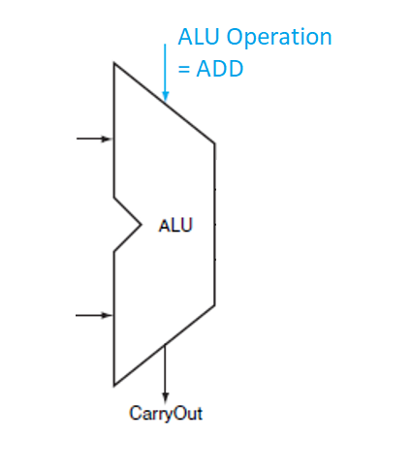
t0: VALUE = X
t1: VALUE = X +1
ASYNCHRONOUS
REGISTER
FILE
/WE
READ ADDR = 0
WRITE ADDR = 0
t0: VALUE = X + 1
t1: VALUE = X + 1 + 1
VALUE = 1

Slide 5
t0: VALUE = X
t1: VALUE = X +1
ASYNCHRONOUS
REGISTER
FILE
8 BIT
NEGATIVE EDGE TRIGGERED
D TYPE FLIP-FLOP
CLOCK
READ ADDR = 0
WRITE ADDR = 0
t0: VALUE = X + 1
t1: VALUE = X + 1 + 1
/WE
VALUE = 1

