Slide 1
COMP541
Combinational Logic - 4
Montek Singh
Jan 30, 2012

Slide 2
Today’s Topics
Combinational Building Blocks
  Multiplexers
  Decoders
  Encoders
Delays and Timing

Slide 3
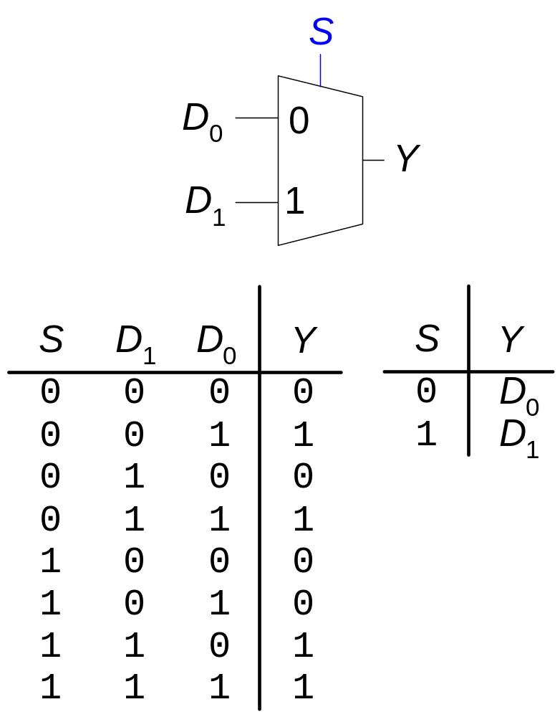
Multiplexer (Mux)
Selects one of out of N inputs
  a control input (“select” signal) determines which input is chosen
  # bits in select = ceil(log₂N)
Example: 2:1 Mux
  2 inputs
  1 output
  1-bit select signal

Slide 4
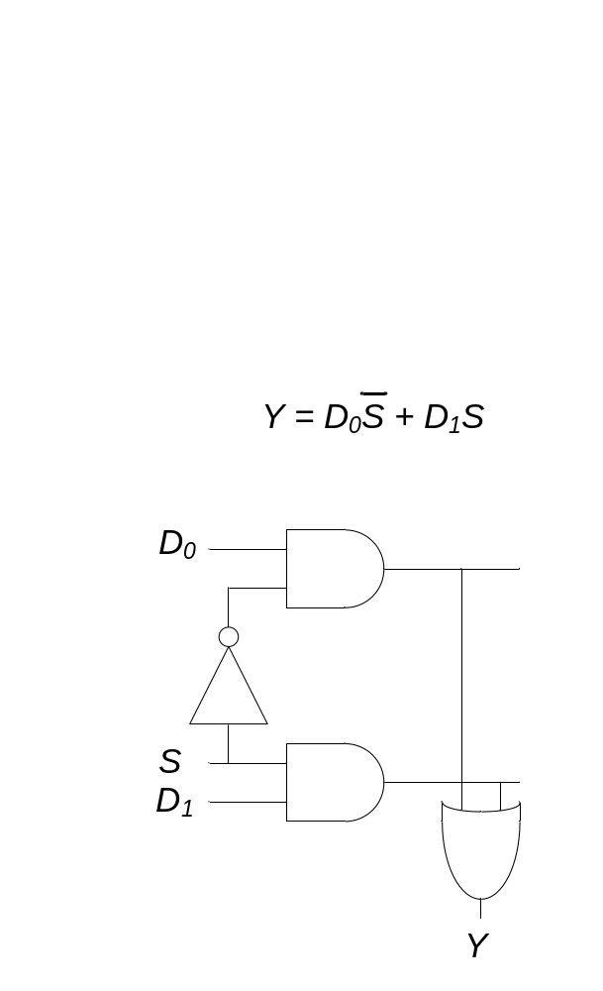
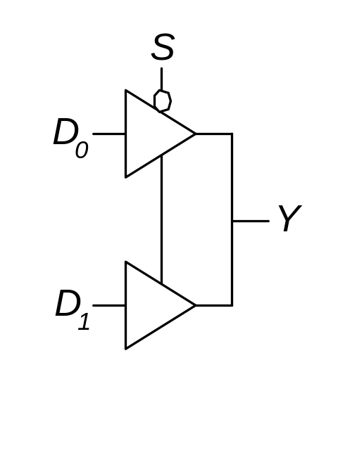
Multiplexer Implementations
Logic gates
  Sum-of-products form
Tristate buffers
  For an N-input mux, use N tristate buffers
  Turn on exactly one buffer to propagate the appropriate input
    all others are in floating (Hi-Z) state

Slide 5
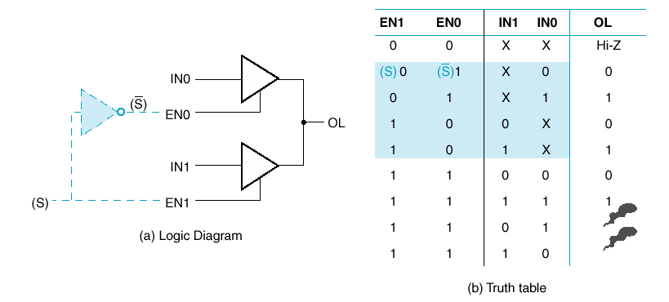
Multiplexer with Hi-Z
Normal operation is blue area
Smoke

Slide 6
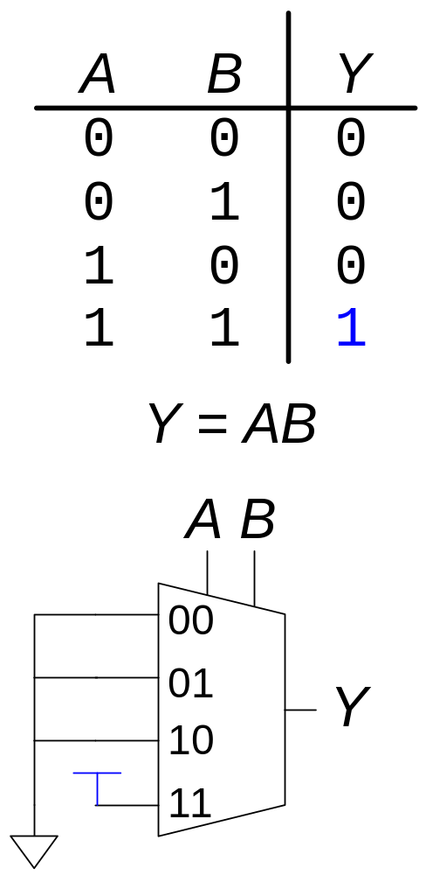
Combinational Logic using Multiplexers
Implement a truth table using a mux
  use a mux with as many input lines are rows in the table
  Y values are fed into the mux’s data inputs
  AB values become the mux’s select inputs

Slide 7
Verilog for Multiplexer
Just a conditional statement:
  module mux(input d0, d1,
  input s,
  output y);
  assign y = s ? d1 : d0;
  endmodule
Easily extends to multi-bit data inputs:
  module mux4bit(input [3:0] d0, d1,
  input s,
  output [3:0] y);
  assign y = s ? d1 : d0;
  endmodule

Slide 8
Verilog for Multiplexer
Also extends to N-way multiplexers:
  module mux4way4bit(
  input [3:0] d0, d1, d2, d3
  input [1:0] s,
  output [3:0] y);
  assign y = s[1] ? (S[0]? d3 : d2)
  : (S[0]? d1 : d0);
  endmodule

Slide 9
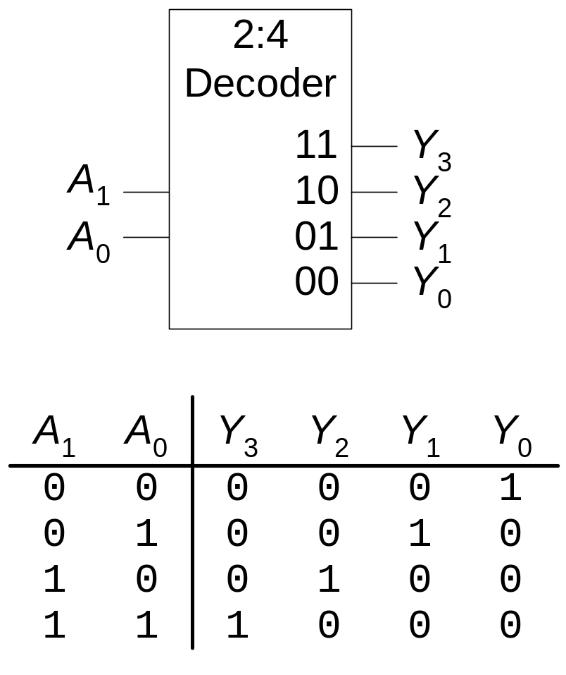
Decoders
N inputs, 2^{N} outputs
“One-hot” outputs
  only one output HIGH time

Slide 10
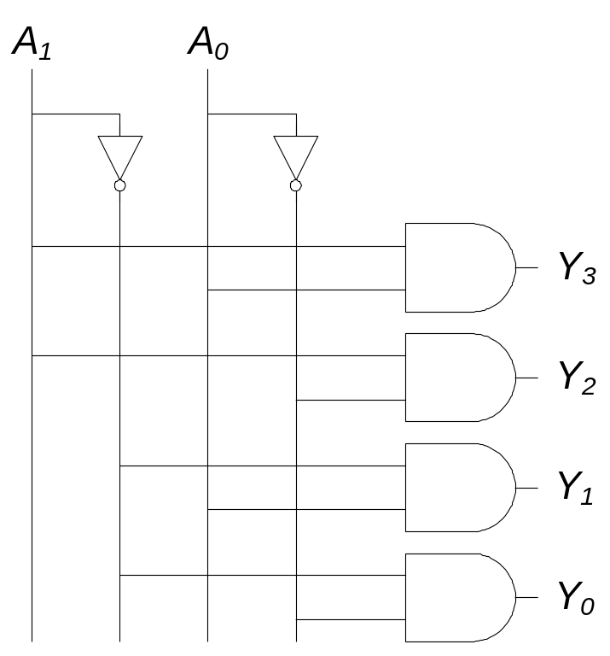
Decoder Implementation

Slide 11
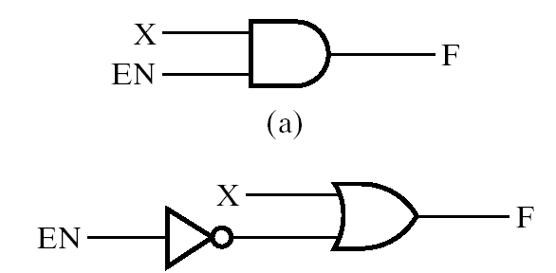
Aside: Enable
Enable is a common input to logic functions
See it in memories and today’s logic blocks

Slide 12
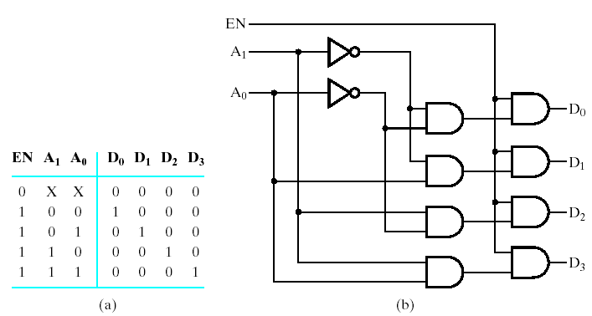
2-to-4 Decoder with Enable

Slide 13
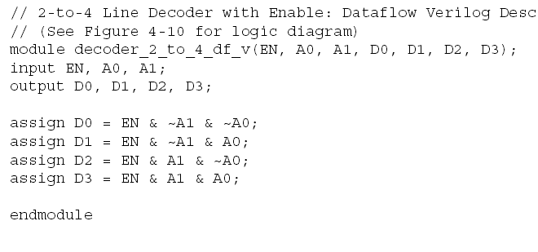
Verilog

Slide 14
Decoders
How about a…
  1-to-2 decoder?
  3-to-8 decoder?
  (N)-to-2^{(N)} decoder?
  (N+1)-to-2^{(N+1)} decoder?

Slide 15
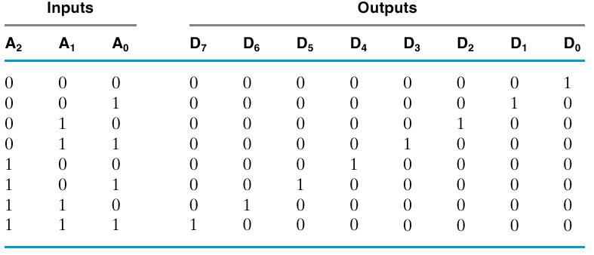
3-to-8 Decoder: Truth Table
Notice they are minterms

Slide 16
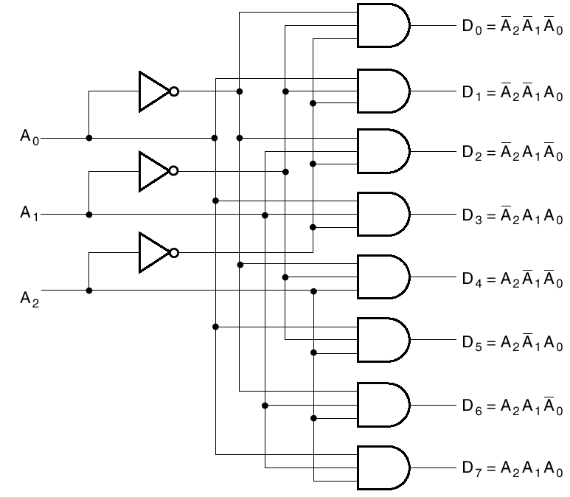
3-to-8 Decoder: Schematic

Slide 17
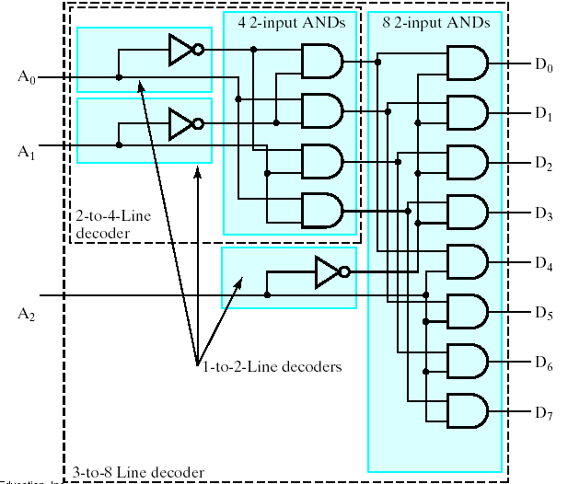
3-to-8 Decoder: Multilevel Circuit

Slide 18
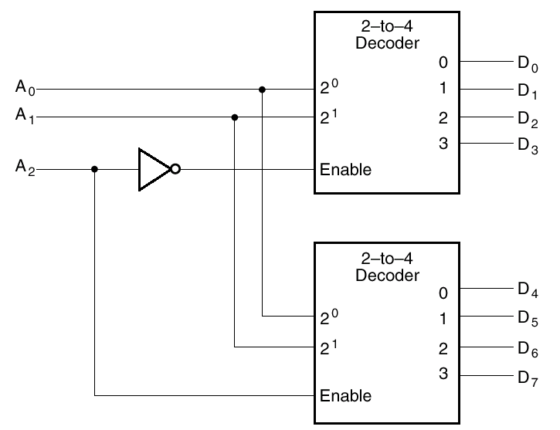
3-to-8 Decoder: “Enable” used for expansion

Slide 19
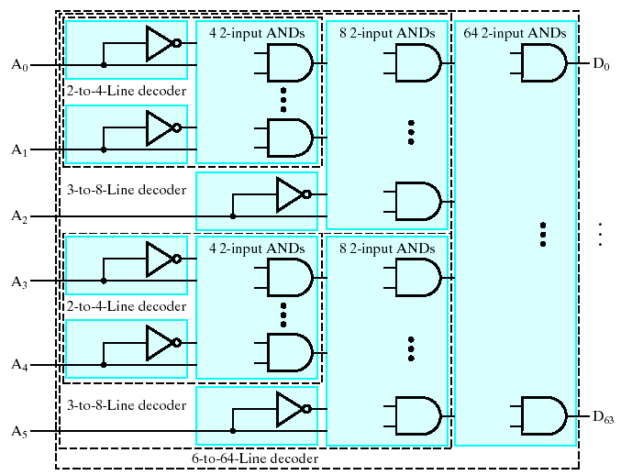
Multi-Level 6-to-64 Decoder

Slide 20
Uses for Decoders
Binary number might serve to select some operation
  Number might encode a CPU Instruction (op codes)
    Decoder lines might select add, or subtract, or multiply, etc.
  Number might encode a Memory Address
    To read or write a particular location in memory

Slide 21
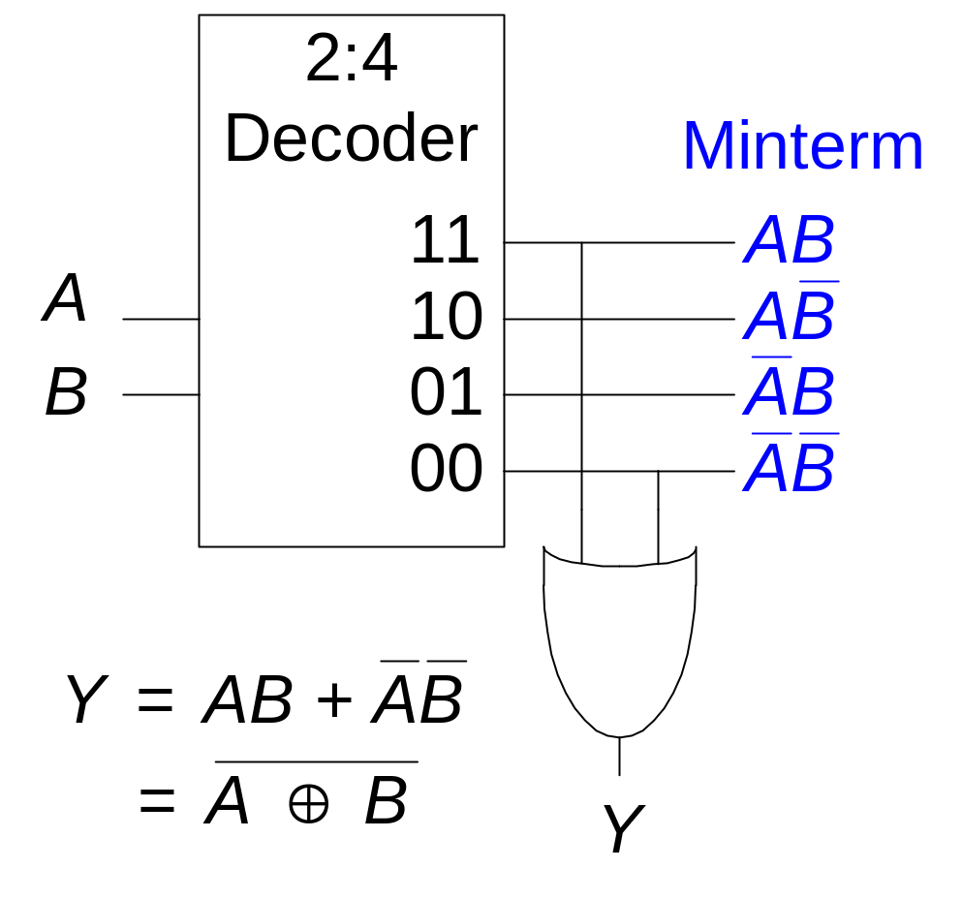
Logic using Decoders
OR the ON-set minterms

Slide 22
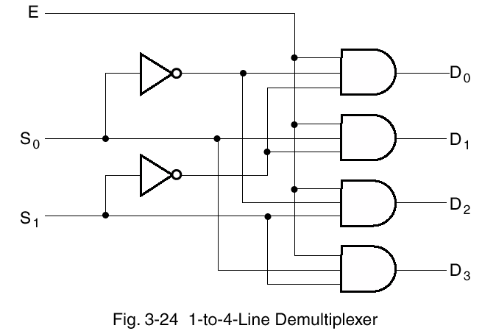
Demultiplexer (demux)
Dual of multiplexer
  One input, multiple outputs (destinations)
  Select signal routes input to one of the outputs
n-bit select implies 2^{n} outputs
  e.g., 4-way demux uses a 2-bit select

Slide 23
Demux vs. Decoder
Similarities
  decoder produces a “1” on one of the 2^{N} outputs
    … “0” elsewhere
  demultiplexer transmits data to one of the 2^{N} outputs
    … “0” elsewhere
Possible to make one from the other
  How?

Slide 24
Encoder
Encoder is the opposite of decoder
  2^{N} inputs (or fewer)
  N outputs

Slide 25
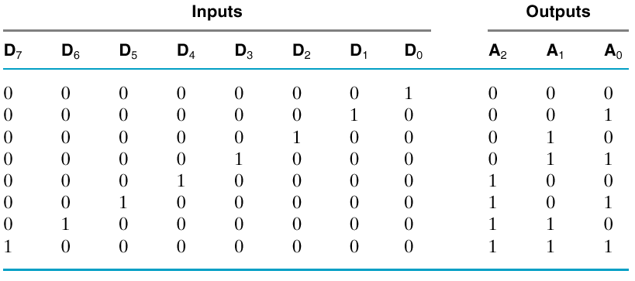
Encoder: Implementation
Inputs are already minterms!
  Simply OR them together appropriately
  e.g.: A₀ = D₁ + D₃ + D₅ + D₇

Slide 26
Encoder Implementation: Problem
Requirement:
  Only one of the D inputs can be high
  What if, say, D3 and D6 are both high?
    Simple OR circuit will set A to 7

Slide 27

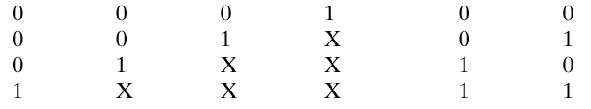
Solution: Priority Encoder
Chooses one with highest priority
  Largest number, usually
Note “don’t cares”

Slide 28
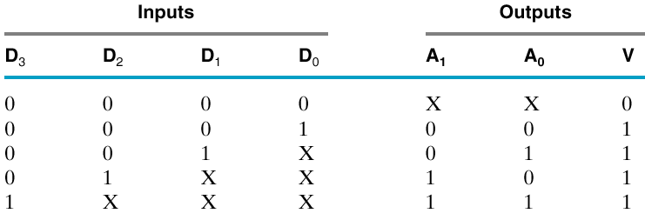
Priority Encoder
What if all inputs are zero?
  Need another output: “Valid”

Slide 29
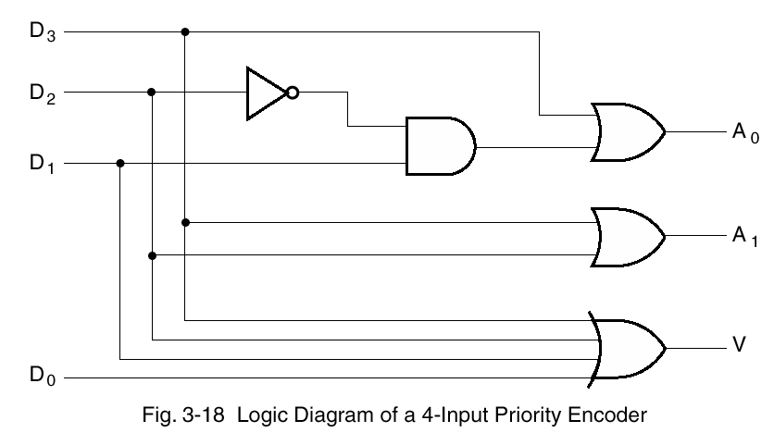
Priority Encoder Implementation
Valid is simply the OR of all the data inputs

Slide 30
Code Converters
General Converters
  convert one code to another
  examples?

Slide 31


Example: Seven-Segment Decoder
7-segment display
  convert single hex digit …
  … to a display character code)
Will be first lab using the hardware kit (Feb 10)

Slide 32
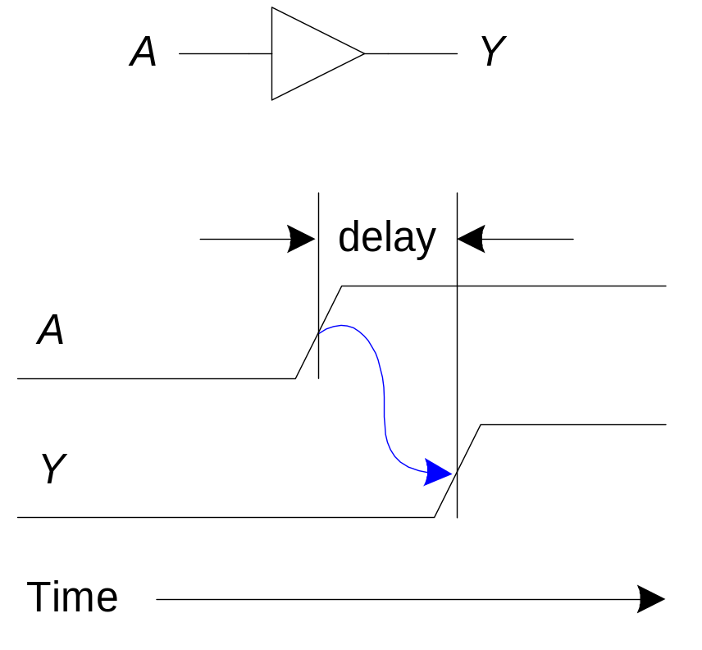
Timing
What is Delay?
  Time from input change to output change
    Transient response
  e.g., rising edge to rising edge
  Usually measured from 50% point

Slide 33
Types of Delays
Transport delay = “pure” delay
  Whatever goes in …
  … comes out after a specified amount of time
Inertial delay
  Inputs have an effect only if they persist for a specified amount of time
    No effect if input changes and changes back in too short a time (can’t overcome inertia)
    can filter out glitches

Slide 34
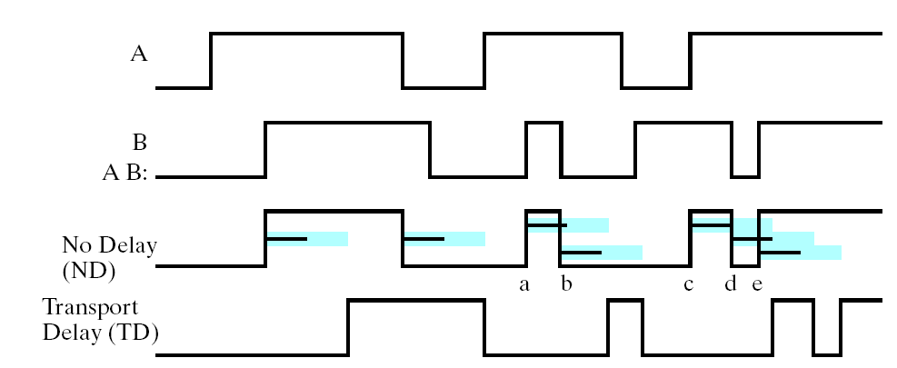
Effect of Transport Delay (blue)
Delay just shifts signal in time
  focus on the blue bars; ignore the black ones

Slide 35
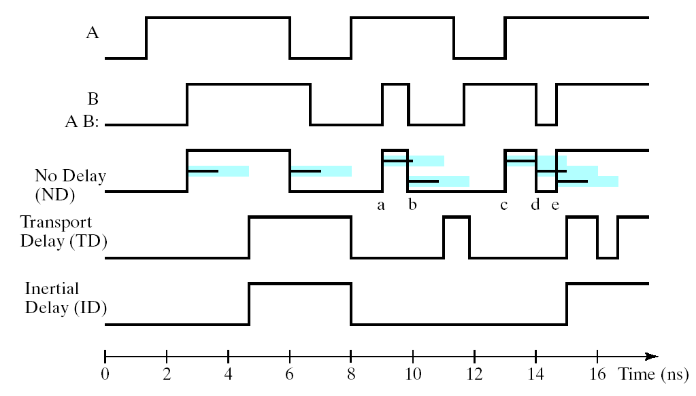
Effect of Inertial Delay
Blue – Propagation delay time Black – Rejection time (filter out)

Slide 36
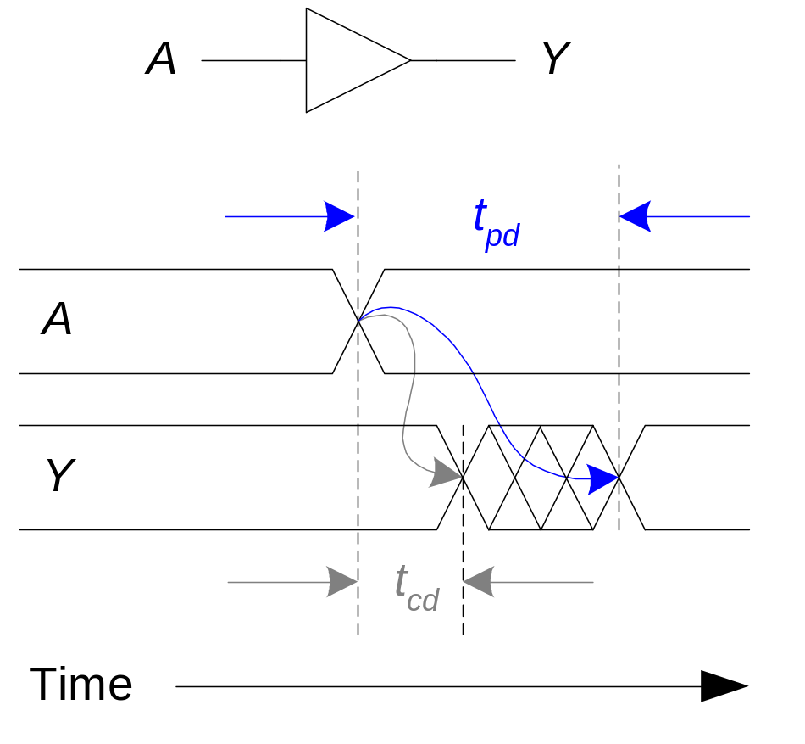
Propagation & Contamination Delay
Propagation delay: t_{pd}
  max delay from input to output
Contamination delay: t_{cd}
  min delay from input to output

Slide 37
Propagation & Contamination Delay
Delay is caused by
  Capacitance and resistance in a circuit
    More gates driven, longer delay
    Longer wires at output, longer delay
  Speed of light is the ultimate limitation
Reasons why t_{pd} and t_{cd} may be vary:
  Different rising and falling delays
    What is typically reported? Greater of the two
  Multiple inputs and outputs, some faster than others
  Circuits slow down when hot and speed up when cold
    So, both maximum and typical given
Specs provided in data sheets

Slide 38
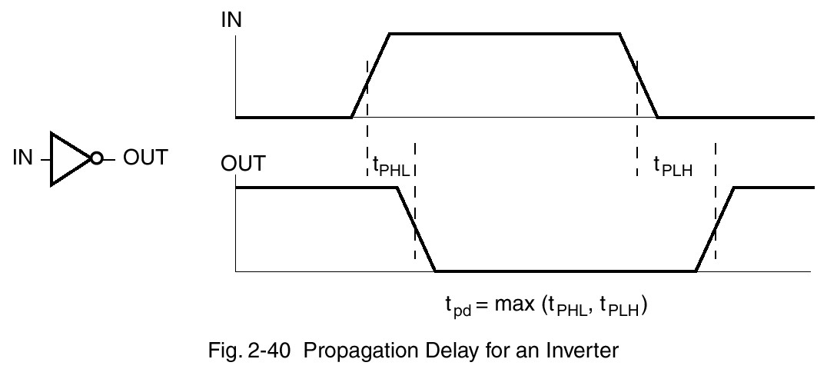
Propagation & Contamination Delay

Slide 39
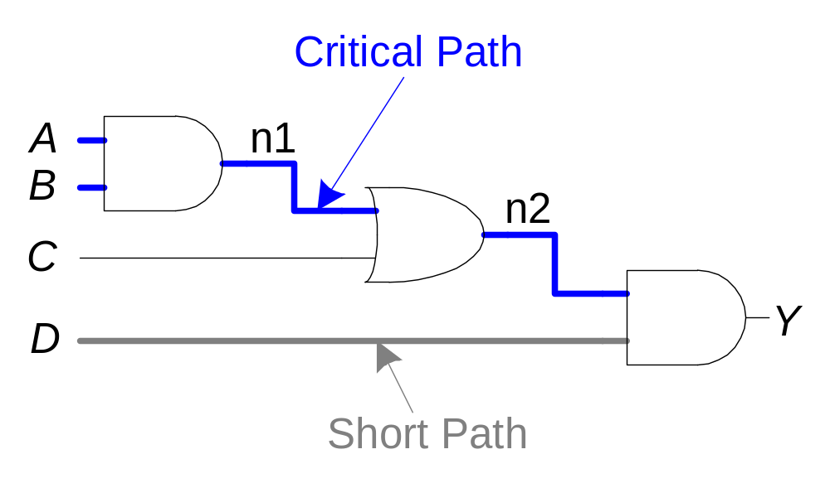
Critical and Short Paths
Critical (Long) and Short Paths
Critical (Long) Path: t_{pd} = 2t_{pd_AND} + t_{pd_OR}
Short Path: t_{cd} = t_{cd_AND}

Slide 40
Glitches
What is a Glitch?
  a non-monotonic change in a signal
  e.g., a single input change can cause multiple changes on the same output
  a multi-input transition can also cause glitches
Are glitches a problem?
  Not really in synchronous design
    Clock time period must be long enough for all glitches to subside
  Yes, in asynchronous design
    Absence of clock means there should ideally be no spurious signal transitions, esp. in control signals
  It is important to recognize a glitch when you see one in simulations or on an oscilloscope
  Often cannot get rid of all glitches

Slide 41
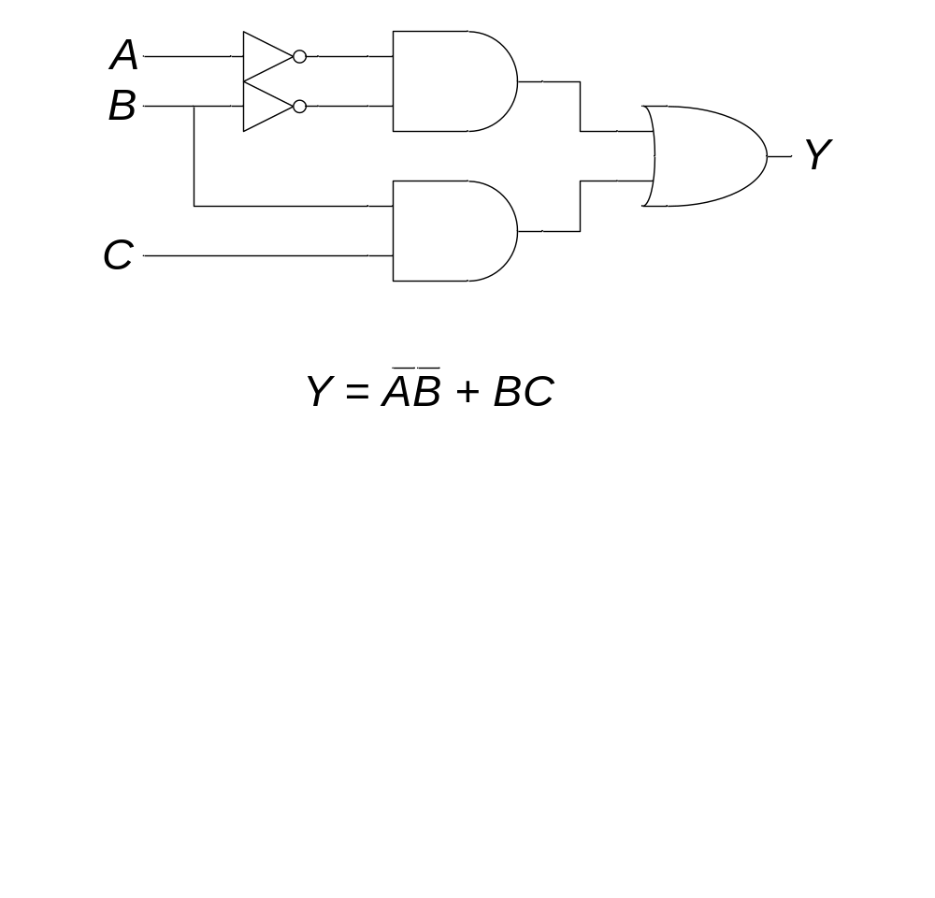
Glitch Example: Self-Study
What happens when:
  A = 0, C = 1, and
  B goes from 1 to 0?
Logically, nothing
  Because although 2nd term goes to false
  1st term now is true
But, output may glitch
  if one input to OR goes low before the other input goes high

Slide 42
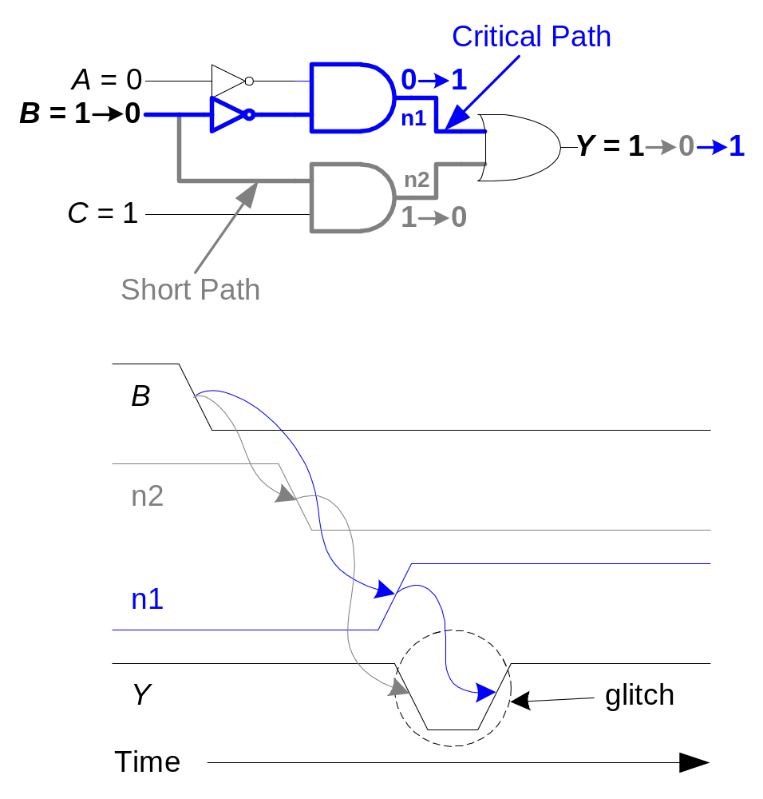
Glitch Example: Self-Study (cont.)

Slide 43
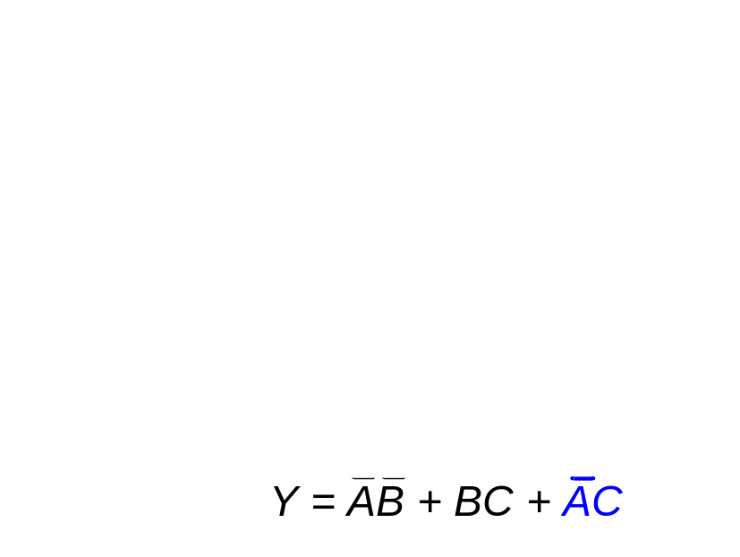
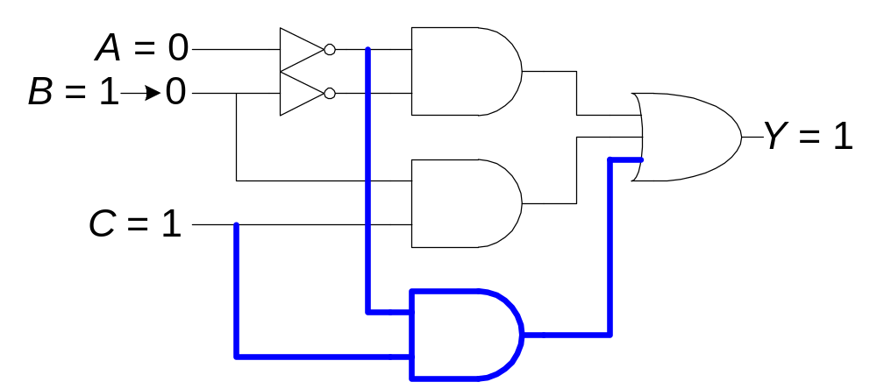
Glitch Example: Self-Study (cont.)
Fixing the glitch: Add redundant logic term

Slide 44
Next
Sequential Design

