Slide 1



Reduce Security Risks to
Protect Your Network
Presented by:
Tim Levad
© 2015 Cisco and/or its affiliates. All rights reserved.
#CiscoSmartTalk
1

Slide 2






An Optimized Network is the Foundation for
Business Innovation & Outcomes
CiscoSmartTalk
Security & Risk
Analytics & Modeling
Six Areas
Operations Efficiency
& Automation
Architecture Strategy
& Planning
You Need to
Address
Compliance & Change
Management
Operations Support
& Lifecycle Management
© 2015 Cisco and/or its affiliates. All rights reserved.
#CiscoSmartTalk
2

Slide 3

Security
& Risk
© 2015 Cisco and/or its affiliates. All rights reserved.
#CiscoSmartTalk
3

Slide 4
Agenda
• Assessing and evolving your security strategy
• Maintaining your security posture
• Security services to help prepare your network
© 2015 Cisco and/or its affiliates. All rights reserved.
#CiscoSmartTalk
4

Slide 5
When was the last time you validated
your security posture?
© 2015 Cisco and/or its affiliates. All rights reserved.
#CiscoSmartTalk
5

Slide 6

Do you know what weak links are?
© 2015 Cisco and/or its affiliates. All rights reserved.
#CiscoSmartTalk
6

Slide 7
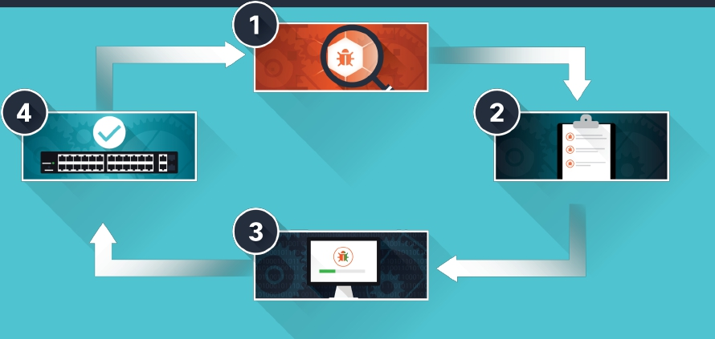
The Vulnerability Lifecycle
Identify Risk
Validate Removal of Risk
Prioritize Risk
© 2015 Cisco and/or its affiliates. All rights reserved.
Remediate Risk
#CiscoSmartTalk
7

Slide 8



Validate Your Current Security Posture
Current State
Desired State
Strategy Map
© 2015 Cisco and/or its affiliates. All rights reserved.
#CiscoSmartTalk
8

Slide 9



Assess Risk Based on Your Needs
Assessment Examples
Perimeter
Assessment
Wireless
Assessment
Device Security
Assessment
© 2015 Cisco and/or its affiliates. All rights reserved.
#CiscoSmartTalk
9

Slide 10

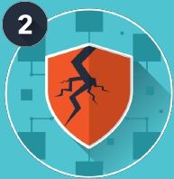


What does an Assessment look like?
Review
© 2015 Cisco and/or its affiliates. All rights reserved.
Probe
Analyze
Recommend
#CiscoSmartTalk
10

Slide 11




Uncovering Risk
Agents
IT Staff
Management
© 2015 Cisco and/or its affiliates. All rights reserved.
#CiscoSmartTalk
11

Slide 12
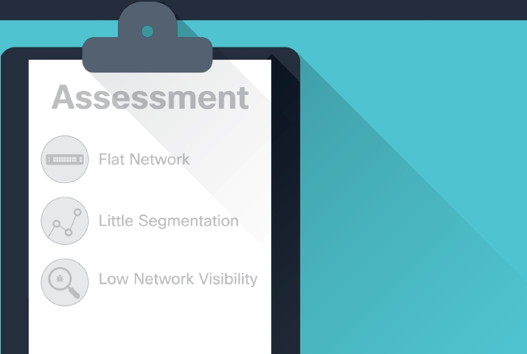
Prioritize Risk Based on Your Business
© 2015 Cisco and/or its affiliates. All rights reserved.
#CiscoSmartTalk
12

Slide 13
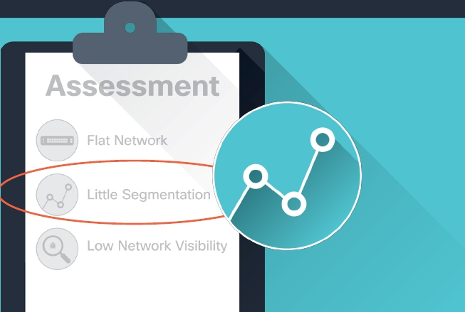
Develop a Risk Framework
© 2015 Cisco and/or its affiliates. All rights reserved.
#CiscoSmartTalk
13

Slide 14


Risk Remediation Strategy
© 2015 Cisco and/or its affiliates. All rights reserved.
#CiscoSmartTalk
14

Slide 15




Protection by Segmentation
Agents
IT Staff
Management
© 2015 Cisco and/or its affiliates. All rights reserved.
#CiscoSmartTalk
15

Slide 16



Validate Risk Removal
Agents
IT Staff
Management
© 2015 Cisco and/or its affiliates. All rights reserved.
#CiscoSmartTalk
16

Slide 17
Recap: The Vulnerability Lifecycle
Identify Risk
Validate Removal of Risk
Prioritize Risk
© 2015 Cisco and/or its affiliates. All rights reserved.
Remediate Risk
#CiscoSmartTalk
17

Slide 18



Cisco Security Services
Network
Optimization
Service
Security
Optimization
Service
Managed
Threat
Defense
© 2015 Cisco and/or its affiliates. All rights reserved.
#CiscoSmartTalk
18

Slide 19
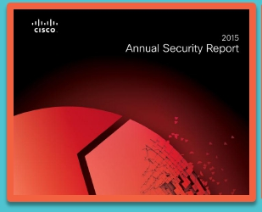
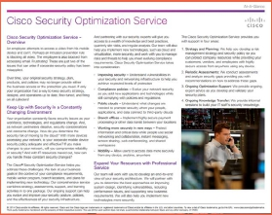
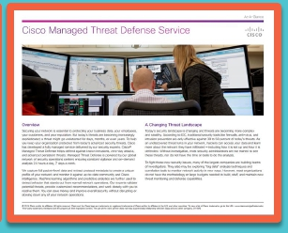
Resources
Cisco 2015 Annual
Security Report
Security Optimization
Service At-A-Glance
Managed Threat
Defense At-A-Glance
© 2015 Cisco and/or its affiliates. All rights reserved.
#CiscoSmartTalk
19

Slide 20


Learn More About
Security & Risk
30-MIN WEBINAR
© 2015 Cisco and/or its affiliates. All rights reserved.
#CiscoSmartTalk
20

