Slide 1


Slide 2
What
R language and environment
A short introduction to R
A few examples of using R
Not a MATLAB® vs. R comparison

Slide 3
Why
Because it's interesting and fun
Because it's got Microsoft support
Because it's FREE (like both 'free beer' and 'free software')
BECAUSE it "might" provide a better alternative to running MATLAB code in our applications since SQL server 2016 offers some integration with R (more work is needed to asses this)

Slide 4
What is R
https://www.r-project.org/about.html
R is a language and environment for statistical computing and graphics.
R provides a wide variety of statistical (linear and nonlinear modelling, classical statistical tests, time-series analysis, classification, clustering, …) and graphical techniques, and is highly extensible.

Slide 5
What is R
http://www.sqlservercentral.com/articles/Microsoft/145393/
R is a statistical programming language, mainly used for statistical computing and analysis, data mining and machine learning, and it is a very strong tool for graphics and data visualizations. It is a free software environment, is cross-platform (UNIX, Windows, MacOS), with most of the libraries and package development driven by community efforts.

Slide 6
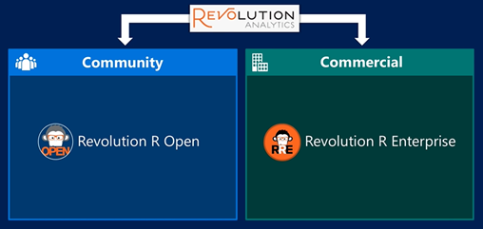
Microsoft and R
In 2015 Microsoft acquired Revolution Analytics

Slide 7
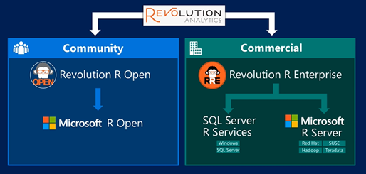
Microsoft and R
After acquisition:

Slide 8
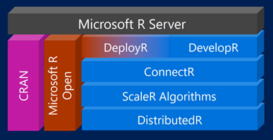
Microsoft R Server

Slide 9
Microsoft R products
1. Microsoft R Open
  Enhanced R distribution version by Microsoft, and it is 100% open source.
  This version is fully compatible with any existing R engine, making also R code fully compatible with existing code.
  additional high-performance multi-threaded enhancements (both on Windows or on Linux platforms) when using the Math Kernel Library (MKL) for vector/matrix based mathematical operations.
  This edition is fully compatible with the CRAN repository. GitHub packages can also be used within R Open.
  Limited by memory available, meaning that only data that can fit into the memory of a computer can be processed.
  Proprietary ScaleR algorithms and functions (RevoScaleR library) will not run under R Open
  Will run on any SQL Server 2016 edition, except on Express or Express with Tools.

Slide 10
Microsoft R products
2. Microsoft R Client
  100% free version, built on top of Microsoft R Open.
  Can use any CRAN/GitHub based library,
  This edition introduces the powerful RevoScaleR Library to allow heavy parallelization and multi-threaded computing. The RevoScaleR library is a library using ScaleR technology and its proprietary functions for parallel computation.
  Limitation:
  Memory is limited to local memory, which means that the data must fit into local memory.
  ScaleR functions can use parallel computation, but processing is limited to two threads only (regardless of computer having more cores and supporting multi-threated operations).
  All the computation is limited to client capabilities: disk, ram and speed.
  Microsoft R Client Server will run only on Enterprise or Developer editions.

Slide 11
Microsoft R products
3. Microsoft R Server
  Microsoft R Server is the most often used version of R in the Microsoft R product family, especially for enterprise analytics purposes.
  Like R Open / R Client version, it supports all statistical analysis, data mining and predictive analytics with machine learning, but for big data as well.
  Fully compatible with CRAN / Github / Bioconductor library repositories
  ScaleR algorithms with its functions are capable of parallel and multi-threaded data processing and computation with data much larger than the server memory size.
  An R-based application will be able to use multiple platforms using ConnectR and be deployable across multiplatform as well (using DeployR functions). Disk scalability is also available with this version.
  Microsoft R Client Server will run only on Enterprise or Developer editions.

Slide 12
Microsoft R products
4. SQL Server R Services
  Essentially in-database version of Microsoft R Server version
  It covers most of ScaleR algorithms for scalable and high-performance environment.
  Memory and disk will be managed by your instance of SQL Server.
  An additional SQL Server service will be installed locally, called the SQL Server Trusted Launchpad.
  Capable of communication between SQL Server and R Server
  DeployR and ConnectR functions will not work.

Slide 13
Installing R
It is possible to get the R-Project binaries from CRAN (Comprehensive R Archive Network), but we're considering the Microsoft implementation.
Available in the SQL Server installation image.

Slide 14
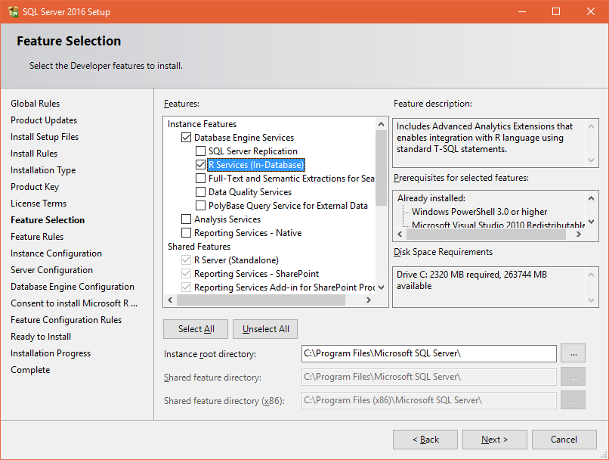
Installing R

Slide 15
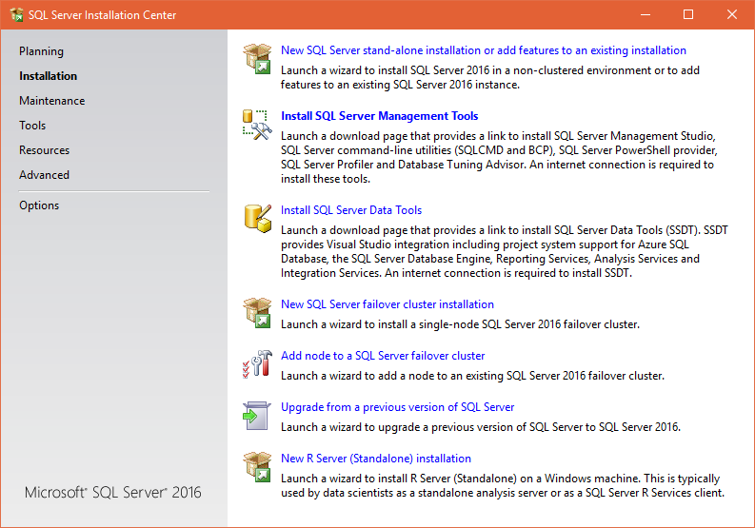
Installing R

Slide 16
R IDEs
RGui is the Microsoft provided IDE when installed from SQL Server image
R Tools for Visual Studio
http://microsoft.github.io/RTVS-docs/
Not yet ready for VS 2017
RStudio
https://www.rstudio.com/

Slide 17
R language fundamentals
Resources:
https://app.pluralsight.com/library/courses/r-programming-fundamentals
by Abhishek Kumar
https://cran.r-project.org/manuals.html
https://docs.microsoft.com/en-us/sql/advanced-analytics/r-services/sql-server-r-services
https://msdn.microsoft.com/en-us/microsoft-r/

Slide 18

R language fundamentals
Getting help inside the IDE:
1_Help.R

Slide 19
R language fundamentals
Assignment
Arithmetic operators
Logical operators
Mathematical functions
Special constants
Infinity
Undefined
Missing values
2_Assignment_Operators_Etc.R

Slide 20
R language fundamentals
Operations with vectors.
R has a lot of functionality for dealing with sets of data.
3_VectorOperations.R

Slide 21
R language fundamentals

Slide 22
R language fundamentals

Slide 23
R language fundamentals

