Slide 1
Road trip Planner v1.0
By Dung Duc Nguyen (johnny)

Slide 2
Application Overview
Road trip planner allows users to select the travel destination
Provides a brief description about the destination
Calculates distance that needs to travel
Gives a range of vehicle options
Summaries the total fuel cost of chosen vehicles for each trip

Slide 3
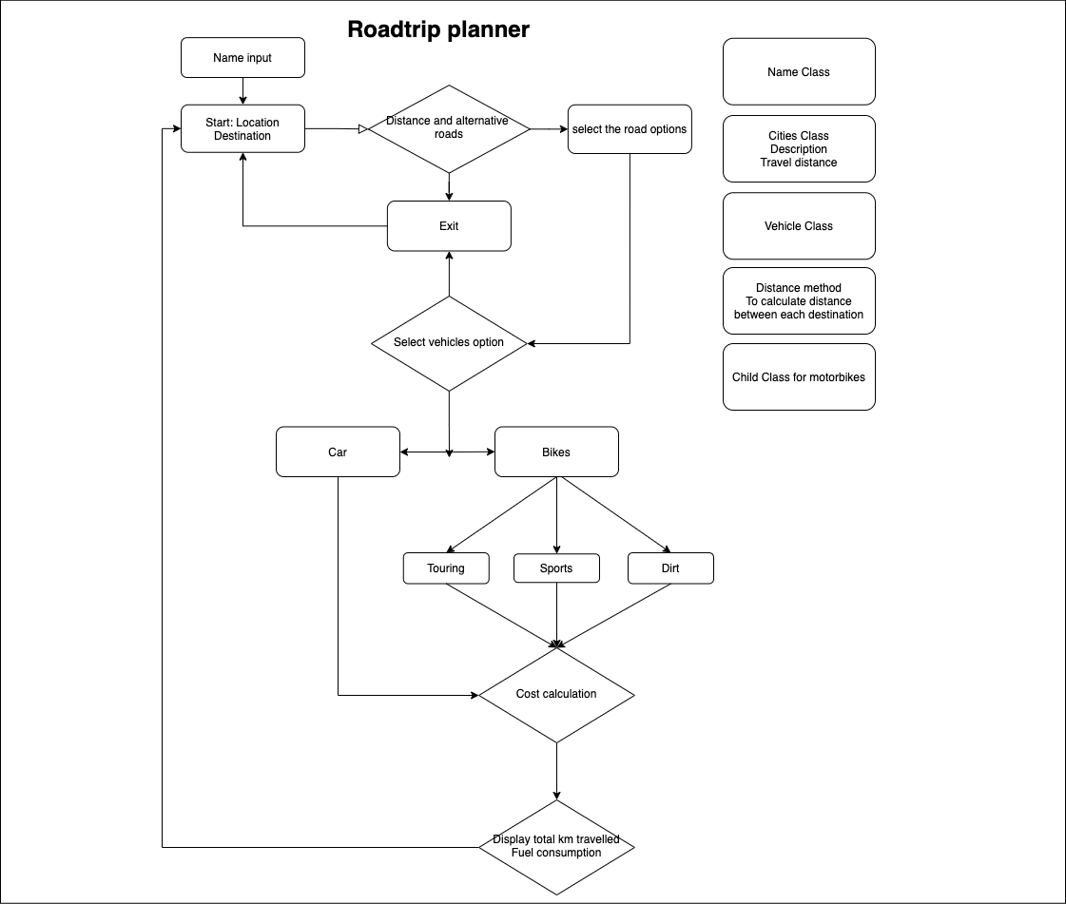
Flowchart

Slide 4
Features
Allows users to input their names up to three times
Display travel options, cities in particular
When destination selected, display the information about the city and provides distance in km
After selecting travel options, users could then select their means of vehicle such as Cars, or motorbikes.
Display the fuel consumption of each vehicle chosen
Print out the summary of total cost for each selected trip
Back to main menu, and exit button to quit the program

Slide 5
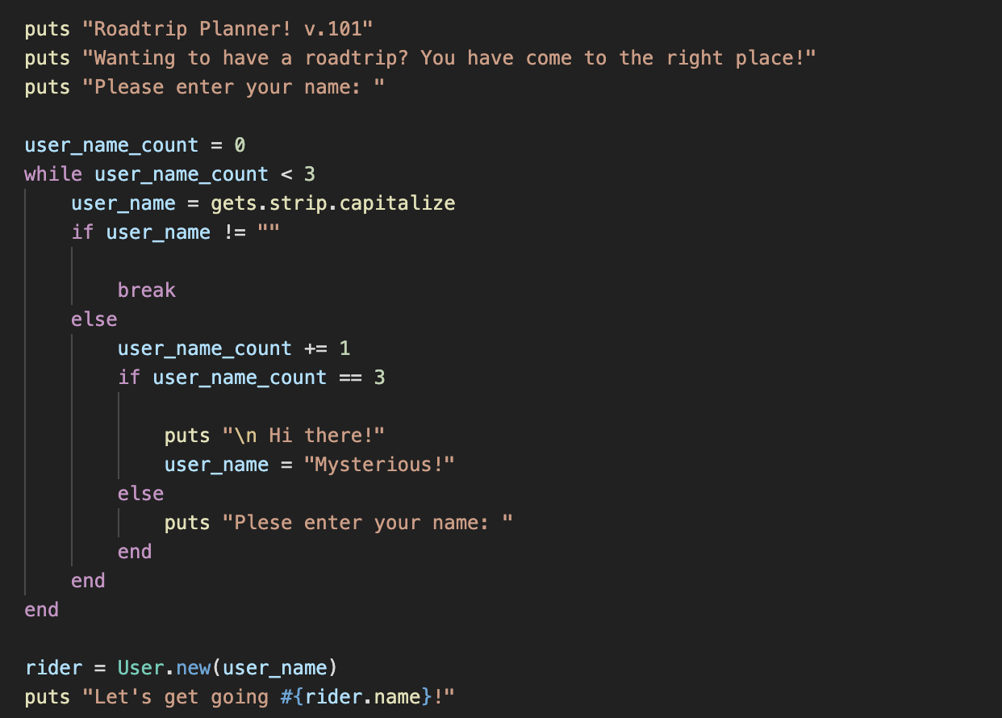
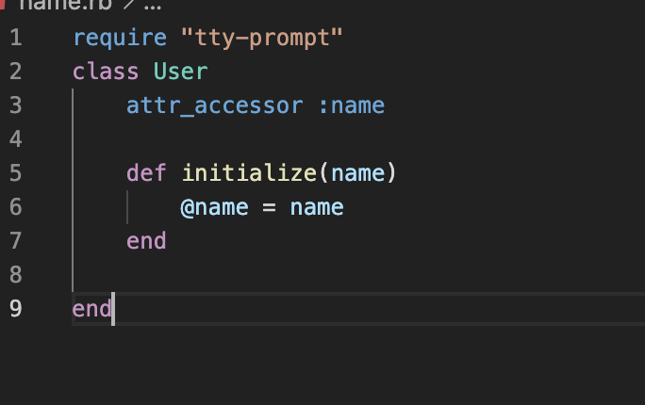
Logic & code
Name input
While loops
Conditional statement - IF
User class

Slide 6
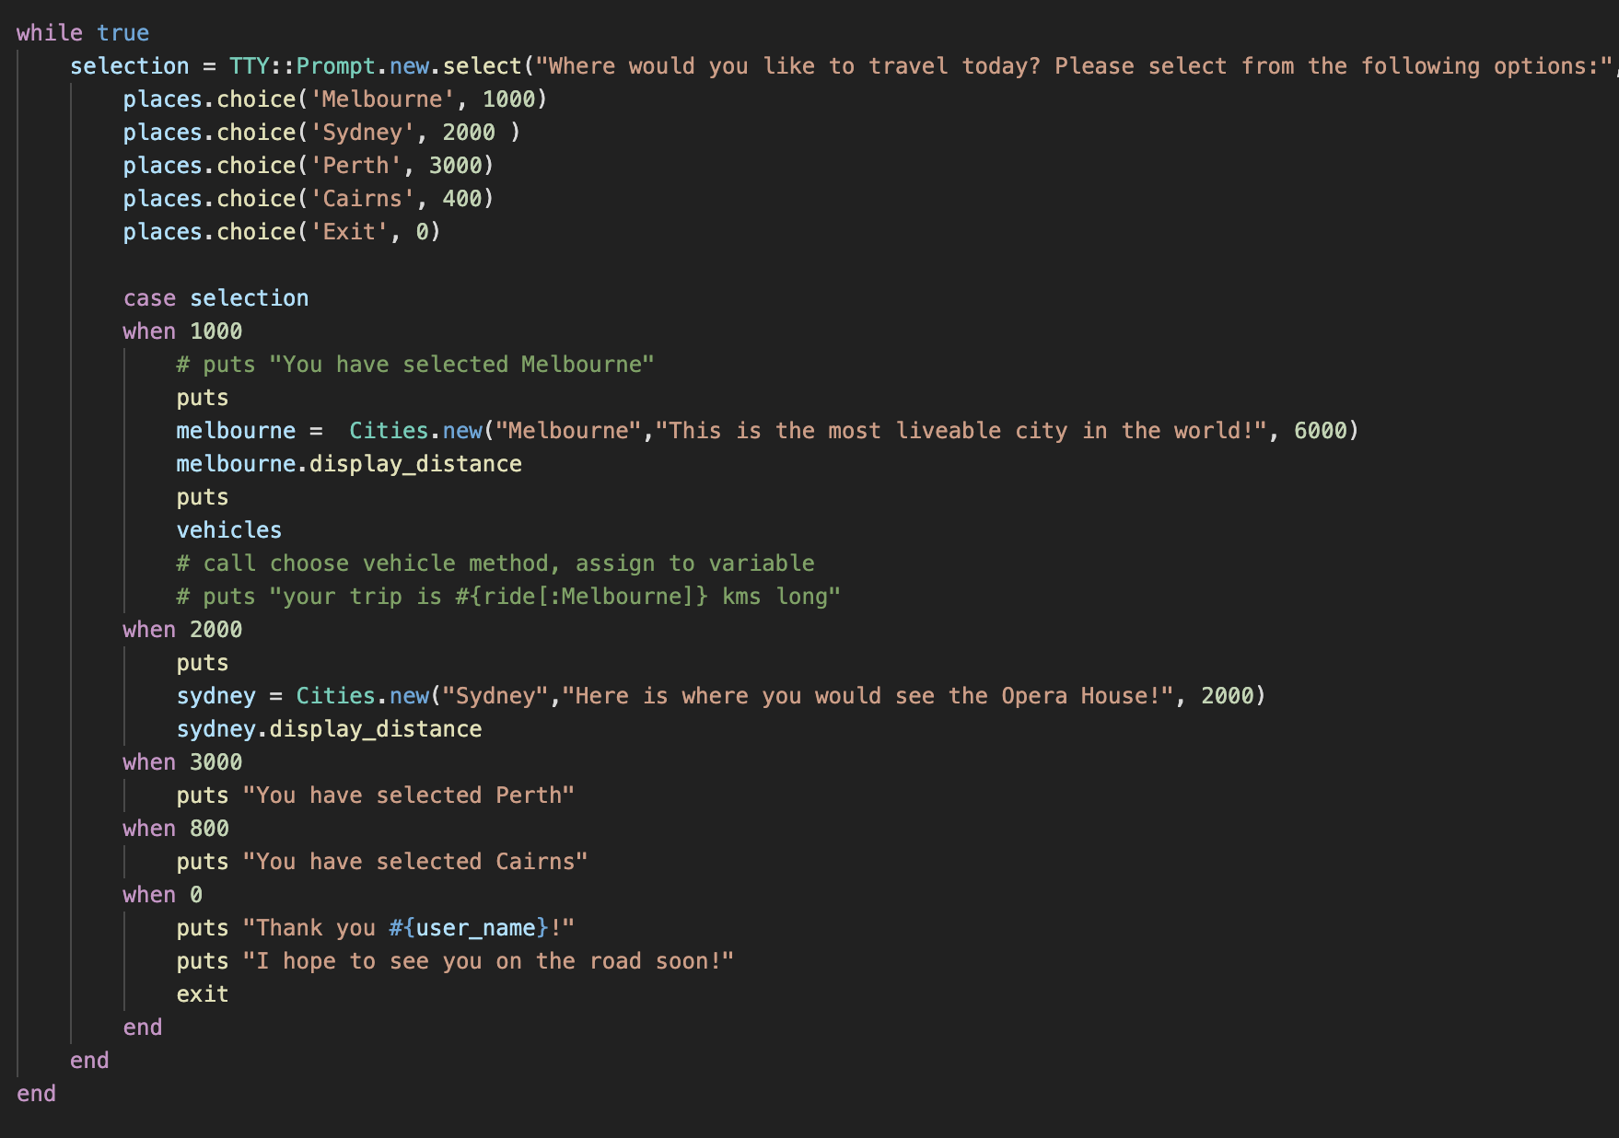
Logic & code
Travel options
While loops
Iterating through a hash with cities and their destination
Case statement to display each city
Exit method

Slide 7
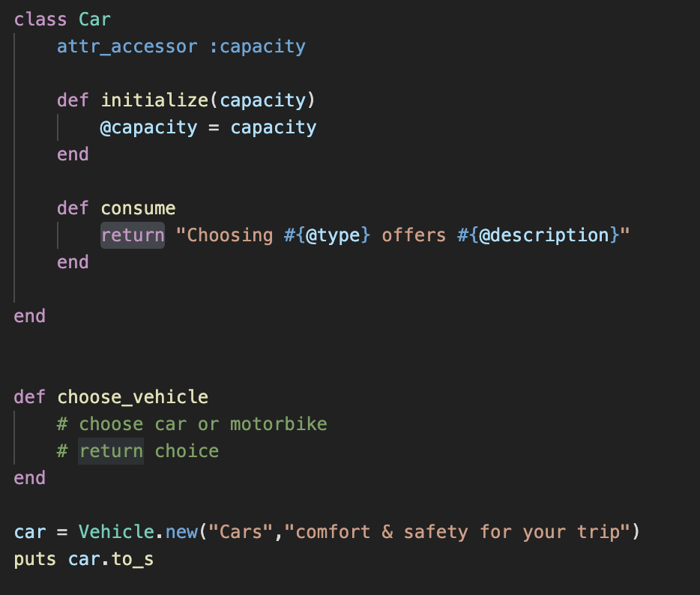
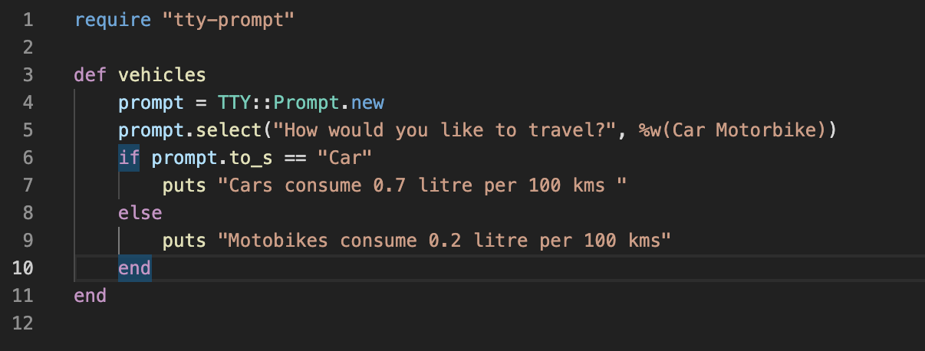
LOGIC & Code
Cities & vehicles
Cities class
Vehicles class
Cost calculation method

Slide 8
Development review
Decision making
Simple, fulfill basic requirements
Easy to maintain the code later
Codes & Syntaxes
Variables, loops, conditions
Methods, classes, gems
Error handling
Testing

Slide 9
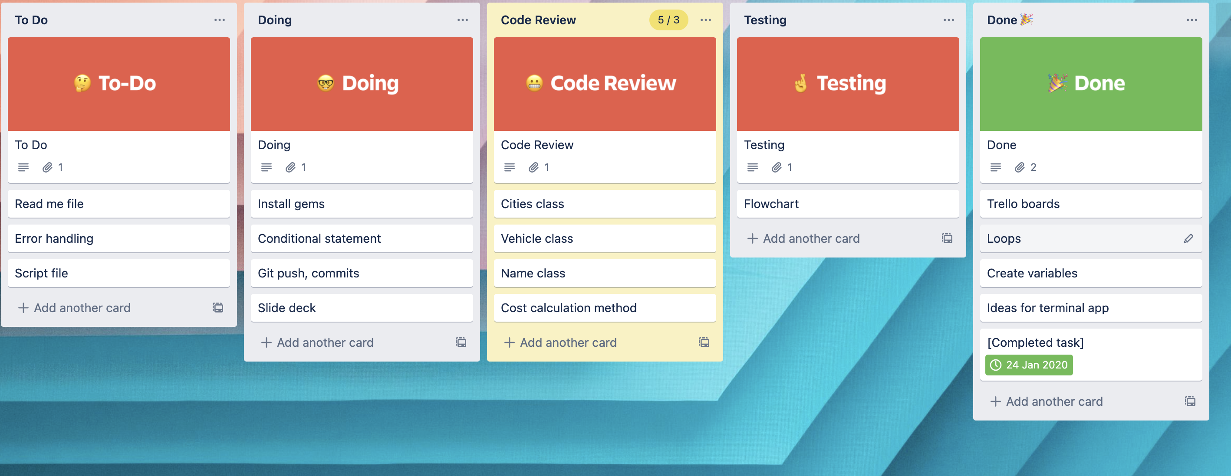
Trello board

Slide 10
Development review
Favorite parts
Iterating through hash
Gems – TTY
Problem solving
Challenges
First terminal app
Lack of experience
Coding practice
Programming tools
Languages & time management
Thank you for listening!

