Slide 1
SAGE / HACKATHON DEMO
01
SKILL AGENT GOVERNANCE ENGINE
SAGE
SKILL
GATE
API
Team Skills, Governed as Agent APIs
Prompt / Script / Tool
Policy + Evidence
Team Runtime
VALIDATE / PUBLISH / PIN / ROLLBACK
PERSONAL ASSET
GOVERNED DELIVERY
TEAM REUSE
0:00-0:07
Turn personal Skills into governed AI capabilities the whole team can reuse.
Notes:
0:00-0:07 | 7 seconds
Narration: SAGE turns personal prompts, scripts, and tools into governed AI capabilities that the whole team can reuse.
Visual cue: Hold on the title, then emphasize Skill, governance gate, and team API.

Slide 2
SAGE / HACKATHON DEMO
02
AI Capabilities Are Trapped on Personal Machines
01
LOCAL
02
POLICY
03
CHANGE
DEPENDENCY FRICTION
POLICIES STAY IN DOCS
UPGRADES DISRUPT WORK
Others must copy files and install runtimes
to reuse the same capability.
Schemas, permissions, timeouts, and side effects
lack one enforcement gate.
Overwrite releases lack version pinning,
and bad changes are hard to contain.
The question is not 'Can we call it?' but 'Can we ship it safely?'
0:07-0:18
The challenge is not calling a Tool. It is safe delivery and continuous change.
Notes:
0:07-0:18 | 11 seconds
Narration: Teams already have AI capabilities. But they are trapped in personal environments, execution boundaries live in documents, and upgrades can disrupt active work.
Visual cue: Move left to right through environment, policy, and upgrade risk.

Slide 3
SAGE / HACKATHON DEMO
03
One Trusted Delivery Chain, Two Execution Paths
SKILL
VERIFY
CANDIDATE
GENERATION
RESOLVE
RUN
Source
Schema · Eval
Release gate
Immutable
Identity · Policy
Evidence
DIRECT
0
AGENT
ON DEMAND
DETERMINISTIC TASKS
MODEL CALLS
COMPLEX GOALS
Typed I/O that bypasses model reasoning
Load Skills on demand; compose governed Tools
IDENTITY · SCHEMA · RISK · BUDGET · APPROVAL · AUDIT
0:18-0:34
Validation, release, version pinning, and policy form one trusted loop.
Notes:
0:18-0:34 | 16 seconds
Narration: SAGE validates and evaluates each Skill, builds a Candidate, then activates an immutable Generation. Known tasks bypass the LLM. Complex goals load Skills on demand. Every request stays version-pinned behind the same policy boundary.
Visual cue: Follow the main chain, then compare the Direct and Agent paths.

Slide 4
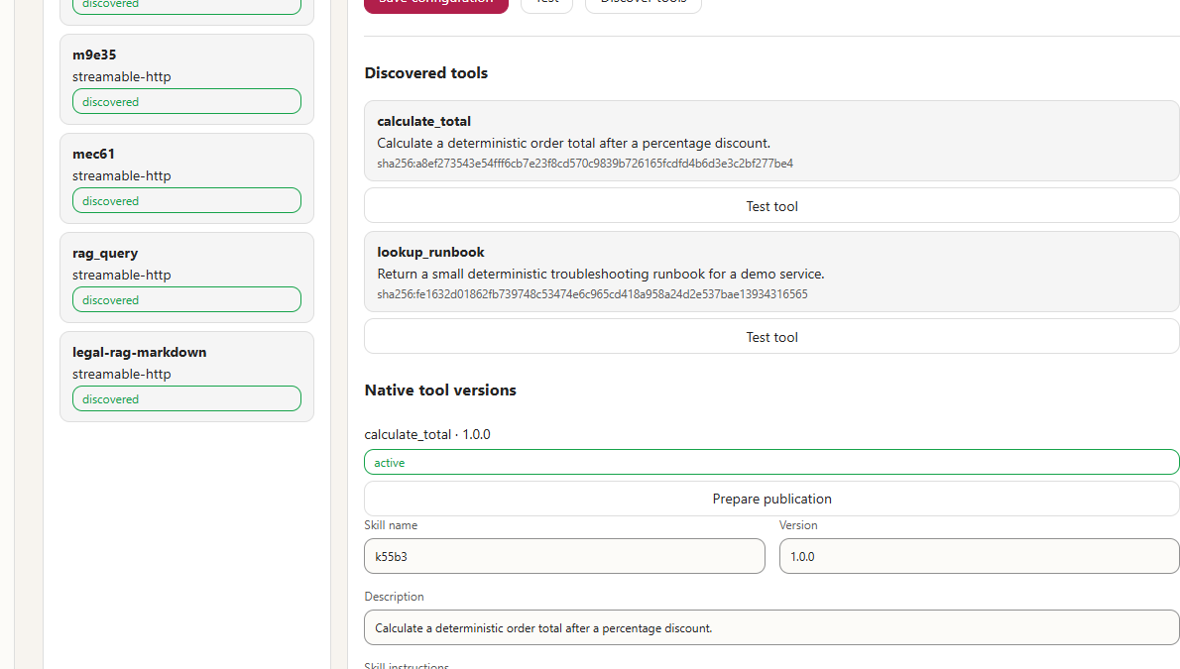
SAGE / HACKATHON DEMO
04
1. Onboard and Govern an MCP Tool
Governance starts before
the capability can run
1
CONNECT
MCP Server
2
DISCOVER
calculate_total
3
REGISTER
version · risk · digest
READ-ONLY
ACTIVE
0:34-0:48
Every MCP Tool enters with a version, risk class, and content digest.
Notes:
0:34-0:48 | 14 seconds
Narration: An administrator connects an MCP server, discovers calculate total, and registers it as a read-only native tool with a version and content digest. Governance begins at onboarding.
Visual cue: Point to calculate_total, read-only, version, and active status.

Slide 5
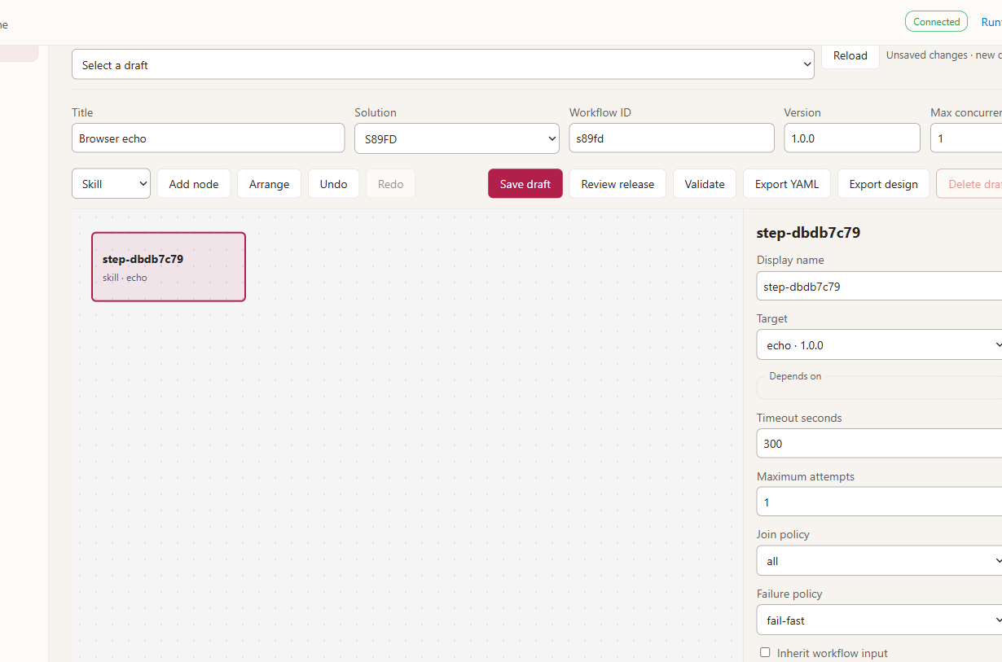
SAGE / HACKATHON DEMO
05
2. Design, Publish, and Run in One Click
VALIDATED QUICK FLOW
WORKFLOW DESIGNER
NORMALIZE
Echo Skill
CALCULATE
calculate_total
PACKAGE
Calc Skill
QUICK PUBLISH AND RUN
resolve · build · validate · activate · run
0:48-1:06
One action resolves dependencies, builds, activates, and starts a durable run.
Notes:
0:48-1:06 | 18 seconds
Narration: The designer provides visual configuration. On the right is the validated Quick Flow execution chain. Quick Publish and Run resolves dependencies, builds, validates, activates, and starts a durable run in one step.
Visual cue: Show the designer, follow the validated chain, then emphasize Quick Publish and Run.

Slide 6
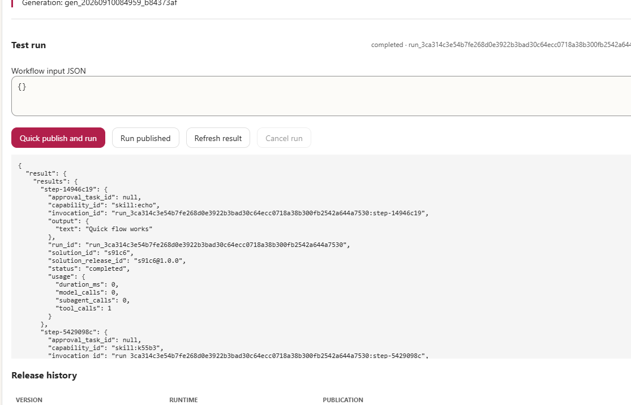
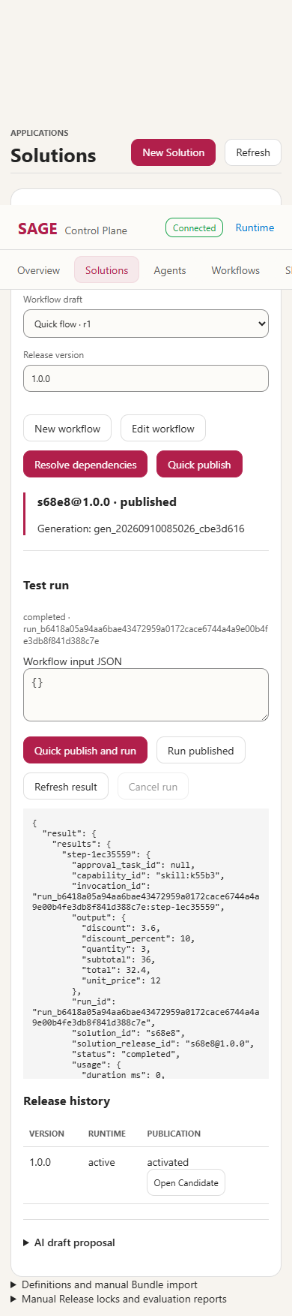
SAGE / HACKATHON DEMO
06
3. Inspect the Structured Run Output
TEMPORAL RUN
Unit price 12 · Quantity 3 · Discount 10%
32.4
STRUCTURED JSON
RUN OUTPUT
RUN
RELEASE
GENERATION
completed
immutable
pinned
1:06-1:24
Output: 32.4. Run, Release, and Generation remain traceable.
Notes:
1:06-1:24 | 18 seconds
Narration: Temporal runs the workflow durably. Unit price twelve, quantity three, and a ten percent discount produce a JSON total of thirty-two point four, linked to its Run, Release, and Generation.
Visual cue: Show completed, point to the real JSON zoom, then name the result and version links.

Slide 7
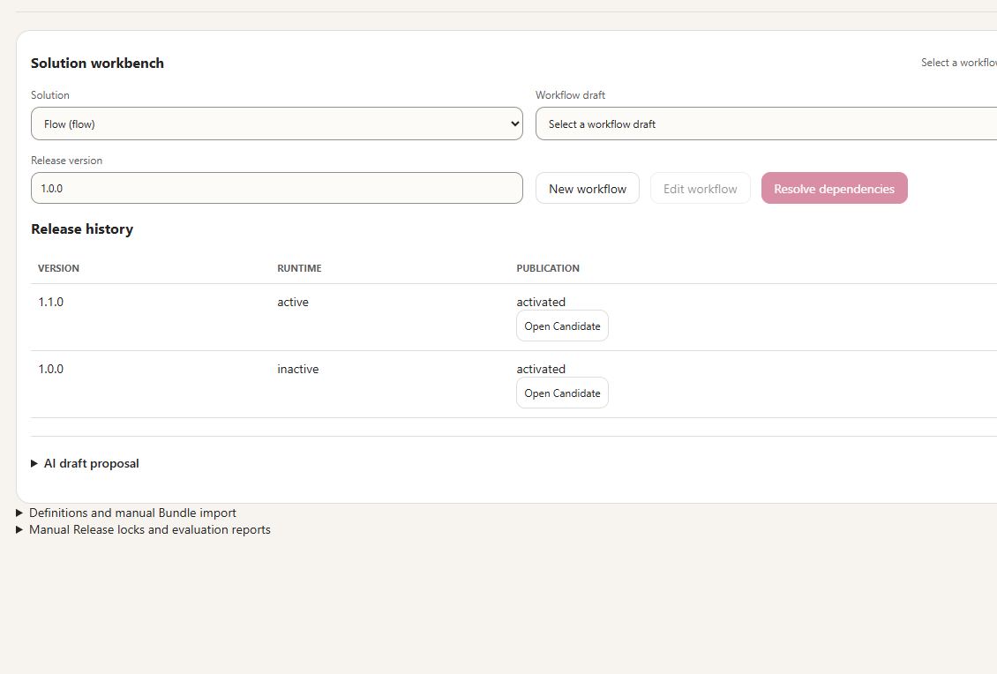
SAGE / HACKATHON DEMO
07
Only Gated Releases Go Live
RELEASE GATE
Validate · Evaluate · Approve
PASS
FAIL
1.1.0 ACTIVE
KEEP CURRENT
FAILED CANDIDATE
ACTIVE GENERATION UNCHANGED
1:24-1:39
Pass: activate atomically. Fail: keep the active Generation.
Notes:
1:24-1:39 | 15 seconds
Narration: Publishing never overwrites a live version. A new release activates atomically only after validation, evaluation, and approval. If any gate fails, the active Generation remains unchanged. Release history records the version switch.
Visual cue: Compare version 1.1.0 active with 1.0.0 inactive, then explain both branches.

Slide 8
SAGE / HACKATHON DEMO
08
SAGE
Turn Personal Skills into Team Capabilities
Not another Tool Gateway: the governance and delivery layer for Agent Skills.
0
MODEL CALLS
32.4
RUN OUTPUT
v1→v2
GATED RELEASES
DIRECT PATH ONLY
STRUCTURED RUN OUTPUT
ACTIVATE AFTER GATES
01:46
1:39-1:46
Build once, reuse across the team. Releases are gated; failures keep the active version.
Notes:
1:39-1:46 | 7 seconds
Narration: SAGE is not another tool gateway. It is the governance and delivery layer for Agent Skills.
Visual cue: Hold on the three proof points and the SAGE mark.

