Slide 1
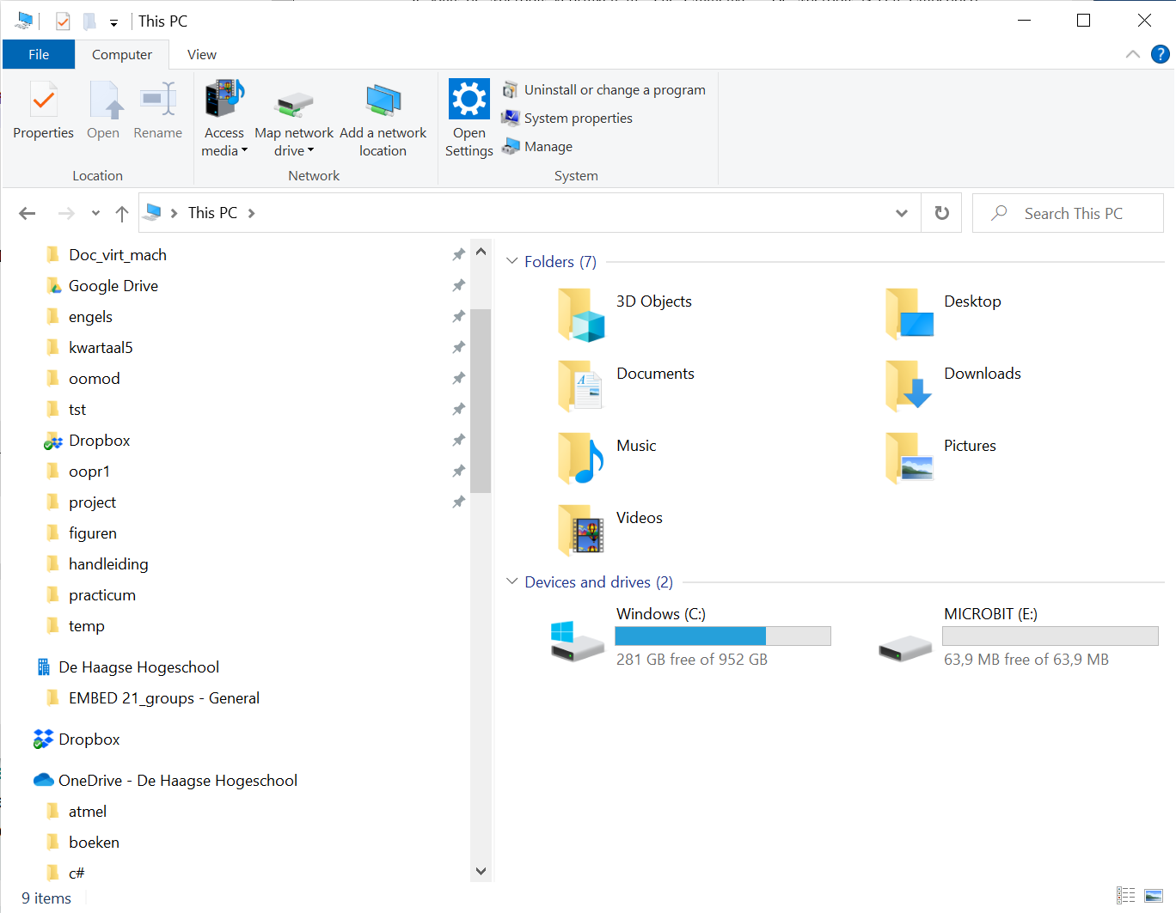

Slide 2
1
4
buttonPin
2
3

Slide 3
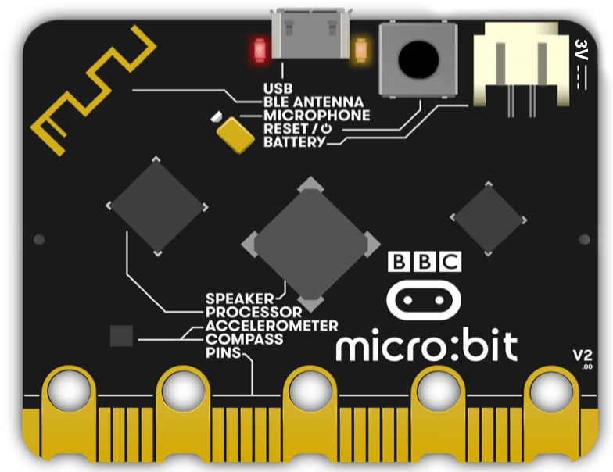
Motion sensor

Slide 5
