Slide 1
5/24專研進度 報告
03360351
黃嘉偉

Slide 2
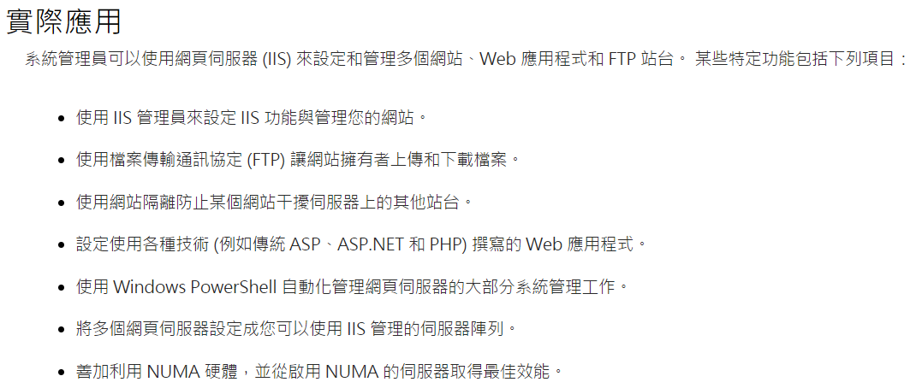
網頁伺服器 (IIS)

Slide 3
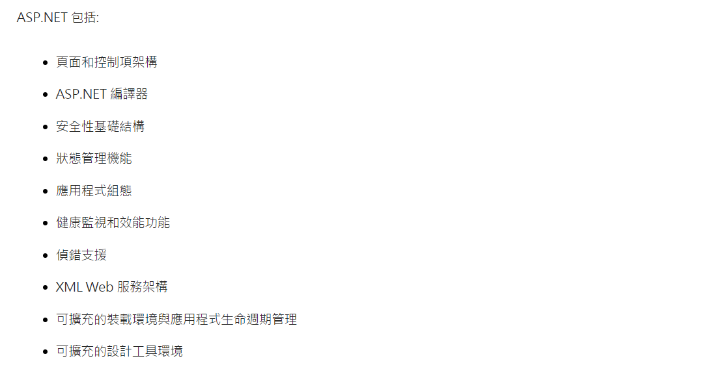
ASP.NET功能概觀

Slide 4
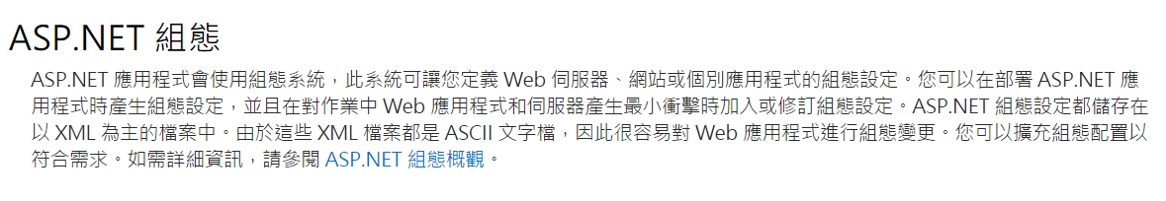
XML

Slide 5
AWS Elastic Beanstalk
https://aws.amazon.com/tw/premiumsupport/features/
https://aws.amazon.com/tw/elasticbeanstalk/?p=tile

