Slide 1
5/24進度報告

Slide 2
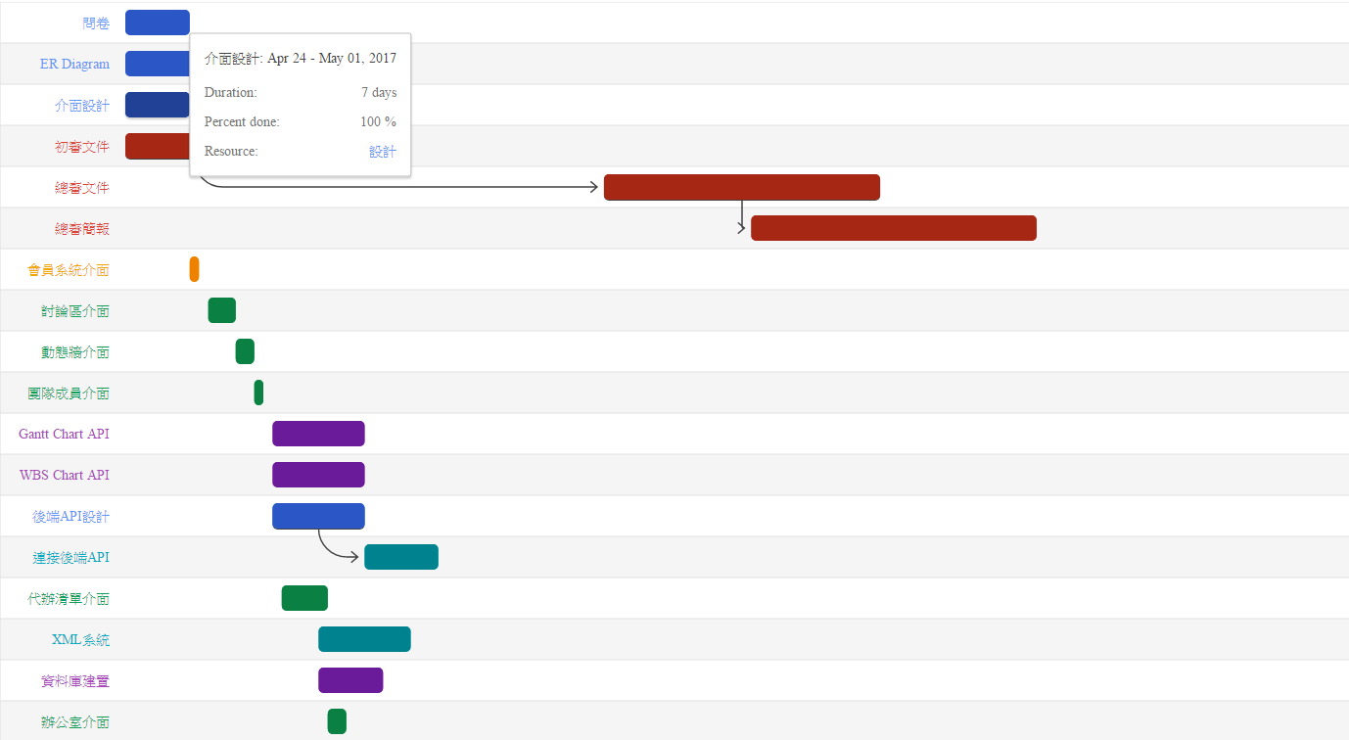
Gantt Chart API
http://waterball.lionfree.net/waterball.lionfree.net/johnny850807/Gantt.html

Slide 3
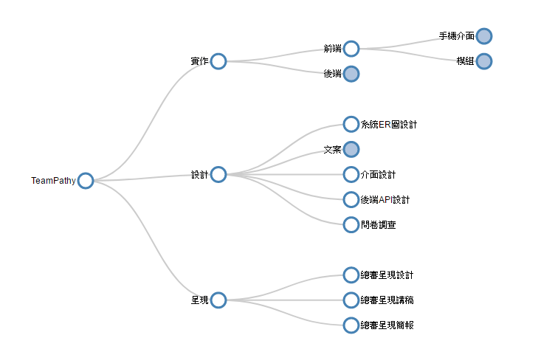
WBS API
http://waterball.lionfree.net/waterball.lionfree.net/johnny850807/Word%20Trees.html

Slide 4
未來進度
5/22~6/5 JavaScript熟讀
6/5~12 jQuery研讀

