Slide 1
Baseball Life
Speaker : Zong-Yi

Slide 2
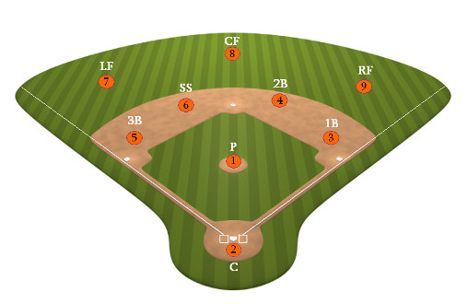
Baseball Positions
ShortStop

Slide 3
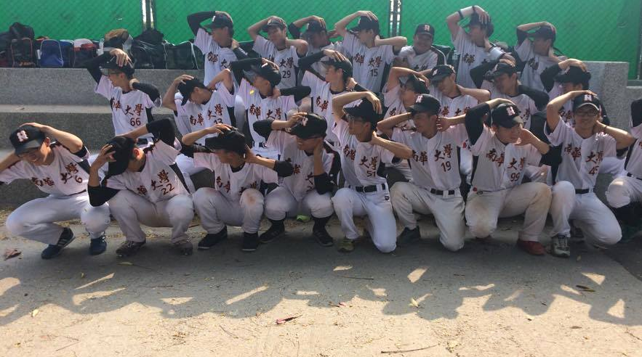


Baseball Team

Slide 4
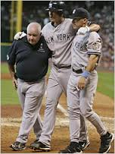
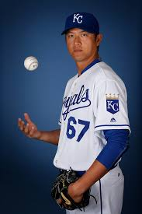
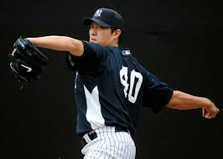
Favorite Player
2005~2009
2009
2016

Slide 5
Questions

Slide 6
Thanks for listening

