Slide 1
Baseball
Speaker : Zong-Yi

Slide 2
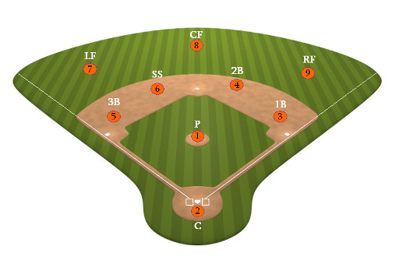
Baseball Positions
ShortStop

Slide 3
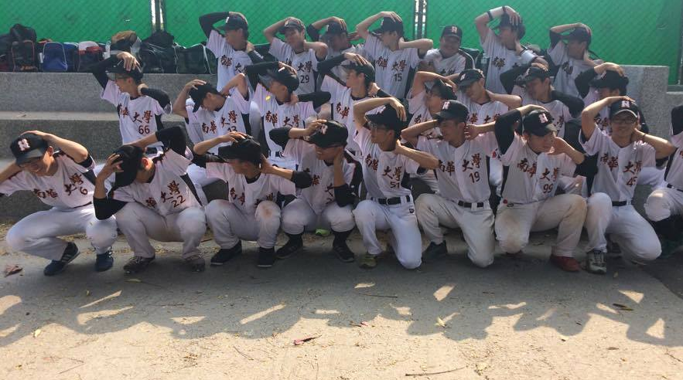


Baseball Team

Slide 4
Questions

Slide 5
Thanks for listening

