Slide 1
2017-5-24

Slide 2
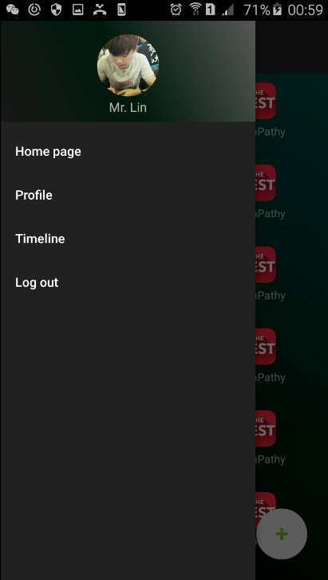
Android Navigation Drawer

Slide 3
API Document Design

