Slide 1
PRG Wildfires Graphs
John Vincent

Slide 2
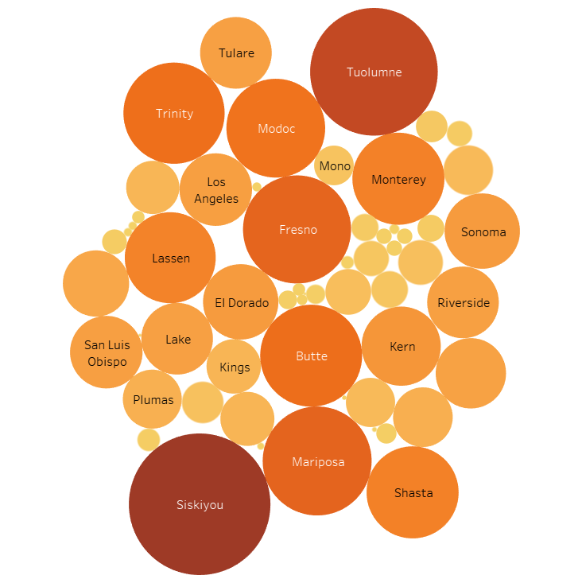

Acres burned for each county

Slide 3
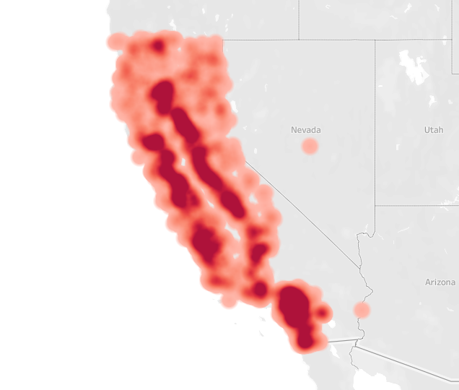
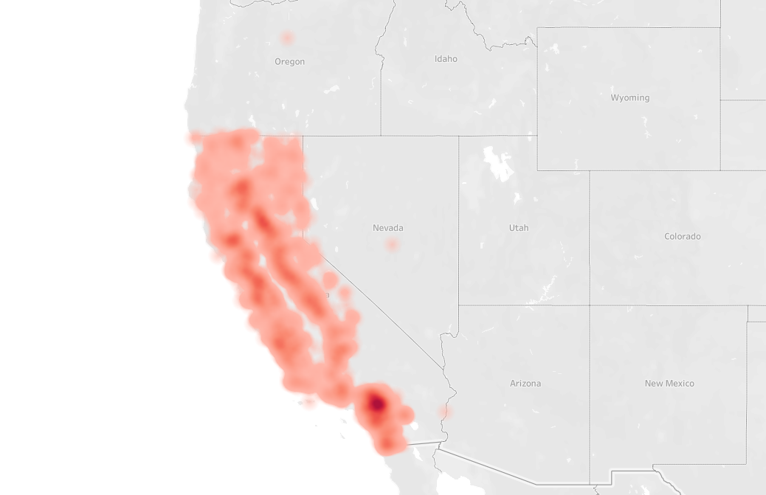
Wild Fire Occurrences

Slide 4
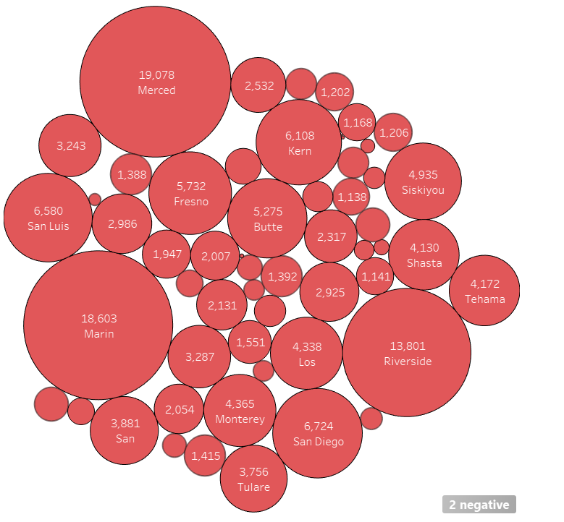
Total hours burned by county

Slide 5
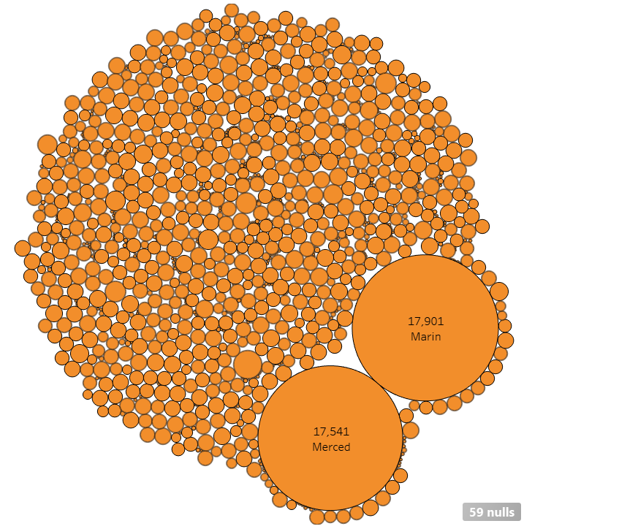
Largest fires by hour

Slide 6
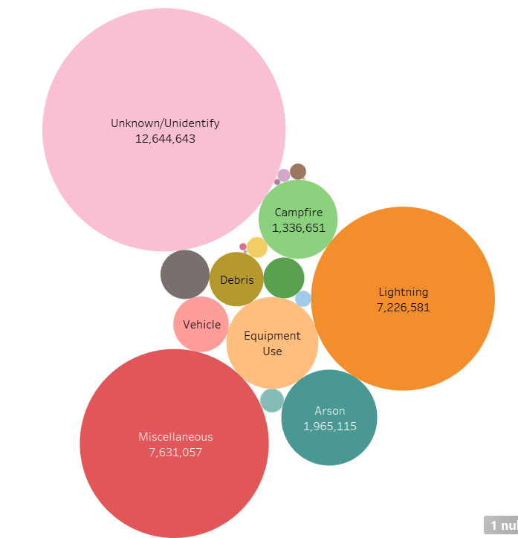
Acres burned by cause

Slide 7
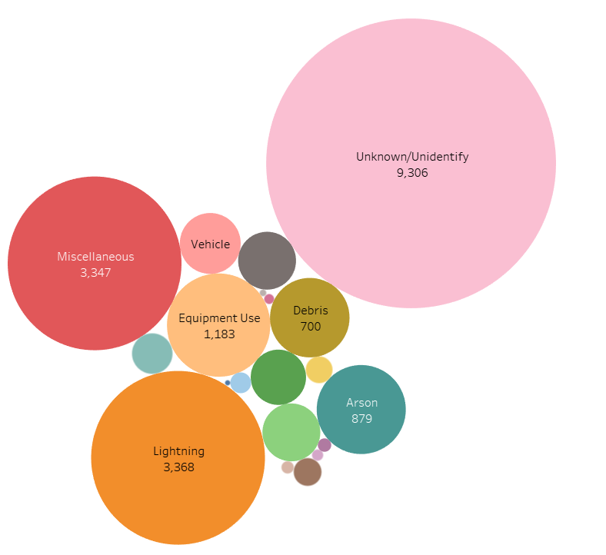
Number of fires by each factor

Slide 8
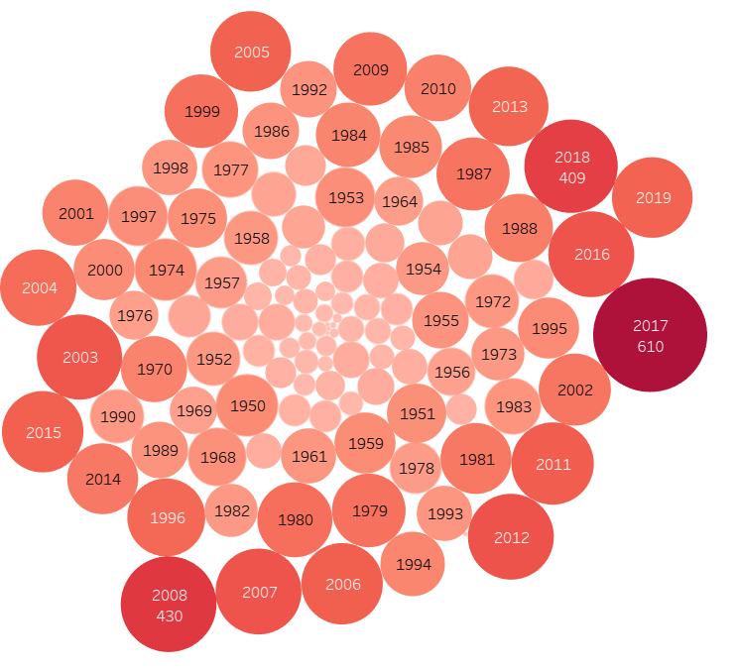
Number of Fires by Year

