Slide 1

Data Link Control
Md Mashrur Rahman
2015-2-60-020
Md Mustafizur Rahman
2015-2-60-100
Kowshik Ahmed
2016-2-60-094
Department of Computer Science & Engineering
University of Dhaka
Dhaka -1000, Bangladesh

Slide 2

Problem Statement
Sending and receiving data frames in data layer protocol
Go Back n Sliding Window to send and receive data
CRC-32 to check error

Slide 3
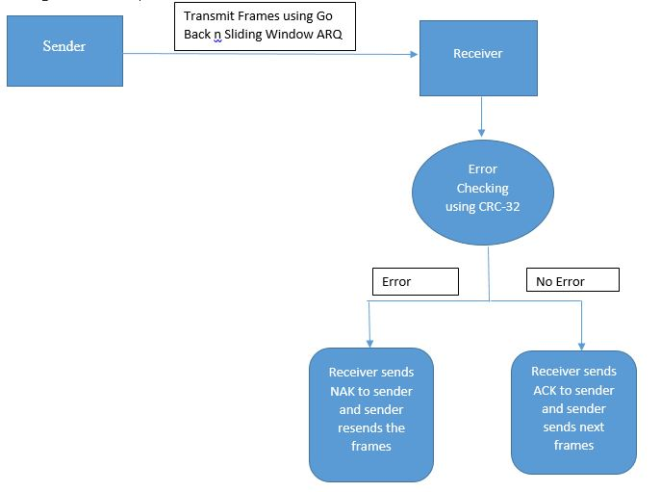
Working Procedure

Slide 4
Go Back n Sliding Window
When any damaged frame is received, receiver sends a negative acknowledgement frame (NAK).
When any frame is lost, receiving NAK the sender retransmits all the frames back from the frame of NAK.
But when the ACK is lost, then the sender again retransmits all the frames back since the last ACK is sent.

Slide 5
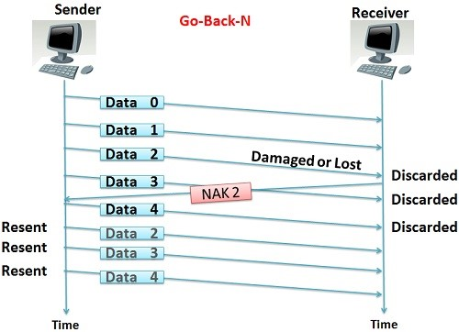
Go Back n Sliding Window

Slide 6
CRC 32
Divide the data by divisor
XOR operation
CRC or CRC remainderis added to the end of a data unit

Slide 7
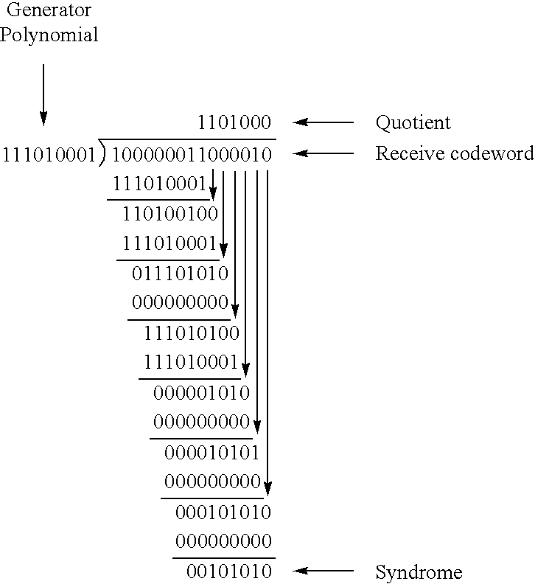
CRC 32

Slide 8
CRC 32
Transmmiter
Value of divisor is fixed
Divide the frame.
Add the FCS code into frame.
Reciver
Check the frame
If reminder is zero then no error.Otherwise it contain error

Slide 9
Our approach
We have fixed some values
Frame size 100 bite
Sequence number 2 bite, Data field 66 bite, FCS code 32 bite
Buffer size 3
We have used file to save the binary data and use from it.
We have generate the divisor from 32 bit polynomial ewuation

Slide 10
Our approach
From file we count the data and calculated the how many frame is needed.
Then we generate the FCS code and added to the frame.
for(int j=2; j<=n+1 ; j++)
{if(divisor[0]==crc[j])
{for(int k=0 ; k<divisor_size ; k++)
{if(divisor[k]==crc[k+j])
crc[k+j] = '0‘;
else
crc[k+j] = '1' ;}
}

Slide 11
Our approach
We used rand function to create error
srand((int)time(NULL));
int x = rand();
x = x%4;
Checked the frame again (reciver’s part)
for(int i=2; i<s; i++)
if(crc[i]=='1')
return 1 ;
return 0 ;

Slide 12

Questions or Suggestions

Slide 13
Thank You!

