Slide 1


Morling
Agresti
Research Methods and Statistics
Lecture 20: Introduction to Bayesian Statistics
Johnny van Doorn
Pictures source: pixabay
Notes:
1

Slide 2
What Are We Doing?
We set an alpha (i.e., desired type 1 risk) and determine the hypotheses
We observe data, compute test statistic and corresponding p-value
p > α
p < α
Fail to reject H0
Reject H0
= absence of evidence
= evidence against H0
Black/white reasoning is dangerous and arbitrary (see bonus slide of lecture 16)
We cannot gain evidence for H0 (i.e., evidence of absence)

Slide 3
“… is associated with a myriad of negative consequences including reduced optimism and task performance (Porath & Erez, 2007), reduced working memory and attention (Erez et al., 2015), and higher levels of stress (Adams & Webster, 2013).”
Anna Kaminska & Devin G. Ray (2023) Interpersonal memory failure in the workplace: The effect of memory and hierarchy on employee’s affective commitment, The Journal of Social Psychology

Slide 4


Slide 5
The Next 3 Lectures
Today (Chapters 1-4)
Introduction to Bayesian Estimation of a Proportion
Thursday Dec 4 (Chapters 1-4)
Bayesian Hypothesis Testing of a Proportion
Thursday Dec 11(Chapter 5)
Bayesian Inference for Correlation and T-Test
Statistics in the Wild
van Doorn, J. (2024). A Brief Introduction to Bayesian Inference: From Tea to Beer.

Slide 6
Two important notes
Tuesday Dec 9: No lecture due to the demonstration
Lecture recording on Canvas, adjusted exam material
Thursday Dec 11: Different lecture location
Pathe Tuschinschki

Slide 7
Today
Bayesian statistics
What are models?
How do models learn from data?
Live demonstration
Recap
Practical stuff & next week
Example exam question

Slide 8

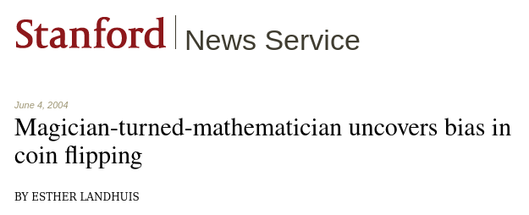
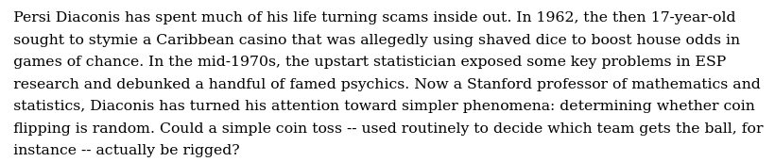
Source: https://news.stanford.edu/pr/2004/diaconis-69.html
Fair Coins Tend To Land On The Same Side They Started: Evidence From 350,757 Flips

Slide 9
What is Bayesian Inference?
What are the tools we need?

Slide 10
What is Bayesian Inference?
An alternative framework to “frequentist statistics”
Not based on studying what happens on repeated sampling
Different way of parameter estimation and hypothesis testing

Slide 11
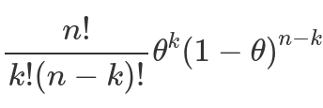
What are Statistical Models?
A statistical model is a combination of a general statistical model (e.g., the binomial model) and a statement about a parameter value that describe a certain phenomenon
The general binomial model describes a series of chance-based events with a binary outcome, and is governed by a single parameter θ
For instance, for flipping a coin:
A binomial model with θ = 0.5
What is the theoretical implication of this model?

Slide 12
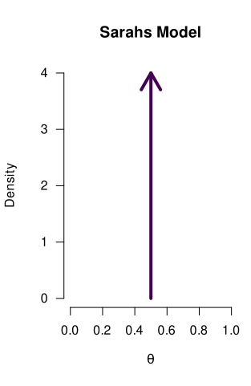
What are Statistical Models?
A binomial model with θ = 0.5
We can reflect a model’s statement by means of a probability distribution

Slide 13

What are Statistical Models?
A binomial model with θ = 0.8
We can reflect a model’s statement by means of a probability distribution

Slide 14
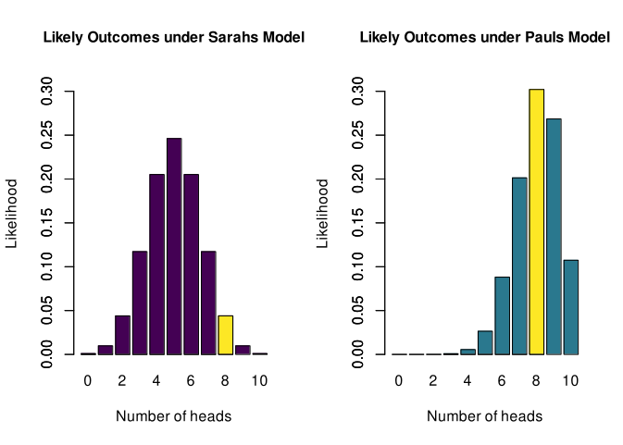
Statistical Models Make Predictions
Based on what these models claim about θ, certain outcomes are more/less likely
The yellow bar indicates how likely an outcome of 8/10 heads is, under Sarah’s model
To create this figure, we take the binomial formula, and fill in θ = 0.5
For instance, for an outcome of k=8 heads, the formula gives 0.0439

Slide 15
Statistical Models Make Predictions
Based on what these models claim about θ, certain outcomes are more/less likely
The yellow bar indicates how likely an outcome of 8/10 heads is, under Paul’s model
To create this figure, we take the binomial formula, and fill in θ = 0.8
For instance, for an outcome of k=8 heads, the formula gives 0.302

Slide 16
Statistical Models Make Predictions
Based on what these models claim about θ, certain outcomes are more/less likely

Slide 17
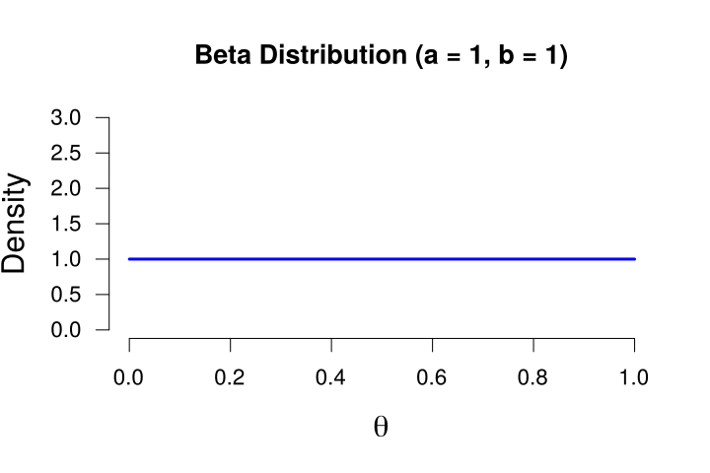
Models Can Also State a Range of Values
Introducing the beta distribution:
It ranges from 0 to 1
Its shape is determined by two values: a and b
If a and b equal 1, it is uniform
We use the beta distribution here because:
A proportion is also between 0 and 1
We can create many different shapes, which allows us to reflect many different prior ideas
We can reflect a model’s statement by means of a probability distribution

Slide 18
Models Can Also State a Range of Values
Introducing the beta distribution:
It ranges from 0 to 1
Its shape is determined by two values: a and b
If a and b equal 1, it is uniform
Some apps that let you shape a beta distribution
https://researchmethodsuva.shinyapps.io/test/
https://maglit.me/antivichmfy

Slide 19
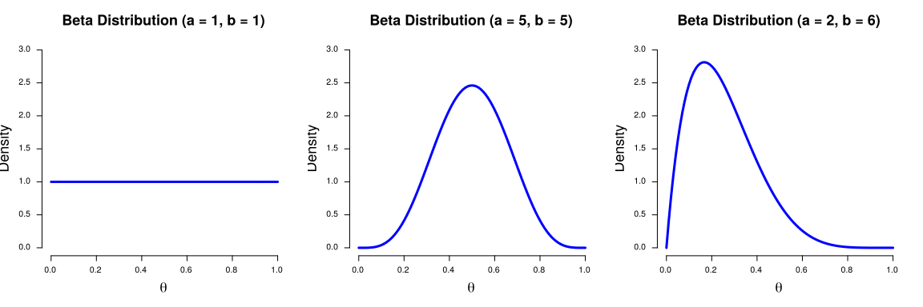
Models Can Also State a Range of Values
A model that reflects the idea that all values of the proportion are equally plausible - we call this an uninformative model
A model that reflects the idea that values close to 0.5 are more plausible
A prior distribution that reflects the idea that values below 0.5 are more plausible (i.e., the coin is biased towards tails)

Slide 20
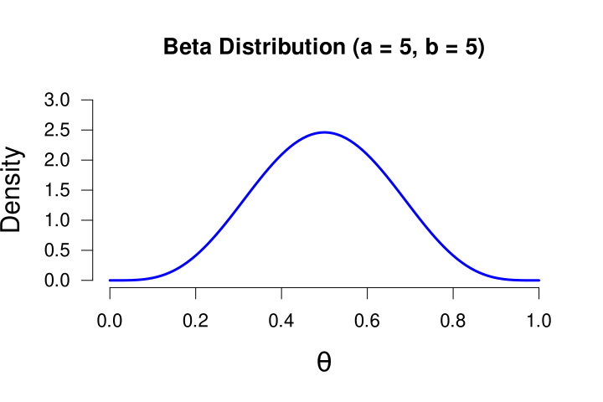

Beta Distribution Interpretation
Models that go all in on a single value have a very strong conviction: Sarah believes as if she has seen infinitely many heads and tails already!
In the context of a prior distribution for a proportion, the a and b can be interpreted as previously observed heads and tails.
We cannot start with an empty distribution (a and b cannot be 0), no matter how clueless you are about something, there will always be starting point (e.g., a = b = 1)

Slide 21
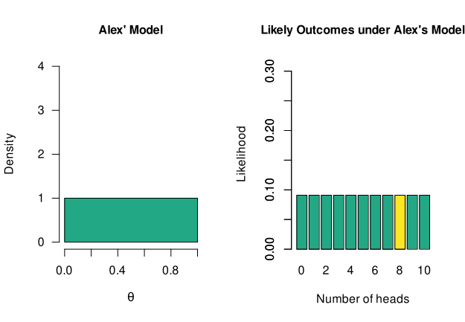
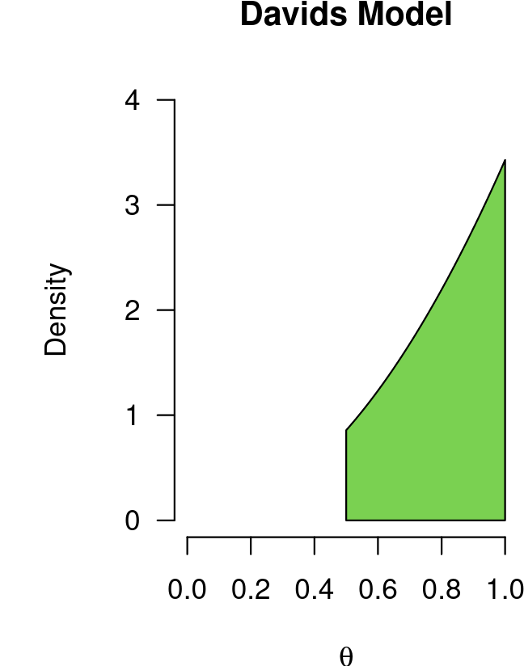
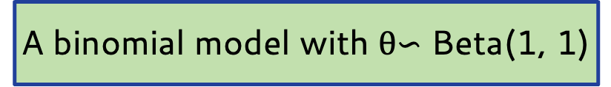
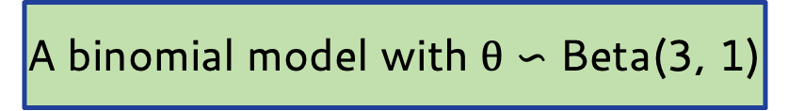
Models Can Also State a Range of Values
We can reflect a model’s statement by means of a probability distribution
A binomial model with θ$∽$ Beta(1, 1)
A binomial model with θ $∽$ Beta(3, 1)
It is truncated below 0.5, so Davids model only postulates values > 0.5
What are the theoretical implications of these models?

Slide 22
So, We Have All Sorts of Models...
On Thursday we discuss comparing these models to each other
Now we focus on a single model, and how they learn from data

Slide 23
So, We Have All Sorts of Models...
These models reflect prior knowledge/beliefs
We will update this prior knowledge with data
To end up with posterior knowledge

Slide 24
Today
Bayesian statistics
What are models?
How do models learn from data?
Live demonstration
Recap
Practical stuff & next week
Example exam question

Slide 25
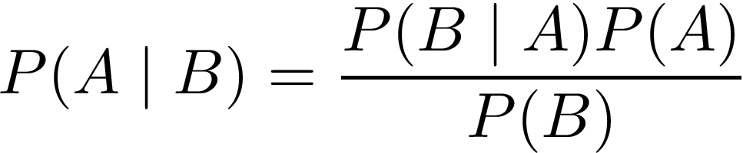
Bayes’ Theorem

Slide 26
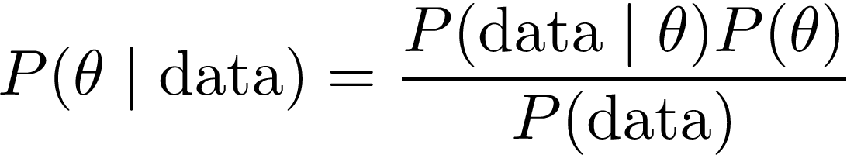
Applying Bayes’ Theorem to Statistical Inference
We can replace “A” and “B”, with parameter value “θ” and observed “data”

Slide 27
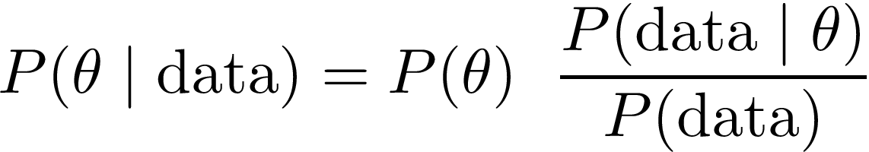
Applying Bayes’ Theorem to Statistical Inference
We can rewrite the theorem slightly:

Slide 28
Applying Bayes’ Theorem to Statistical Inference
Our knowledge about θ, before seeing the data
Also known as the “prior beliefs”

Slide 29
Applying Bayes’ Theorem to Statistical Inference
Our knowledge about θ, after seeing the data
Also known as the “posterior beliefs”

Slide 30
Applying Bayes’ Theorem to Statistical Inference
How well did each value of θ predict the data, compared to all other values of theta?
Also known as the “predictive updating factor”

Slide 31
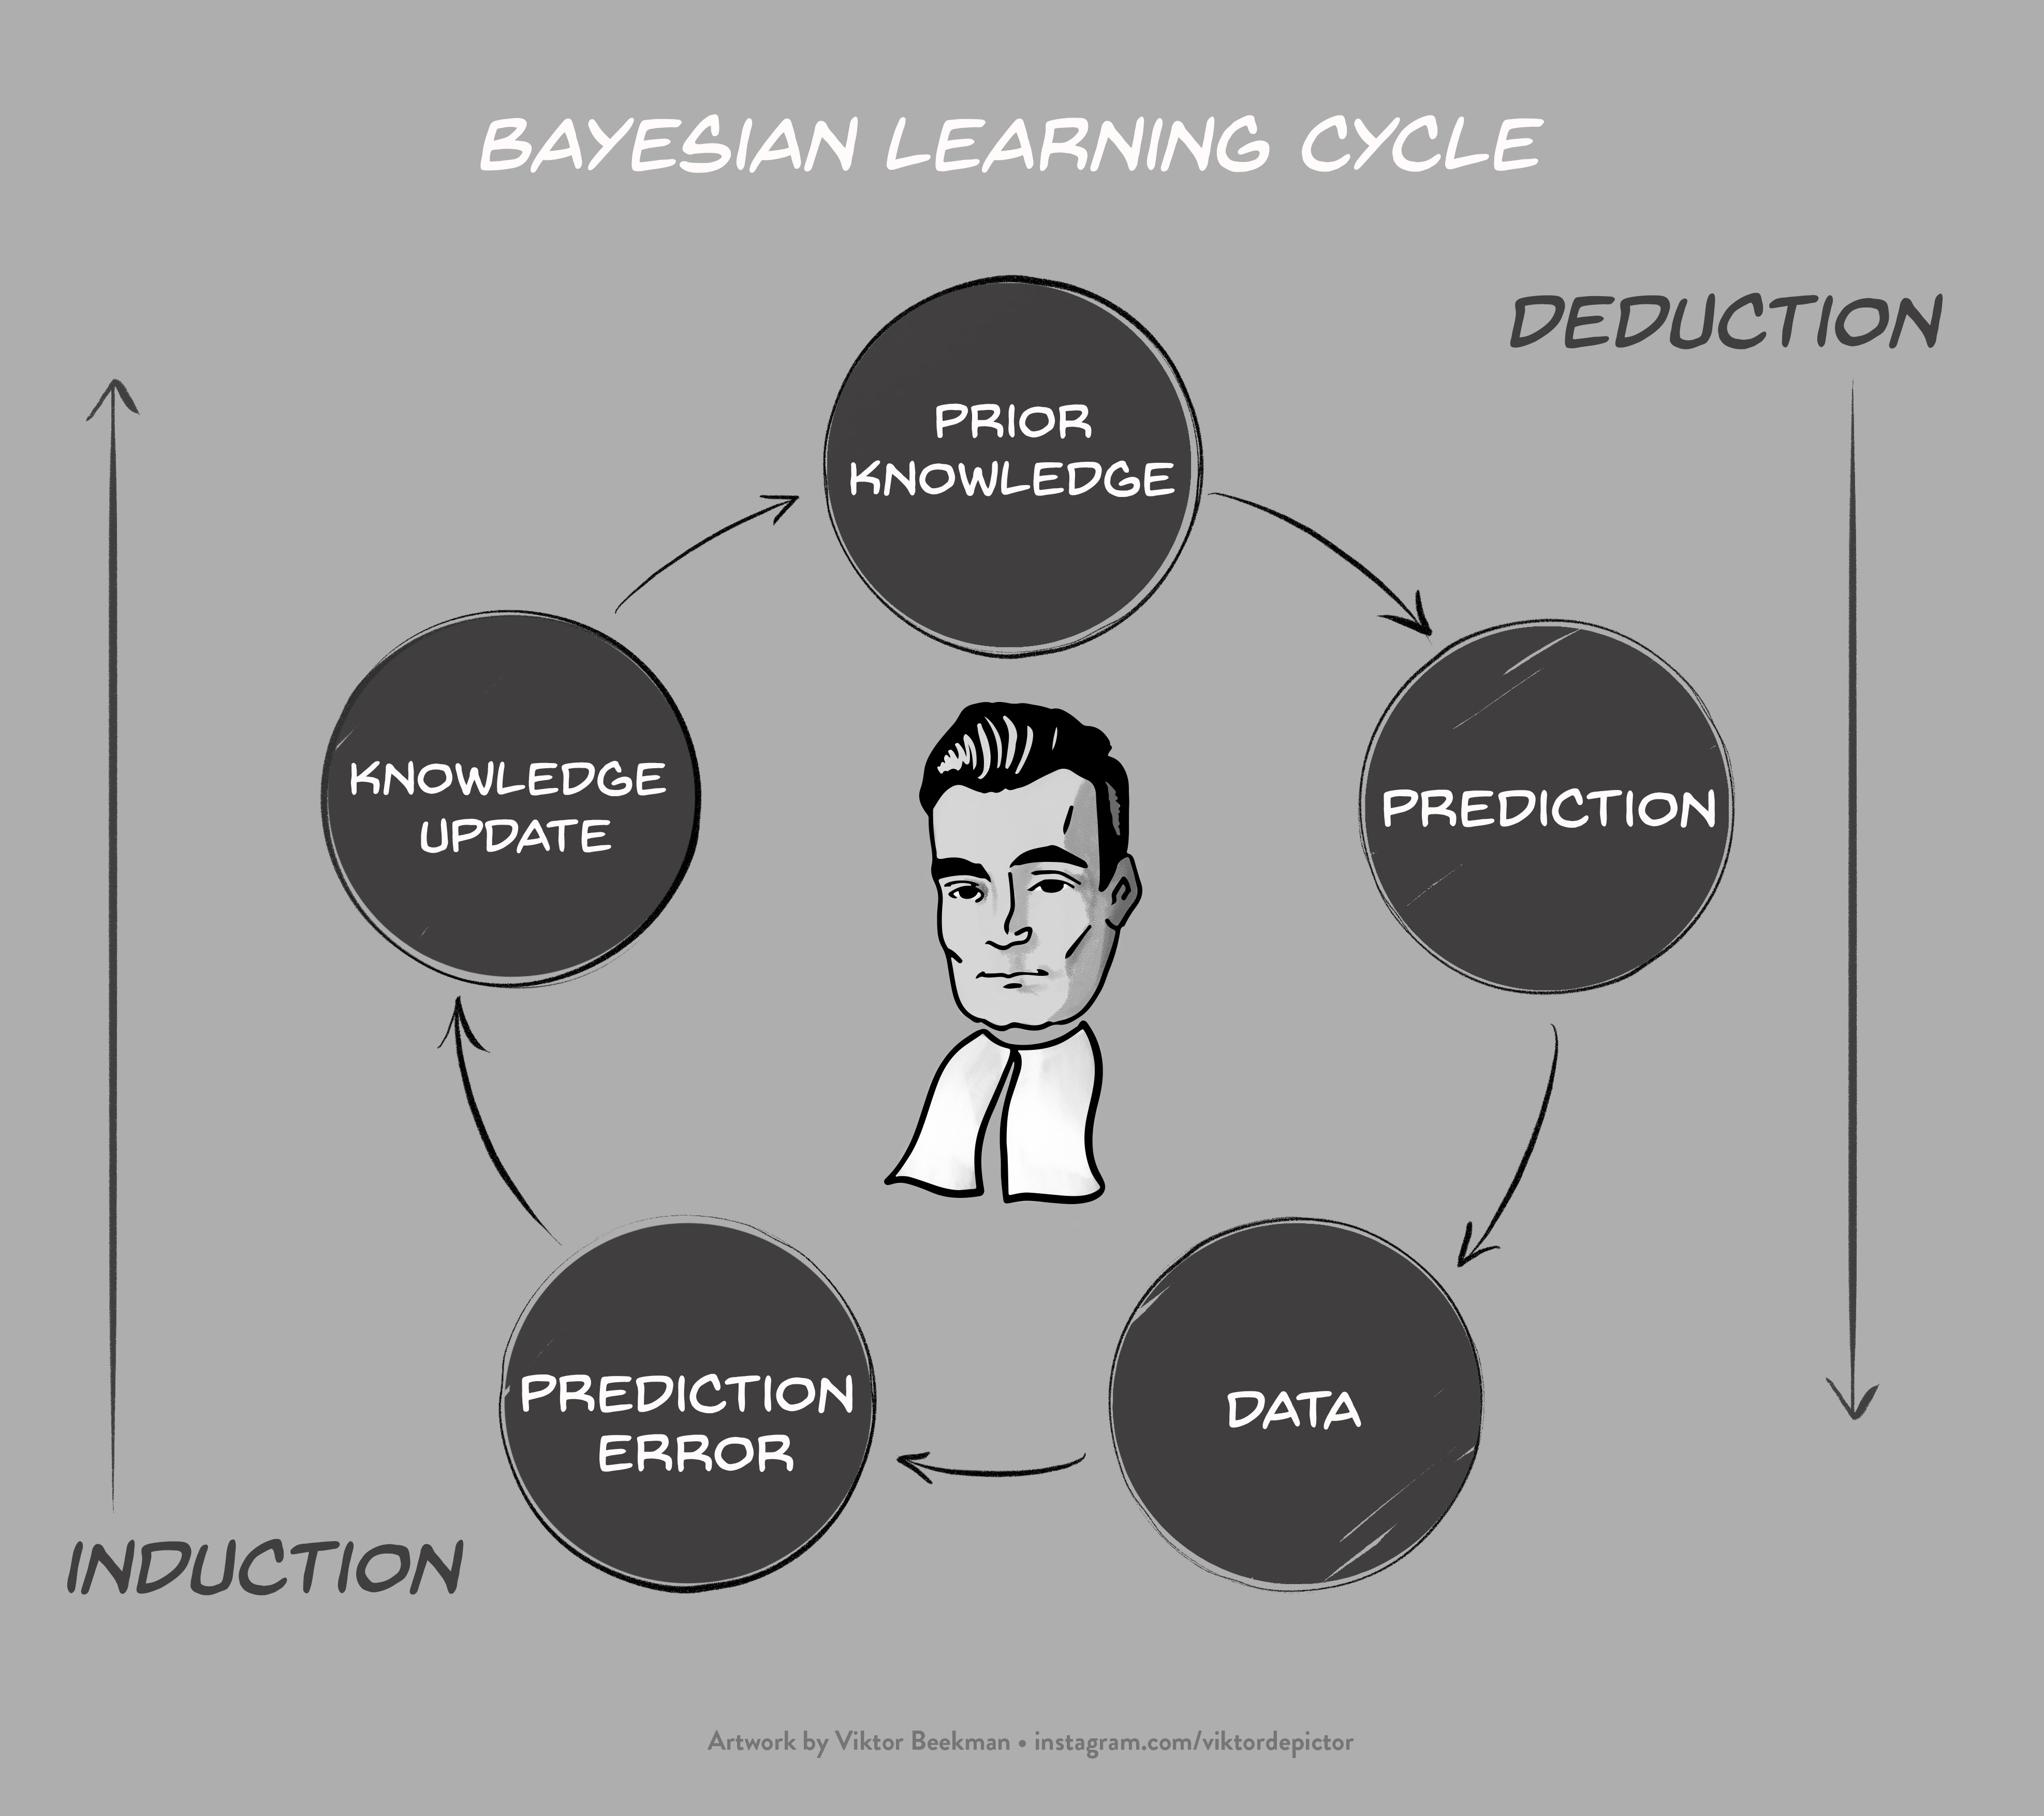
Source:
https://www.bayesianspectacles.org

Slide 32
Estimating a Proportion: Prior Distribution
The prior distribution reflects our beliefs about the parameter, before observing the data
In other words, one of the models we have seen so far!
For now, we focus on Alex’ model

Slide 33
Estimating a Proportion: Data
We observe the following data (n = 10):
2 tails
8 heads
Our statistic is the observed proportion: 8/10 = 0.8

Slide 34
Estimating a Proportion: Predictive Updating Factor
The likelihood of the data, given a certain value of θ
The marginal likelihood, across all values of θ
This tells us something about how well a specific value of θ predicted the data (i.e., it is the quality of the prediction for this specific value)
This tells us something how well θ predicted the data, averaged over all possible values of θ (i.e., it is the average quality of the prediction of the model)
Taken together, this ratio tells us how well each value of θ predicted the data, relative to all other values!

Slide 35
Estimating a Proportion: Predictive Updating Factor
The likelihood of the data, given a certain value of θ
For instance, how likely is our observed data, if θ equals 0.7?
This is again determined by the general binomial model

Slide 36
Estimating a Proportion: Predictive Updating Factor
The likelihood of the data, given a certain value of θ
For instance, how likely is our observed data, if θ equals 0.7?
We take the binomial formula, and fill in θ = 0.7

Slide 37
Estimating a Proportion: Predictive Updating Factor
The likelihood of the data, given a certain value of θ
For instance, how likely is our observed data, if θ equals 0.7?

Slide 38
Estimating a Proportion: Predictive Updating Factor
The likelihood of the data, given a certain value of θ
For instance, how likely is our observed data, if θ equals 0.7?

Slide 39
Estimating a Proportion: Predictive Updating Factor
The likelihood of the data, given a certain value of θ
For instance, how likely is our observed data, if θ equals 0.7?

Slide 40
Estimating a Proportion: Predictive Updating Factor
The likelihood of the data, given a certain value of θ
For instance, how likely is our observed data, if θ equals 0.7?
We do this for each possible value of θ (i.e., between 0 and 1)

Slide 41
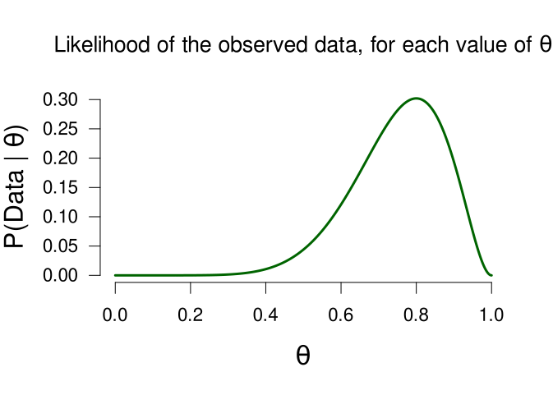
Estimating a Proportion: Predictive Updating Factor

Slide 42
Estimating a Proportion: Predictive Updating Factor

Slide 43
Estimating a Proportion: Predictive Updating Factor

Slide 44
Estimating a Proportion: Predictive Updating Factor

Slide 45
Estimating a Proportion: Predictive Updating Factor
The likelihood is not a probability distribution!
E.g., its surface area does not sum to 1

Slide 46
Estimating a Proportion: Predictive Updating Factor
Both figures give the likelihood, but differ in their x-axis
This figure fixes θ (θ =0.5) and varies k
This figure fixes k (heads = 8) and varies θ

Slide 47
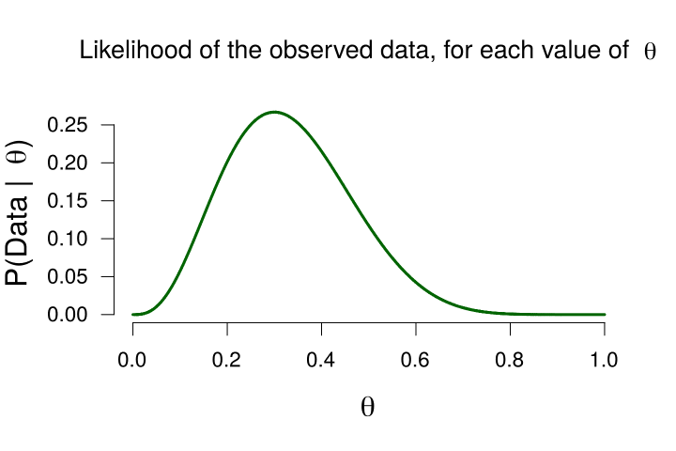
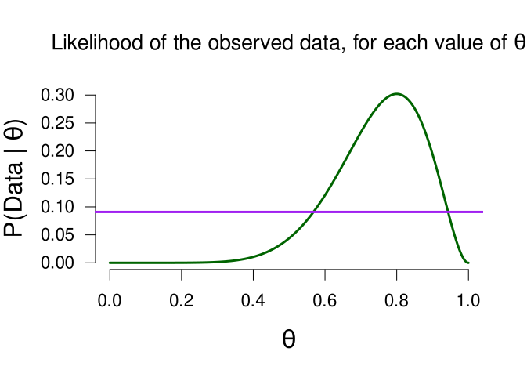
Estimating a Proportion: Predictive Updating Factor
The marginal likelihood, across all values of θ
This tells us something how well θ predicted the data, averaged over all possible values of θ (i.e., it is the average quality of the prediction of the model)
Usually this is very difficult and we need computers to compute this. In our case, the marginal likelihood equals 0.091

Slide 48
Estimating a Proportion: Predictive Updating Factor
The likelihood of the data, given a certain value of θ
The marginal likelihood, across all values of θ
Taken together, this ratio tells us how well each value of θ predicted the data, relative to all other values!
Now we know that the marginal (i.e., average) likelihood is 0.091. This means that when the likelihood of the data for a specific value of θ is greater than 0.091, that value of θ has predicted the data above average.
If that is the case, the predictive updating factor is > 1. If a specific value of θ predicted the data worse than average, that ratio is < 1.

Slide 49
Estimating a Proportion: Predictive Updating Factor
The marginal likelihood, across all values of θ (= 0.091)

Slide 50
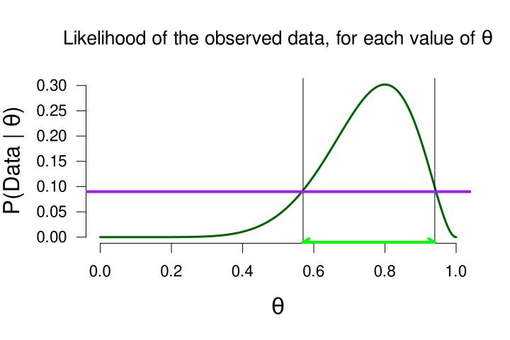
Estimating a Proportion: Predictive Updating Factor
The marginal likelihood, across all values of θ (= 0.091)
Values of θ that predicted the data better than average (i.e., their likelihoods are greater than the marginal likelihood)

Slide 51
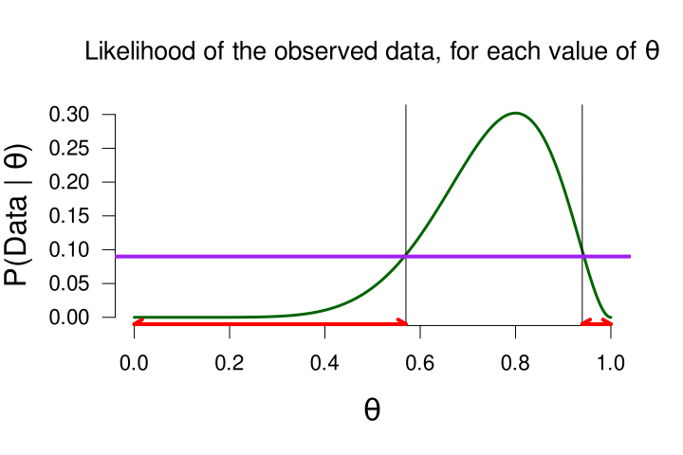
Estimating a Proportion: Predictive Updating Factor
The marginal likelihood, across all values of θ (= 0.091)
Values of θ that predicted the data worse than average (i.e., their likelihoods are less than the marginal likelihood)

Slide 52
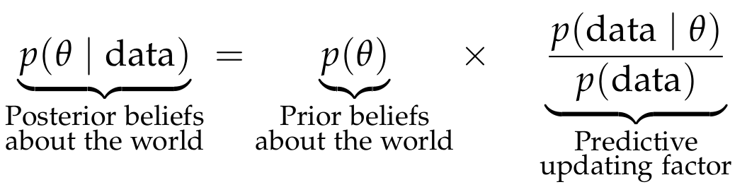
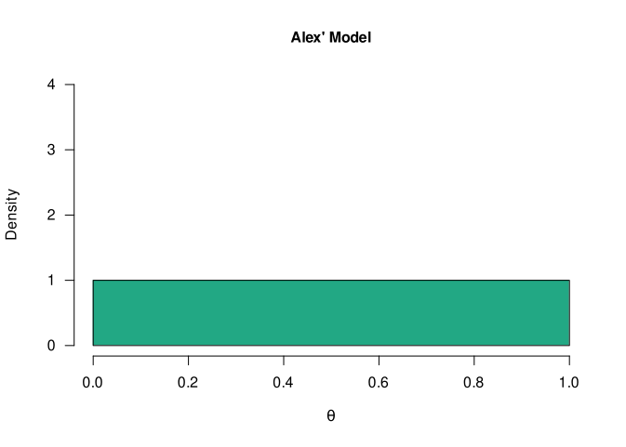
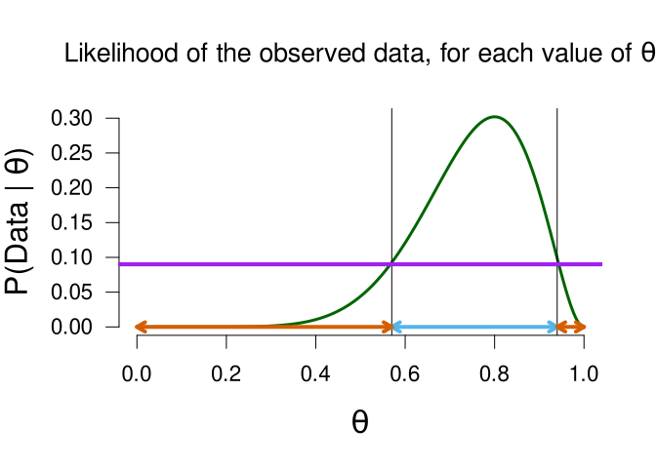
Estimating a Proportion: Posterior Distribution

Slide 53
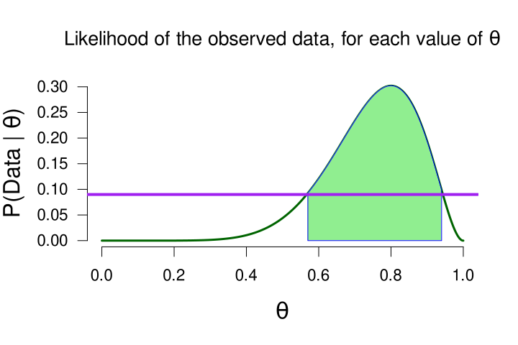
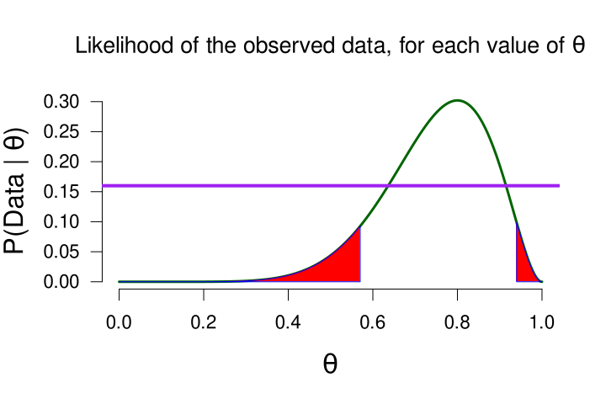
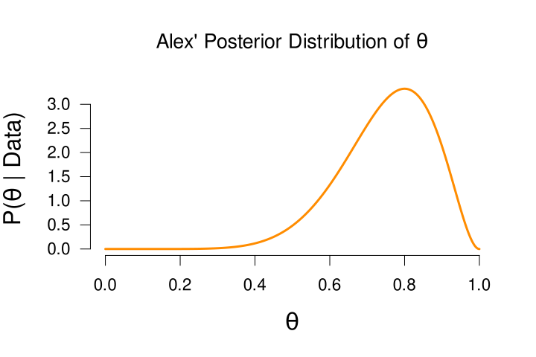
We start with our prior beliefs
We update those with data
Values of θ that predicted the data better than average receive a boost in plausibility (i.e., their updating ratio >1
Values of θ that predicted the data worse than average receive a penalty in plausibility (i.e., their updating ratio < 1
We end with our posterior beliefs

Slide 54
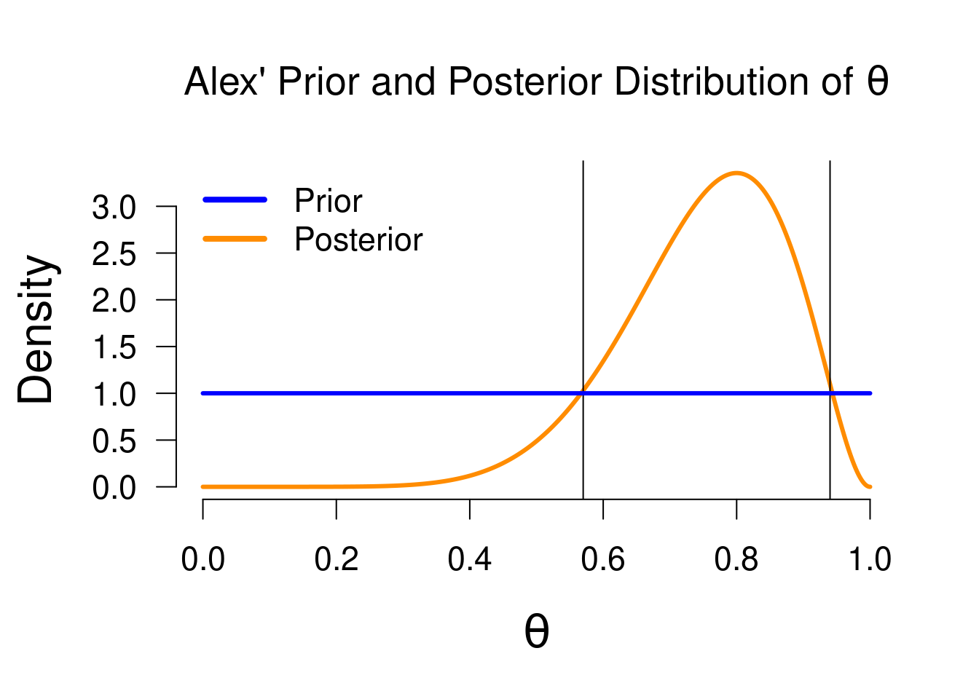
Estimating a Proportion: Posterior Distribution
Same lines as on slide 48/49! It shows which values of theta received a decrease/increase in plausibility, because of the data

Slide 55
Estimating a Proportion: Posterior Distribution
The posterior distribution is a probability distribution!

Slide 56
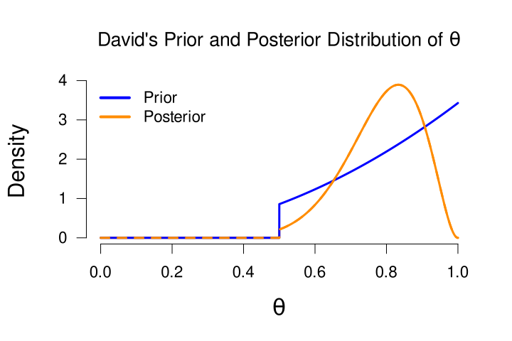
Estimating a Proportion: Posterior Distribution
What about other models/prior distributions?
David’s Model (a = 3, b = 1, truncated)
Because all prior mass below 0.5 is set to 0, also all posterior mass below 0.5 will be equal to 0

Slide 57
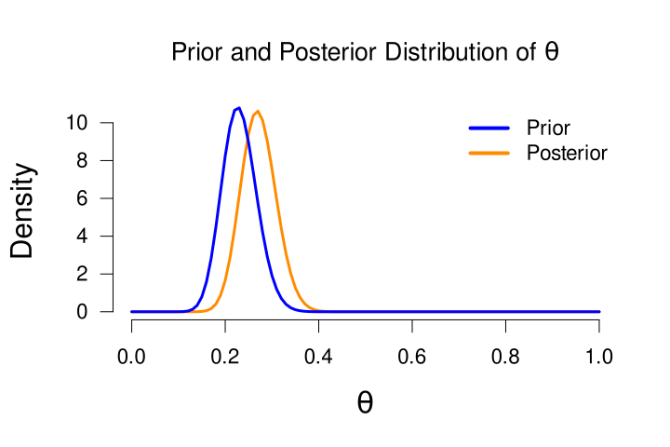
Estimating a Proportion: Posterior Distribution
What about other models/prior distributions?
A = 30, b = 100
A very strong prior that assigned more mass to values < 0.5 (coin biased to tails). The prior conviction is so strong that the data cannot overthrow this conviction: the posterior is still situated at values > 0.5
This highlights an important feature of learning: strong beliefs need a lot of data to be convinced otherwise!
This also makes Sarah and Paul very poor learners: they are so convinced of their value that there is no updating

Slide 58
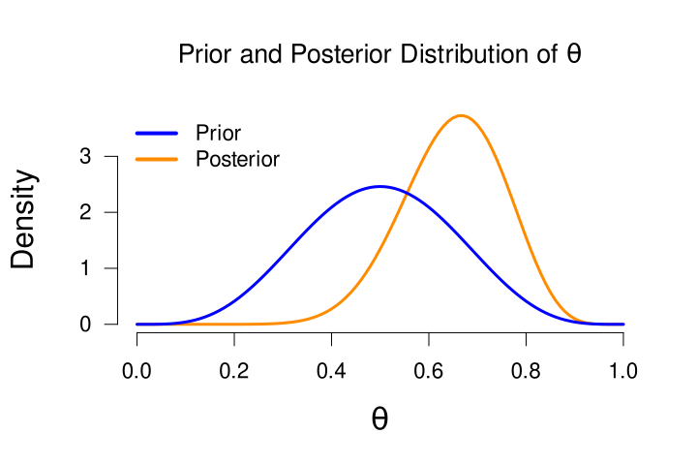
Estimating a Proportion: Posterior Distribution
What about the other models/prior distributions?
a = b = 5
A model that was more certain that the coin is fair

Slide 59
Estimating a Proportion: Posterior Distribution
Easy way of computing the posterior, if we are working with proportions and the beta distribution
If we start with a prior Beta distribution, then the posterior distribution will also be a Beta distribution, with: a = a + #successes (in our case, #heads) b = b + #failures (in our case, #tails)

Slide 60

Estimating a Proportion: Posterior Distribution
Easy way of computing the posterior, if we are working with proportions and the beta distribution
This is a beta distribution with a = 1 + 8
b = 1 + 2

Slide 61
Estimating a Proportion
Now that we have a posterior distribution, we can do estimation!

Slide 62
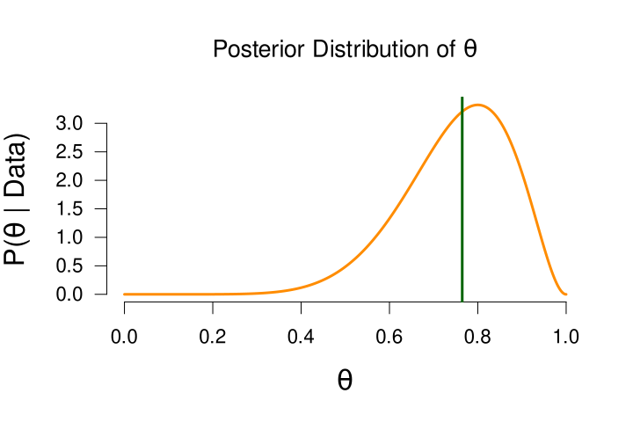
Estimating a Proportion
We can make a point estimate, and take the posterior median or mean
Median = 0.764

Slide 63
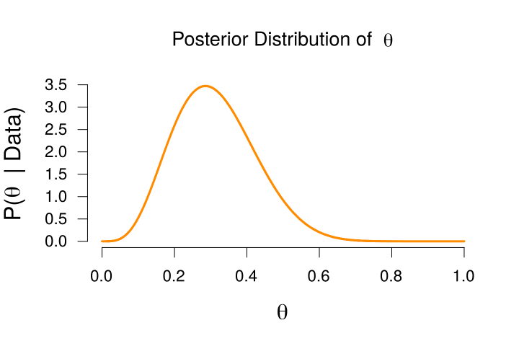
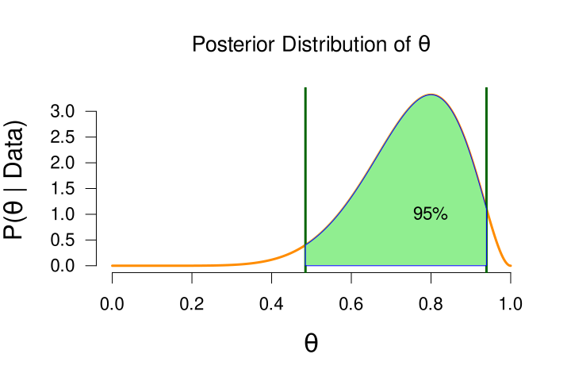
Estimating a Proportion
We can make an interval estimate, and take the central Credible Interval
To obtain the x% central credible interval, we take x% of the most central posterior mass, and see which 2 points are the thresholds
95% Credible interval = (0.49, 0.94)

Slide 64
Estimating a Proportion
We can make an interval estimate, and take the central Credible Interval
How to interpret a 95% central credible interval?
Under Alex’ model, there is a 95% probability that the true proportion is between 0.49 and 0.94
95% Credible interval = (0.49, 0.94)

Slide 65
Today
Bayesian statistics
What are models?
How do models learn from data?
Live demonstration
Recap
Practical stuff
Example exam question

Slide 66



Sinterklaastimation!!
Source:
Pixabay.com

Slide 67
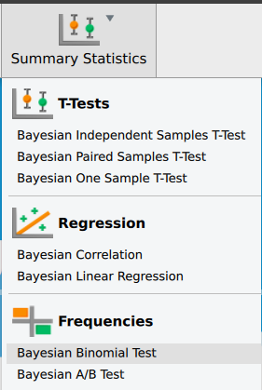
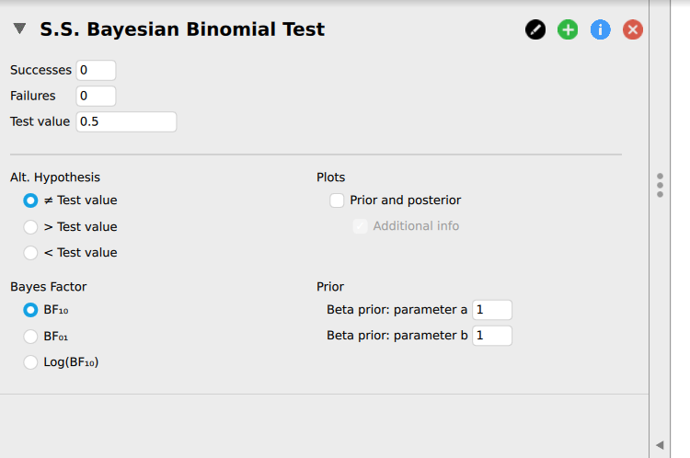

Binomial Analysis in JASP
Enable this extra module first by clicking on the big in the top right corner

Slide 68
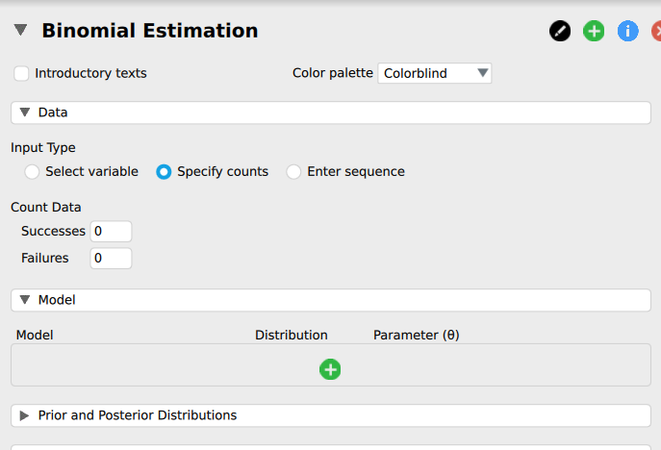
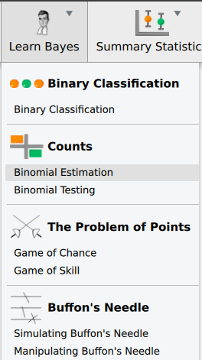
Binomial Analysis in JASP
“Specify counts” to input the data yourself
Click “+” to add models (like Alex’, Sarah’s, Paul’s)
Enable these extra modules first by clicking on the big “+” in the top right corner

Slide 69
Recap
We have some prior knowledge about a phenomenon
We formalize this knowledge in the form of a probability distribution
Then we update this with the information in the data to form posterior knowledge
A central term here is “predictive quality”: how well does each possible value of the parameter predict the observed data, compared to the other values

Slide 70
Source:
https://www.bayesianspectacles.org

Slide 71
Practical Stuff
Course literature:
van Doorn, J. (2024). A Brief Introduction to Bayesian Inference: From Tea to Beer. Free at https://johnnydoorn.github.io/IntroductionBayesianInference/

Slide 72
Practical Stuff
New software:
JASP 0.95.4 – Free at https://jasp-stats.org/download/
Also available on library computers and https://apps.uva.nl/
Instructions included in Exercise chapter and in WA
Exercises
The book and WA include practice in JASP (but also include output, if you just want to practice with interpreting output)
Exam
On the exam you only need to be able to work with the “Summary Statistics” Module (binomial test, t-test, correlation)
For example, Question 6 in WA15, Question 6.4 in book
Other questions will provide JASP output and ask you to interpret

Slide 73
Practical Stuff
Exam questions Bayes: more conceptual than calculating
Interpret Bayesian results/JASP output
Obtain prior/posterior/Bayes factor in JASP’s Summary Statistics module
Proportional to lectures: about 60% of exam will be Bayes
Weekly assignment: next week will include Bayes
The literature contains exercises in the back
Week 16 (trial exam) will contain old Bayesian exam questions
Exam material: Slides + course literature

Slide 74
Example Exam Question
Which of the following is a probability distribution:
Posterior distribution
Likelihood
Both

Slide 75
Example Exam Question
Which of the following is a probability distribution:
Posterior distribution
Likelihood
Both

Slide 76
Bayesian Hypothesis Testing
Sneak peek: https://www.youtube.com/watch?v=9TDjifpGj-k

Slide 77
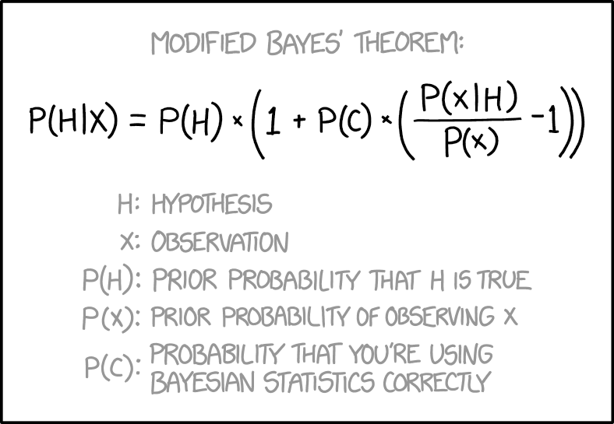
Questions?
Thank you for your attention
https://xkcd.com/2059/
Notes:
77

Slide 78
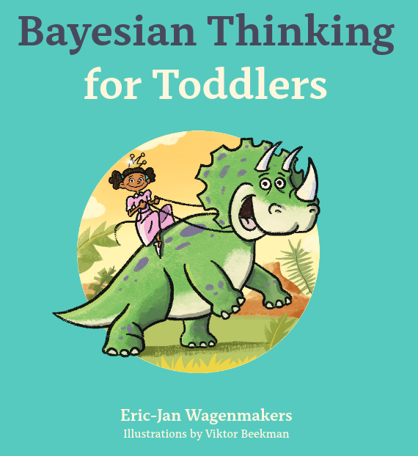
Bonus Book
One of my colleagues has written a very introductory text book to introduce some core Bayesian concepts. And it features dinosaurs!
Notes:
78

