Slide 1
Discovering Statistics Using JASP
2026 Workshop

Slide 2

Outline
JASP Intro
Correlation
Regression
PROCESS
T-test
ANOVA’s
Free-for-all
https://maglit.me/dsuj-2026
Notes:
2

Slide 3
Goals of this Workshop
Get you familiar with JASP
Show JASP workflow
Know how to get in touch
Have ran your favorite analysis in JASP
Notes:
3

Slide 4
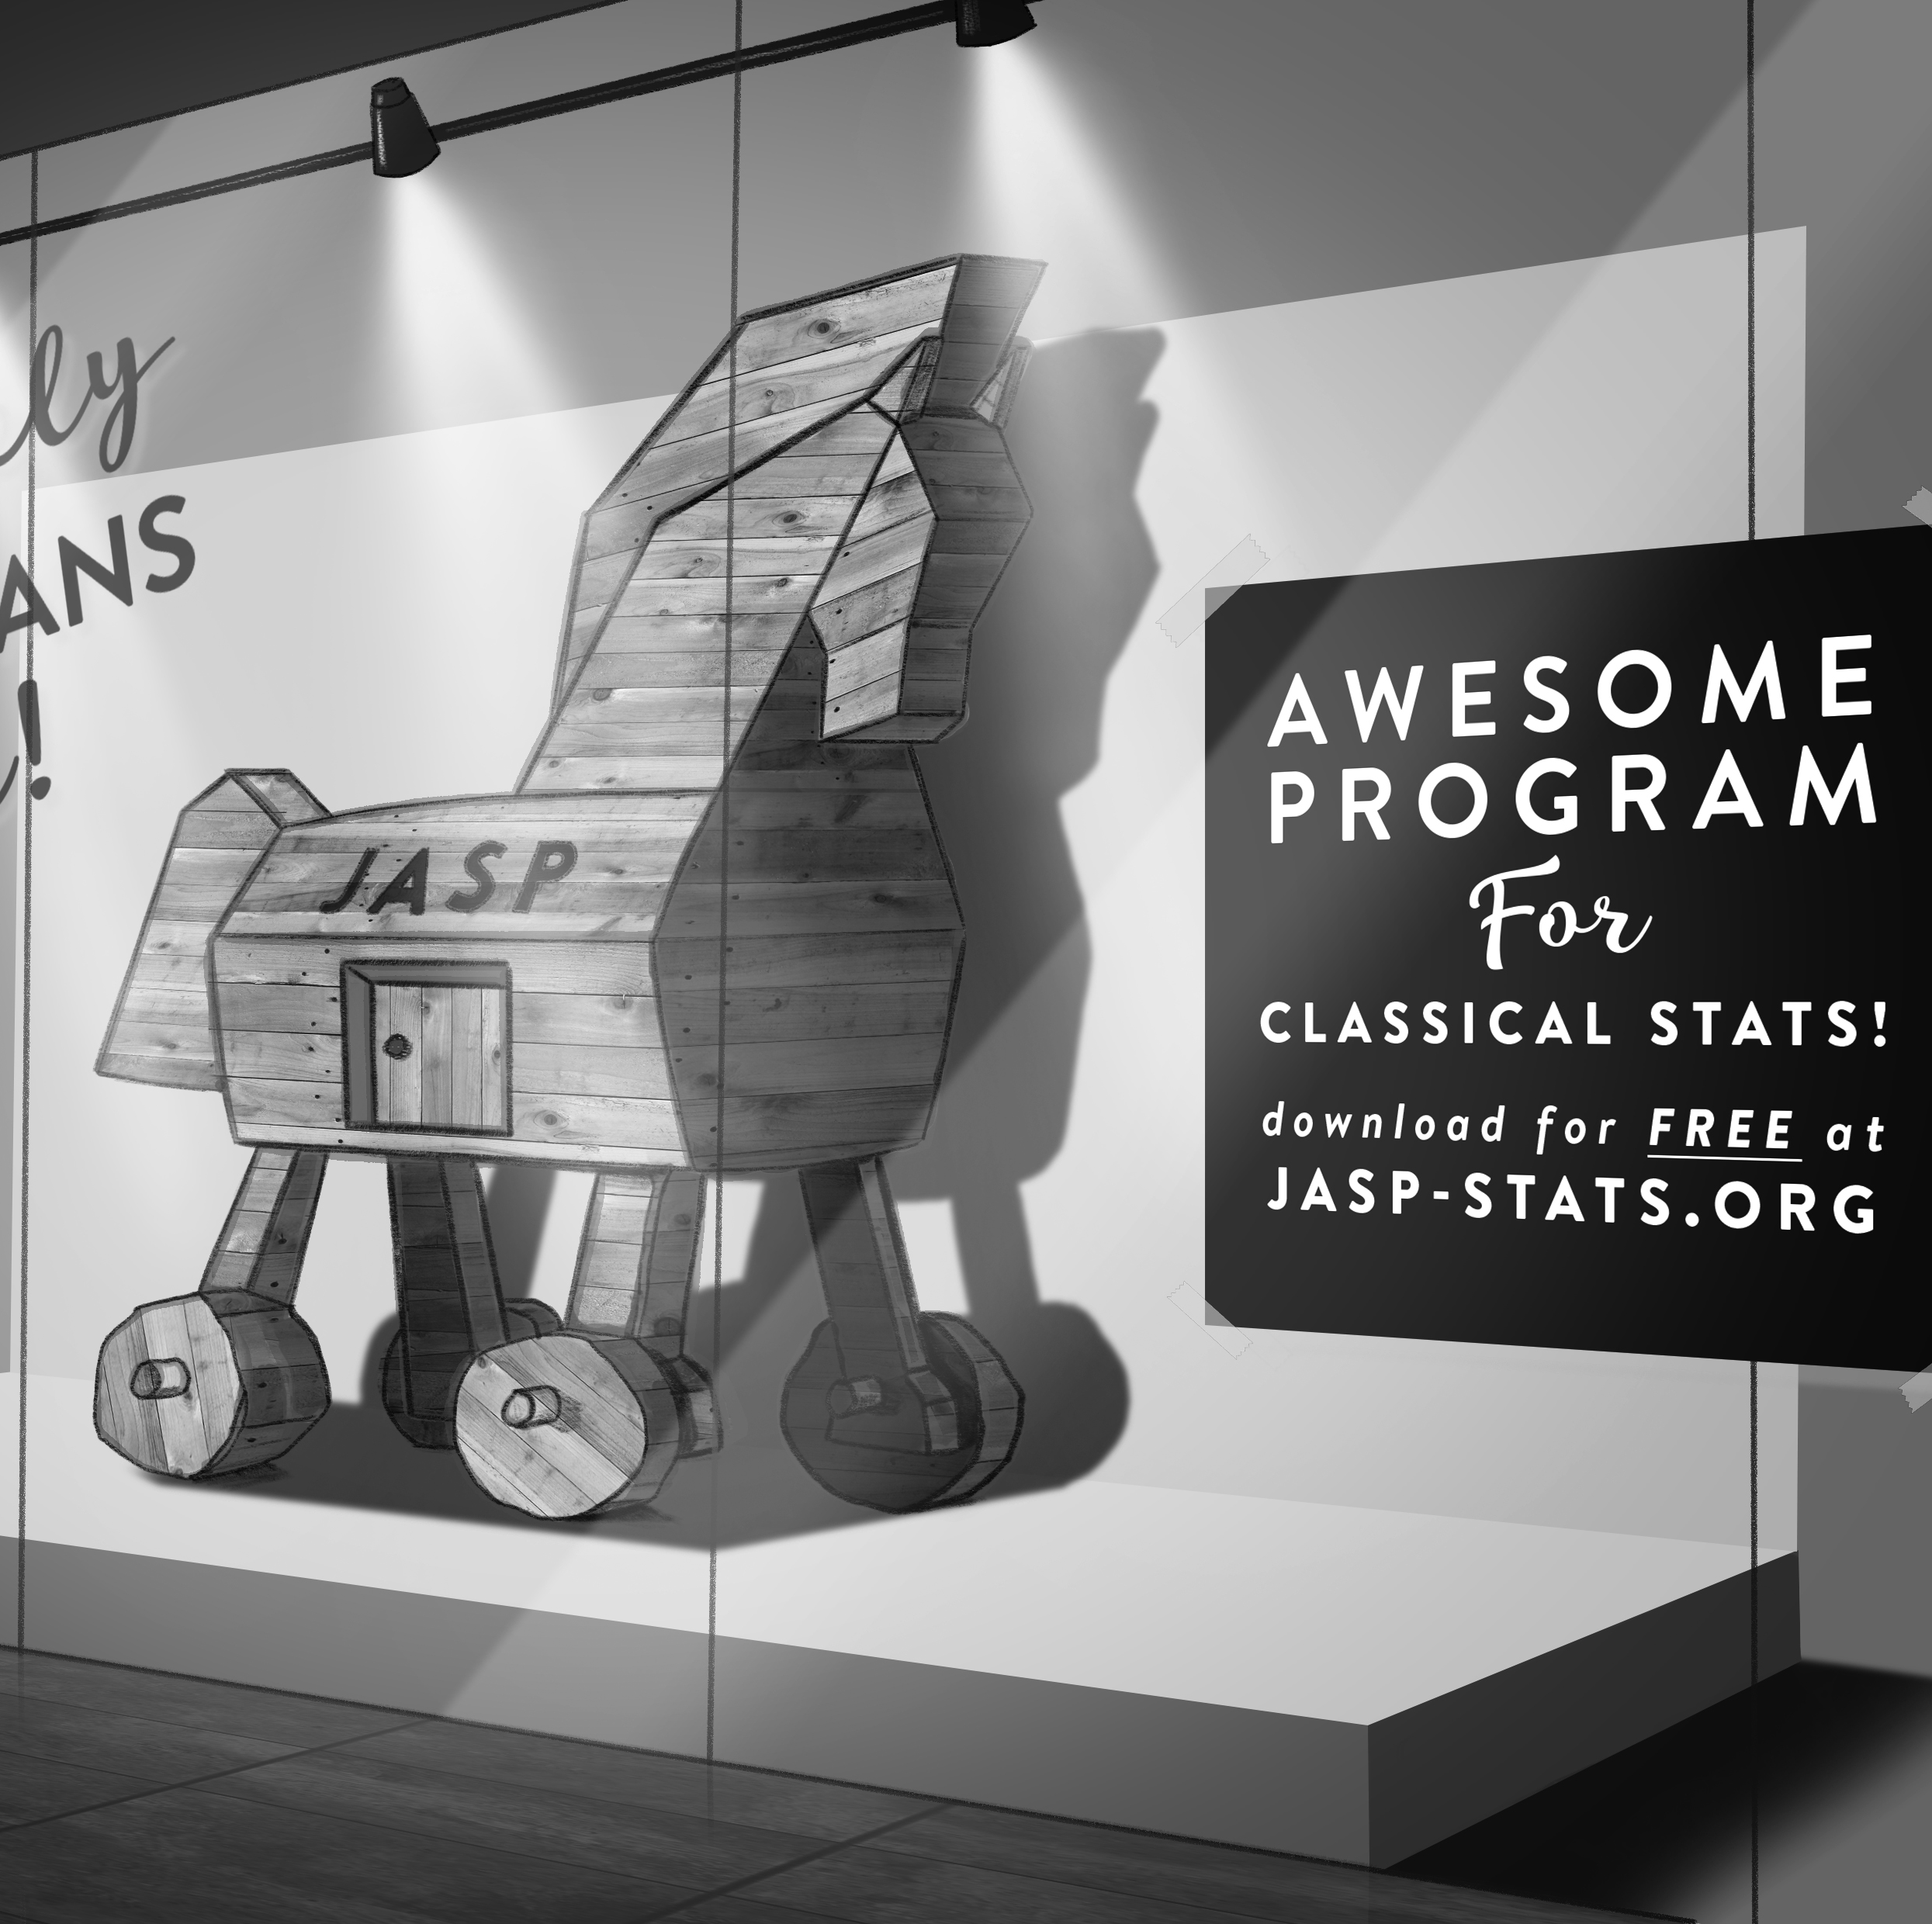
What is JASP?
Developed at UvA over the past 10+ years, funded by research grants (NWO/EU)
Graphical user interface for conducting frequentist and Bayesian statistics
https://jasp-stats.org/

Slide 5
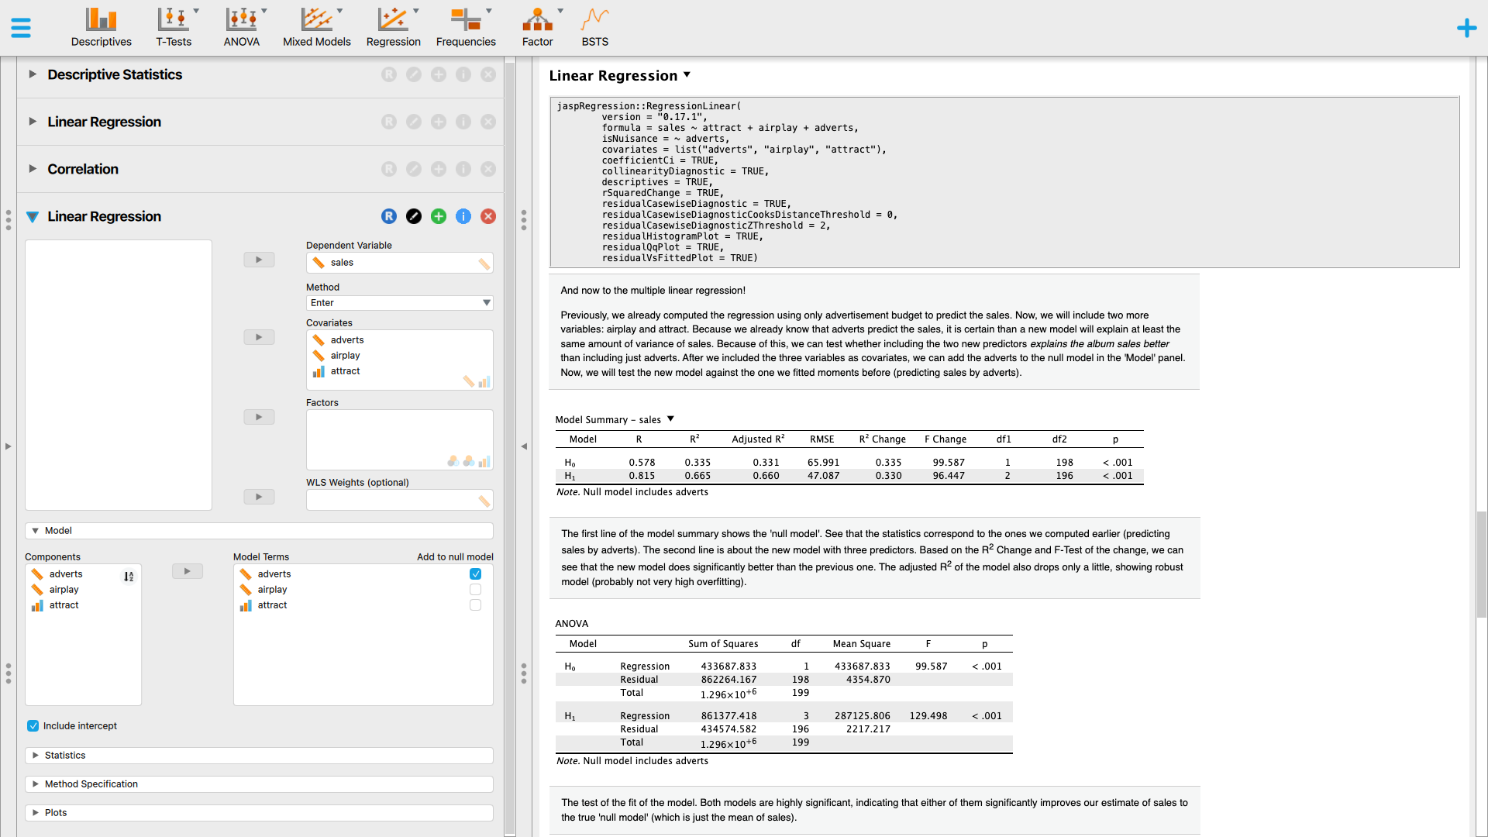
What is JASP?

Slide 6
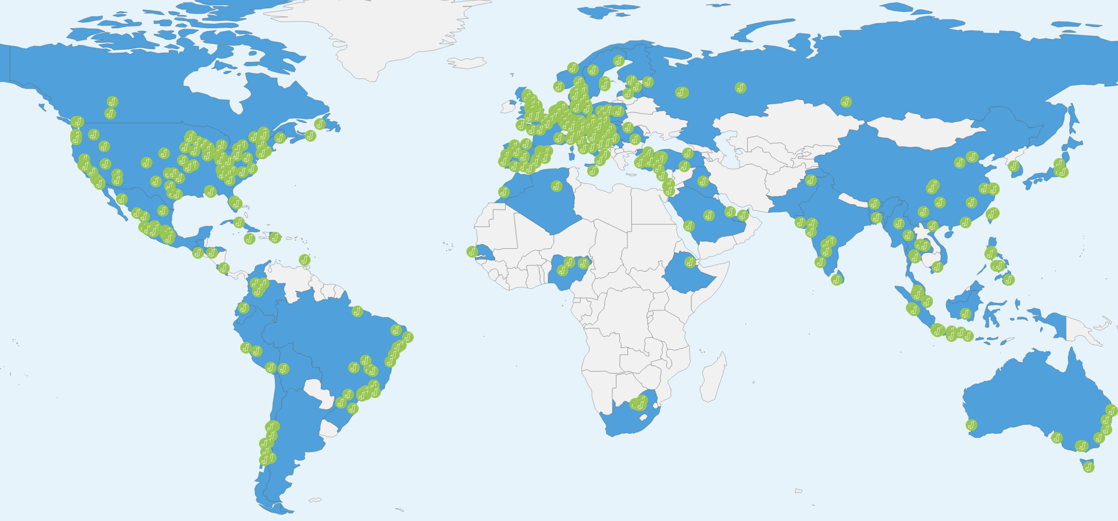
What is JASP?
Used at 389 universities across 77 countries
100,000 monthly downloads
https://jasp-stats.org/teaching-with-jasp/#worldmap

Slide 7
Features
Website overview
JASP vs. SPSS feature comparison
Data formats: .sav, .xls, .txt, .csv, .ods, .tsv, .dta, .por, .sas7bdat, .sas7bcat, and the .jasp format
APA tables
OSF integration
R console
Compute columns
Filtering

Slide 8
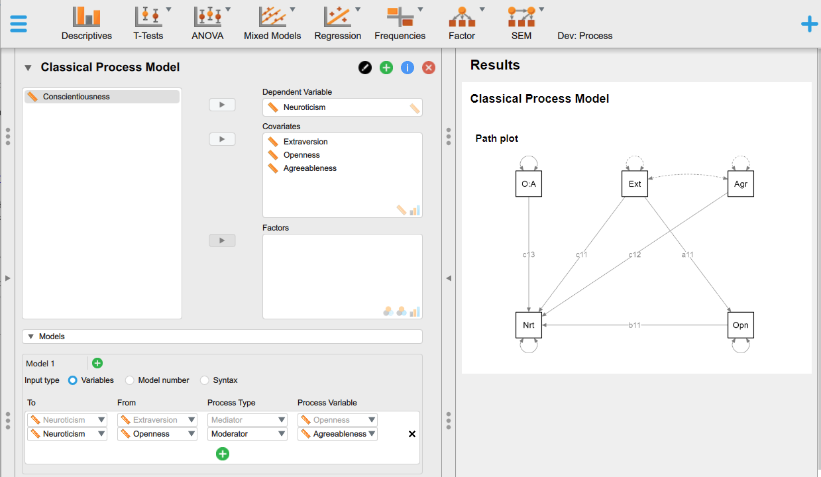
Feature Roadmap
Full syntax mode (blog about the first implementation)
More data manipulation
Select filters

Slide 9
Other Handy Resources
How to Use JASP – Inventory of blogs/videos/gifs for frequentist and Bayesian analyses
JASP YouTube page
The JASP Video Library
Step By Step Guide: 1. Bayesian One-Way ANOVA and the full playlist
JASP on Bluesky - https://bsky.app/profile/jaspstats.bsky.social
JASP forum - https://forum.cogsci.nl/index.php?p=/categories/jasp-bayesfactor
Found a bug? Please report on Github: https://github.com/jasp-stats/jasp-issues/issues
JASP Verification Project
More JASP workshops: https://jasp-stats.org/workshop/

Slide 10
JASP Literature
The JASP Data Library
Discovering Statistics Using JASP
Learning Statistics with JASP: A Tutorial for Psychology Students and Other Beginners by Danielle J. Navarro, David R. Foxcroft, and Thomas J. Faulkenberry
Statistics of Doom by Erin Buchanan
Statistical Analysis in JASP. A Guide for Students by Mark Goss-Sampson
Quantitative Analysis with JASP open-source software by Chris Halter (amazon)

Slide 11
Some Examples/Demos
From my own course (Research Methods & Statistics)
https://johnnydoorn.github.io/IntroductionBayesianInference/06-exercises.html
OSF integration
https://osf.io/u2e9d/files/osfstorage
Discover JASP
https://discoverjasp.com/

Slide 12
JASP

Slide 13
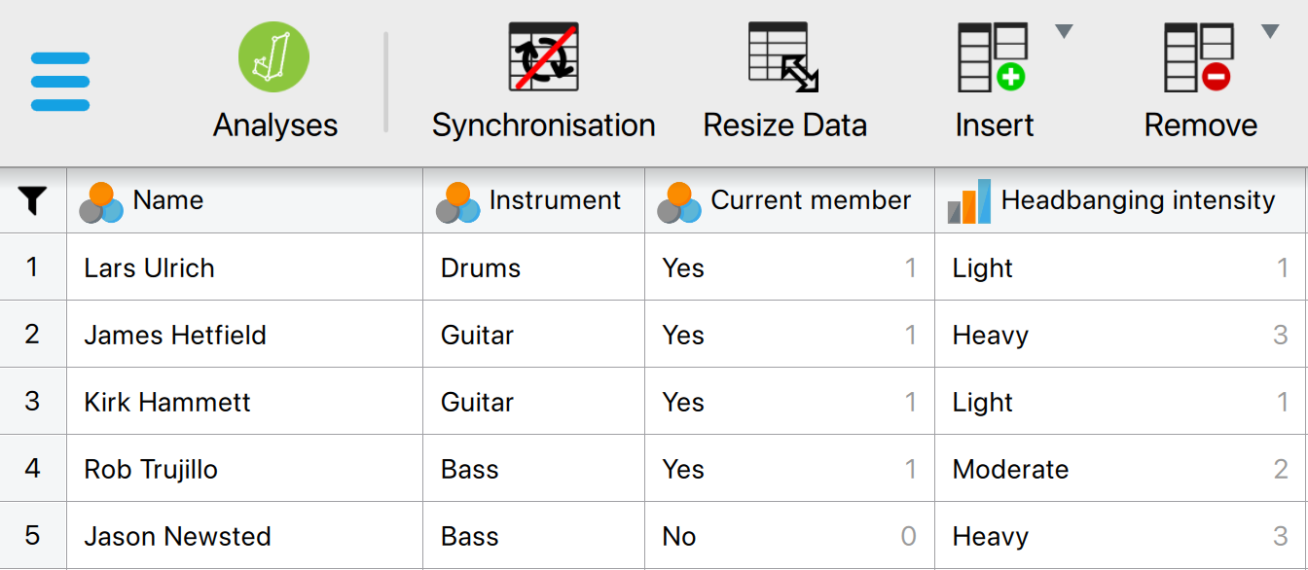
Data Management
The JASP data editor for the Metallica data

Slide 14
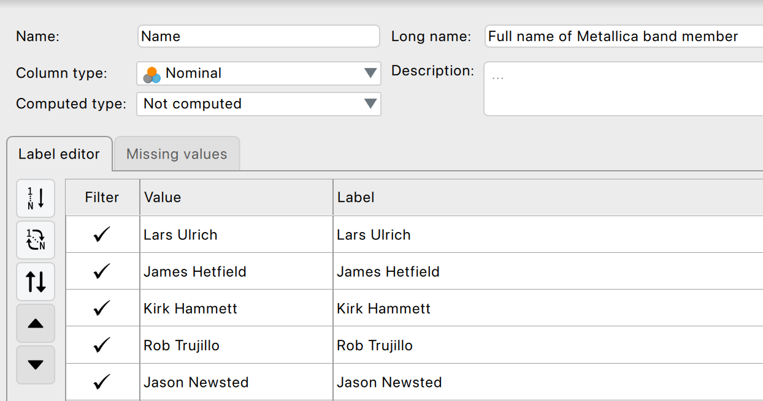
The Variable View
Figure 4.6 The variable settings for ‘Name’

Slide 15



Variable Types
Scale
Numbers (e.g., 7, 0, 120, 8.5)
Nominal
Categories (e.g., ‘Control group’, ‘Experimental group’)
Ordinal
Ordered values (e.g., ‘Dislike’, ‘Neutral’, ‘Like’)

Slide 16
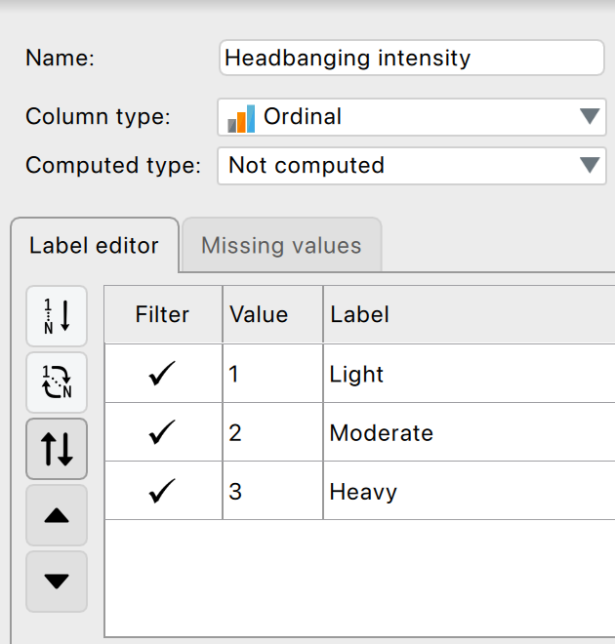
Variable Settings
Figure 4.7 Specifying the values for an ordinal variable

Slide 17
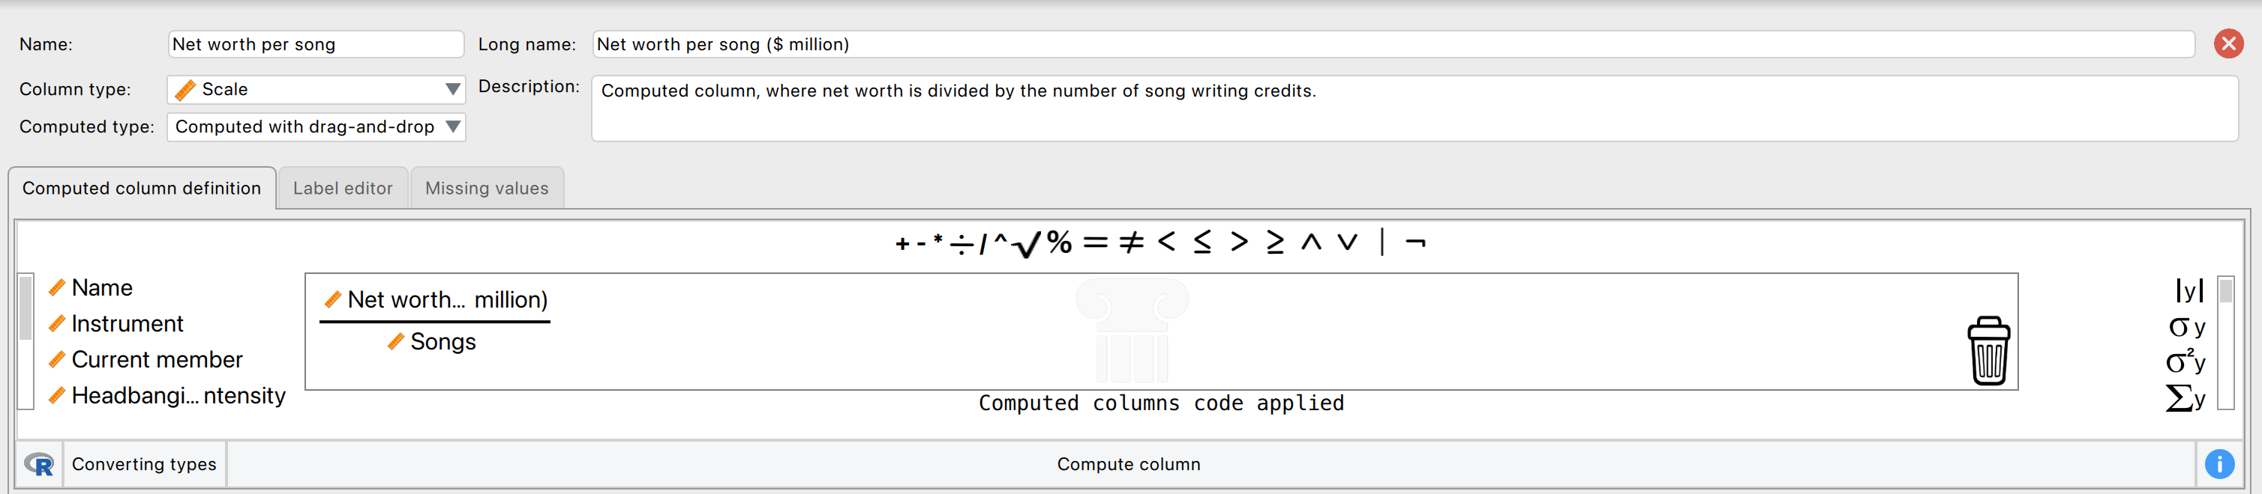

Computing a New Variable
Figure 4.8 The drag and drop interface for computing a new variable

Slide 18

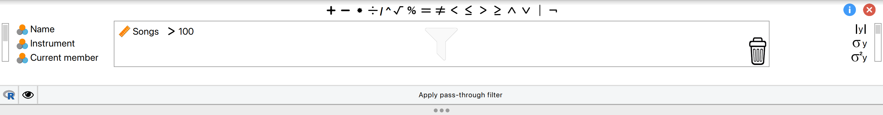
Filtering Data
Using Variable Settings
Using the Filter functionality
Drag and drop
R-mode

Slide 19
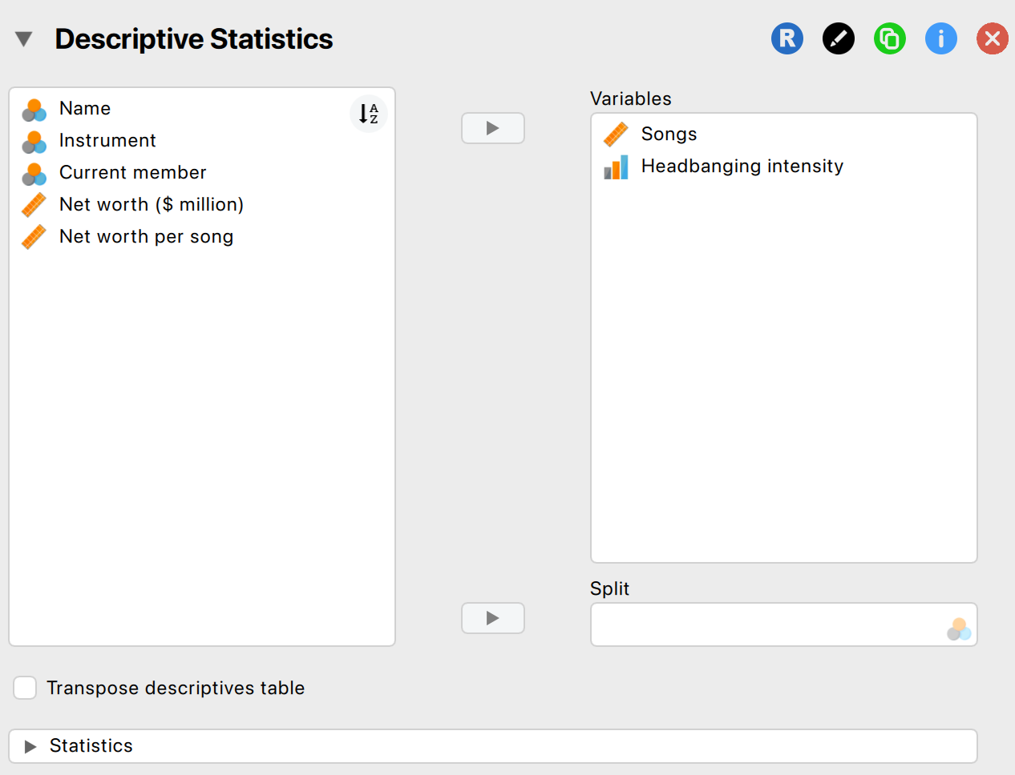
Descriptives
Figure 4.10 Input window for the Descriptives module

Slide 20
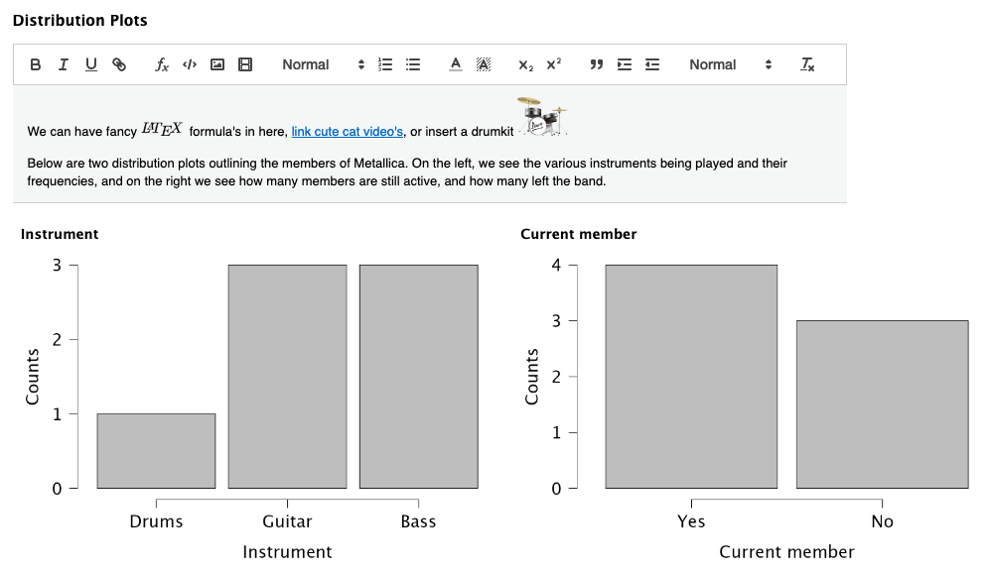
Output Window in JASP
Figure 4.11 Example of annotated output

Slide 21
Visualization

Slide 22
Correlation

Slide 23
Basic Flow of Data Analysis in JASP
Describe/visualize data
Specify the analysis in JASP
Assess the assumptions (tip: see the help-files)
Interpret the main analysis table
Consider follow-up analyses

Slide 24
Regression

Slide 25
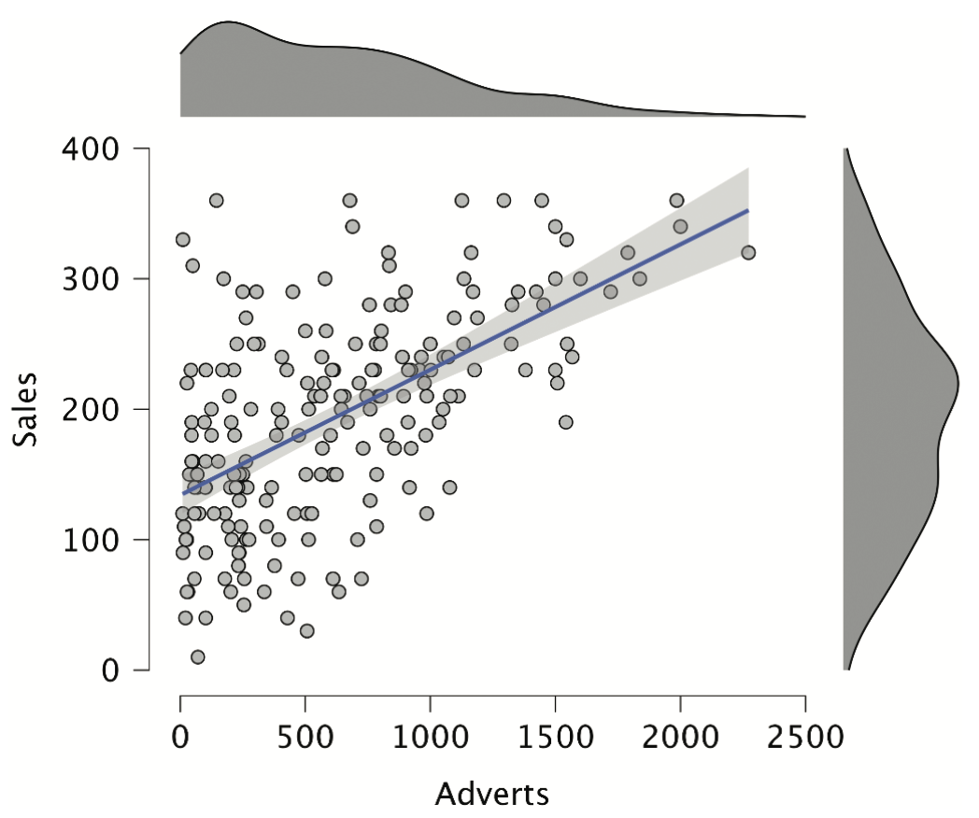
Regression with One Predictor
A record company boss was interested in predicting album sales from advertising.
Data
200 different album releases
Outcome variable:
Album sales in the week after release (x1000)
Predictor variables
Advertisement budget (in £1000)
Number of plays on the radio
Image of the band.

Slide 26
The Model as an Equation
The model contains two regression weights:
b₀ is the intercept
The intercept is the value of the Y variable when all Xs = 0
E.g., how many albums are sold for 0£ advertisement budget
b₁ is the coefficient for Adverts.
$$Y_{i}=\left(b_{0}+b_{1}X_{1i}\right)+ε_{i}$$
Notes:
A similar equation can be derived in which each predictor variable has its own coefficient, and the outcome variable is predicted from a combination of all the variables multiplied by their respective coefficients plus a residual term (see equation above).
Y is the outcome variable, β₁ is the coefficient of the first predictor (X₁), β₂ is the coefficient of the second predictor (X₂), β_{n} is the coefficient of the n^{th} predictor (X_{n}), and ε_{i} is the difference between the predicted and the observed value of Y for the i^{th} subject. In this case, the model fitted is more complicated, but the basic principle is the same as simple regression. That is, we seek to find the linear combination of predictors that correlate maximally with the outcome variable.

Slide 27
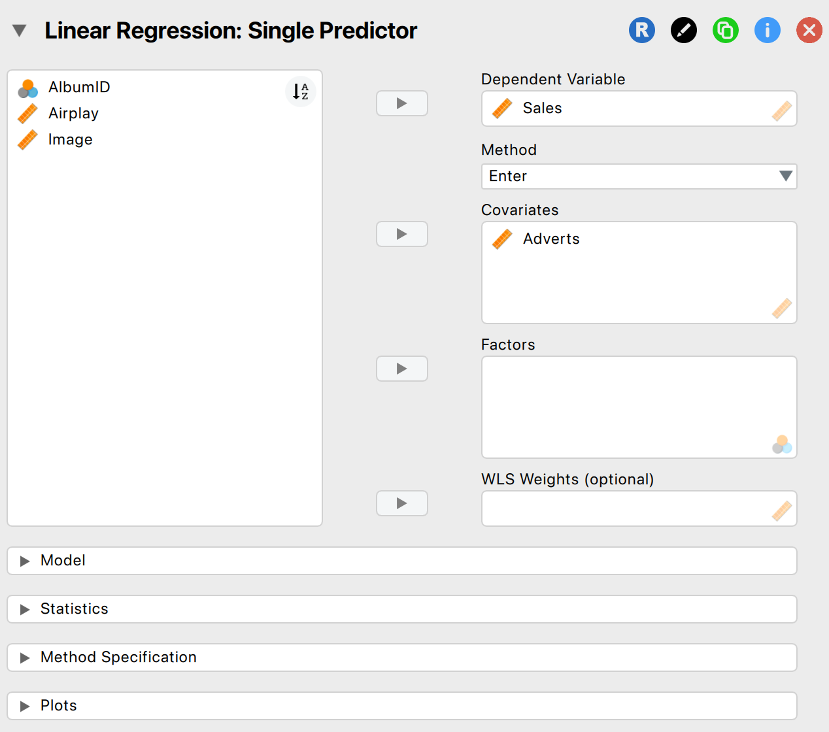
Regression with One Predictor
Figure 8.10 Main menu for regression

Slide 28
Model Summary
Output 8.2
Model Summary - Sales
Model |  | R |  | R² |  | Adjusted R² |  | RMSE
M₀ |  | 0.000 |  | 0.000 |  | 0.000 |  | 80.699
M₁ |  | 0.578 |  | 0.335 |  | 0.331 |  | 65.991
Note. M₁ includes Adverts

Slide 29
Multiple Regression
With several predictors the model now contains multiple regression weights:
b₀ is the intercept.
The intercept is the value of the Y variable when all Xs = 0
b₁ is the coefficient for Adverts
b₂ is the coefficient for Airplay
b_{n} is the coefficient for n^{th} variable.
$$Y_{i}=\left(b_{0}+b_{1}X_{1i}+b_{2}X_{2i}+⋯b_{n}X_{ni}\right)+ε_{i}$$
Notes:
A similar equation can be derived in which each predictor variable has its own coefficient, and the outcome variable is predicted from a combination of all the variables multiplied by their respective coefficients plus a residual term (see equation above).
Y is the outcome variable, β₁ is the coefficient of the first predictor (X₁), β₂ is the coefficient of the second predictor (X₂), β_{n} is the coefficient of the n^{th} predictor (X_{n}), and ε_{i} is the difference between the predicted and the observed value of Y for the i^{th} subject. In this case, the model fitted is more complicated, but the basic principle is the same as simple regression. That is, we seek to find the linear combination of predictors that correlate maximally with the outcome variable.

Slide 30
A model with Several Predictors
Figure 8.11 Matrix scatterplot of the relationships between advertising budget, airplay, image rating and album sales

Slide 31
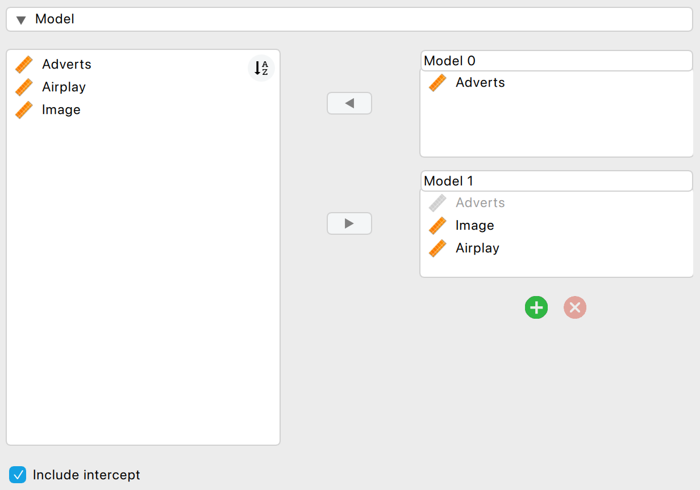
Multiple Regression
Figure 8.12 Main menu for block 2 of the multiple regression

Slide 32
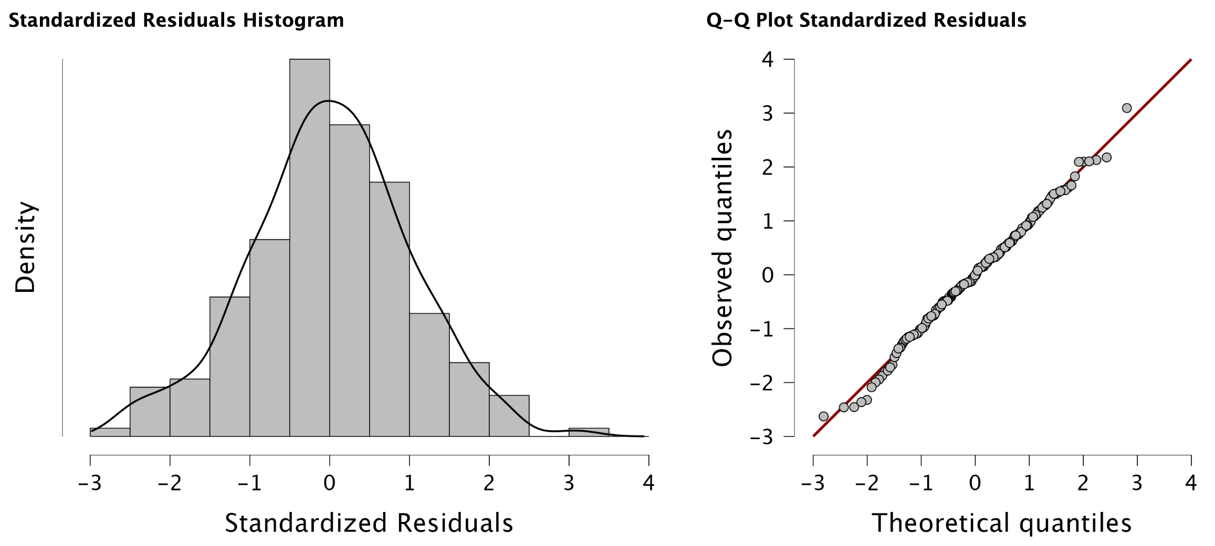
Normality of Residuals: Histograms and Q-Q Plots
Figure 8.17 Histogram and Q-Q plot for the residuals from our model

Slide 33
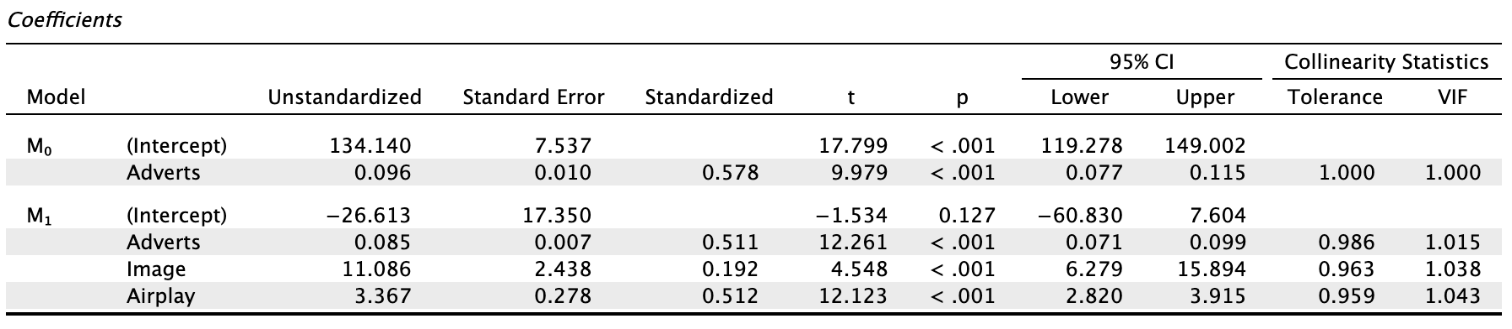
Model Parameters
Output 8.7

Slide 34
Interpreting Model Parameters
b-values:
The change in the outcome associated with a unit change in the predictor.
E.g., Advertising budget: b = 0.085
As advertising budget increases by one unit, album sales increase by 0.085 units. Both variables were measured in thousands; therefore, for every £1000 more spent on advertising, an extra 0.085 thousand albums (85 albums) are sold. This interpretation is true only if the effects of band image and airplay are held constant.

Slide 35
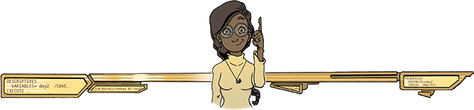
Regression Exercises
Alex Examples
Leni Examples

Slide 36
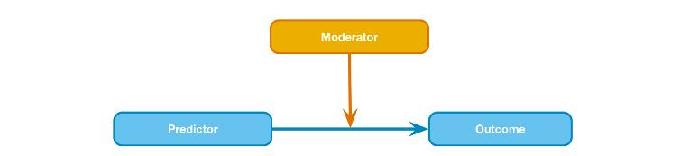
Moderation
Figure 10.2 Diagram of the conceptual moderation model

Slide 37

Example
Do violent video games make people antisocial?
Participants
442 youths
Variables
Aggression
Callous unemotional traits (CaUnTs)
Number of hours spent playing video games per week
Is ‘CaUnTs’ a moderator?
Warning
That’s a Lot to Process! Pitfalls of Popular Path Models

Slide 38
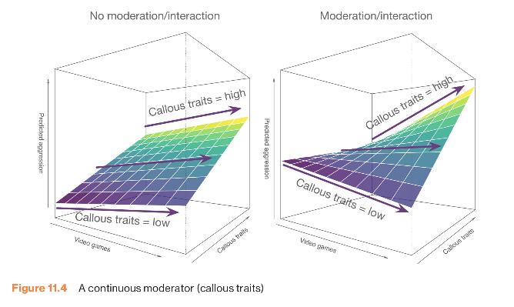
Moderation
Figure 10.4 Callousness as a moderator

Slide 39
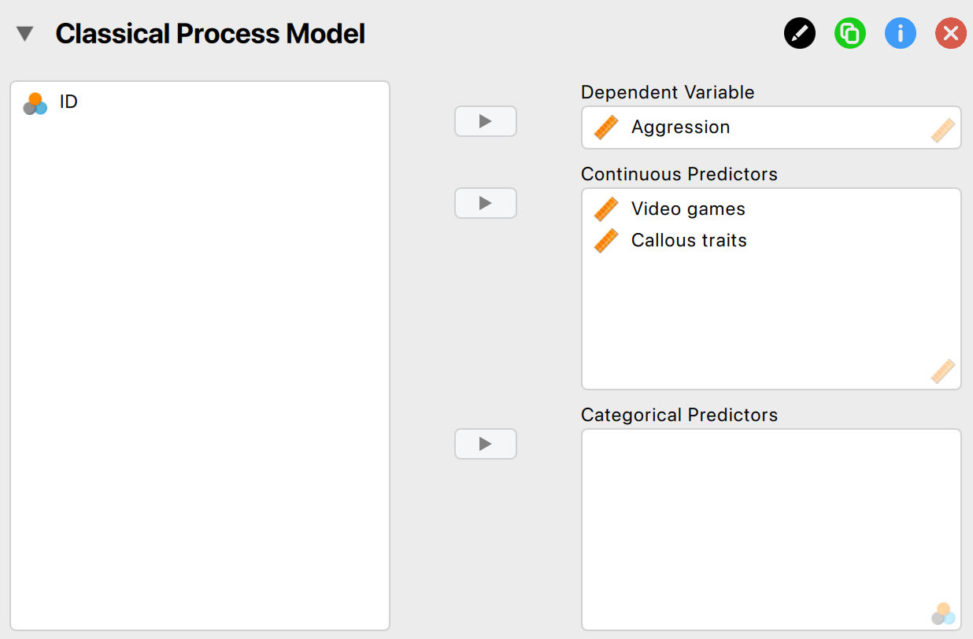
Moderation Analysis in JASP
Figure 10.6 The main menu for running moderation analysis in the Process module

Slide 40
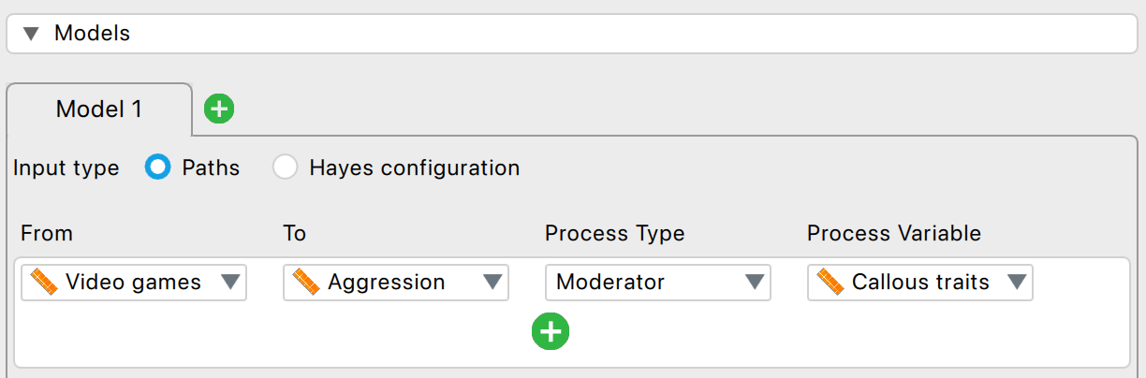
Moderation Analysis in JASP
Figure 10.7 Menu for the model builder for a moderation analysis

Slide 41
Figure 10.9 Plotting the interaction effect using Flexplot, where Callous traits is binned

Slide 42
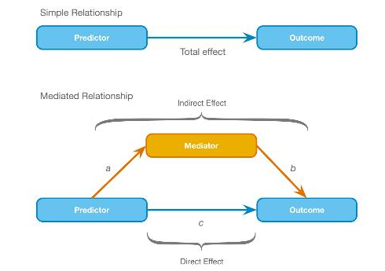
Mediation
Figure 11.9 Diagram of a mediation model

Slide 43
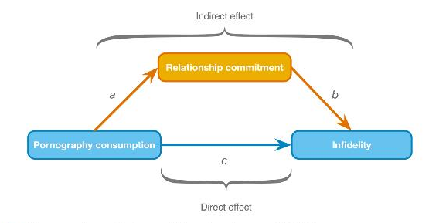
Mediation Example
Figure 10.12 Diagram of a mediation model from Lambert et al. (2012)

Slide 44
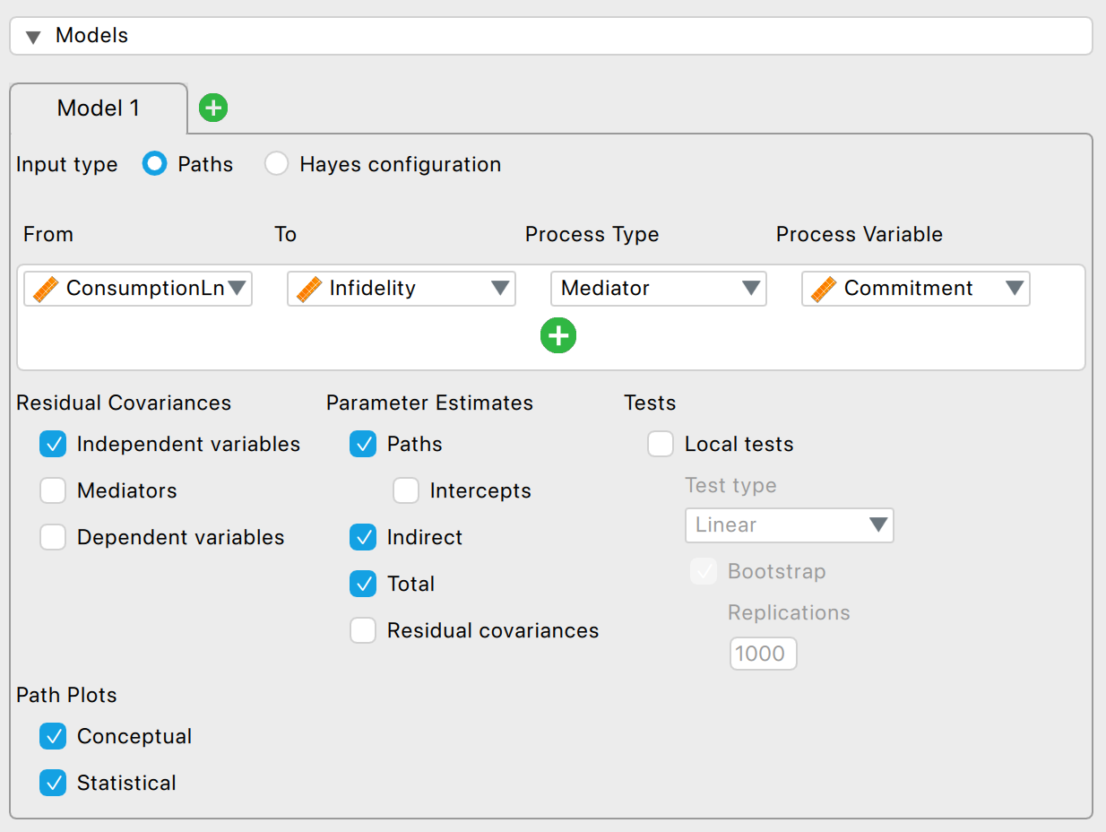
Mediation Analysis in JASP
Figure 10.14 The menu for specifying a mediation path

Slide 45
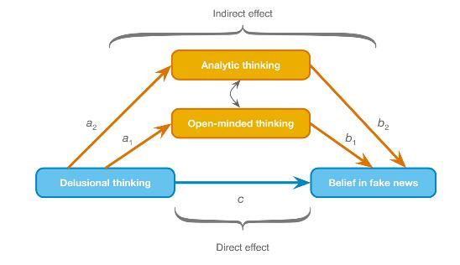
Mediation Model with Two Mediators
Figure 10.16 A mediation model with two mediators (Bronstein, 2019)

Slide 46
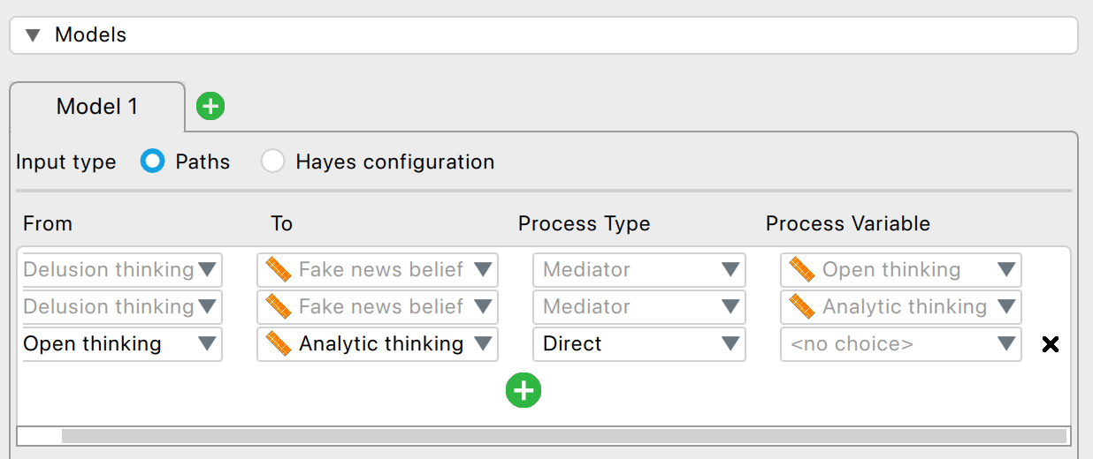
Figure 10.17 The dialogue boxes for running mediation analysis with two mediators

Slide 47
Moderation & Mediation
Alex Examples
Leni Examples

Slide 48
Comparing Means

Slide 49
ANOVA: Puppy Example
A puppy therapy RCT in which we randomized people into three groups:
A control group
15 minutes of puppy therapy
30 minutes of puppy contact
The DV is happiness (0 = unhappy) to 10 (happy)
Predictions:
Any form of puppy therapy should be better than the control (i.e. higher happiness scores).
A dose-response hypothesis that as exposure time increases (from 15 to 30 minutes), happiness will increase too

Slide 50
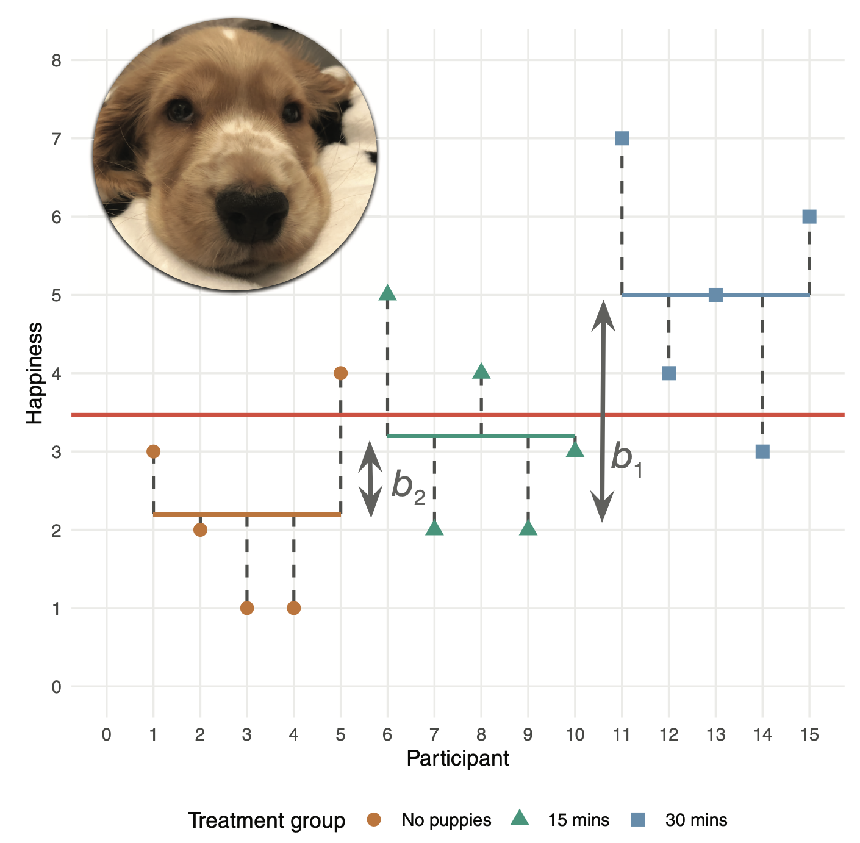
ANOVA

Slide 51
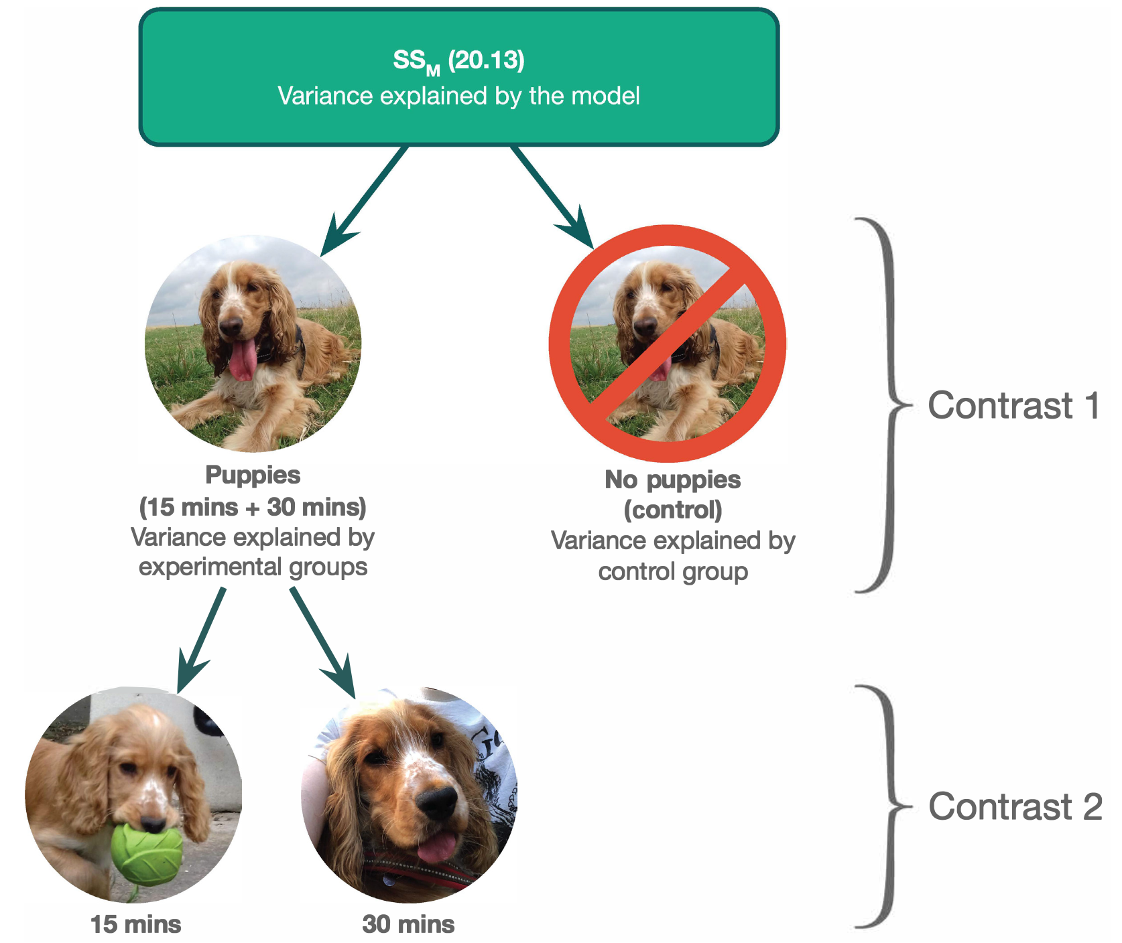
Contrasts

Slide 52
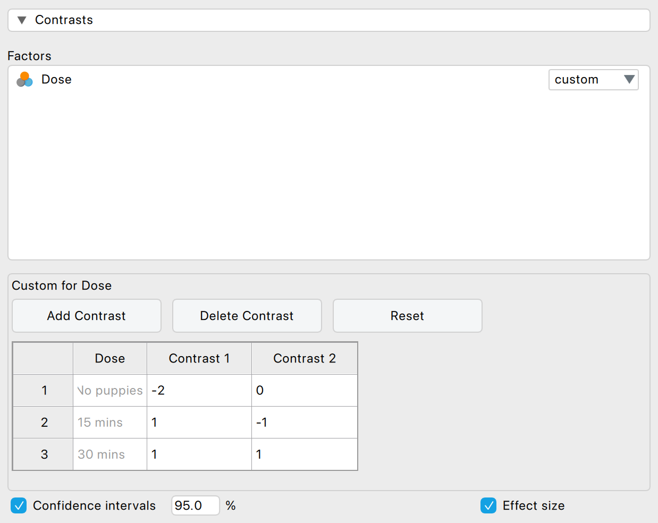
Contrasts in JASP

Slide 53

Post Hoc Tests
Compare each mean against all others.
In general terms, they use a stricter criterion to accept an effect as significant.
Hence, control the family-wise error rate.
Simplest example is the Bonferroni method:
$$P_{Crit}=\frac{α}{K}$$

Slide 54
Post Hoc Tests
Assumptions met:
Tukey HSD
Safe Option:
Bonferroni
Unequal variances:
Games-Howell

Slide 55
ANCOVA
Reduces error variance
By explaining some of the unexplained variance (SSR) the error variance in the model can be reduced
Greater insight
By including more variables, we gain deeper insight into their interplay (e.g., interactions, shared variance)
Warning
Hidden multiplicity in exploratory multiway ANOVA: Prevalence and remedies

Slide 56
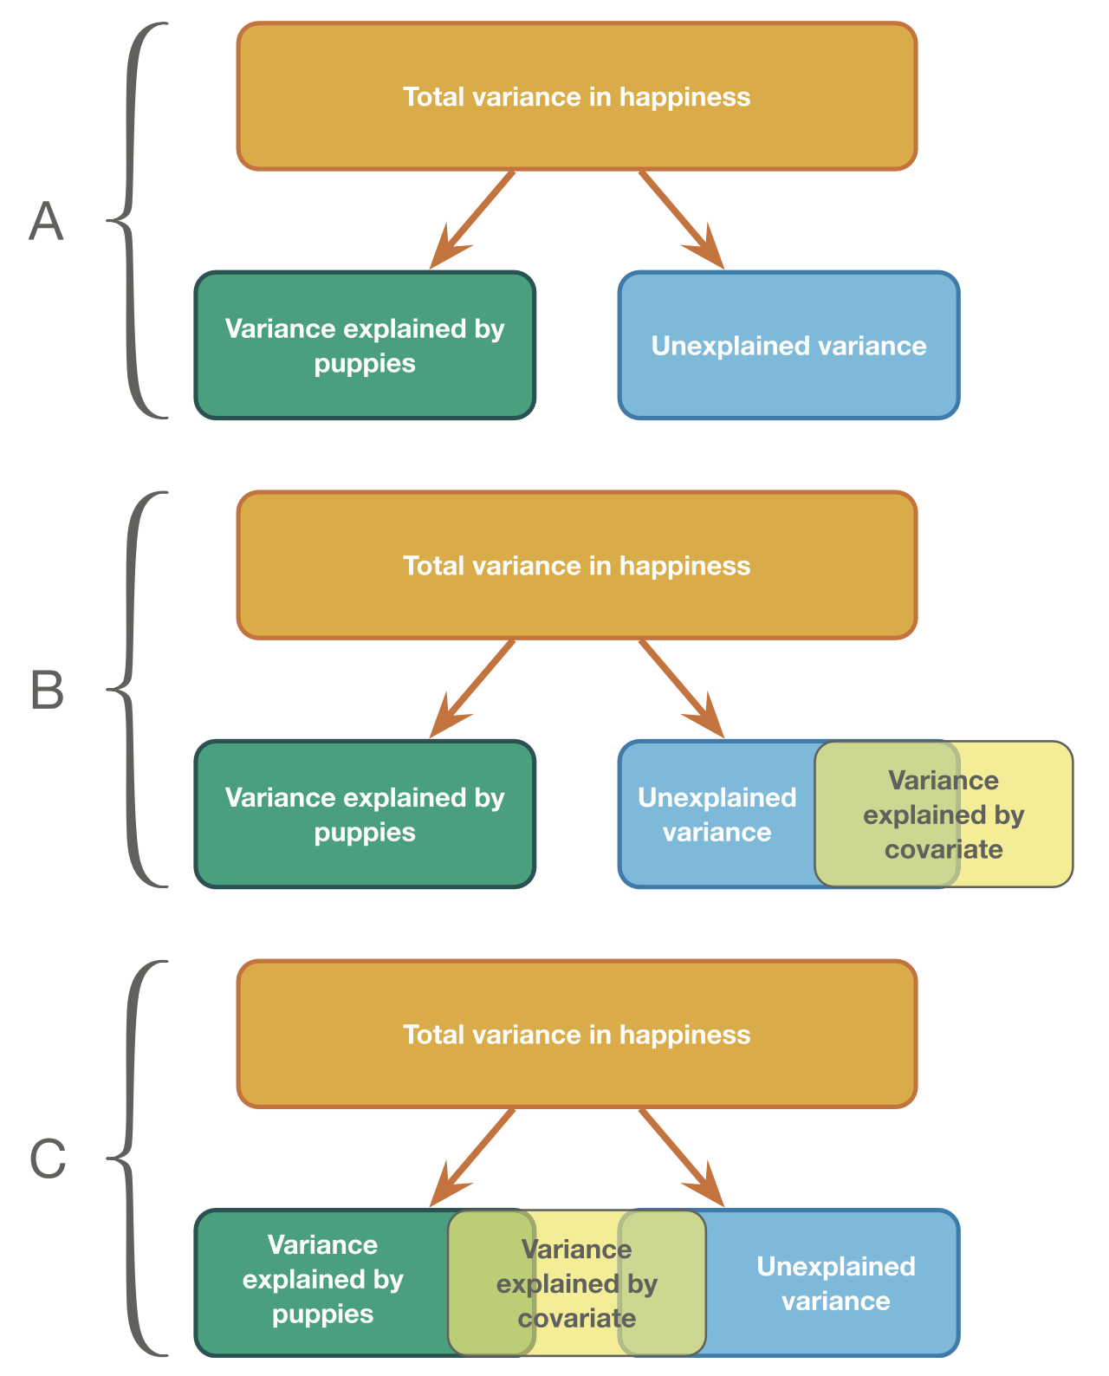
ANCOVA
Figure 12.2 The role of the covariate in ANCOVA

Slide 57
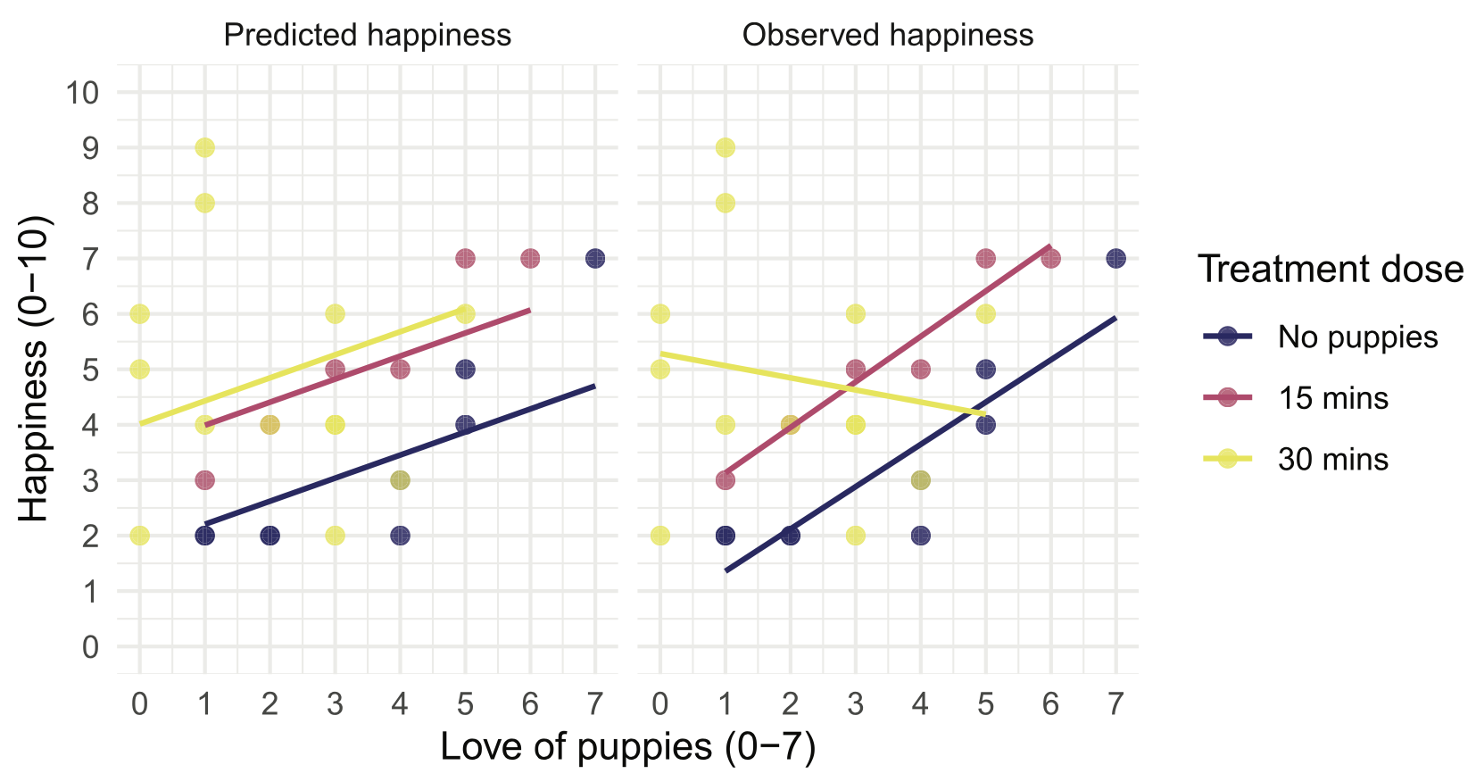
Homogeneity of Slopes
Figure 12.3 Scatterplot and linear models of happiness against love of puppies for each therapy condition

Slide 58
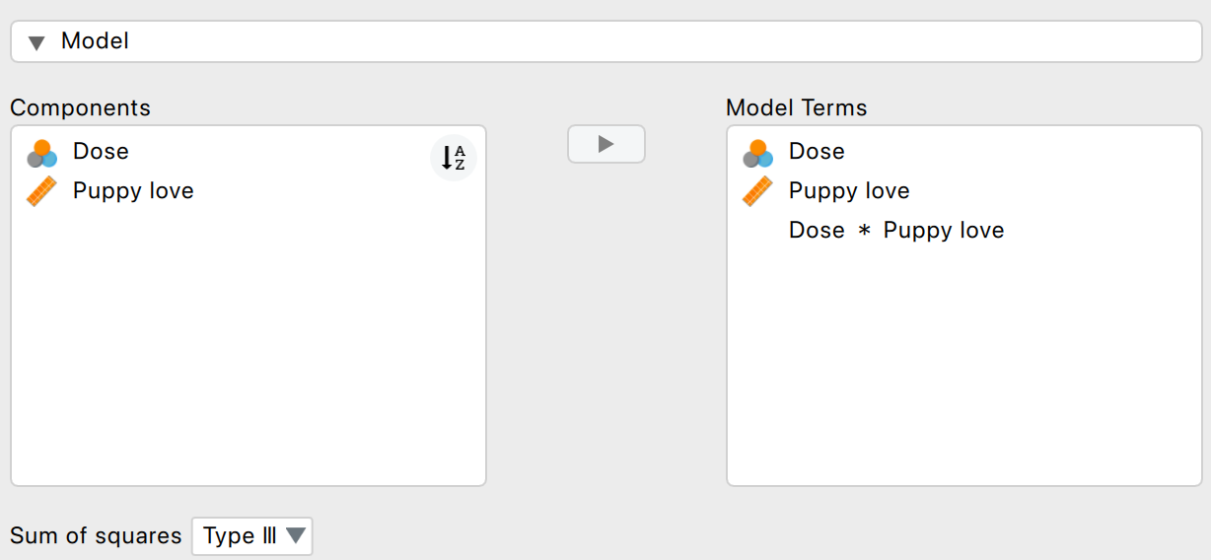
Assessing Homogeneity of Slopes
Figure 12.8 Model tab for ANCOVA

Slide 59
ANCOVA
Alex Examples
Leni Examples

Slide 60
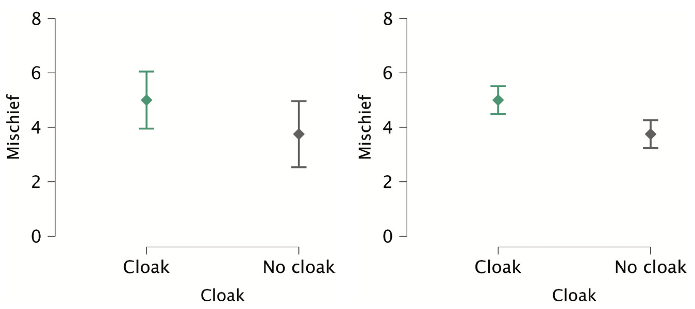
RM ANOVA
Advantages
Unsystematic variance is reduced
More sensitive to experimental effects
Figure 9.7 Same data, between-subjects (left) and within-subjects (right)

Slide 61
RM ANOVA Example
Training sniffer dogs to detect aliens
After rigorous training, eight dogs sniffed each of four entities for 1 minute:
Alien space lizard in its natural form
Alien space lizard who had shapeshifted into humanoid form
Human
Human mannequin
DV: Number of vocalizations made during each 1-minute sniffing session

Slide 62
Data for Sniffer Dog Example
Table 14.1 Data for the sniffer-dog example
Dog | Alien | Human | Mannequin | Shapeshifter | Mean | s²
Milton | 8 | 7 | 1 | 6 | 5.50 | 9.67
Woofy | 9 | 5 | 2 | 5 | 5.25 | 8.25
Ramsey | 6 | 2 | 3 | 8 | 4.75 | 7.58
Mr. Snifficus III | 5 | 3 | 1 | 9 | 4.50 | 11.67
Willock | 8 | 4 | 5 | 8 | 6.25 | 4.25
The Venerable Dr. Waggy | 7 | 5 | 6 | 7 | 6.25 | 0.92
Lord Scenticle | 10 | 2 | 7 | 2 | 5.25 | 15.58
Professor Nose | 12 | 6 | 8 | 1 | 6.75 | 20.92
Mean | 8.13 | 4.25 | 4.13 | 5.75

Slide 63
The Assumption of Sphericity
Assumes that the variances of differences between conditions are equal
Estimated and adjusted df using:
Greenhouse-Geisser estimate
Huynh-Feldt estimate
Tested using Mauchly’s test (not recommended)
P < .05, sphericity is violated
P > .05, sphericity is met
Rule of thumb: G-G is conservative and H-F liberal
Notes:
variances.

Slide 64
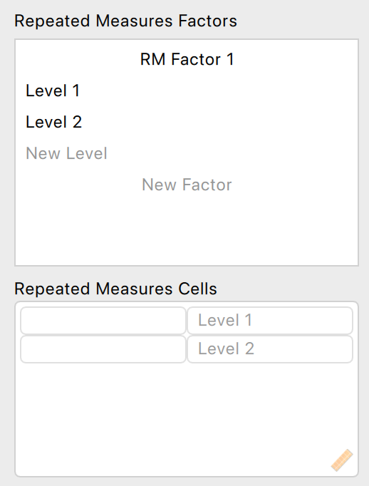
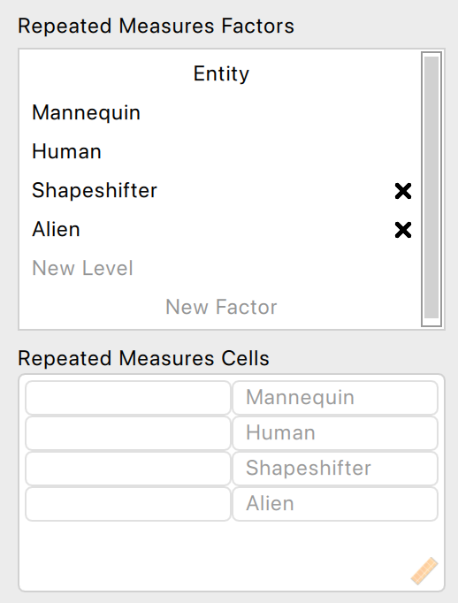
Defining the Repeated Factors
Figure 14.6 The Repeated Measures Factors menu for repeated-measures ANOVA

Slide 65
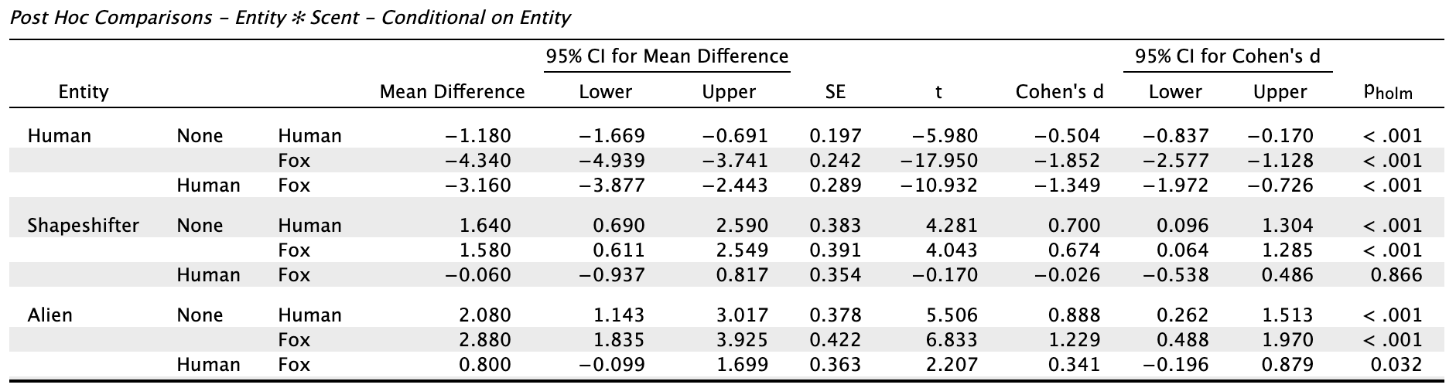
Factorial: Post hoc comparisons
Output 14.15

Slide 66
RM ANOVA
Alex Examples
Leni Examples

Slide 67
JASP

