Slide 1
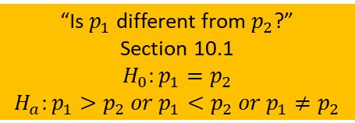
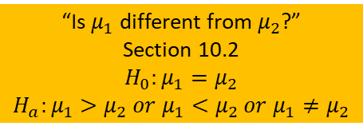
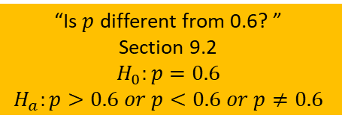
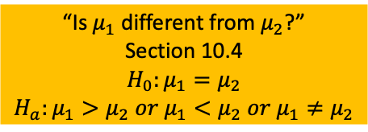
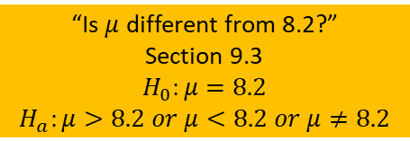
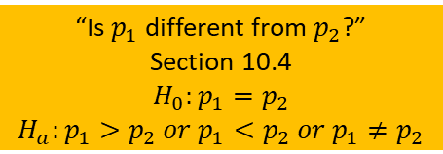
Comparing one group to a specific value
“Is $p$ different from 0.6? ”
Section 9.2
$$H_{0}:p=0.6$$
$$H_{a}:p>0.6 or p<0.6 or p≠0.6$$
Proportion (variable is categorical)
Independent groups
“Is $p_{1}$ different from $p_{2}$?”
Section 10.1
$$H_{0}:p_{1}=p_{2}$$
$$H_{a}:p_{1}>p_{2} or p_{1}<p_{2} or p_{1}≠p_{2}$$
Comparing two groups to each other
Dependent groups (within-person or matched pairs)
“Is $p_{1}$ different from $p_{2}$?”
Section 10.4
$$H_{0}:p_{1}=p_{2}$$
$$H_{a}:p_{1}>p_{2} or p_{1}<p_{2} or p_{1}≠p_{2}$$
Significant tests for different designs
Comparing one group to a specific value
“Is $μ$ different from 8.2?”
Section 9.3
$$H_{0}:μ=8.2$$
$$H_{a}:μ>8.2 or μ<8.2 or μ≠8.2$$
Mean (variable is quantitative)
Independent groups
“Is $μ_{1}$ different from $μ_{2}$?”
Section 10.2
$$H_{0}:μ_{1}=μ_{2}$$
$$H_{a}:μ_{1}>μ_{2} or μ_{1}<μ_{2} or μ_{1}≠μ_{2}$$
Comparing two groups to each other
Dependent groups (within-person or matched pairs)
“Is $μ_{1}$ different from $μ_{2}$?”
Section 10.4
$$H_{0}:μ_{1}=μ_{2}$$
$$H_{a}:μ_{1}>μ_{2} or μ_{1}<μ_{2} or μ_{1}≠μ_{2}$$

Slide 2

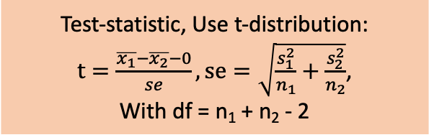
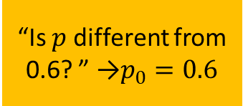

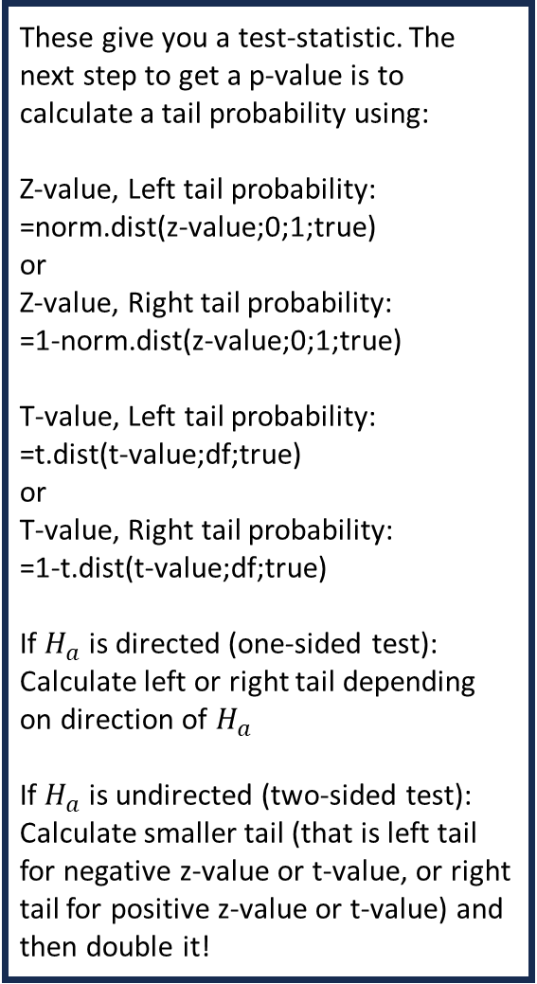
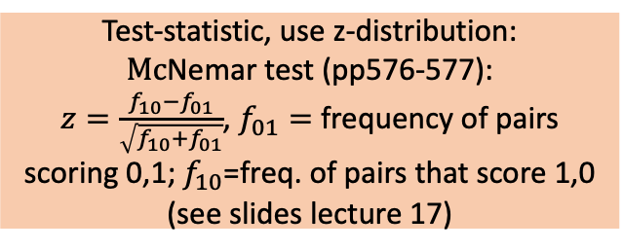
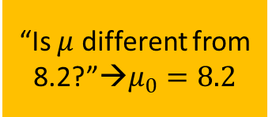
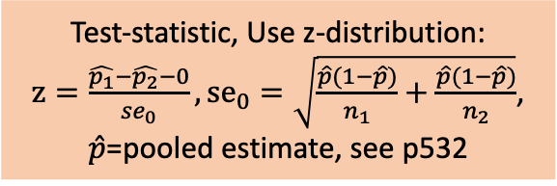

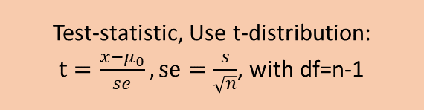

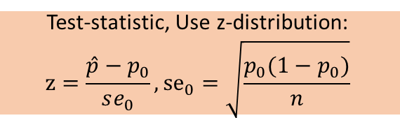
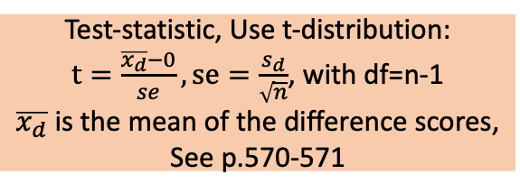
Comparing one group to a specific proportion
“Is $p$ different from 0.6? ” →$p_{0}=0.6$
Test-statistic, Use z-distribution:
$$z=\frac{\hat{p}−p_{0}}{se_{0}}, {se}_{0}=\sqrt{\frac{p_{0}(1−p_{0})}{n}}$$
These give you a test-statistic. The next step to get a p-value is to calculate a tail probability using:
Z-value, Left tail probability:
=norm.dist(z-value;0;1;true)
or
Z-value, Right tail probability:
=1-norm.dist(z-value;0;1;true)
T-value, Left tail probability:
=t.dist(t-value;df;true)
or
T-value, Right tail probability:
=1-t.dist(t-value;df;true)
If $H_{a}$ is directed (one-sided test):
Calculate left or right tail depending on direction of $H_{a}$
If $H_{a}$ is undirected (two-sided test):
Calculate smaller tail (that is left tail for negative z-value or t-value, or right tail for positive z-value or t-value) and then double it!
Test-statistic, Use z-distribution:
$z=\frac{\hat{p_{1}}−\hat{p_{2}}−0}{se_{0}}, {se}_{0}=\sqrt{\frac{\hat{p}(1−\hat{p})}{n_{1}}+\frac{\hat{p}(1−\hat{p})}{n_{2}}}$,
$\hat{p}$=pooled estimate, see p532
Comparing independent groups
proportions
“Is $p_{1}$ different from $p_{2}$?”
Test-statistic, use z-distribution:
$Mc$Nemar test (pp576-577):
$z=\frac{f_{10}−f_{01}}{\sqrt{f_{10}+f_{01}}}$, $f_{01}=$ frequency of pairs scoring 0,1;$f_{10}$=freq. of pairs that score 1,0 (see slides lecture 17)
Comparing dependent groups proportions
“Is $p_{1}$ different from $p_{2}$?”
Comparing one group to a specific mean
“Is $μ$ different from 8.2?”→$μ_{0}=8.2$
Test-statistic, Use t-distribution:
$t=\frac{\overline{x}−μ_{0}}{se}, se=\frac{s}{\sqrt{n}}$, with df=n-1
Test-statistic, Use t-distribution:
$t=\frac{\overline{x_{1}}−\overline{x_{2}}−0}{se}, se=\sqrt{\frac{s_{1}^{2}}{n_{1}}+\frac{s_{2}^{2}}{n_{2}}}$,
With df = n₁ + n₂ - 2
Comparing independent groups
means
“Is $μ_{1}$ different from $μ_{2}$?”
Test-statistic, Use t-distribution:
$t=\frac{\overline{x_{d}}−0}{se}, se=\frac{s_{d}}{\sqrt{n}}$, with df=n-1
$\overline{x_{d}}$ is the mean of the difference scores,
See p.570-571
Comparing dependent groups means
“Is $μ_{1}$ different from $μ_{2}$?”

