Slide 1

Track Time
Tim Bly
Steven An
Amar Jandu

Slide 2
Summary
Time Tracker for Circuit Racing
  Ayrton Senna A0000001 Tsukuba Circuit 01/04/2014 275.21
(name) (driver id)(circuit name)(date)(total time)
Notes:
Project name called trackTime
It can be used for tracking time spent on a circuit, or a drive
takes drivers name, driver id, circuit name, date and total time
Driver ID is our searchingKey.

Slide 3
Data Structure

Slide 4
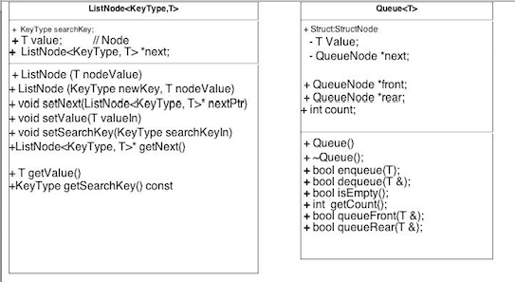
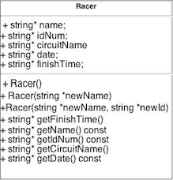
UML

Slide 5
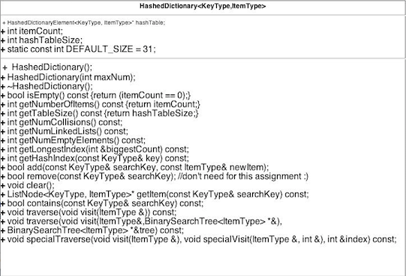

Slide 6
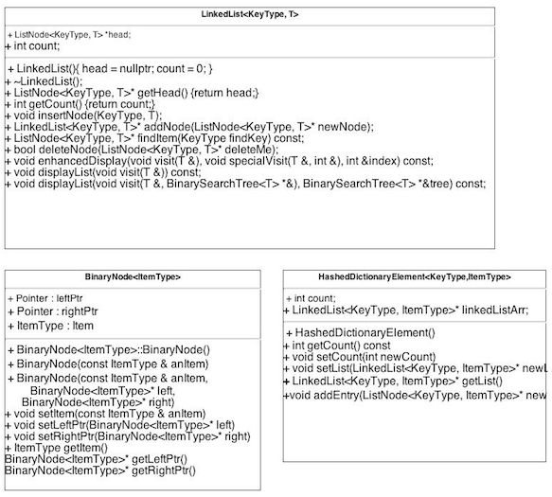

Slide 7
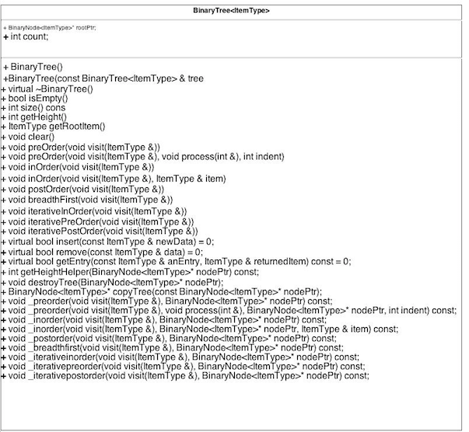

Slide 8
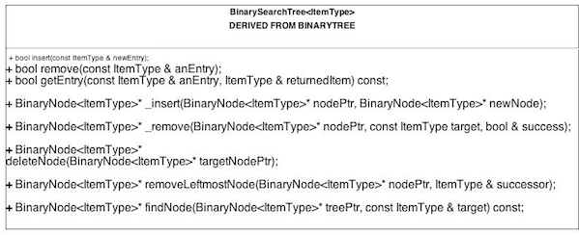


Slide 9
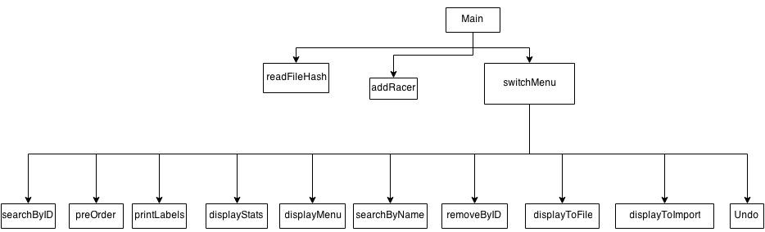
Structure Chart

Slide 10

Hash Function
template<class KeyType, class ItemType>
int HashedDictionary<KeyType, ItemType>::getHashIndex(const KeyType& key) const
{
std::tr1::unordered_map<KeyType, ItemType> mapper;
typename std::tr1::unordered_map<KeyType, ItemType>::hasher hashFunction = mapper.hash_function();
return static_cast<int>(hashFunction(key) % hashTableSize);
}
Notes:
template<>
class hash<_STD string>
: public unary_function<_STD string, size_t>
{ // hash functor
public:
typedef _STD string _Kty;
size_t operator()(const _Kty& _Keyval) const
{ // hash _Keyval to size_t value by pseudorandomizing transform
size_t _Val = 2166136261U;
size_t _First = 0;
size_t _Last = _Keyval.size();
size_t _Stride = 1 + _Last / 10;
for(; _First < _Last; _First += _Stride)
_Val = 16777619U * _Val ^ (size_t)_Keyval[_First];
return (_Val);
}
};

Slide 11
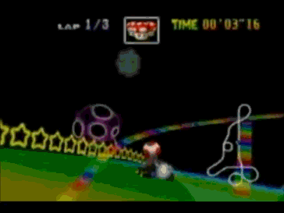
Collision Management

Slide 12

El Fin

