Slide 1
Reversible data hiding based on histogram shifting scheme
Reporter: Date: | Wan-Yu Lu 2012/12/13
Notes:
<number>

Slide 2
Introduction(1/3)
Data hiding is referred to as a process to hide some information data into cover media.
The data hiding schemes can be generally classified into two categories:
- Irreversible data hiding
- Reversible data hiding
Notes:
<number>

Slide 3

Introduction(2/3)
Data hiding
SD
Cover image
Secret data
Embedded image
Notes:
<number>

Slide 4
Introduction(3/3)
Reversible data hiding
Extract
SD
Secret data
Embedded image
Reversible
data hiding
Cover image
Notes:
<number>

Slide 5
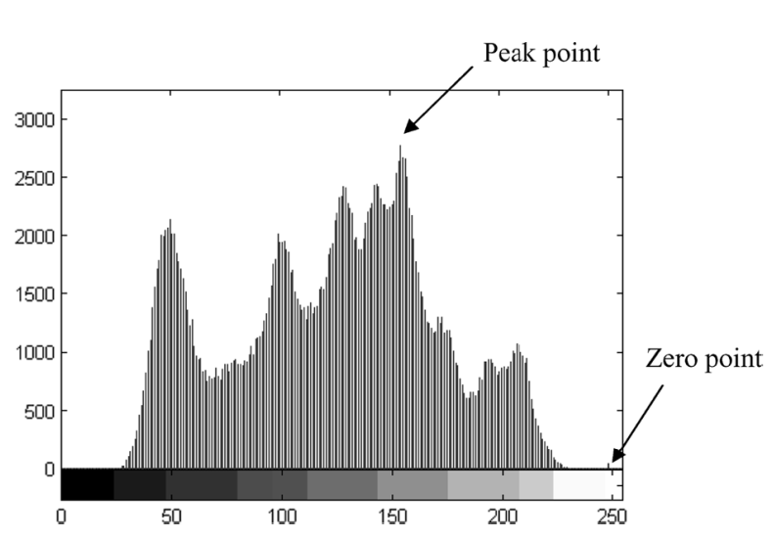
Related works – histogram shifting (1/7)
Step 1: Generate image histogram
(P)
Histogram
(Z)
Original gray image
Histogram of Lena image
Source: Zhicheng Ni, Yun-Qing Shi, Nirwan Ansari, and Wei Su, “Reversible Data Hiding”,
IEEE TRANSACTIONS ON CIRCUITS AND SYSTEMS FOR VIDEO TECHNOLOGY(16:3), 2006.
Notes:
<number>

Slide 6
Related works – histogram shifting (2/7)
Step 2: To shift the pixels of histogram
If P>Z → To shift the range of the histogram , [Z+1, P-1], to the left-hand side by 1 unit.
If P<Z → To shift the range of the histogram , [P+1, Z-1], to the right-hand side by 1 unit.
-------------------------------------------------------------------------------------
Step 3: To hide the secret data by pixels P
If P>Z → To be embedded bit is “1”, the pixel value is changed to P-1. If the bit is ”0”, the pixel value remains.
If P<Z → To be embedded bit is “1”, the pixel value is changed to P+1. If the bit is ”0”, the pixel value remains.
Notes:
<number>

Slide 7
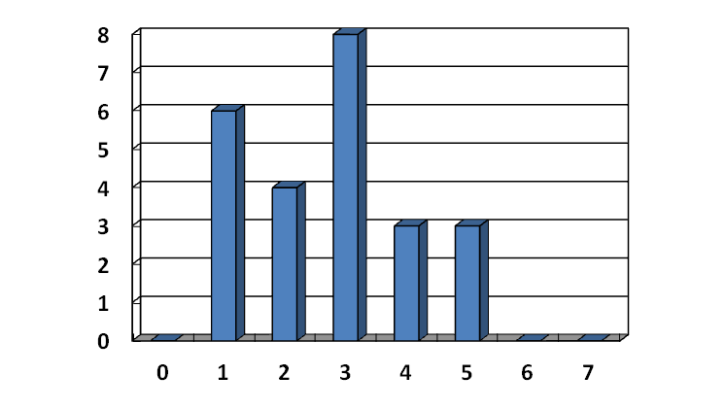
Related works – histogram shifting (3/7)
2 | 5 | 3 | 1 | 1
4 | 2 | 5 | 1 | 1
2 | 3 | 4 | 4 | 1
3 | 3 | 1 | 2 | 5
3 | 3 | 3 | 3 | 2
Original image
Peak point
Zero point
P=3, Z=6 and P<Z shift to right-hand
2 | 6 | 3 | 1 | 1
5 | 2 | 6 | 1 | 1
2 | 3 | 5 | 5 | 1
3 | 3 | 1 | 2 | 6
3 | 3 | 3 | 3 | 2
[3+1,6-1]
4 → 5
5 → 6
Notes:
<number>

Slide 8
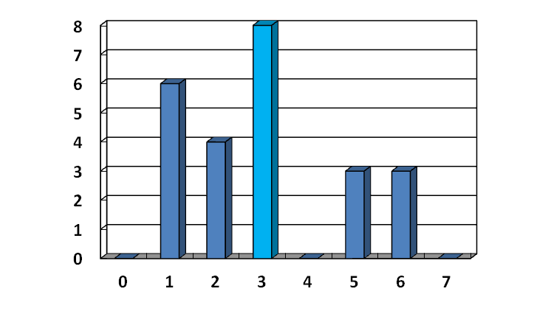
Related works – histogram shifting (4/7)
2 | 6 | 3 | 1 | 1
5 | 2 | 6 | 1 | 1
2 | 3 | 5 | 5 | 1
3 | 3 | 1 | 2 | 6
3 | 3 | 3 | 3 | 2
Secret bits: 1 1 0 0 1 1 0 1
2 | 6 | 4 | 1 | 1
5 | 2 | 6 | 1 | 1
2 | 4 | 5 | 5 | 1
3 | 3 | 1 | 2 | 6
4 | 4 | 3 | 4 | 2
Using P=3,
0 → 3
1 → 4
Marked image
Notes:
<number>

Slide 9
Related works – histogram shifting (5/7)
P=3, Z=6
2 | 6 | 4 | 1 | 1
5 | 2 | 6 | 1 | 1
2 | 4 | 5 | 5 | 1
3 | 3 | 1 | 2 | 6
4 | 4 | 3 | 4 | 2
2 | 6 | 4 | 1 | 1
5 | 2 | 6 | 1 | 1
2 | 4 | 5 | 5 | 1
3 | 3 | 1 | 2 | 6
4 | 4 | 3 | 4 | 2
Extracted secret bits:
1 1 0 0 1 1 0 1
Extract
3 → 0
4 → 1
Marked image
2 | 5 | 3 | 1 | 1
4 | 2 | 5 | 1 | 1
2 | 3 | 4 | 4 | 1
3 | 3 | 1 | 2 | 5
3 | 3 | 3 | 3 | 2
6 → 5
5 → 4
4 → 3 3 → 3
Recover
Original image
Notes:
<number>

Slide 10
Related works – histogram shifting (6/7)
Maximum and minimum points
2 | 5 | 3 | 0 | 0
4 | 2 | 5 | 1 | 6
2 | 3 | 4 | 4 | 7
3 | 3 | 1 | 2 | 5
3 | 3 | 3 | 3 | 2
Original image
maximum point
minimum point
Notes:
<number>

Slide 11
Related works – histogram shifting (7/7)
Multiple pairs
Example of 2 pairs.
2 | 5 | 3 | 0 | 0
4 | 2 | 5 | 1 | 6
2 | 3 | 4 | 4 | 7
3 | 3 | 1 | 2 | 5
3 | 3 | 3 | 3 | 2
Original image
Z2
P2
P1
Z1
Notes:
<number>

Slide 12
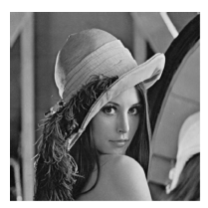
Thanks for your attention !
Notes:
<number>

