Slide 1
Artificial Intelligence Project Presentation
3D Tic Tac Toe
BY
DEEPESH CHUGH
2017UCO1692

Slide 2
Motivation
  First Topic Covered
  Familiarity with topic
  Interest In Game Development

Slide 3
Technique Used
Technology Used
Minimax Algorithm
Python with PyGame

Slide 4
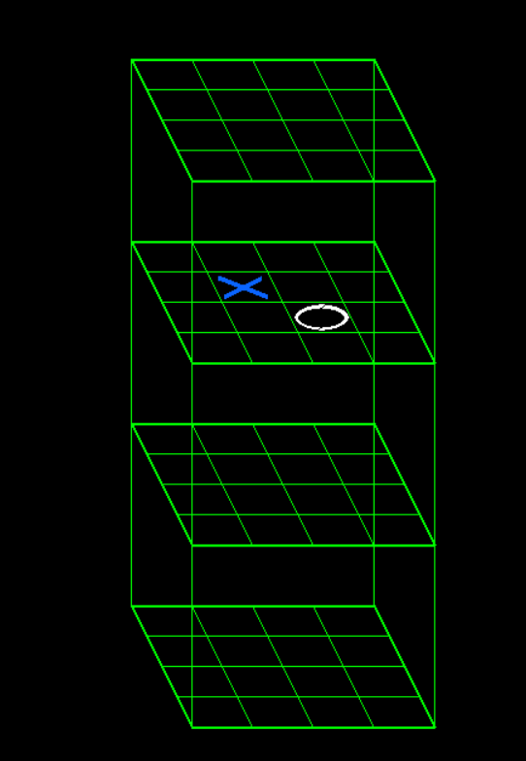
State Space Description
4X4X4 GRID
Blank , X or O in Cell
4³ = 64 Cells
3 States Per Cell
3⁶⁴ ~ 3.4 x 10³⁰ States

Slide 5
Issues Faced
  Limited Depth
  Input and Output
if-else Chain
PyGame

Slide 6
Block Diagram
Start
Evaluate Blank Cells
Let Player Play
Find Move
Using if-else
Chain
Found
Move?
Win
State?
NO
NO
YES
YES
Declare Winner
Play Move
YES
Win
State?
Stop
NO

Slide 7
if-else Chain
Comparison To More Depth
  Two in a row
  Center of whole grid
  Center of single grid
  Random
  Equivalent in win rate, too slow
  Equivalent in time, lower win rate

Slide 8
Final Thoughts
  Scope For Improvement
  Giving Player Space
  Developing Variations

Slide 9
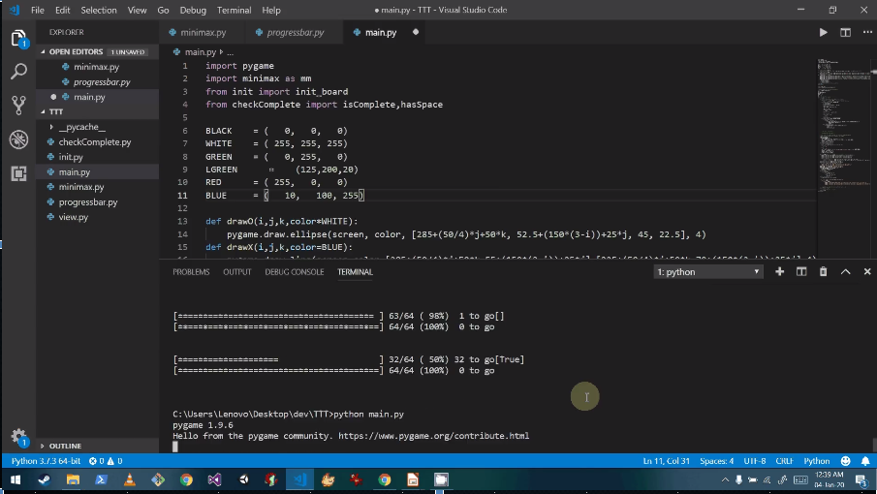
AI In Action

Slide 10
AI In Action

Slide 11
THANK YOU

