Slide 1


Slide 2



PCL: Proxy-based Contrastive Learning for Domain Generalization
Xufeng Yao¹, Yang Bai¹, Xinyun Zhang¹, Yuechen Zhang¹, Qi Sun¹, Ran Chen¹, RuiYu Li², Bei Yu¹
¹The Chinese University of Hong Kong
²SmartMore
{xfyao,byu}@cse.cuhk.edu.hk
May. 27, 2022
2/19

Slide 3
Background and Motivation

Slide 4
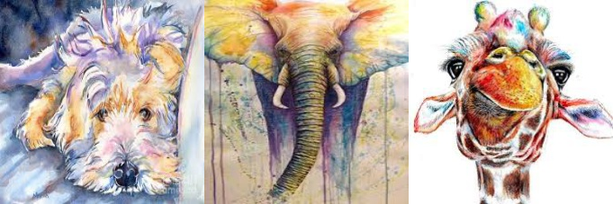
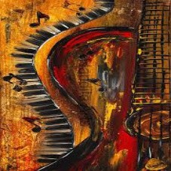
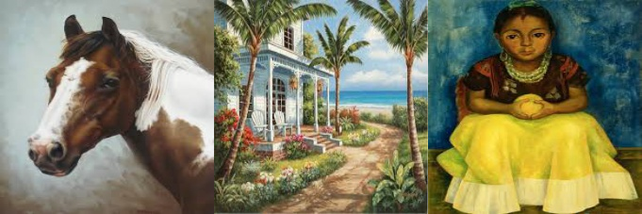
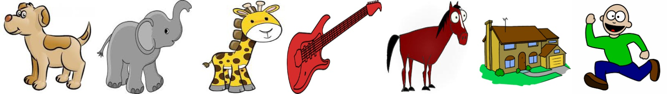
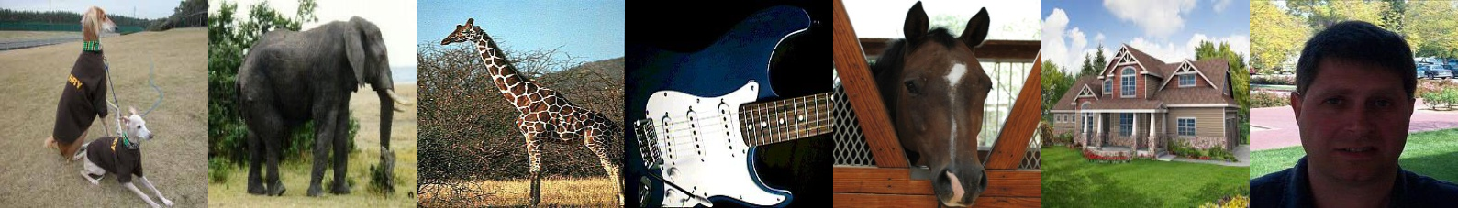
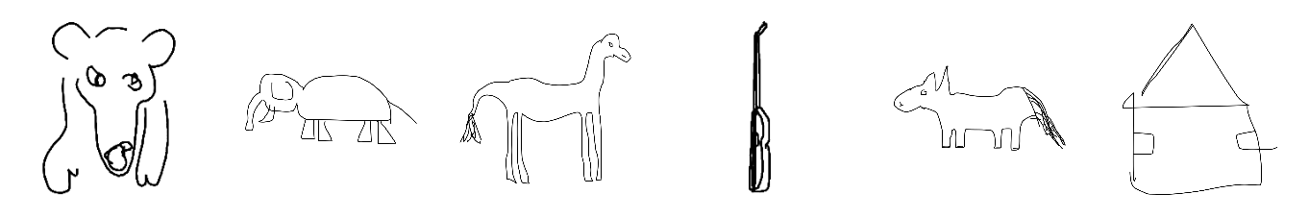
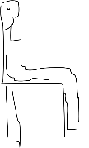


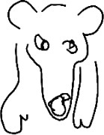
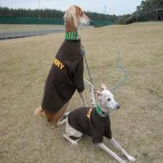
Background of Domain Generalization
Art
Cartoon Photo Sketch
Typical DG benchmark, i.e., pacs
Similarity
Similarity
_{z}q
_{z}k _{z}q
w₊
encoder q
encoder k
encoder q
Target proxy
_{x}q _{x}k
contrastive-based loss
_{x}q
proxy-based contrastive loss
DG aims to train a model from multiple source domains that can generalize well on target domain.
Contrastive learning offers a potential solution, but is not effective in DG.
We aims to use proxy-based contrastive learning to address the problem.
4/19

Slide 5


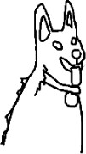
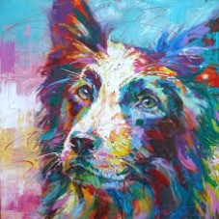


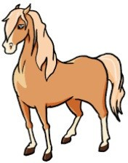
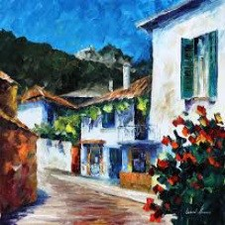
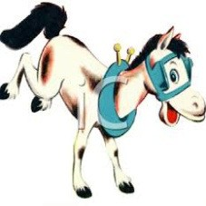
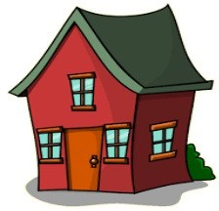
Comparison between two losses
x₊
proxy
w₊
dog
x_{q}
x_{q}
Hypersphere
Hypersphere
—
proxy
—
proxy
—
Horse
House
—
—
—
(a) Contrastive-based Loss
(b) Proxy-based Loss
Contrastive loss: sample-to-sample pairs
Proxy loss: proxy-to-sample pairs

Slide 6
Complexity comparison
Loss function | positive pair | negative pair | relations | category | training complexity
softmax CE loss | (w_{y}, x_{i}) | (w₁, x_{i}), (w₂, x_{i}), ..., (w_{j}, x_{i}) | proxy-to-sample | proxy-based | O(CN)
Contrastive loss | (x_{i}, x∗) i | (x_{i}, x₁), (x_{i}, x₂), ..., (x₁, x_{n}) | sample-to-sample | pair-based | O(N²)
MS Loss | (x_{i}, x_{j})...(x_{i}, x_{m}) | (x_{i}, x₁), (x_{i}, x₂)...(x₁, x_{n}) | sample-to-sample | pair-based | O(N²)
triplet Loss | (x_{i}, x_{j})...(x_{i}, x_{m}) | (x_{i}, x₁), (x_{i}, x₂)...(x₁, x_{n}) | sample-to-sample | pair-based | O(N³)
Pair-based loss: rich sample-to-sample pairs, high complexity
Proxy-based loss: low complexity, high generalization

Slide 7
Proxy-based Contrastive Learning

Slide 8
Review of softmax CE Loss
Review of softmax CE loss
Pros: Learn a proxy for each classes efficiently.
Pros: Low complexity, safe convergence.
Cons: Miss rich sample-to-sample pairs.
exp(w^{T}z_{i})
L_{CE} = − log
Σ
c
,
(1)
exp(w^{T}z_{i}) +
C—1
j=1
T
exp(w z )
c
j
i

Slide 9
Review of Contrastive Loss
Review of Contrastive loss
Pros: Leverage dense sample-to-sample pairs.
Pros: Implicit hard pair mining.
Cons: High complexity, unstable convergence.
exp(z^{T}z₊ · α)
i
L = − log
Σ
(2)
CL
T
T
exp(z z · α) + exp(
z z · α),
i
+
i
—

Slide 10
Hard pair mining
Implicit hard pair mining in contrastive loss
By controlling α, contrastive loss implicitly conduct hard pair mining.
Sufficient pairs guarantee the performance.
1
exp(α · s_{p})
L_{CL} = lim − log(
Σ
)
α→∞ α
exp(α · s ) +
N—1 j
j=1
exp(α · s )
p
n
Σ
1
N—1
(3)
j
= lim log(1 + exp(α(s − s )))
α→∞ α
n p
j=1
= max[s^{j} − s ] ,
n p +

Slide 11
Gradient Analysis
High complexity may impede the performance
∂L ∂L ∂L ∂L
_{s}a
_{s}b
_{s}c
_{s}d
…
n
n
n
n
Negative A
Negative B
Negative C
Negative D
…
0
N−1
∂L ∂L s_{p}
∂L s_{p}
X
_{s}j
= | |
…
j=1
n
∂L s_{p}
Gradients of the positive similarity score
gradients analysis

Slide 12
Our solution
Combine Softmax CE and Conrtastive Loss
Softmax: Low complexity, overlook sample-to-sample pairs
Contrastive: High complexity, rich pairs, unstable convergence.
N
1 ^{Σ} exp(w^{T}z_{i} · α)
L_{PCL} = −_{N} log
c
Z
,
(4)
i=1
where Z is given by:
Σ
Σ
j=1,j/=i
C—1
K
Z = exp(
T
T
T
w z · α) + exp(
w z · α) +
exp(
z z · α).
(5)
c
i
k
j
i
j
k=1

Slide 13
Experimental Results

Slide 14
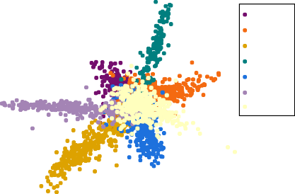
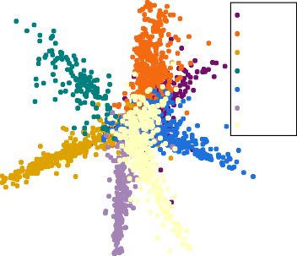
Visualizaiton of learned features
Baseline
PCL
40
dog elephat giraffe guitar horse
house person
40
dog elephat giraffe guitar horse
house person
20
20
0
0
−20
−20
−40
−40
−60 −40 −20 0
20 40 60
−60 −40 −20 0
20 40 60
softmax
Ours
14/19

Slide 15
Experimental Results
Table: Comparison with state-of-the-art methods on OfficeHome benchmark with ResNet-50 imagenet-pretrained model
Algorithm | A | C | P | R | Avg
Mixstyle¹ | 51.1 | 53.2 | 68.2 | 69.2 | 60.4
SagNet² | 63.4 | 54.8 | 75.8 | 78.3 | 68.1
CORAL³ | 65.3 | 54.4 | 76.5 | 78.4 | 68.7
SWAD⁴ | 66.1 | 57.7 | 78.4 | 80.2 | 70.6
Ours | 67.3 | 59.9 | 78.7 | 80.7 | 71.6
¹Zhou; Kaiyang; et al. Domain generalization with mixstyle. ICLR 2021..
²Nam; Hyeonseob; et al. Reducing domain gap by reducing style bias. CVPR. 2021..
³Sun; Baochen;
and Kate Saenko. Deep coral: Correlation alignment for deep domain adaptation. ECCV; 2016..
⁴Cha; Junbum; et al. Swad: Domain generalization by seeking flat minima. NeurIPS; 2021..

Slide 16
Experimental results
Table: Comparison with state-of-the-art methods on PACS benchmark with ResNet-50 imagenet-pretrained model
Algorithm | A | C | P | S | Avg.
Mixstyle⁵ | 86.8 | 79.0 | 96.6 | 78.5 | 85.2
CORAL⁶ | 88.3 | 80.0 | 97.5 | 78.8 | 86.2
SagNet⁷ | 87.4 | 80.7 | 97.1 | 80.0 | 86.3
SWAD⁸ | 89.3 | 83.4 | 97.3 | 82.5 | 88.1
Ours | 90.2 | 83.9 | 98.1 | 82.6 | 88.7
⁵Zhou; Kaiyang; et al. Domain generalization with mixstyle. ICLR 2021..
⁶Sun; Baochen;
and Kate Saenko. Deep coral: Correlation alignment for deep domain adaptation. ECCV; 2016..
⁷Nam; Hyeonseob; et al. Reducing domain gap by reducing style bias. CVPR. 2021..
⁴Cha; Junbum; et al. Swad: Domain generalization by seeking flat minima. NeurIPS; 2021..

Slide 17
Experimental Resutls
Table: Comparison with state-of-the-art methods on TerraIncognita benchmark with ResNet-50 imagenet-pretrained model
Algorithm | Location100 | Location38 | Location43 | Location46 | Avg.
Mixstyle⁹ | 54.3 | 34.1 | 55.9 | 31.7 | 44.0
CORAL¹⁰ | 51.6 | 42.2 | 57.0 | 39.8 | 47.7
SagNet¹¹ | 53.0 | 43.0 | 57.9 | 40.4 | 48.6
SWAD¹² | 55.4 | 44.9 | 59.7 | 39.9 | 50.0
Ours | 58.7 | 46.3 | 60.0 | 43.6 | 52.1
⁹Zhou; Kaiyang; et al. Domain generalization with mixstyle. ICLR 2021..
¹⁰Sun; Baochen;
and Kate Saenko. Deep coral: Correlation alignment for deep domain adaptation. ECCV; 2016..
¹¹Nam; Hyeonseob; et al. Reducing domain gap by reducing style bias. CVPR. 2021..
¹²Cha; Junbum; et al. Swad: Domain generalization by seeking flat minima. NeurIPS; 2021..
17/19

Slide 18
Experimental Results
Table: Comparison with state-of-the-art methods on DomainNet benchmark with ResNet-50 ImageNet pre-trained model
Algorithm | clip | info | paint | quick | real | sketch | Avg
Mixstyle¹³ | 51.9 | 13.3 | 37.0 | 12.3 | 46.1 | 43.4 | 34.0
SagNet¹⁴ | 57.7 | 19.0 | 45.3 | 12.7 | 58.1 | 48.8 | 40.3
CORAL¹⁵ | 59.2 | 19.7 | 46.6 | 13.4 | 59.8 | 50.1 | 41.5
SWAD¹⁶ | 66.0 | 22.4 | 53.5 | 16.1 | 65.8 | 55.5 | 46.5
Ours | 67.9 | 24.3 | 55.3 | 15.7 | 66.6 | 56.4 | 47.7
¹³Zhou; Kaiyang; et al. Domain generalization with mixstyle. ICLR 2021..
¹⁴Nam; Hyeonseob; et al. Reducing domain gap by reducing style bias. CVPR. 2021..
¹⁵Sun; Baochen;
and Kate Saenko. Deep coral: Correlation alignment for deep domain adaptation. ECCV; 2016..
¹⁶Cha; Junbum; et al. Swad: Domain generalization by seeking flat minima. NeurIPS; 2021..
18/19

Slide 19
THANK YOU!

