Slide 1

Application simplification with machine learning techniques
Presented by : Johnny Peng
SID: 440278452
Supervised by : Dr.Xu Chang

Slide 2
Context
Motivation & Objective
Data
Related work & Background study
Approach & Results & Evaluation
Generalise to real world problem
Conclusion & Further research

Slide 3
1. Motivation & Objective
Motivation 1 : Long list of unnecessary questions in the legacy applications create inconvenience for the customers.
Motivation 2 : Companies accumulated tons of application data over time, we need to find a way to turn them into something that is useful for the business.
Objective: Creating an approach for designing shorter & cohort-based applications with existing application data.

Slide 4
2. Data – Application Data
Application data generally comprise following 3 components:
Application Questions – Questions designed for the applicants/customers to fill in, which will help the service provider to understand the applicant’ situation and determine the application outcome.
Application Answers – Responses from the applicant to the application questions, note that depending on the circumstances, not all application questions will be answered.
Application Outcomes – Service provider’s decision on whether to go ahead with providing the service to the applicants.
Overall, the main characteristics of the application data is high-dimensional, and highly sparse.

Slide 5

2. Data – Data Source
Applications are generally designed to acquire personal data from the customer, and hence application data usually cannot be found from public source.
Alternatively, we have found an interesting web-based game call “Akinator”, which can be potentially treated as a public source of application data, and we are able to collect with a web bot.

Slide 6

2. Data – Akinator
Akinator is a gene who can guess any animals in players’ mind after asking 20-30 questions to the player.
At the end of each of question, depending on the answers given by the player, the follow up question may vary.

Slide 7
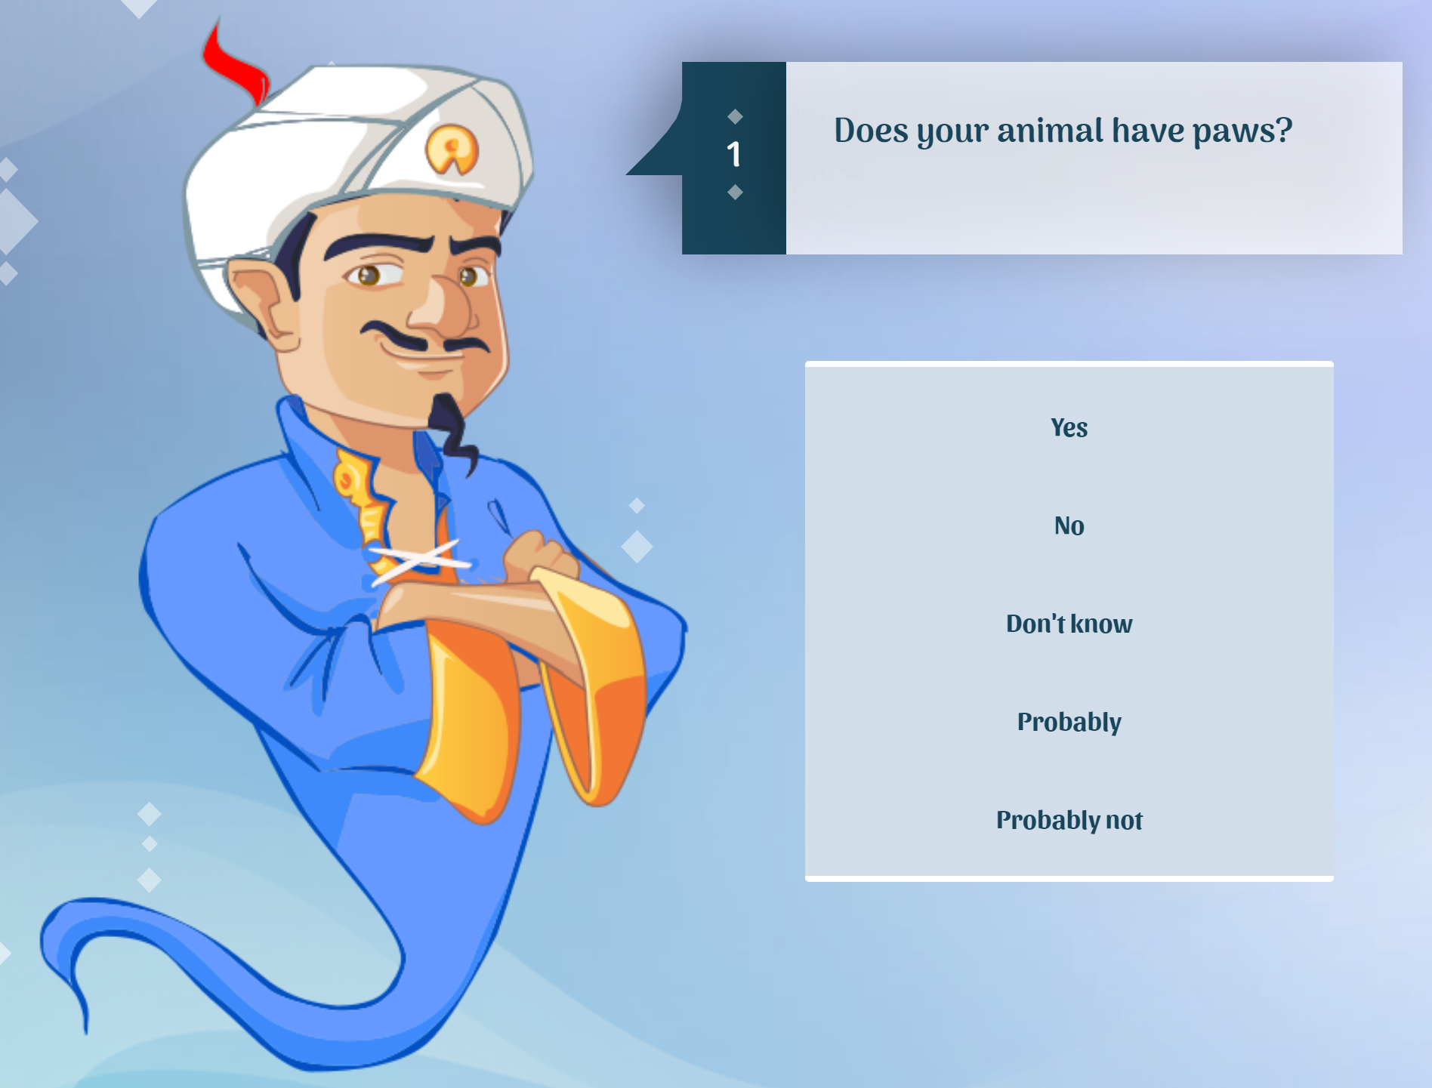
2. Data – Akinator
Application Questions
There are only 5 possible answers, “Yes”, “No”, “Don’t know”, “Probably”, and “Probably not” can be chosen as the response to the questions from Akinator.
After certain number of questions, the Akinator will give his best guess.
Application Answers

Slide 8
2. Data – Assumptions
Following assumptions are made for simplifying our research.
Only “Yes” or “No” will be selected as the answers by the web bot.
All guess from Akinator will be treated as the correct guess.

Slide 9
2. Data – Components
In the context of Akinator, following are the components that made up our application data.
Application Questions – 609 unique questions asked by Akinator.
Application Answers – Answers selected by the web bot. Possible value includes “Yes”, “No”, and N/A.
Application Outcome – 95 unique animal guessed by Akinator.

Slide 10
3. Related work & background study
There is work been done related to the application data, but the objective is totally different to ours.
We will be using clustering methods and decision tree classifier for this research; hence we have focused on reviewing existing clustering methods and decision tree algorithms.
Clustering: K-means clustering, Hierarchical clustering with different linkage functions will be discussed.
Decision tree: ID3, C4.5, CART are reviewed and will be discussed in the research process.

Slide 11

4. Approach/Framework
Following steps form the general framework of creating the cohort-based application forms.
Construct the one-fits-all application form (benchmark).
Create clusters
Create cohort-based application form based on the samples in each clusters
Evaluation

Slide 12
4.1 Construct the one-fits-all application form
The idea is simple - Fit a decision tree on the existing application data to represent the one-fits-all application form. But how can we handle the missing values?
While ID3 decision tree cannot handle missing values, C4.5 and CART decision tree both have their own ways of handling missing values.

Slide 13
4.1.1 Handling Missing Values – C4.5
Distribute to all children, but with diminished weights, proportional with the number of instances from each child node. (C4.5)
Problem with this approach: This approach did not consider the features (other than the primary split) of those distributed data point, and added unwanted randomness into our research result.

Slide 14
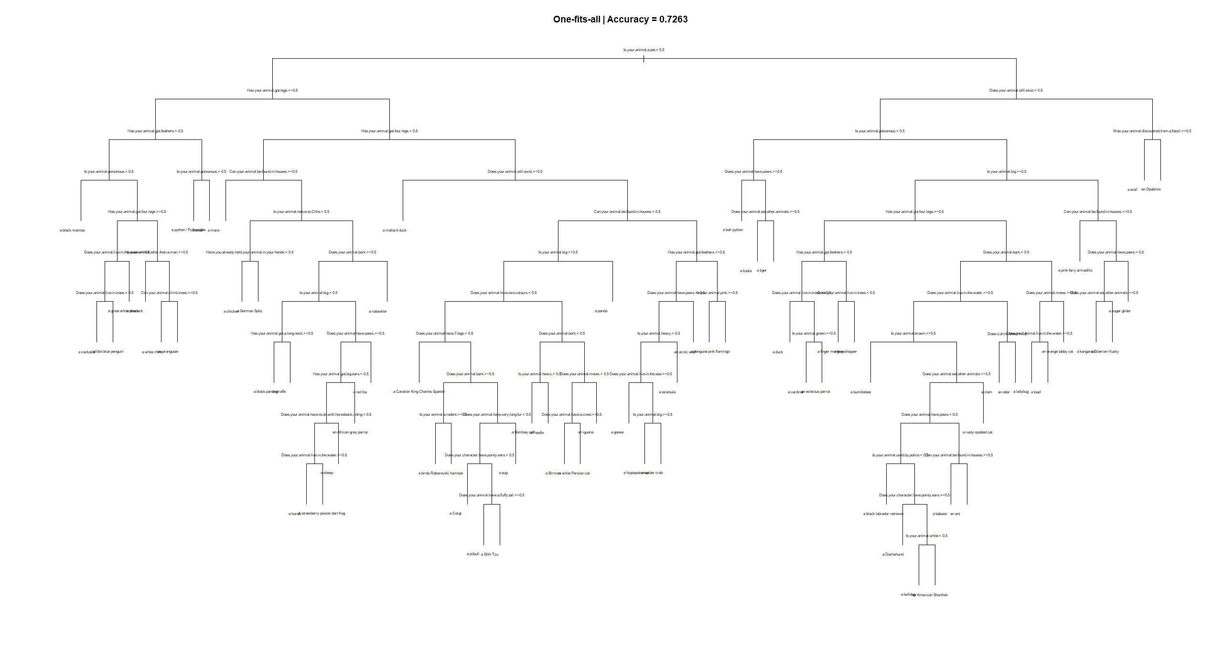
4.1.2 Handling Missing Value - CART
Use surrogates to split subjects missing the primary variable; if all surrogates are missing, then send the observation in the majority direction.
+ No randomness in result
+ Other features are considered.
Surrogate splits were used 86 times in total.

Slide 15
4.2 Create Clusters - Goal
Why accuracy is still less than 1 when number of features is more than number of sample? Surrogate splits are imperfect.
Why do we need surrogate splits? -> There are missing values in data
Where are the missing values come from? -> The mismatch in features between samples.
Goal: The samples in each clusters should have a lot of overlaps in features, so the missing values and the use of surrogate splits can be minimized.

Slide 16
4.2 Create Clusters – Latent data set
In order to create clusters that fits our goal. We will first create latent data set based on the application data. The features in the latent data set will have a value of 1 if a question was asked, else (when missing) it will has a value of 0.

Slide 17
4.2 Create Clusters – Clustering methods
Then we can run clustering methods on the latent dataset to group samples that is similar in terms of questions asked.
K-means clustering or Hierarchical clustering? Due to time constraint we won’t test both.
We will be using Hierarchical clustering since we lack of domain knowledge to pick K.
What linkage/distance function?
Ward’s Method

Slide 18
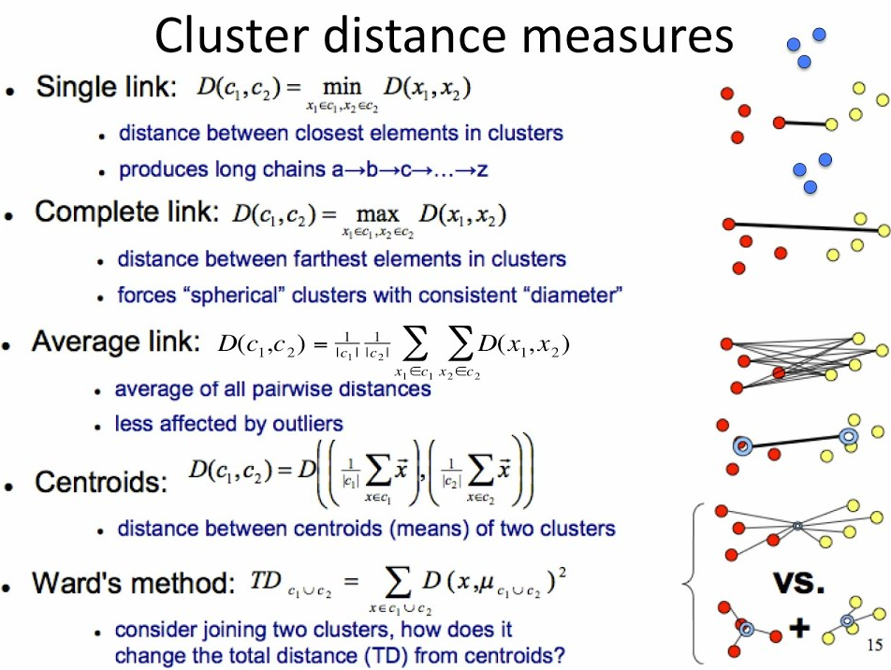
4.2 Create Clusters – Ward’s method
There are a few different linkage function available, but after trial and error we found ward’s method shows the best result.

Slide 19
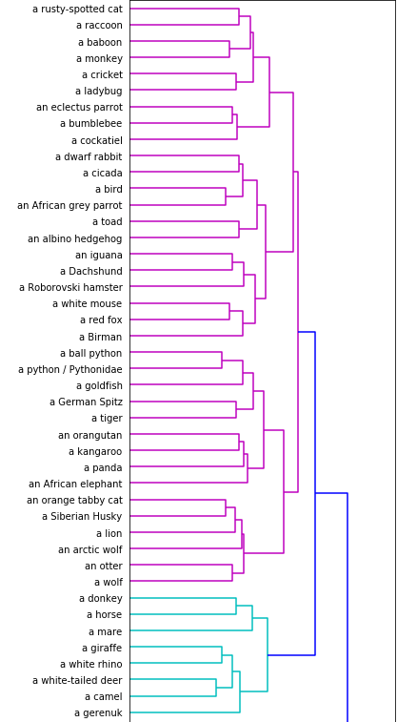
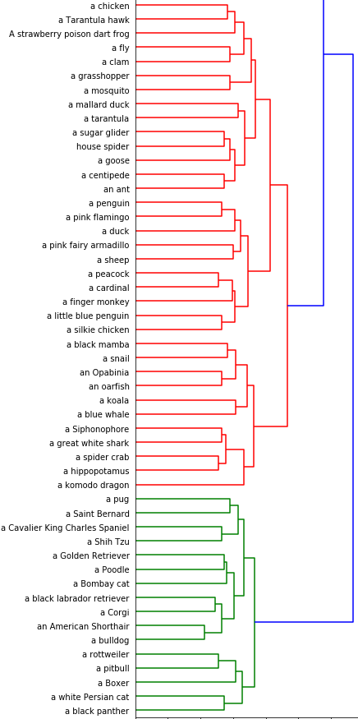
4.2 Create Clusters – Results
There 4 clusters in total, but only two clusters have obvious commonality between the in-cluster samples.
More clusters can be found if we have more data or have the time to look at the clustering in dimensions other than Animal Name.
Animals with Hoof
Dogs &
Cats

Slide 20
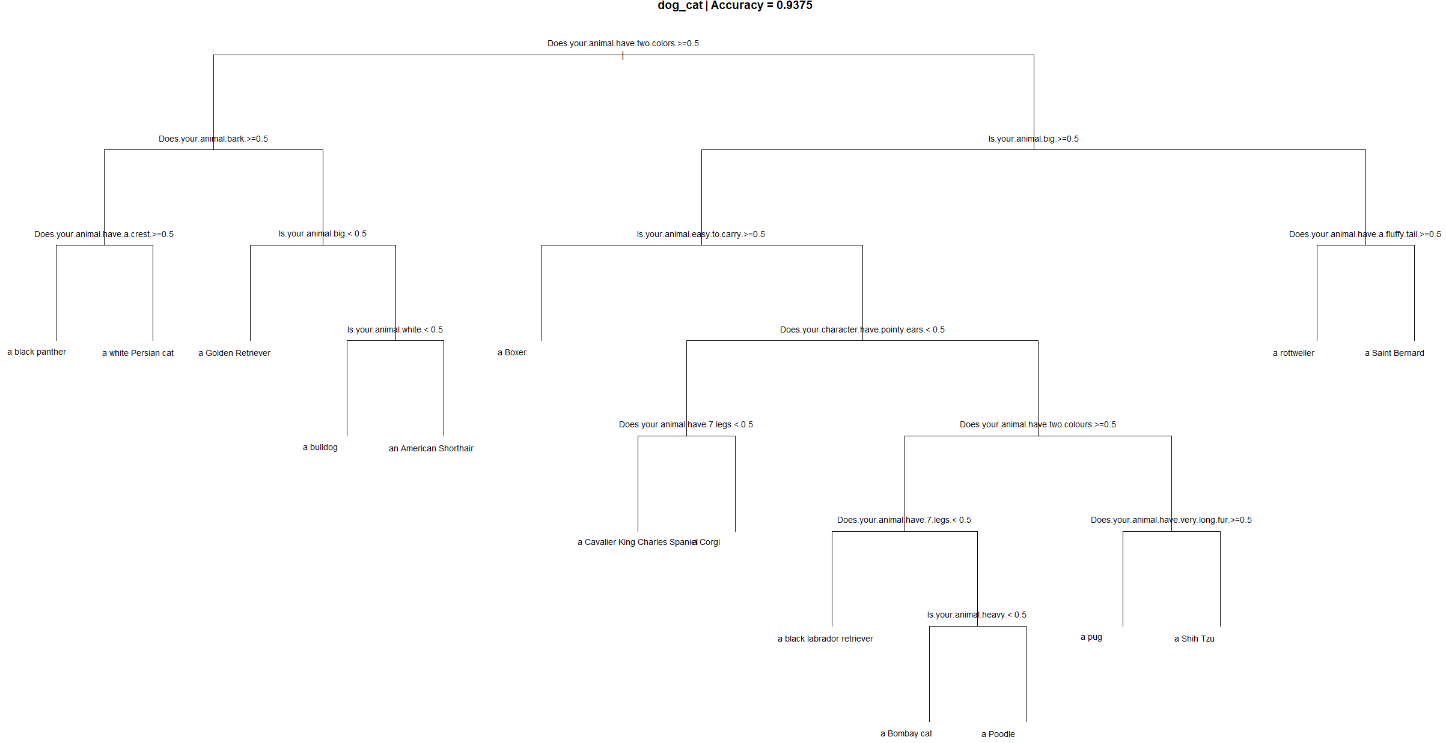
4.3 & 4.4 Evaluation of Cohort Based DT - Dog & Cat
Accuracy: 0.9375
Average number of splits:5.625
Surrogate splits were used 5 times in total.
One-fits-all accuracy: 0.875
One-fits-all average number of splits:10.214

Slide 21
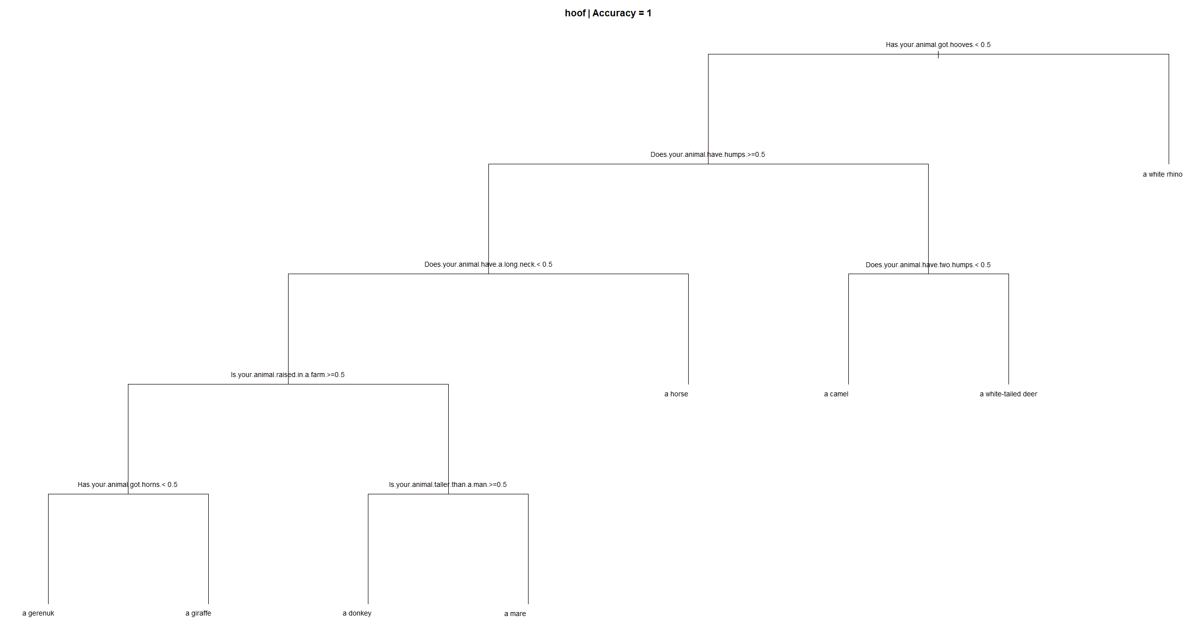
4.3 & 4.4 Evaluation of Cohort Based DT - Hoof
Accuracy: 1
Average number of splits:3.75
No surrogate splits are used
One-fits-all accuracy: 0.625
One-fits-all average number of splits:7.5

Slide 22
6. Generalise to real world problem – Major Differences
Now we have showed that this approach is able generate new set of shorter and more accurate cohort-based application form. This is good enough for our toy dataset, but how robust is this approach when solving real world problem?
Following are some of major differences in the real-world situation.
Less classes – There will be just “Approved”, “Declined”, “Refer to Underwriter” etc. which is much less than 95 class of animals.
More possible answers – Apart from “Yes” or “No”, we may have numerical answers. For example, questions like “How old are you?” and “How many years have you been driving?” will require a numerical answers from the customers.
Much more data – Corporations accumulated a lot of application data over time, definitely will have more than what we have in the toy dataset (95 data points).
Existing benchmark – No need to construct the one-fits-all application form as our benchmark, there probably is existing legacy application form and rules to determine the application outcomes, which will have an accuracy of 1 of course, hence the business goal then became build a new application form and rules that is shorter and has an accuracy of 1.

Slide 23
6. Generalise to real world problem – Holdout dataset
When dealing with real-world problem, the stake involved can be very high, how can we be sure that this new application form has captured all the important questions without testing it on a holdout data set?
The truth is holdout dataset is actually not that useful for our purpose, because imagine if we implemented this new set of application form, all the new application data we collected should not have missing values. whereas if we test this new application using the past application data, we may have the issue of missing values in holdout data and hence underestimate the accuracy of the new application form.

Slide 24
6. Generalise to real world problem – Communication
Instead of using holdout dataset, following the additional steps below will help us to build a more relevant application and safeguarding against mistakes:
During the development stage - Continuous communication with the relevant business department to understand about the business product and what sort of clusters label will make senses e.g. by product, by gender.
After the draft new application from is generated - Cooperation with relevant business departments to inspect the new application form with logical induction and domain knowledge, and overwrite certain application questions if necessary.

Slide 25
7. Conclusion & Further research
We have proved that this approach can works well on our toy dataset by producing shorter and more accurate cohort-based application forms.
More research should be done around generalising this approach to the real-world business cases, where we can test this approach on a larger and more realistic dataset.

