Slide 1

YouTube
Trending Videos Categorization with Deep Learning

Slide 2
Can machine categorize videos simply base on their thumbnails and video titles?
Question/hypotheses

Slide 3

Thumbnail:
Title:
Founding An Inbreeding-Free Space Colony
+
The task:
How hard is it?
Friend 1:
“Science and Technology”
Categories:
Entertainment
Music
How to and Style
Comedy
News and Politics
People and Blogs
Sport
Science and Technology
Film and Animation
Education
Pets and Animals
Gaming
Auto & Vehicles
Travel and Events
Friend 2:
“Gaming”
Grand Truth:
“Education”

Slide 4
Human-level Performance Experiment results with my friend (~100 trials):
With only images:
30% accuracy
With only titles:
50% accuracy
With both images and titles:
54% accuracy

Slide 5

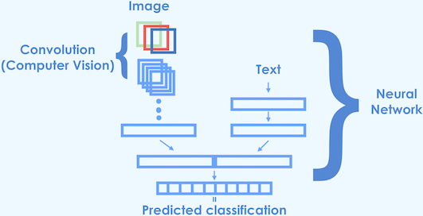


NLP (Titles) + CV (Thumbnails)
1. Build separate models as a independent NLP/CV problem
2. Then combining two models with one dense output layer

Slide 6
Data (5,000 training data + 1,020 test data)
Labels - 14 unique video categories, converted into one hot vector format.
Image data - 120 x 90 x 3 matrix with the numbers representing the brightness of the 120 x 90 pixies for each of the RGB channels.
Text data – Video titles, each word in the title will be converted to a 50-dimensional vectors by using word embedding pre-trained on 2 billion tweets with 1.2 million vocabularies.

Slide 7
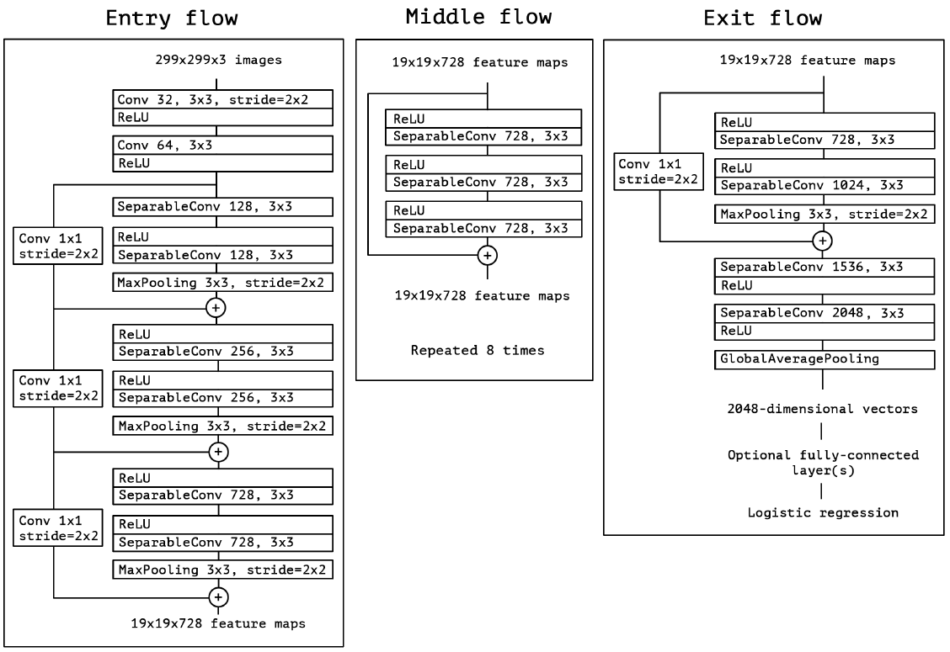
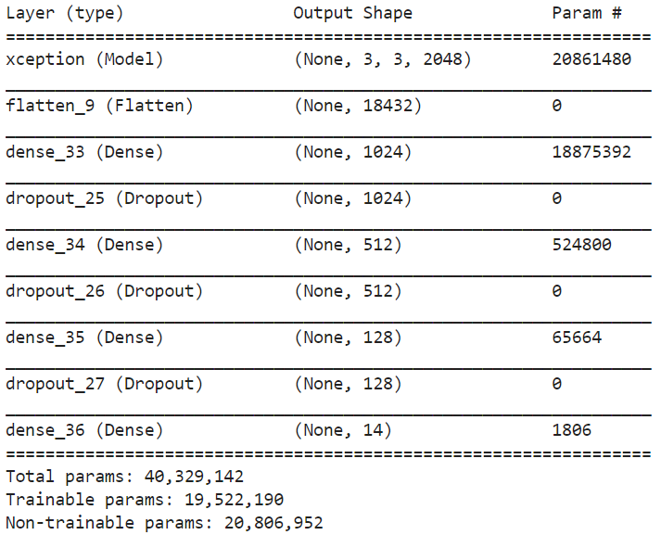
Approach for Image model Xception model with transfer learning
Optimizer: Adam (adaptive moment)
Regularization: Dropout layers

Slide 8
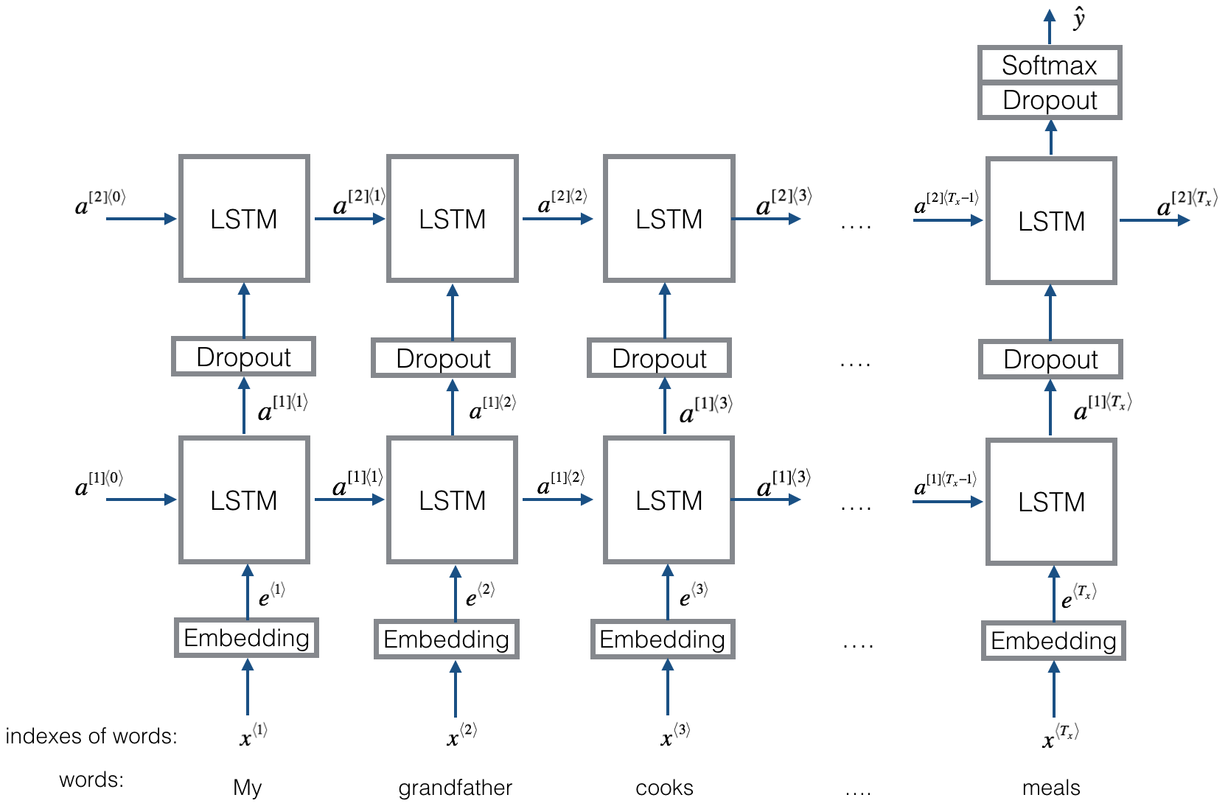
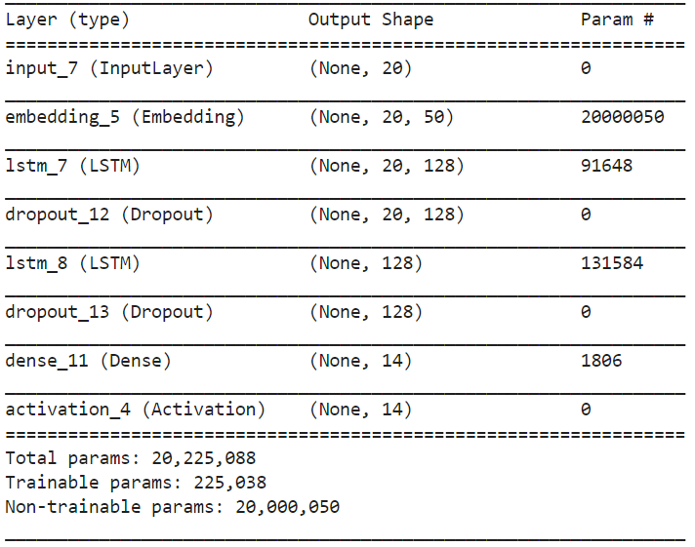
Approach for Text model 2 layers LSTM sequence classifier
Optimizer: Adam (adaptive moment)
Regularization: Dropout layers

Slide 9
Goals Evaluation Metrics
Human-level performance
Top-1 accuracy
Top-5 accuracy
Confusion matrix

Slide 10
Top-1 & top-5 accuracy After fine tuning the hyperparameters:
With only images:
Top-1: 30.39% accuracy
TOP-5: 73.14% accuracy
Goal: 30%
With only titles:
Top-1: 51.18% accuracy
Top-5: 85.78% Accuracy
Goal : 50%
With both images and titles:
TOP-1: 45.30% accuracy
TOP-5: 84.22% accuracy
Goal: 54%

Slide 11
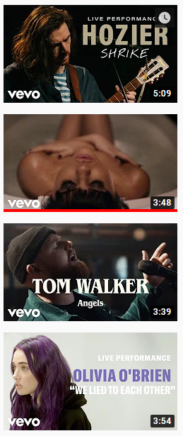
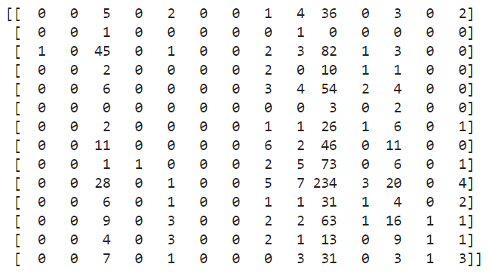
1. Confusion Matrix for Image model
Science and Technology
Education
How to and Style
News and Politics
Entertainment
Comedy
People and Blogs
Gaming
Travel and events
Sport
Pets and Animals
Music
Auto & Vehicles
Films and Animation
Film and Animation
Auto & Vehicles
Music
Pets and Animals
Sport
Travel and events
Gaming
People and Blogs
Comedy
Entertainment
News and Politics
How to and Style
Education
Science and Technology
Grand Truth

Slide 12
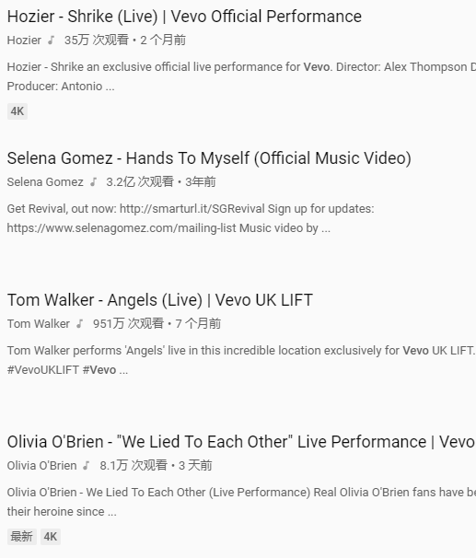
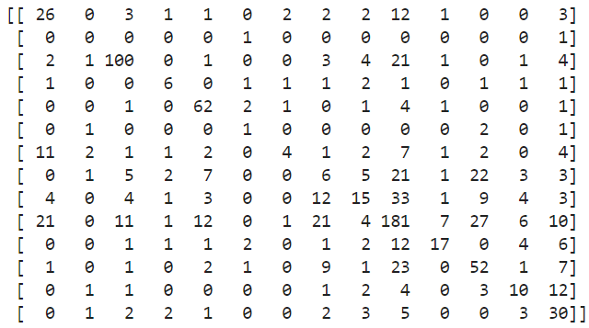
2. Confusion Matrix for Text model
Science and Technology
Education
How to and Style
News and Politics
Entertainment
Comedy
People and Blogs
Gaming
Travel and events
Sport
Pets and Animals
Music
Auto & Vehicles
Films and Animation
Film and Animation
Auto & Vehicles
Music
Pets and Animals
Sport
Travel and events
Gaming
People and Blogs
Comedy
Entertainment
News and Politics
How to and Style
Education
Science and Technology
Grand Truth

Slide 13
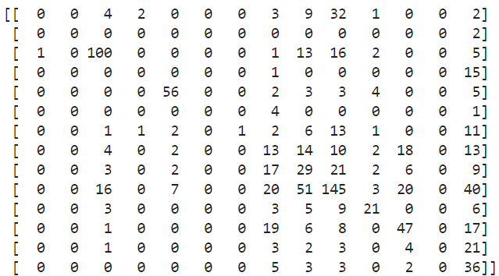

3. Confusion Matrix for Combined model
Science and Technology
Education
How to and Style
News and Politics
Entertainment
Comedy
People and Blogs
Gaming
Travel and events
Sport
Pets and Animals
Music
Auto & Vehicles
Films and Animation
Film and Animation
Auto & Vehicles
Music
Pets and Animals
Sport
Travel and events
Gaming
People and Blogs
Comedy
Entertainment
News and Politics
How to and Style
Education
Science and Technology
Grand Truth

Slide 14
Possible Future Directions
Auto tagging models for videos
Better architectures to connect text and image data
More data to evaluate the model and human-level performance
Deal with class imbalance

