Slide 1
Image Segmentation – the search for the perfect split
By Jonathan Reich
Supervisor: Dr. Juan Nunez-Iglesias

Slide 2
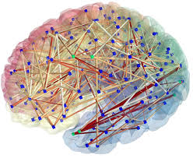
Why do we need to segment data?
Field of connectomics
A map of the neural connections in the brain and understanding how the brain works.
http://www.cmtk.org/viewer/

Slide 3
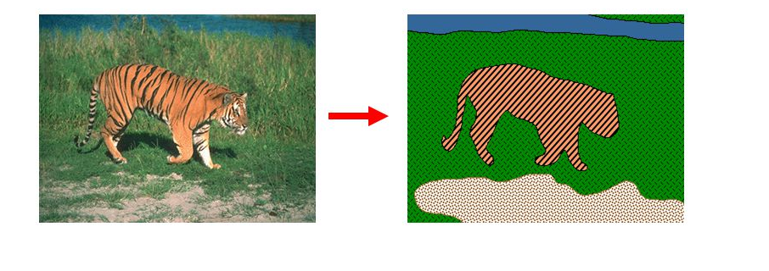
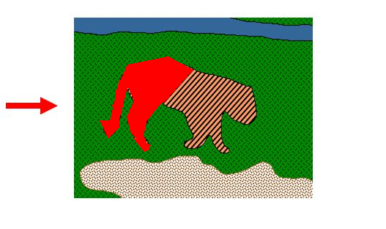
What is a segmentation?
Human-labelled segmentations
Automatic segmentations
Ideal Segmentation
Segmentation with errors
False Split

Slide 4
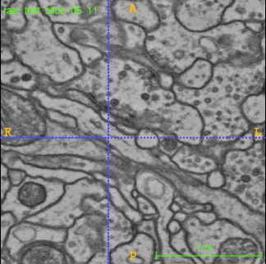
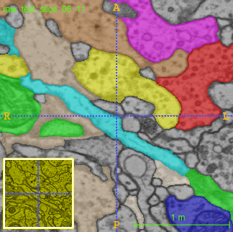
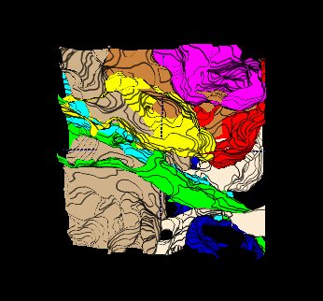
Segmented Neurons
Aim of segmentation – to obtain an idealised version of the segmented neurons.
Human-labelled segments
3D rendering of human-labelled segments
Raw

Slide 5
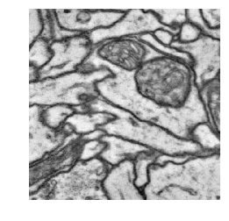
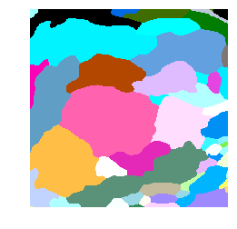
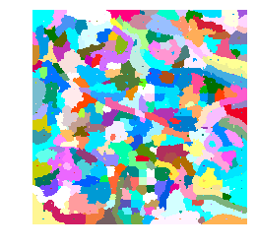
Comparison of GT and Automated Segmentation
Raw slice of original image
Human-labelled GT
Fragment Map (input for automated segmentation)
False Split

Slide 6
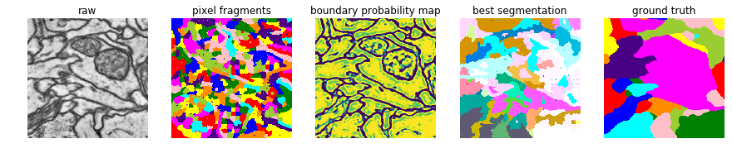
Methodology of performing a segmentation
Train a segmentation volume on human-labelled ‘ground truth’
Predict labels on an unseen volume from the same raw data
Verify the errors
TARGET

Slide 7
Segmentation pipeline
TARGET

Slide 8
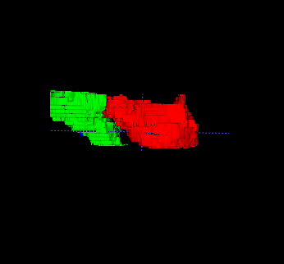
Merge Policy Function
Background on machine learning approach and what I am working on.
what is the probability of this merge?
F(
)->[0,1]

Slide 9
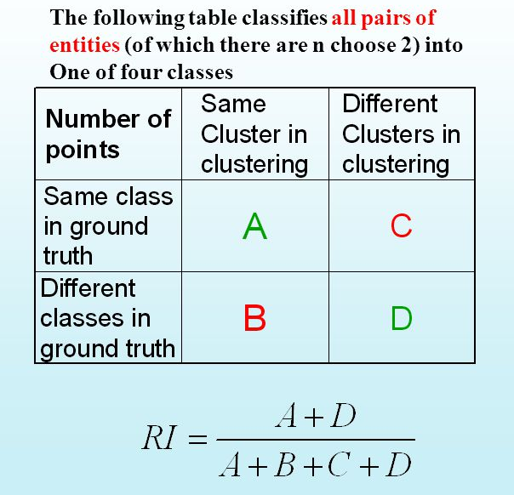
How do we improve performance?
Analysis of errors
Rand Index – gold standard and what is wrong with it.

Slide 10
Shortcomings of the Rand Index
May be good at a local level but not at a global level i.e. may not capture global structure
It captures the fact that most pixels are in different clusterings.
Ground Truth
Rand Index: 0.766
Automated Segmentation
1 | 2 | 3 | 4
2 | 3 | 4 | 5
3 | 4 | 5 | 6
4 | 5 | 6 | 7
4 | 3 | 2 | 1
5 | 4 | 3 | 2
6 | 5 | 4 | 3
7 | 6 | 5 | 4

Slide 11
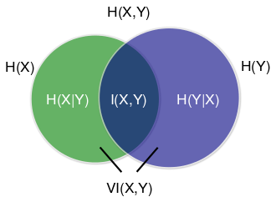
Mutual Information

Slide 12
VI calculation for H(S|T)
T (Ground Truth)
S (Automated Segmentation)
C
2
A
1
B
3

Slide 13
Variation of Information
Split VI: T as GT, S as automated seg.
False merges term: H(T|S)
False splits term: H(S|T)
Overall VI = H(S|T) + H(T|S), conditional entropies.

Slide 14
Contingency Table for H(S|T)
Joint Probabilities | Label 1 | Label 2 | Label 3 | Marginal Probabilities
Label a | 2 | 0 | 0 | 2
Label b | 2 | 0 | 0 | 2
Label c | 0 | 6 | 6 | 12
Marginal Probabilities | 4 | 6 | 6 | Joint Sum 16
C
2
Pij = proportion of pixels with label i from automated seg, and label j from GT. Joint probabilities = i∩j.
0.5log₂2 + 0.5log₂2 = 1 bit of info needed if there is a 50/50 chance of the pixel in question having different labels, where the coefficient is the joint probabilities divided by the marginal probabilities (which is equivalent to the conditional probabilities).
A
1
B
3

Slide 15
Normalised Contingency Table for H(S|T)
Joint Probabilities | Label 1 | Label 2 | Label 3 | Marginal Probabilities
Label a | 0.125 | 0 | 0 | 0.125
Label b | 0.125 | 0 | 0 | 0.125
Label c | 0 | 0.375 | 0.375 | 0.75
Marginal Probabilities | 0.25 | 0.375 | 0.375 | Joint Sum 1.0

Slide 16
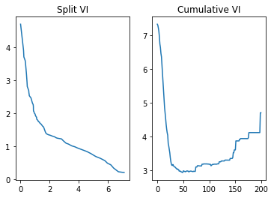
Interpreting the split-VI
Error measured in bits of entropy.
Generate different output segmentations with different threshold for merge policy.
Identify the lowest entropic segmentation.
Lowest cumulative VI

Slide 17
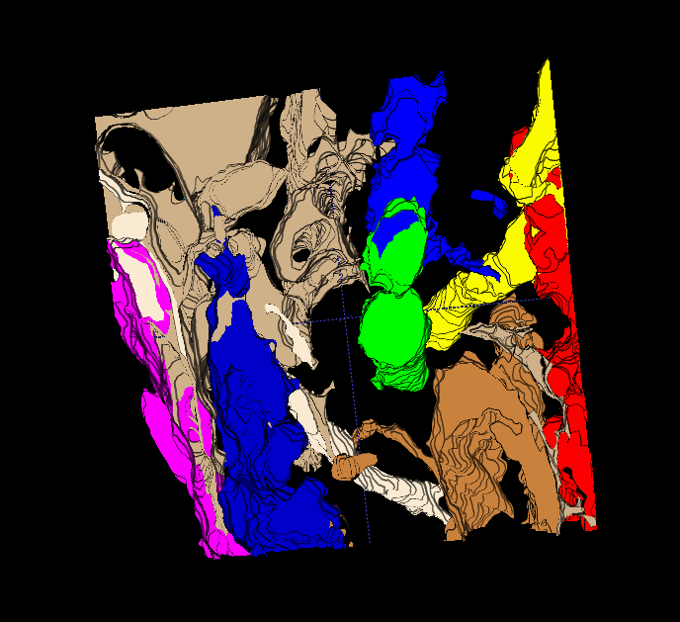
Best segmentation from GALA
Iterative method refinement process.
The purpose of which is to fix the segmentation method itself.
3D rendering of selected segments

Slide 18
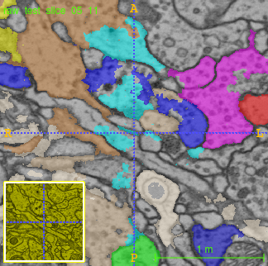
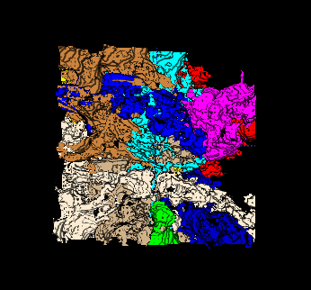
Ground Truth versus Automated Segmentation
Auto
GT

Slide 19
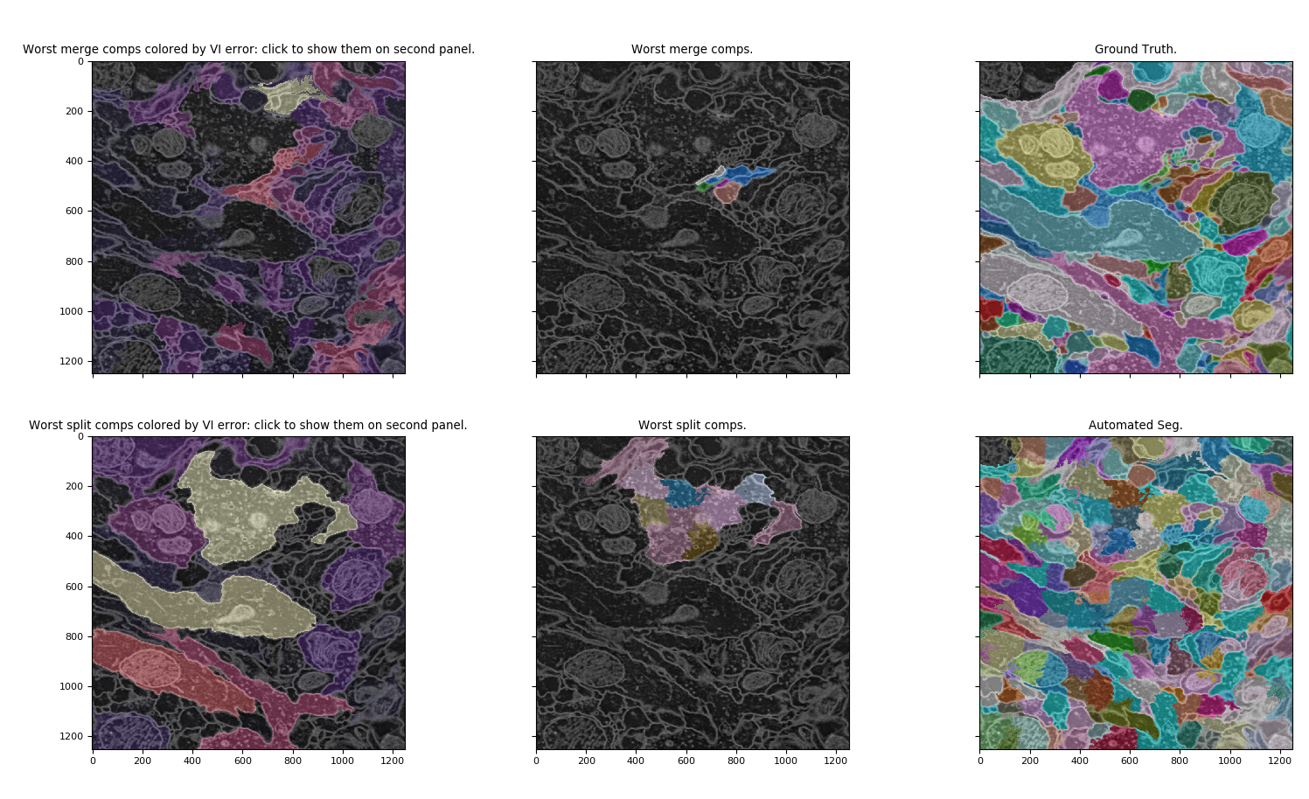
Interactive 2D Error Viewer without join segmentation
False split containing false merge!

Slide 20
‘Join Segmentation’
How do we fix these errors?
VI(S,T) = VI(S,J) + VI(J, T) → paper shows that this is the only metric that satisfied this equality (c.f. Marina Meila, 2007)
VI(J, S) = H(S|J) + H(J|S)
VI(J, T) = H(T|J) + H(J|T)
Terms equal to zero

Slide 21
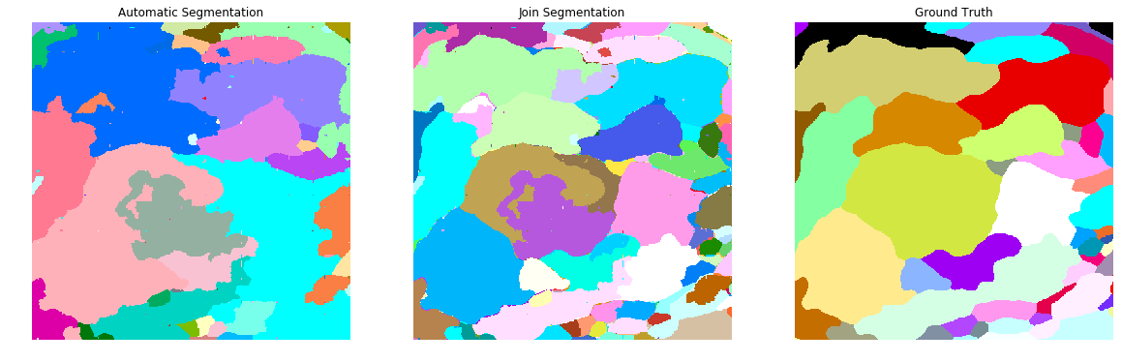
Comparison of Join Seg with Auto and GT
{Automated segmentation}∩{Ground Truth}

Slide 22
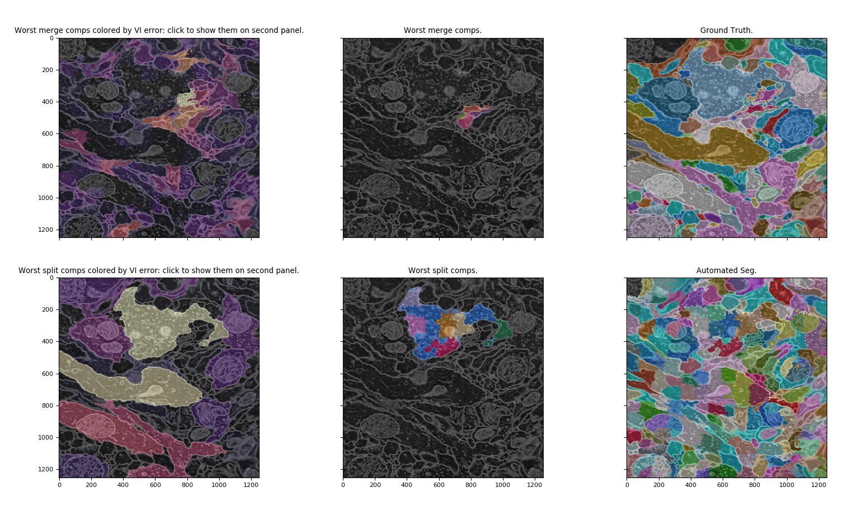
Viewer with join segmentation
False merges
No bleed-over error
False splits

Slide 23
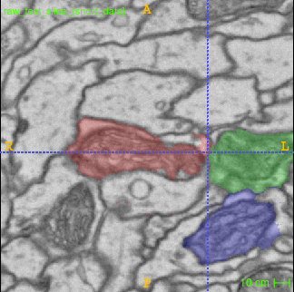
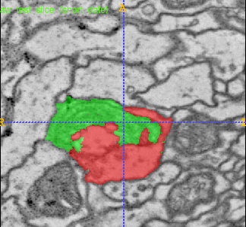
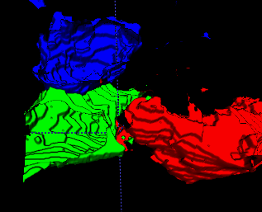
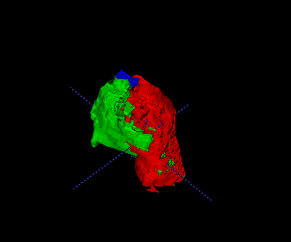
Worst Components in 3D
Worst Merges
Worst Splits
Red and green components overlapping within mitochondrion

Slide 24
Future Directions
Use a mitochondrial probability map to improve the ability to discern different organelles
Train on a larger input volume for further refinement.
Accelerate the iteration of looking at errors.

