Slide 2
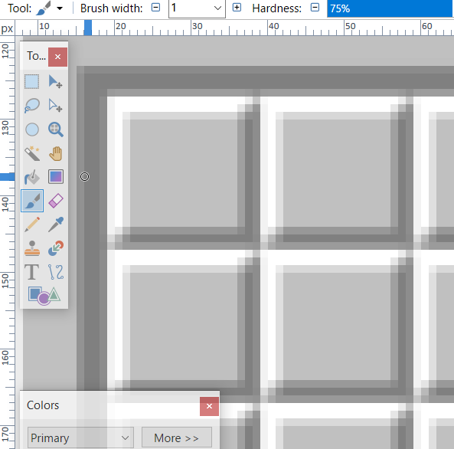
The size of each box is 20x20 pixels.
(19, 127)
(38, 146)

Slide 3
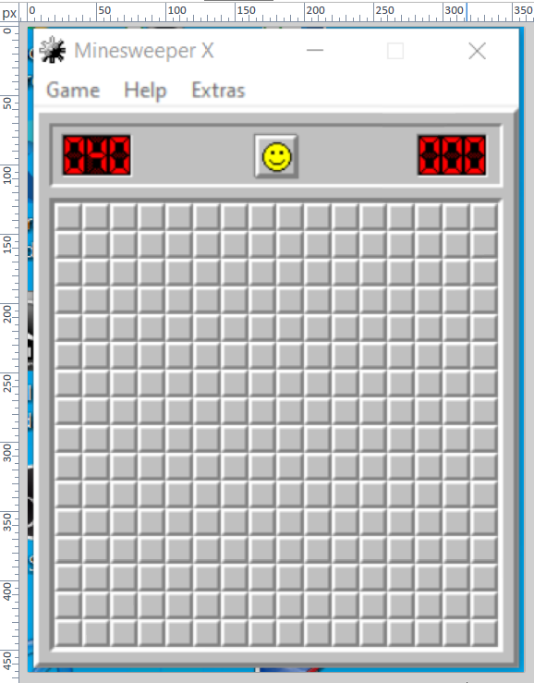
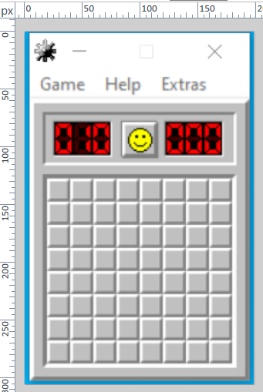
The pixel position at the lowest right of these boxes is always at (width – 20, height – 19)
358 pixels
198 pixels
(19, 127)
(19, 127)
305 pixels
465 pixels
(178, 286)
(338, 446)

Slide 4
The pixel position for the reset button is at (width/2, 94)
358 pixels
198 pixels
(179, 94)
(99, 94)
305 pixels
465 pixels

