Slide 2
Rule-based AI for Minesweeper
High Level Overview:
Download the minesweeper game at https://minesweepergame.com/download/minesweeper-x.php
Use PyGetWindow library to get the game window size and pixel positions
Use Pillow and OpenCV libraries to take snapshots of the game window and perform image processing.
Use Paint.NET to find the detailed pixel information within the game window.
Write a function that converts these snapshots of the game window into a numpy array
Write a function that

Slide 3
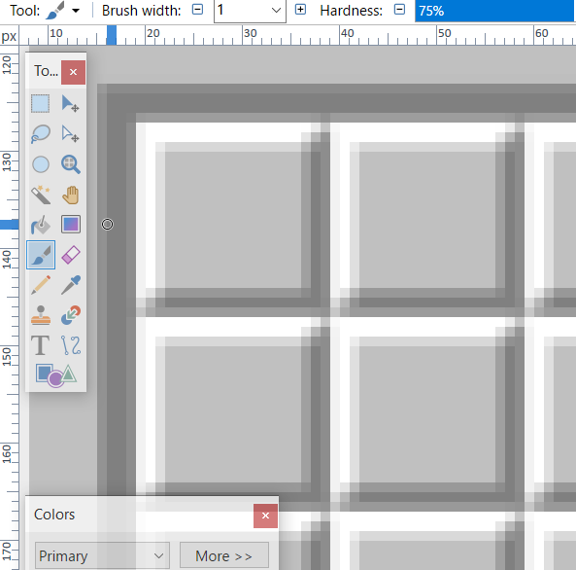
The size of each box is 20x20 pixels.
(19, 127)
(38, 146)

Slide 4
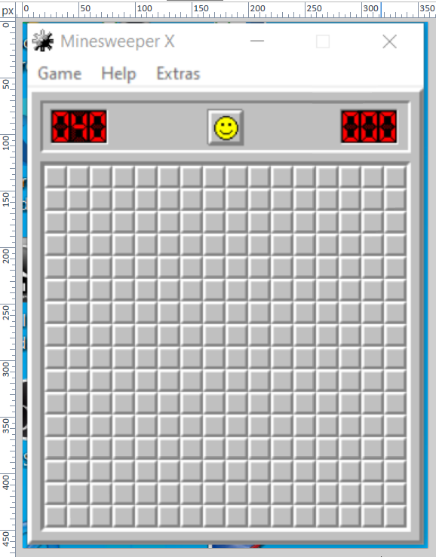
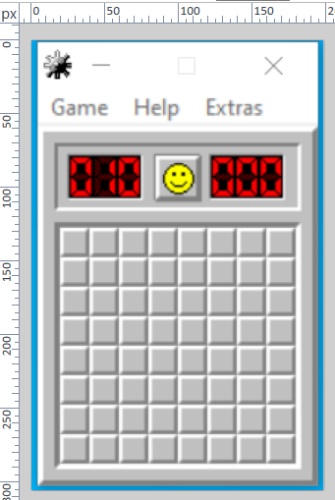
The pixel position at the lowest right of these boxes is always at (width – 20, height – 19)
358 pixels
198 pixels
(19, 127)
(19, 127)
305 pixels
465 pixels
(178, 286)
(338, 446)

Slide 5
The pixel position for the reset button is at (width/2, 94)
358 pixels
198 pixels
(179, 94)
(99, 94)
305 pixels
465 pixels

