Slide 1
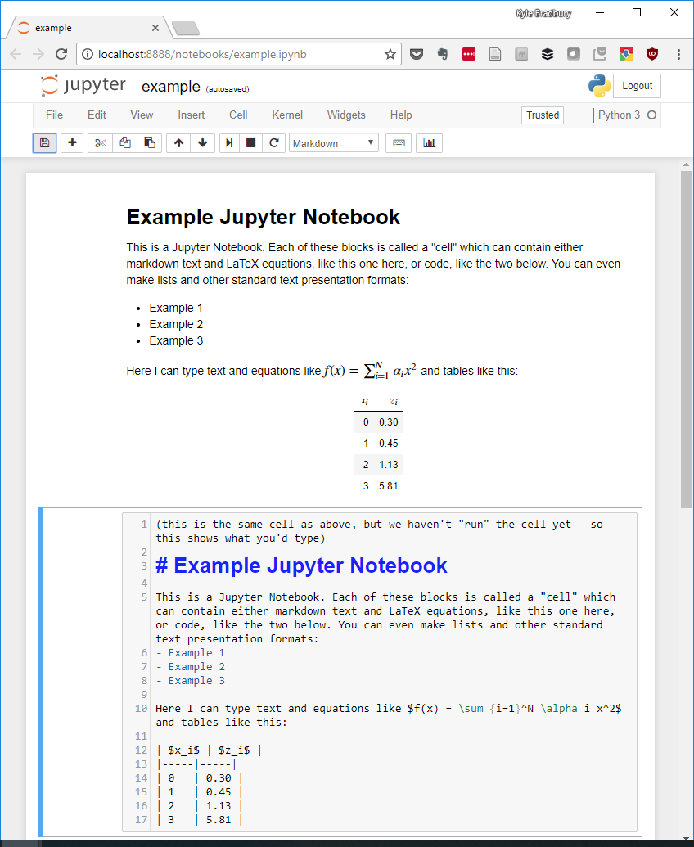
Operates in a web browser
Indicates a Python 3 is running
Write text, lists, math, and tables
Write text in markdown language
Write math in LaTeX

Slide 2
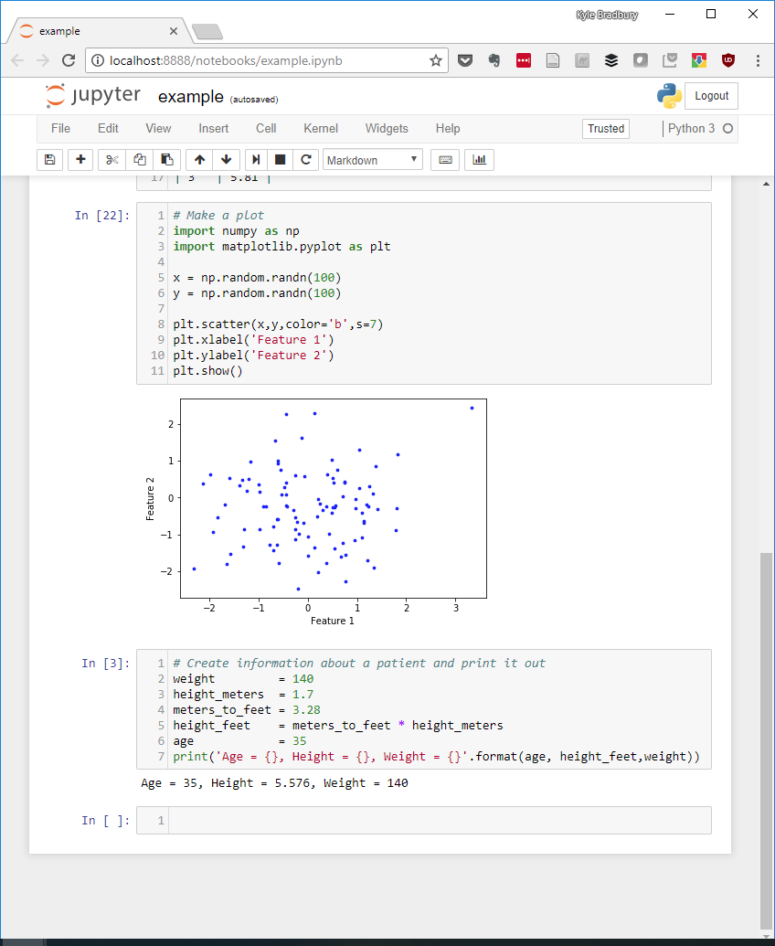
This number shows us IPython executed code with the kernel
Enter code into cells as you would a text document
Can output plots directly to the document
Each cell is followed by its output

