Slide 1

XGBoost
Long-Short
Equity Strategy
ML-Powered Monthly Cross-Sectional Factor Strategy
US Equities
0.7 Net Sharpe
1986 – Present
Dollar-Neutral L/S
Tung Yuen Lok, Johnny
SID: 1155143226
Code: github.com/JohnnyTung123/MLII

Slide 2
METHODOLOGY
Expanding Window Training
[1981-01 to 1985-12]
→
Score 1986-01 → ret_exc_lead1m (1986-02)
Train Model 1
[1981-01 to 1986-12]
→
Score 1987-01 → ret_exc_lead1m (1987-02)
Train Model 2
[1981-01 to 1987-12]
→
Score 1988-01 → ret_exc_lead1m (1988-02)
Train Model 3
1981
1986
1987
1988
Today
No look-ahead: Model always trained on [1981 … T−1], scored on T and then roll forward.
01 Rank Normalization
02 XGBoost Ensemble
rank(x) → [−0.5, +0.5]
seeds 42, 123, 456 | sub=0.8
Cross-sectional rank-normalization is applied to features each month, handling scale heterogeneity for tree-based models.
Three models trained with different random seeds and data subsamples. Final prediction = average of the three models, reducing randomness and improving robustness.
03 Rank + Capped value-weighting & Microcap screen
04 Transaction costs on L1 weight change
w_i ∝ rank(ŷ_i)
TC = 10 bps × Σ|w_t − w_{t−1}|
Stocks get weight proportional to their prediction rank. Larger market cap stocks get slightly more weight so the portfolio stays in liquid names. Microcap stocks, bottom 20 percent by market cap, are excluded.
Subtract 10 bps for every unit of turnover, where turnover is the sum of absolute weight changes vs. last month.

Slide 3
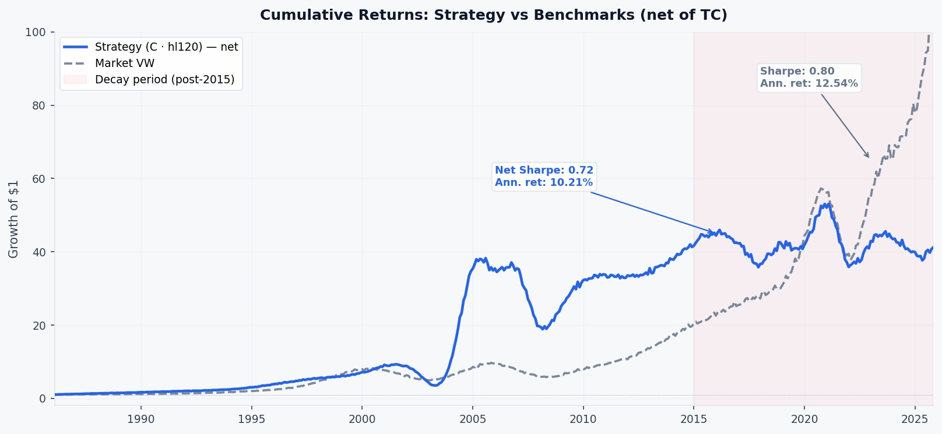
PERFORMANCE
Cumulative Returns: Strategy vs Benchmarks

Slide 4
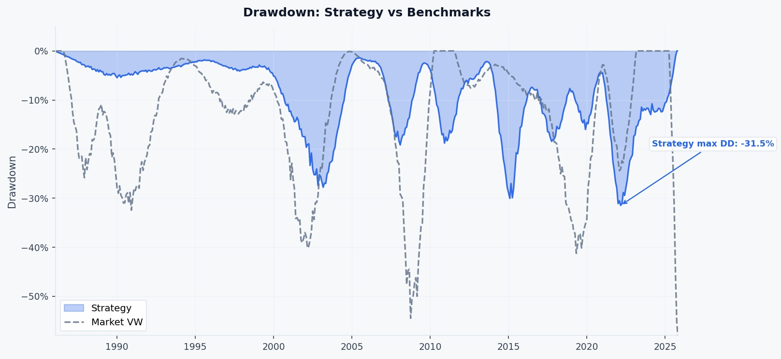
PERFORMANCE
Drawdown: Strategy vs Benchmarks

Slide 5
PROFITABILITY & SUSTAINABILITY
Strategy Decays Monotonically Since the 1990s
0.72
−0.36
0.064
56.9%
Net Sharpe
(full sample)
Net Sharpe
(2020s)
Mean IC
(full sample)
Win Rate
(full Sample)
Period | Net Sharpe | Mean IC | Signal
1990s | 1.54 | 0.080 | Strong ✓
2000s | 0.78 | 0.070 | Good ✓
2010s | 0.59 | 0.054 | Fading ⚠
2020s | −0.36 | 0.036 | Dead ✗
Why It Stopped
Momentum + reversal + value/quality are the most published, most replicated, most traded factors in quant finance.
Post-2010, as quant AUM exploded, these signals were arbitraged away. IC decays 0.080 → 0.036. The strategy is a victim of its own transparency.

Slide 6
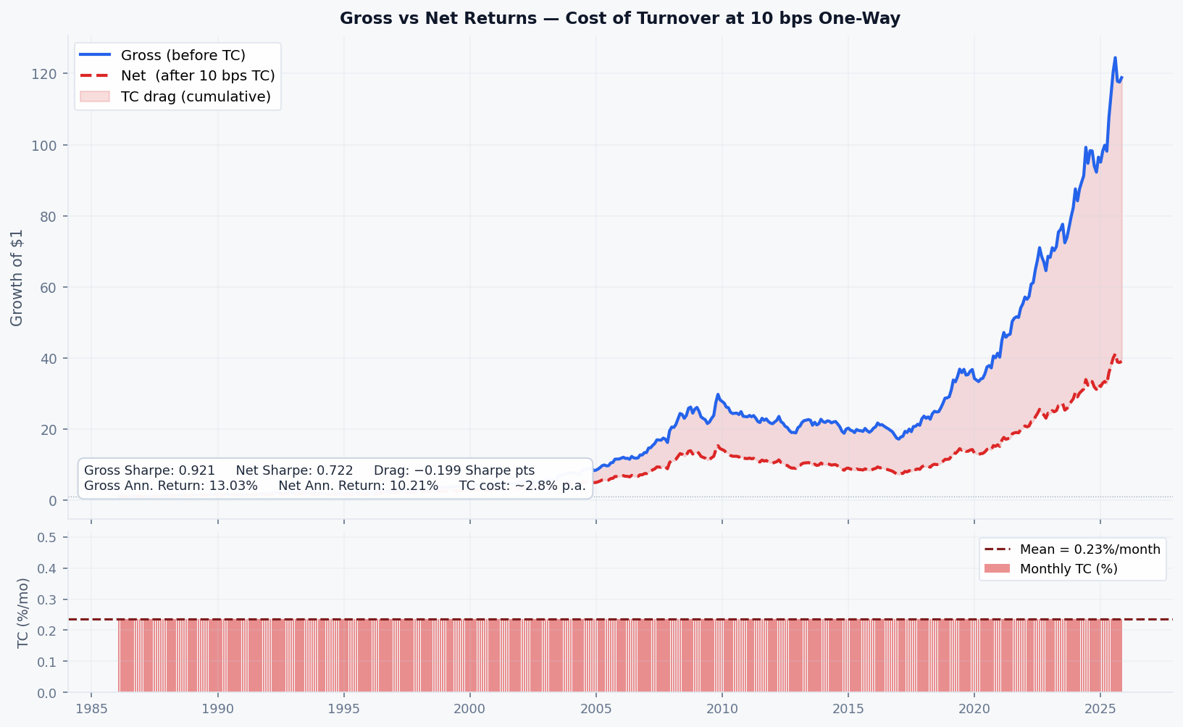
Transection costs
Gross vs Net — Cost of Turnover
0.921
Gross Sharpe
Ann. ret. 13.03%
0.722
Net Sharpe
Ann. ret. 10.21%
0.199
TC Drag (Sharpe)
~2.8% p.a. cost
TC = 10 bps × L1 weight change
0.199 drag = 22% of gross alpha removed by TC

Slide 7
CAPACITY
Real-World Capacity Analysis
2,300
230
120%
$300–500M
Stocks / month
after microcap screen
Stocks per leg
(long + short)
Monthly turnover
(118–133%)
Estimated AUM capacity
before market impact
Turnover Cost Reality
Why $300–500M? Market Impact
TC = 10 bps × L1 weight change
120% monthly = 5× annual turnover.
230 stocks always in the portfolio but replaced so aggressively each year that the original positions turn over 5 times by December.
Without honest transaction costs deduction, full-sample Sharpe appears substantially higher. The 0.72 Sharpe reported here already reflects this drag.
Small fund ($10M): Position ≈ $50K. Market barely notices. Price unaffected.
Large fund ($5B): Position ≈ $20M but stock only trades $10M/day. You ARE the market. Prices move against you before you finish.
At $300–500M with 230 names per leg: avg position ≈ $1–2M/stock/month — safely within daily liquidity for mid-large US equities. Signal survives.
Beyond $500M: trades too large relative to daily volume. You move the price against yourself before finishing. The edge disappears.

Slide 8
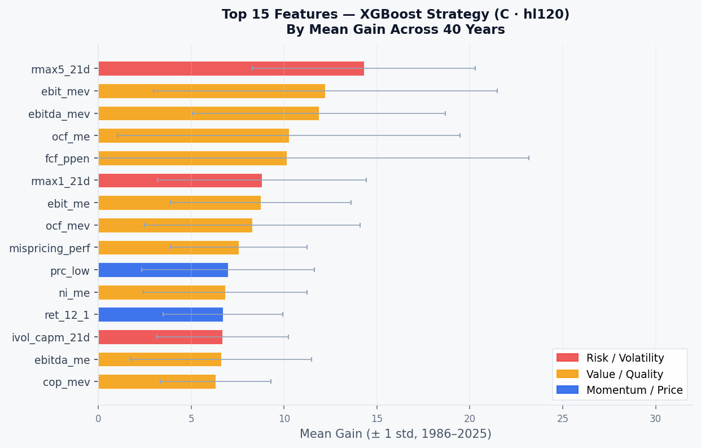
What Is the Strategy Actually Doing?
Risk / Volatility
rmax5_21d (14.3) rmax1_21d ivol
Max 5-day return in 21 days — the model avoids high-volatility, lottery-like stocks.
Value / Quality
ebit_mev (12.2) ocf_me ebitda_mev
Enterprise value multiples dominate — cheap on earnings and cash flow, not just book.
Momentum + Reversal
ret_12_1 (#11, 6.7) ret_1_0 (#17)
Present but no longer dominant — consistent with crowding and post-2010 decay.
Mispricing / Composite
mispricing_perf (#9, 7.6) cop_mev
Composite mispricing score — combines value + momentum + quality signals.

Slide 9

What Makes This Different from Vanilla Factor Regression
Vanilla Approach
This Strategy
✗ Hand-pick 3–5 factors from the zoo
✓ ML selection across all 400+ JKP characteristics
✗ Linear regression — fixed weights
✓ XGBoost: non-linear + interaction effects
✗ Factors assumed independent
VS
✓ Ensemble (3 seeds) for prediction stability
✗ Equal-weight → microcap inflation
✓ Rank-weight + capped VW
✗ All training data weighted equally
✓ $Recency weighting: weight = {0.5}^{\frac{age}{120}}$
Recency weighting: $weight = {0.5}^{\frac{age}{half‑life}}$
half‑life = ∞: all months equal weight | half‑life = 60: 5‑yr‑old data → half weight | half‑life = 120 (chosen): 10‑yr‑old data → half weight

Slide 10
Limitations & What I'd Do Next
LIMITATIONS
NEXT STEPS
📉 Not currently tradable
🌐 Alternative data
Net of costs, negative Sharpe in the 2020s. The honest finding: it no longer generates alpha.
Sentiment, satellite, web signals are not as heavily mined as accounting factors.
🏦 Crowded factor exposure
🔄 Regime-aware training
Momentum + reversal + value = most replicated factors. Alpha arbitraged away as quant AUM grew.
Half-life = 120m implemented. Extend to explicit regime detection to reduce weight on pre-2010 data aggressively.
↩ High turnover drag
🧠 Non-linear interactions
5× annual at 10 bps transaction cost eats into gross. Lower-frequency signals would survive costs better.
XGBoost already captures these implicitly. Explicitly engineer momentum × quality features to test additive lift.

