Slide 1
Ocean Cleanup Adventure
Name: Jeng Yang Weng
Date: 2025/06/01

Slide 2
Introduction
Theme
A 3D game where the player is in an ocean, surrounded by many other ships, tasked with picking up trash of bottles.
Focus: Highlight the problem of ocean pollution and encourage players to clean it up.

Slide 3
Game’s theme / world
The game world is set on a vast ocean, surrounded by multiple different ships during a raining day.
The ocean background music enhances immersion in the sea world.
There are 4 different trashes and 1 rock.
User earns 1 points by collecting 1 trash.
User loss 1 points by hitting the rock.
Complete the cleanup in 50 seconds to maximize your score.

Slide 4
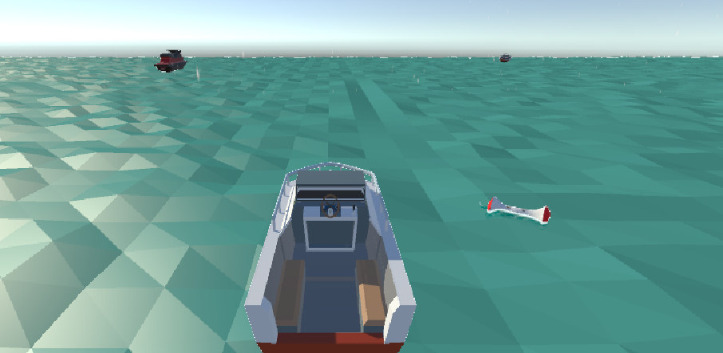
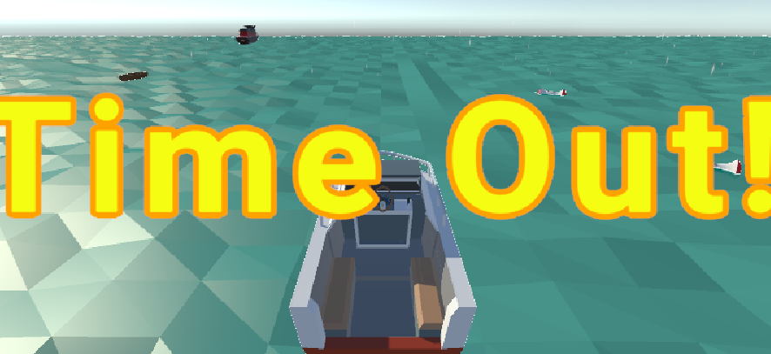
Game’s theme / world

Slide 5

Gameplay Showcase

Slide 6
Key Features

Slide 7
Feature
Environment set up (Dynamic ocean, Ships…)
Rain particles (雨滴粒子效果)
Balance fun, education, and impact.
Highlight the problem of ocean pollution, while encouraging players to clean it up.
Interaction of player and trashes.
Points system

Slide 8
END

