Slide 1
How I Survived Scattering
Tymon Sharp
May 1, 2025
How I Survived Scattering

Slide 2

Starting Point: The Amplitude Matrix
First learned about S₁(θ) and S₂(θ)
These depend on a_{n}, b_{n} (Mie coefficients) and angle functions π_{n}, τ_{n}
How I Survived Scattering

Slide 3
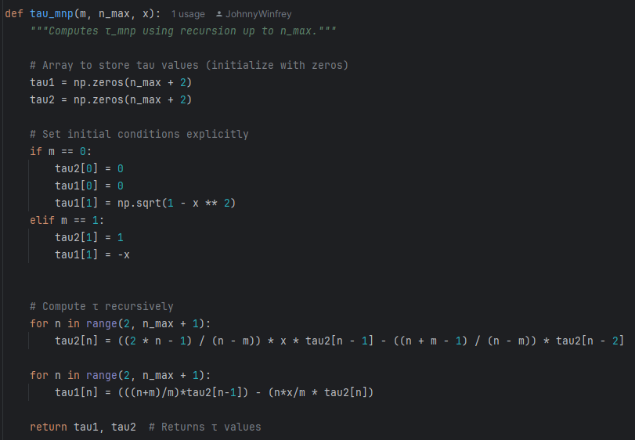
Implemented recursive relations for π_{n}(cos θ) and τ_{n}(cos θ)
Recursively Computing π_{n} and τ_{n}
How I Survived Scattering

Slide 4
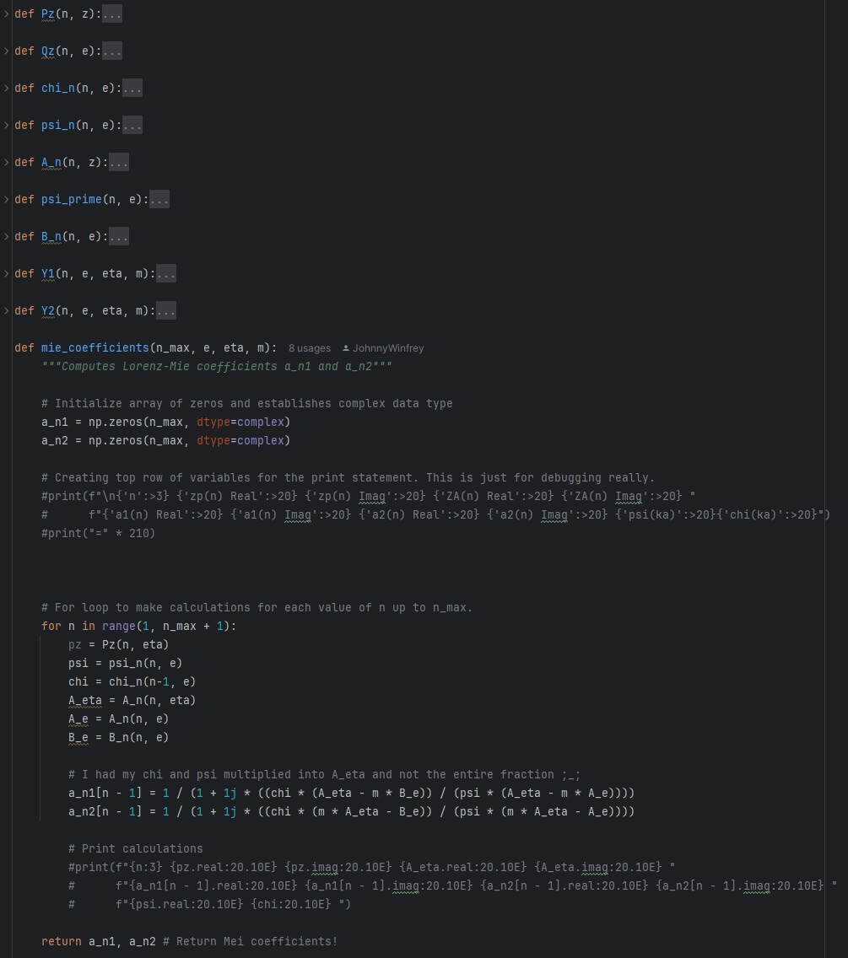
The Core of Mie Theory
Implemented Mie coefficients a_{n1}, a_{n2}
Used recurrence relations for functions ψ_{n}, χ_{n}
How I Survived Scattering

Slide 5
Connecting to Real Data
Compared scattering from gold nanoparticles to bulk reflectance
gold_nanoparticle_plot.png
How I Survived Scattering

Slide 6
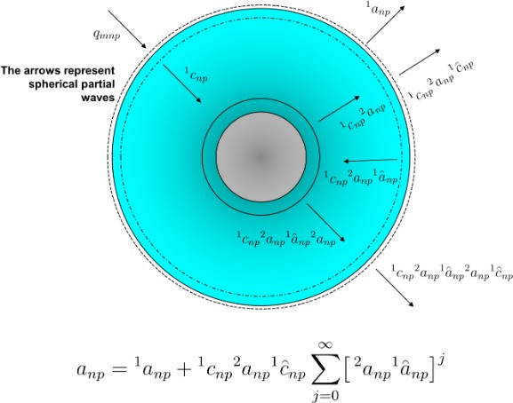
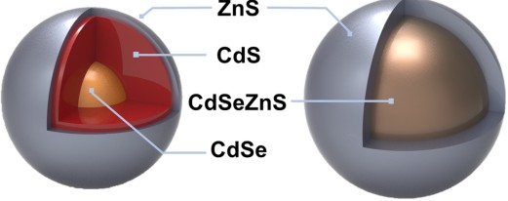
Quantum Dots and Nanoarrays
Mie theory models coated spheres like quantum dots
Helped me visualize field localization and resonance behavior
How I Survived Scattering

Slide 7
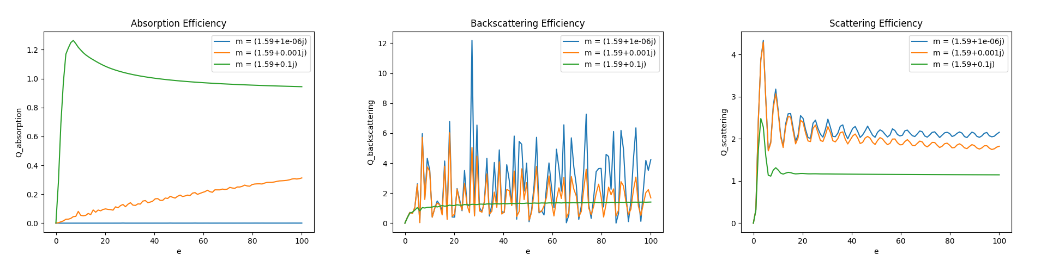
Homework Problem 1: Q Values vs Size Parameter
How I Survived Scattering

Slide 8
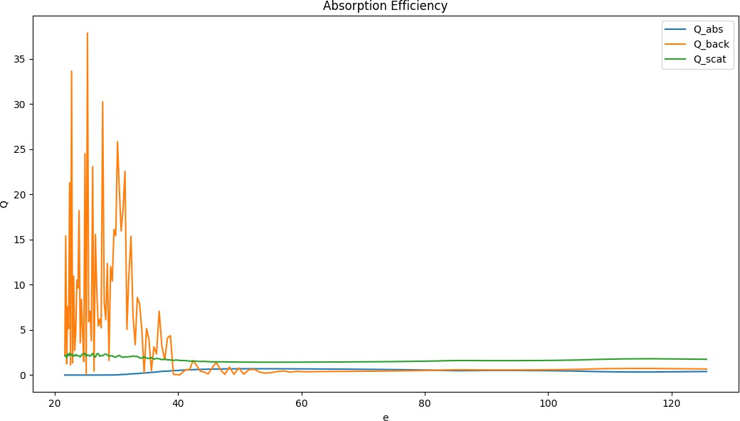
Homework Problem 2: Silicon Q Values vs Wavelength
How I Survived Scattering

Slide 9
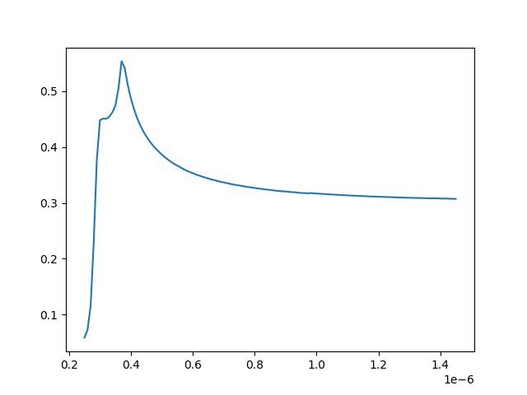
Homework Problem 3: Bulk Reflectance Comparison
How I Survived Scattering

Slide 10
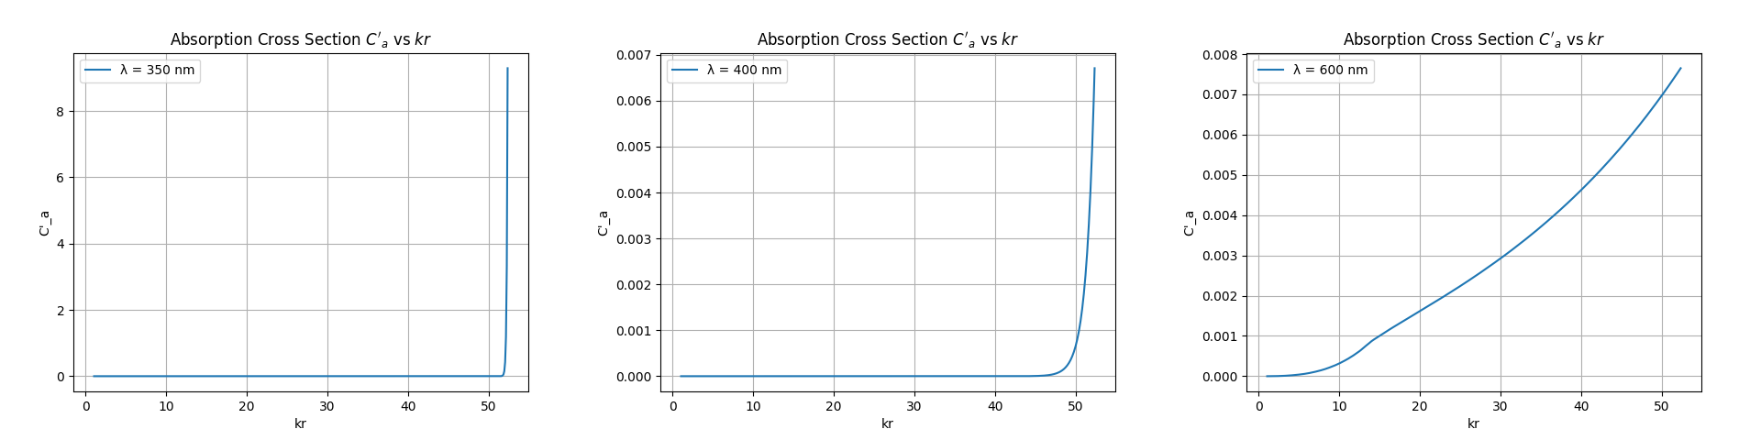
Homework Problem 4: Spatial Absorption σ′ (kr )
a
How I Survived Scattering

Slide 11
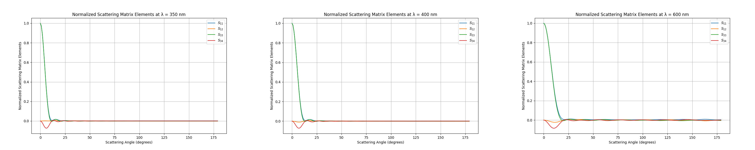
Homework Problem 5: Normalized Mueller Matrix
How I Survived Scattering

Slide 12
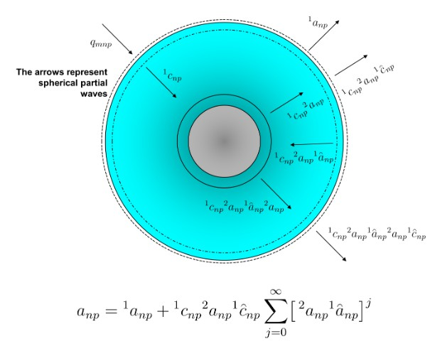
Simulating a Coated Sphere
Modeled a quantum dot as a core-shell particle
Calculated four Mie-like coefficients to account for inner/outer boundary effects
How I Survived Scattering

Slide 13
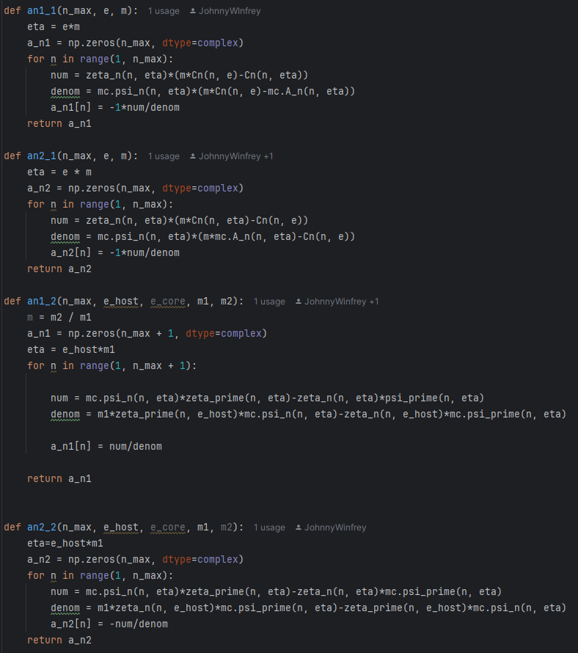
Simulating a Coated Sphere
How I Survived Scattering

Slide 14
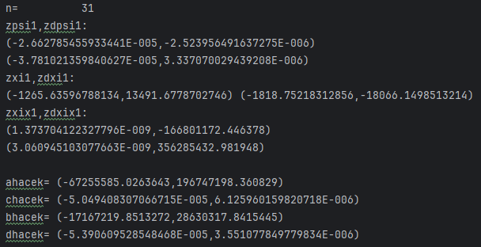
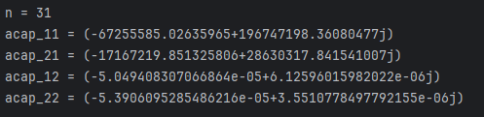
Results
In agreement!!!!!!!!
How I Survived Scattering

Slide 15
Takeaways from the Semester
Mie theory is tough
Recursive Bessel functions, resonances, angular scattering From confusion to applying it in nanophotonics research
How I Survived Scattering

