Slide 1
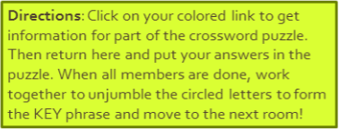
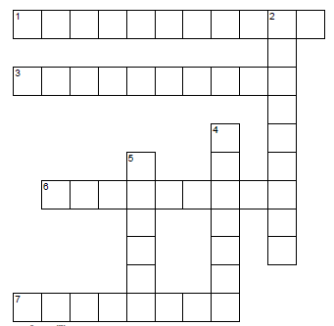
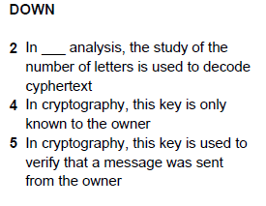
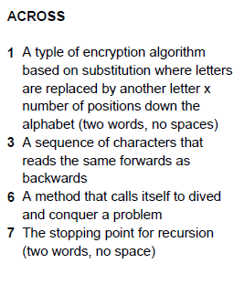

Puzzle #1
C A E S A R S H I F T
R
E
Q
U
E
N
C
Y
P A L I N D R O M
P
R
V
A
T
P
U
B
L
I
R E C R S I O
B A S E C A S E
Clues A3
Clues D4 & D5
Clue A1 & D2
T A C O C A T
Clues A6 & A7
Room Lock:
Hint: Room Lock is a palindrome
Notes:
Clues D4 & D5 - http://tinyurl.com/FLVSAPCS-PublicKey
Clue A3 - http://tinyurl.com/FLVSAPCS-Palindrome
Clue A6 & A7 - http://tinyurl.com/FLVSAPCS-Recursion
Clue A1 & D2- http://tinyurl.com/FLVSAPCS-CipherKey
Room lock: taco cat

Slide 2
PUZZLE #2 - CAESAR SHIFT
A Caesar shift is a Cypher Key type of encryption. You can read more about cypher keys here:
See an example of a Caesar shift here:
Your job is to decode the part of the room lock based on your color!
Cty ayl
Eva can
E oaa
I see
ybbp fk
Bees in
v xvqz
A cave
Room Lock:
Eva, can I see bees in a cave
Hint: Room Lock is a palindrome
Notes:
http://tinyurl.com/FLVSAPCS-CipherKey
http://tinyurl.com/FLVSAPCS-Caesar
Phrase: Eva, can I see bees in a cave?

Slide 3
PUZZLE #3 - DECRYPT USING PRIVATE KEY
Two factor authentication first encodes a message and then encrypts it. Here will use private key encryption to decrypt a coded message and then decode it.
First you decrypt the message using the private key and then decode code it.
You can find an example of how to decrypt and then decode here:
Private Key: 5
Message: 9 0 17 0 13
Decode: 14 5 22 5 18
Decrypt: 9 0 17 0 13
Message: 10 -1 -1
Decode: 15 4 4
Encrypt: 10 -1 -1
Message: 10 13
Decode: 15 18
Encrypt: 10 13
Message: 0 17 0 9
Decode: 4 22 4 14
Encrypt: -1 17 -1 9
Room Lock:
Never odd or even
Notes:
http://tinyurl.com/FLVSAPCS-DecryptExercise
Phrase: Never odd or even
Private key: 5
Never
Encode: 14 5 22 5 18
Encrypt: 9 0 17 0 13
odd
Encode: 15 4 4
Encrypt: 10 -1 -1
or
Encode: 15 18
Encrypt: 10 13
even
Encode: 4 22 4 14
Encrypt: -1 17 -1 9

