Slide 1
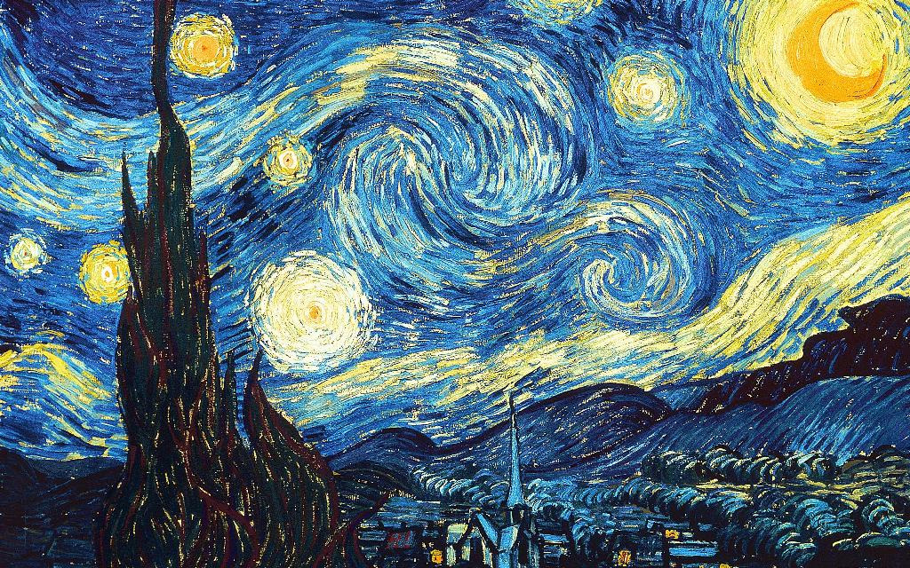
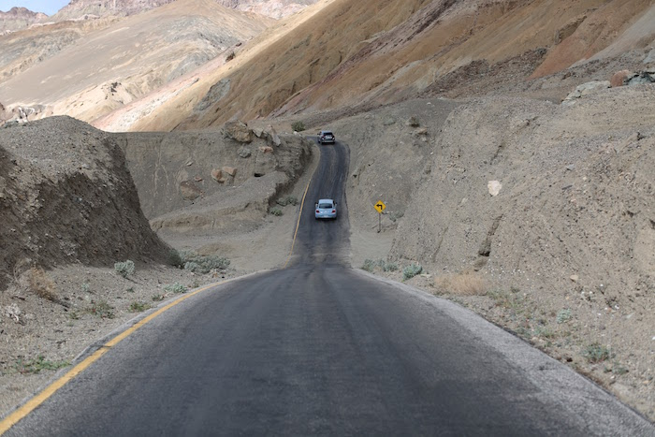
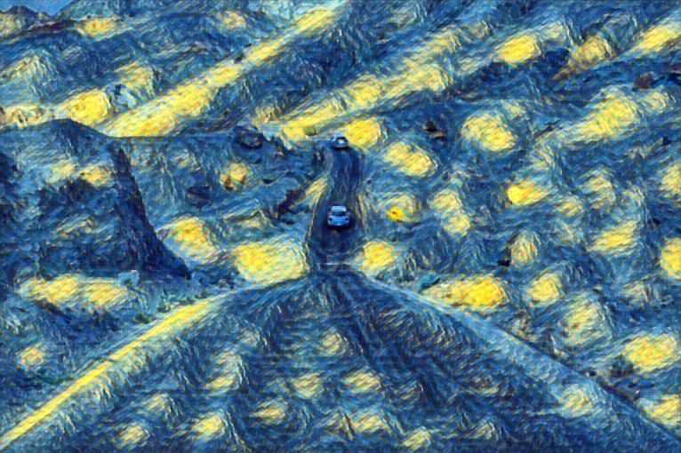
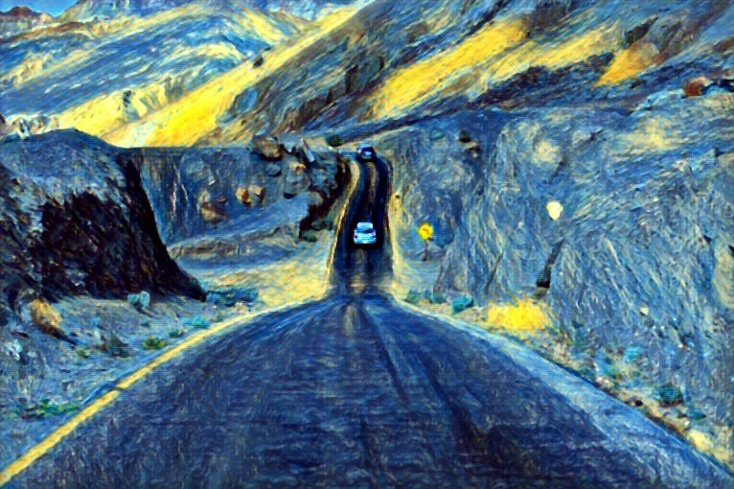
Style
Starry Night
(A) Scene with large variations in depth
(B) Johnson et al., 2016
(C) Our depth-preserving results

Slide 2
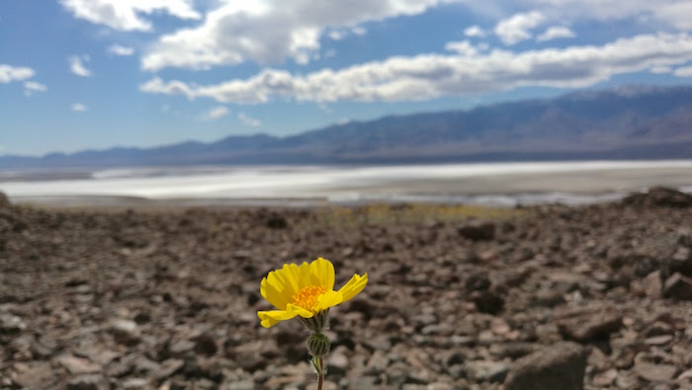
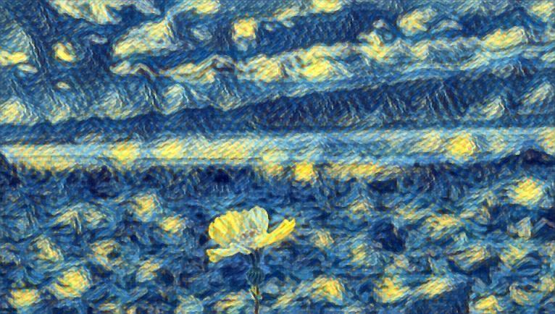
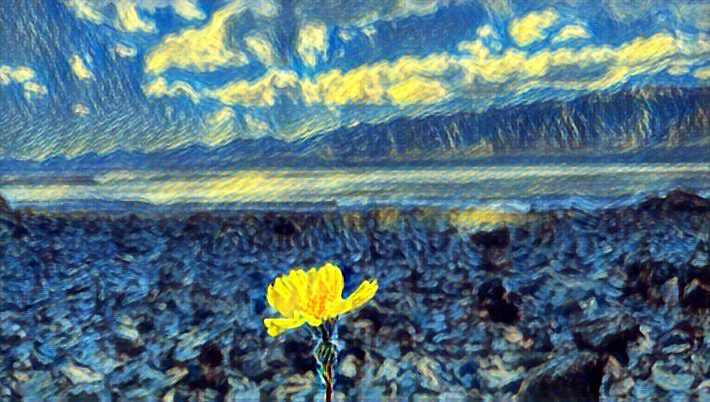
Style
Starry Night
(A) Scene with large variations in depth
(B) Johnson et al., 2016
(C) Our depth-preserving results

