Slide 1
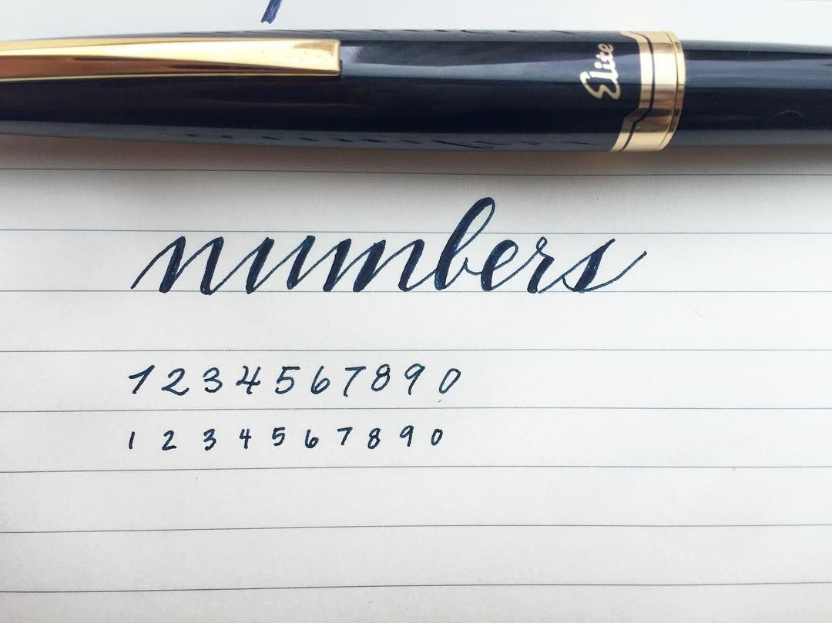
Sales Prediction

Slide 2

Outline
01
02
03
04
Exploratory Data Analysis
Data Preprocessing &
Feature Engineering
Model Building &
Validation
Prediction & Future Improvements

Slide 3
Home Page
EDA
What is the target variable?
And what are the features we have?
From the descriptive analysis we could find out the distribution of target variables is not normalized.
We also found out that there are both continuous and categorical missing values and duplicated dimensions existed in our features.

Slide 4
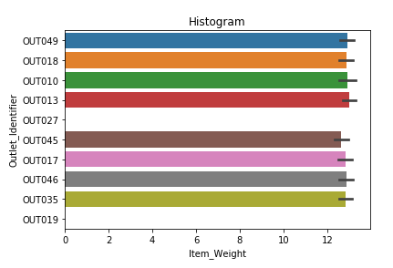
Data
Data Preprocessing
DATA
From the chart, we could see that the Item weight is not missing at random but limited to two Outlet ids.
Data imputation would be conducted based on
The findings, we randomly chose item weights from
Those two kinds of outlet to fill in as the actual item weight
For the missing values.

Slide 5
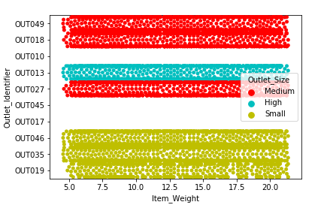
Data
Data Preprocessing
DATA
From the scatterplot, we could see that the feature Outlet Size is not missing at random but only happened with three specific Outlet ids.
Missing values for the categorical variables would be imputed based on
The specific outlet ids and its corresponding Outlet Size and Item sales.
For example, We find out that Out010 corresponds to grocery store therefore
The missing values for Outlet Size should be small.

Slide 6
Transition
Feature Engineering
Encoding
Option A(Target Encoding)
Replacing the categorical feature based on the target mean value of each category.
Option B (Label-Encoding)
Option C(One-Hot Encoding)
Final Suggestion
Encode each categorical feature by creating a new binary column.
Convert categorical features into numerical features based on the feature’s ordinary sequence

Slide 7
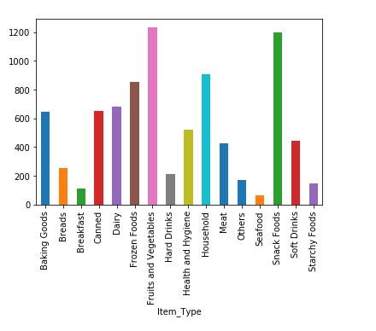
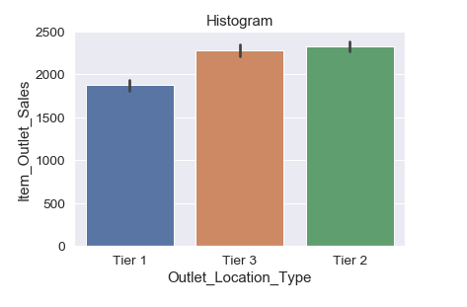
Feature Engineering
Creating New Features
Selling Level
Location Level
Different Item type differs in their sales figures.
Location matters to the outlet as well as to the sales.

Slide 8
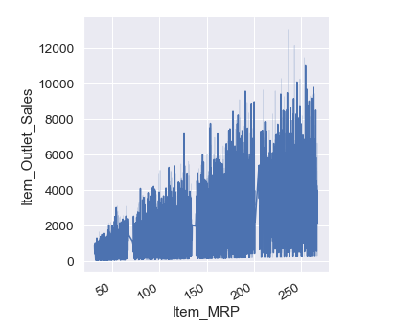
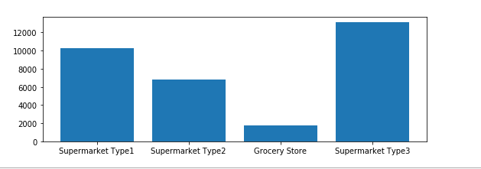
Feature Engineering
Creating New Features
Outlet level
MRP Level
Whether an outlet is a grocery store or not.
Different level of MRP corresponds to different level of sales.

Slide 9
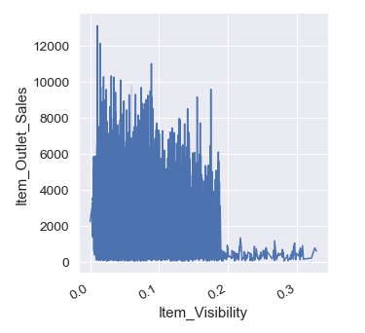
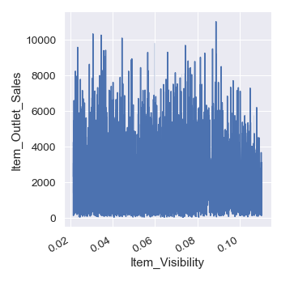
Feature Engineering
Handling Outliers
Item Visibility
After Winsorization
There is a group of outliers in the item visibility feature, we decide to apply winsorization to them. Limit those extreme values to reduce the effects of spurious outliers.
The extreme values has successfully been transformed within the range and the feature looks fine.

Slide 10
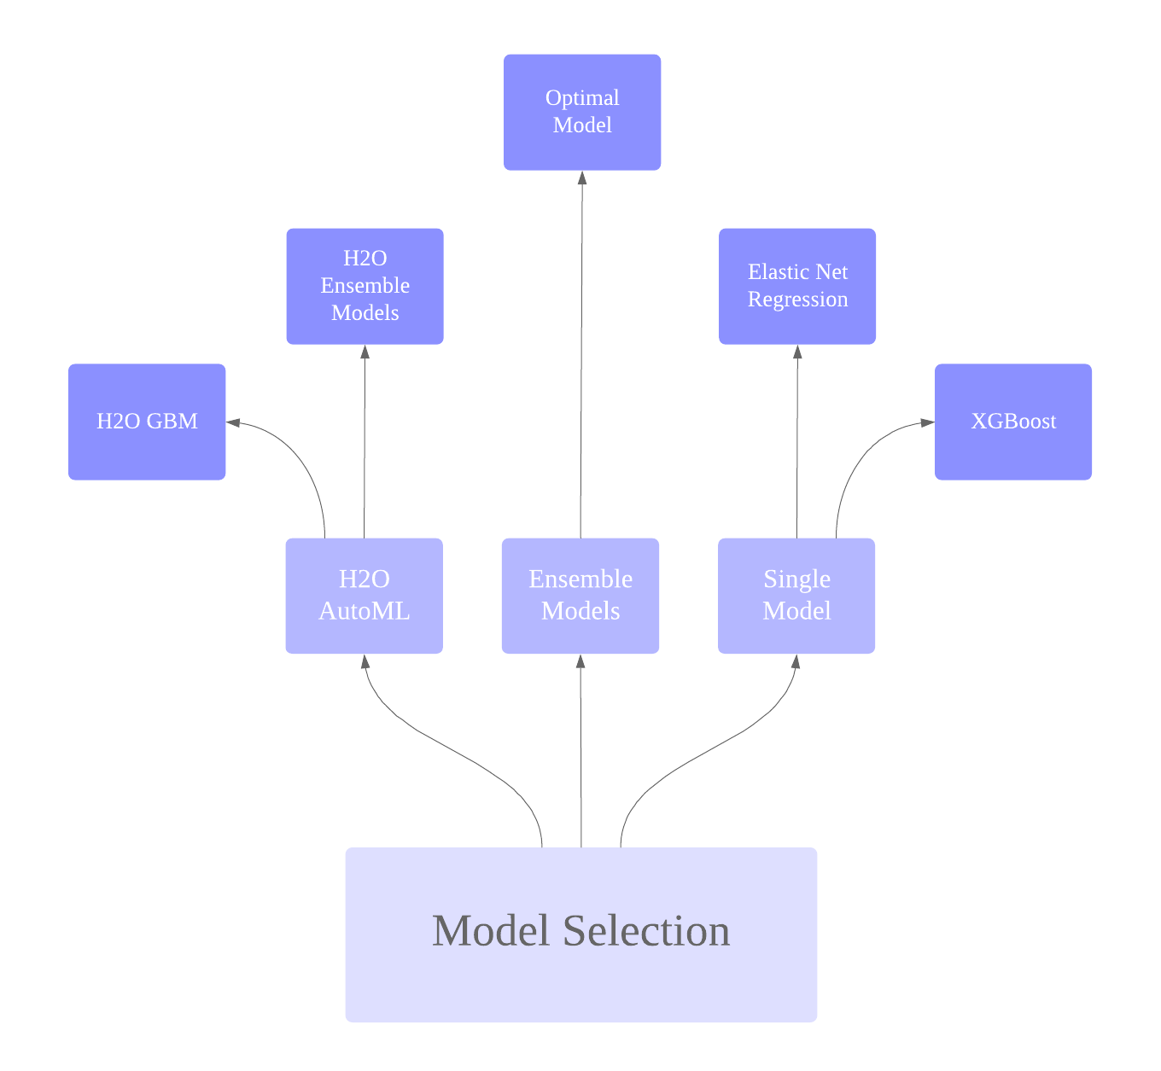
Model Building Iteration
Model Page

Slide 11
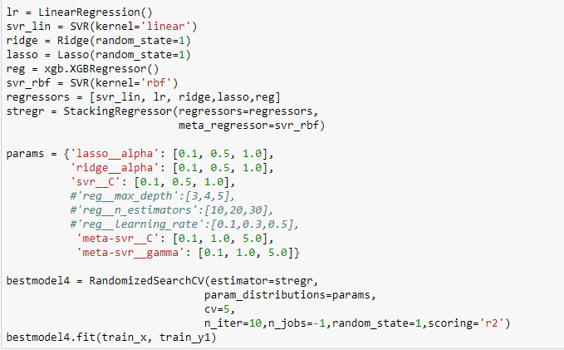
Model Explanation
Model Page
Optimal
Model
Notebook Display

Slide 12
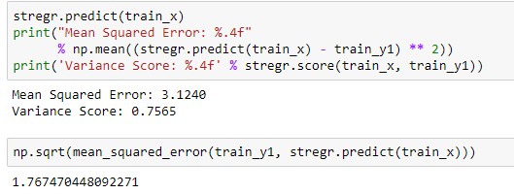
Model Validation
Model Results 1
75.65
%
We used cross-validation to evaluate our model since test.csv did not provide the label. Our model finally achieved a 75.65% goodness of fit score(R^2) with an RMSE of 1.76. Although it is not our ultimate performance since parameter tuning is not finished due to time limit and complexity, it still indicated that our model performed well.
Predicting Power

Slide 13

Prediction & Future Improvement
Home Page
Further Improvement:
Impute the missing values for Item weight based on the relationship with other column values.
Customized feature encoding for every categorical variable.
Parameter tuning for the final ensemble model.
mengqi0128@126.com

Slide 14

THANK YOU
2019.04.03

