Slide 1


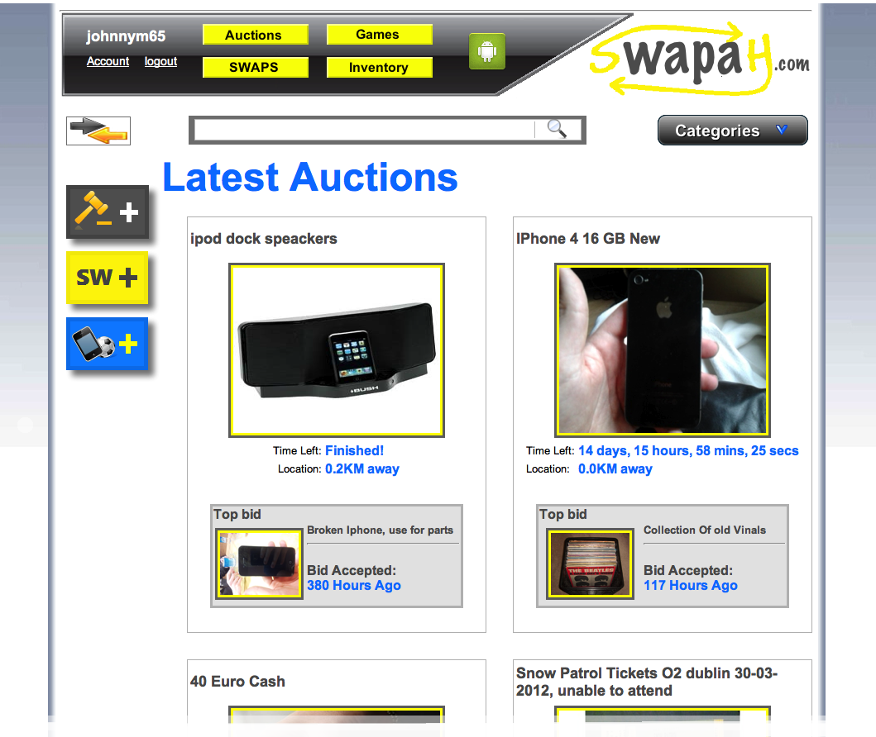

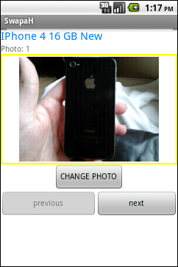

School of computing
Project Description
SwapaH.com is a PHP web application that Gives users a fun and interesting way to swap goods online. They can swap goods using auctions, or straight swaps in a fun timed SwapaH game.
In these auctions the Users don’t bid with money, they bid with items.
In the swapah games, the aim of the game is to trade up as many times as you can.
Also uses geo-coding to find out how far away an item is from
you
Student
Johnny
Murphy

