Slide 1
High-Performance Semantic Correspondence
Project 5
Team: Osagie, Lapadula, Pugliese, Bellanca
Course: Advanced Machine Learning

Slide 2
1. Introduction & Objective
Objective: - Establish dense semantic correspondences between image pairs of the same category but with varying appearance and pose. Challenges: - Large intra-class variations (shapes, textures). - Geometric distortions (viewpoint, scale). - Lack of vast supervised datasets limits full end-to-end training.

Slide 3
2. Framework & Libraries
- PyTorch & Torchvision: Core deep learning framework for tensor operations and image augmentation. - DINOv2 (facebookresearch): Pre-trained ViT backbone used to extract dense semantic features without supervision. - PEFT (Parameter-Efficient Fine-Tuning): Conceptual framework implementing LoRA and BitFit for lightweight adaptation. - Gradio: Used for creating an interactive, real-time web UI to test and demonstrate robustness dynamically. - Matplotlib & Seaborn: Real-time academic plotting and logging.

Slide 4
3. Methodology: Architecture
1. Feature Extraction: Images pass through frozen DINOv2 (ViT-B/14) at Layer 11. 2. Dense Correlation Map: Cosine similarity is computed between source and target feature grids. 3. Adaptive Window Mechanism: Hard-Argmax is unstable. We filter the top-K% similarities dynamically to isolate the relevant neighborhood. 4. Temperature-Scaled Soft-Argmax: Computes the sub-pixel center of mass acting as a local regularizer.

Slide 5
4. Hyperparameters & Rationale
- Learning Rate (1e-4): Found optimal via AdamW. Higher LRs disrupted the pre-trained space; lower LRs stalled. - LoRA Rank (r=16): Sweet spot balancing matrix expressiveness and parameter constraints (only 0.9M params). - Temp (T=0.05): Sharpens Soft-Argmax to prevent blur across background pixels, keeping sub-pixel interpolatability. - Masking (Alpha=0.1): Threshold to suppress matches with extreme uncertainty.

Slide 6
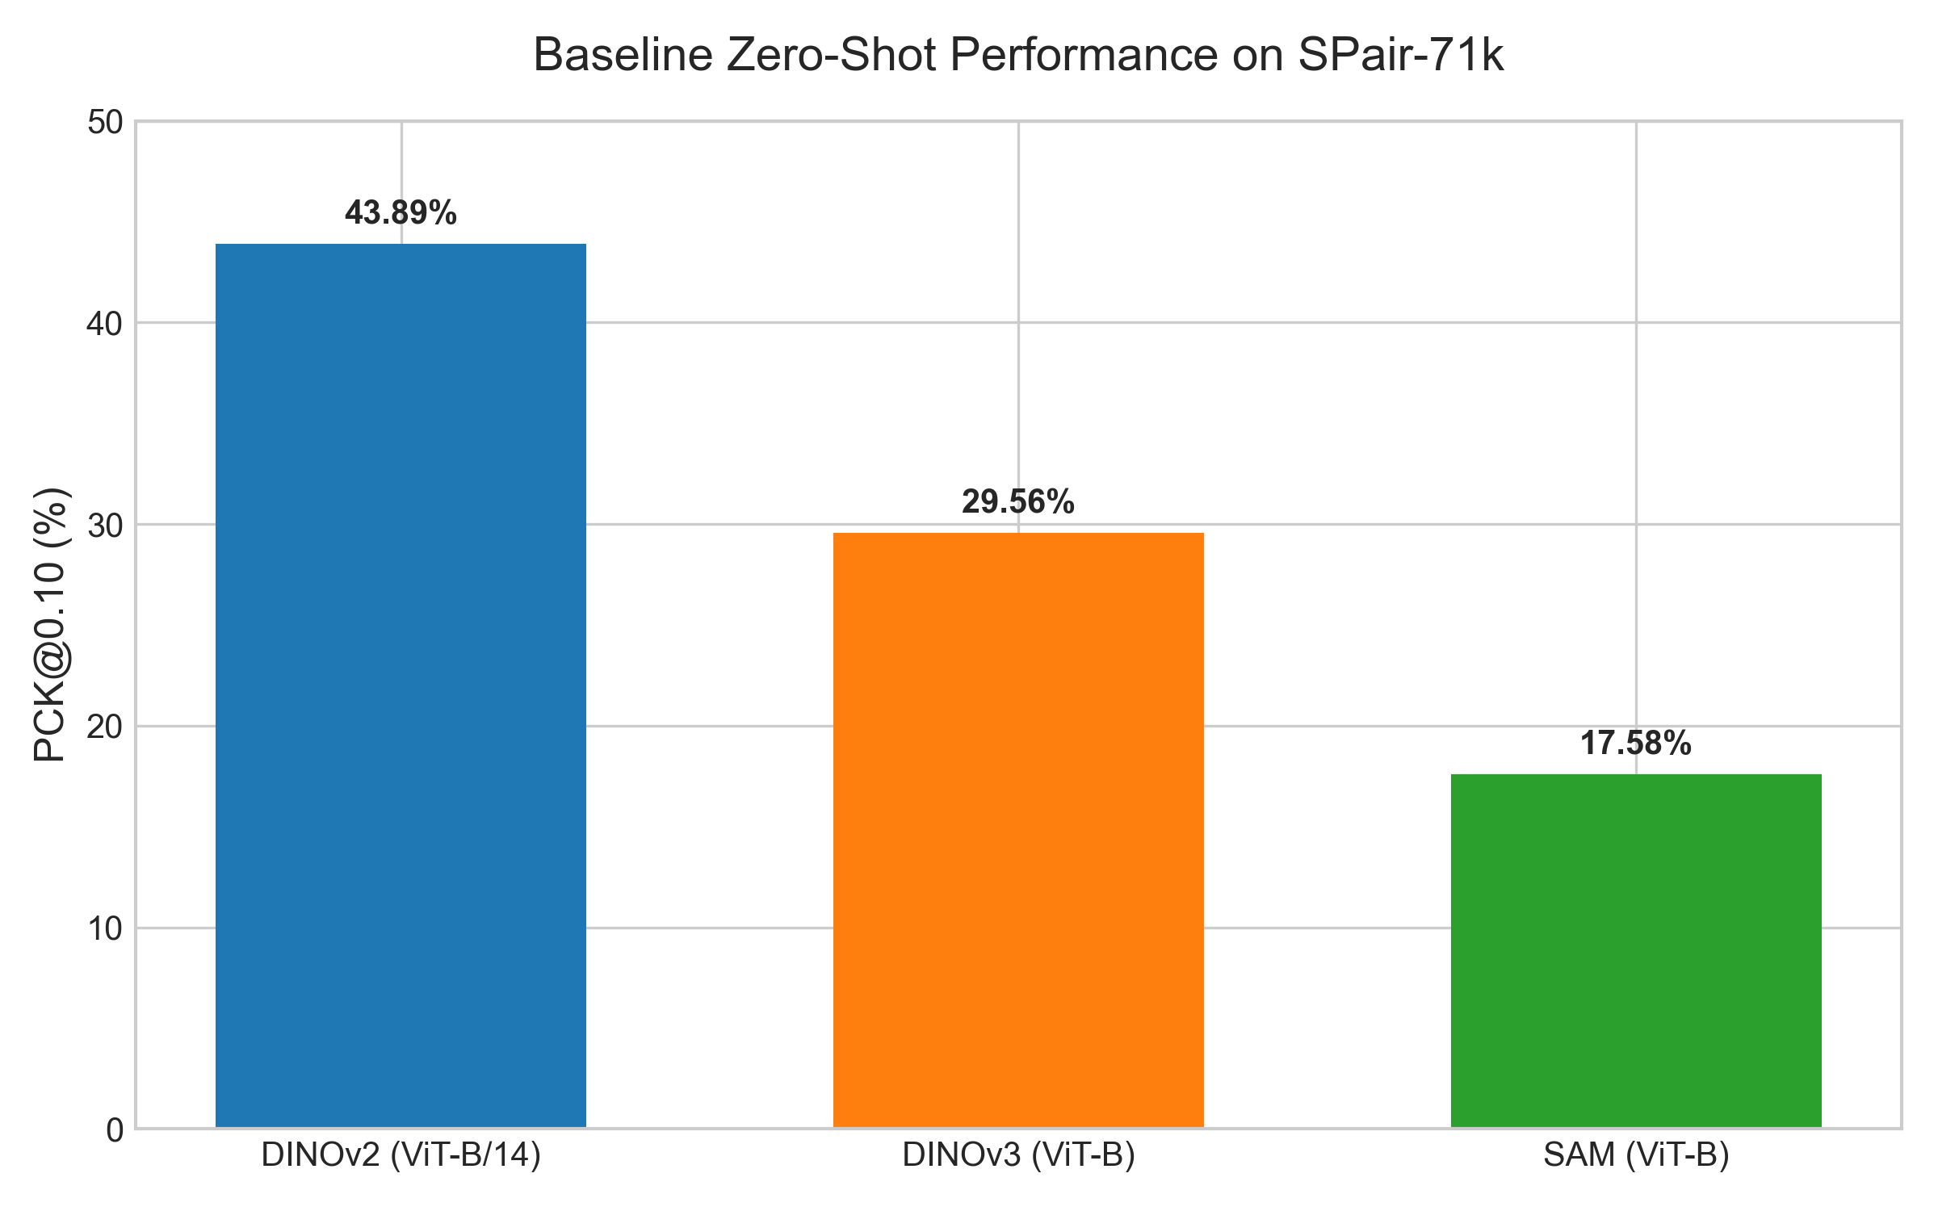
5. Zero-Shot Baselines
Evaluating off-the-shelf Foundation Models without fine-tuning. - DINOv2 strongly outperforms DINOv3 and SAM, proving its superior object-centric representation.

Slide 7
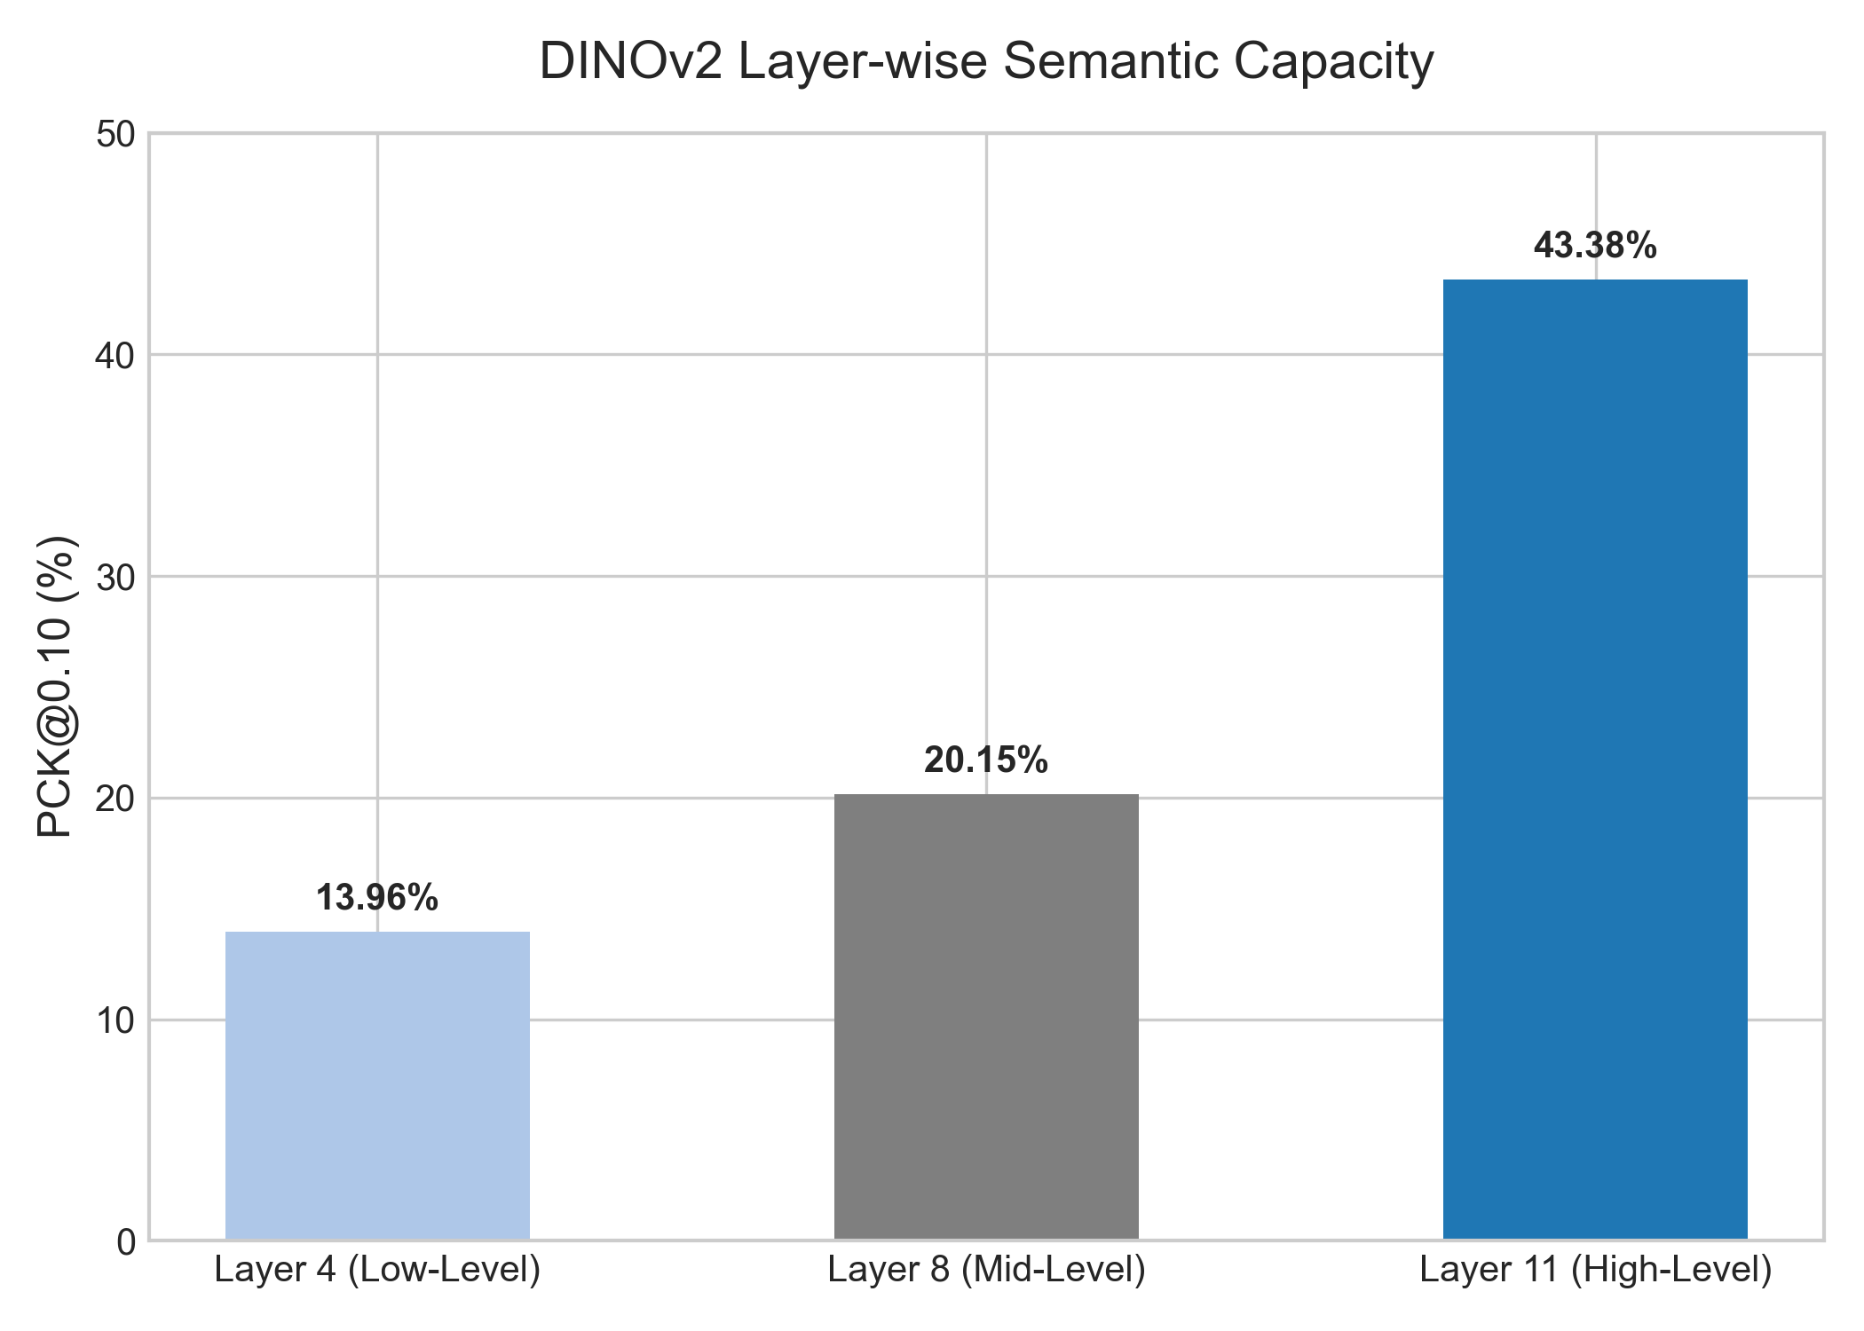
6. Internal DINOv2 Dynamics (Layer-wise Analysis)
- Early layers (L4) focus on low-level textures, yielding poor semantic matches. - Middle layers (L8) begin capturing part-level features. - Deep layers (L11) represent high-level semantic concepts, maximizing PCK.

Slide 8
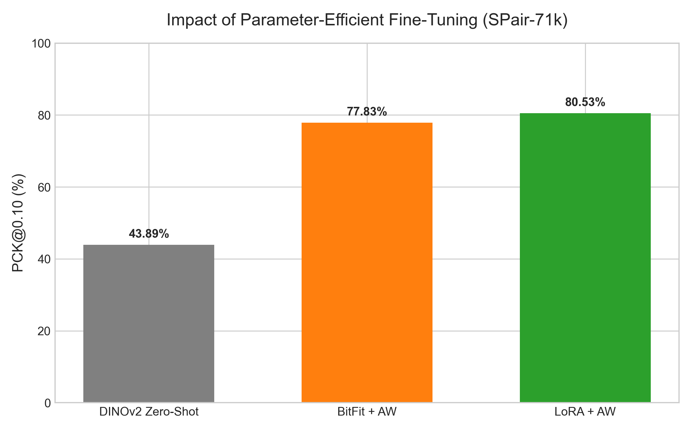
7. Parameter-Efficient Fine-Tuning (SPair-71k)
Implementation of LoRA and BitFit to specialize DINOv2. - LoRA achieves ~80.5% PCK, doubling the baseline zero-shot performance. - BitFit is extremely competitive despite training only bias terms.

Slide 9
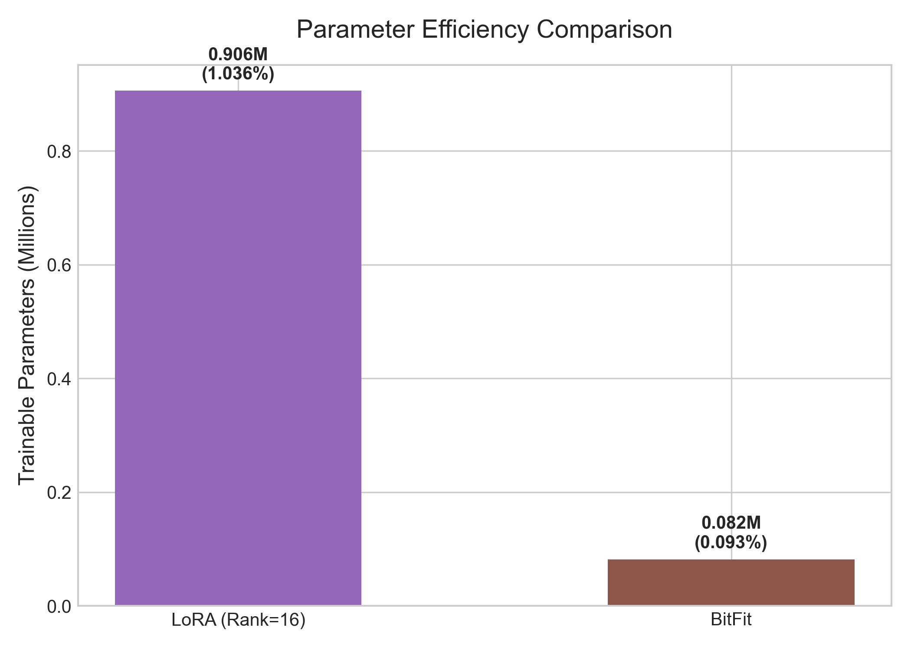
8. Parameter Efficiency Trade-off
- LoRA trains only 1.03% of the network (0.9M parameters). - BitFit trains a negligible 0.09% (82K parameters) yet yields 77.8% PCK, demonstrating incredible bias-driven adaptability.

Slide 10
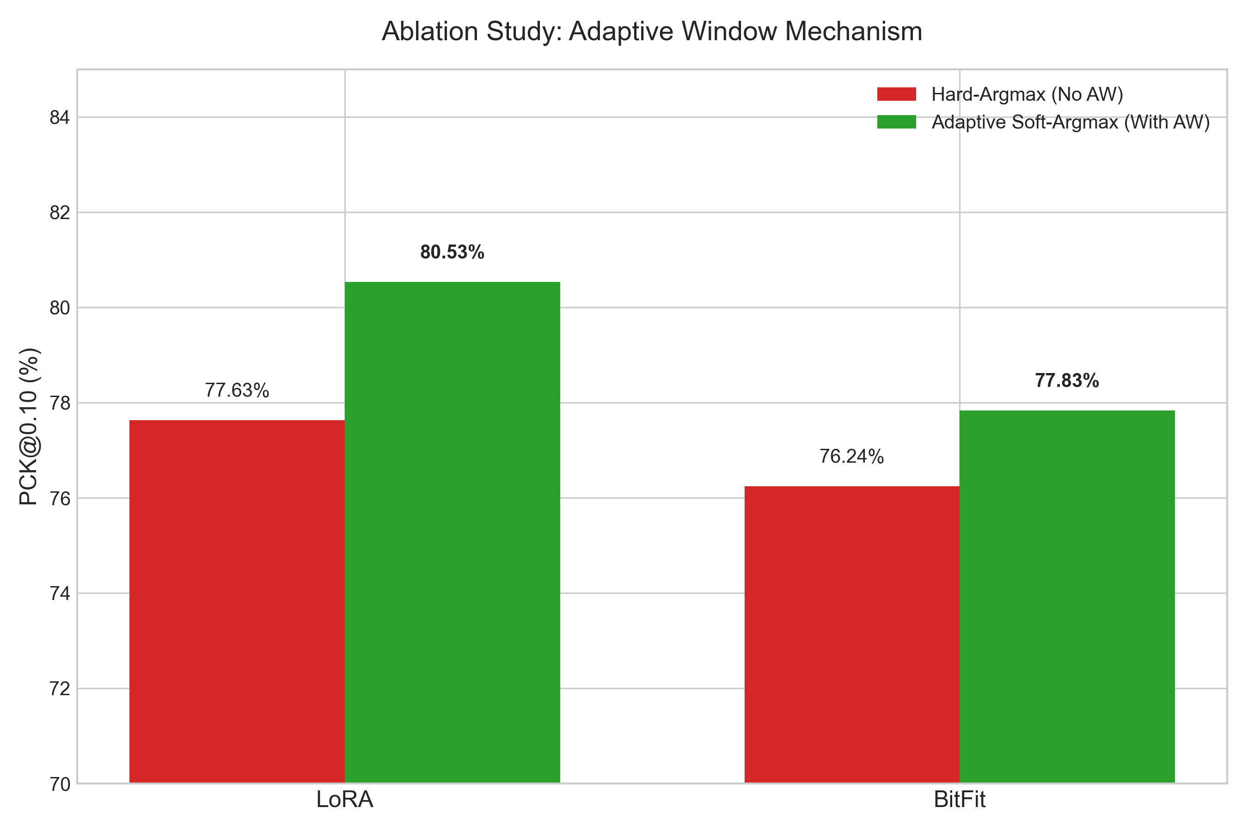
9. Architecture Ablation: Adaptive Window
- Removing the Adaptive Window causes LoRA to drop ~3% PCK. - The adaptive boundary mechanism is critical to suppress background noise before computing the expected value.

Slide 11
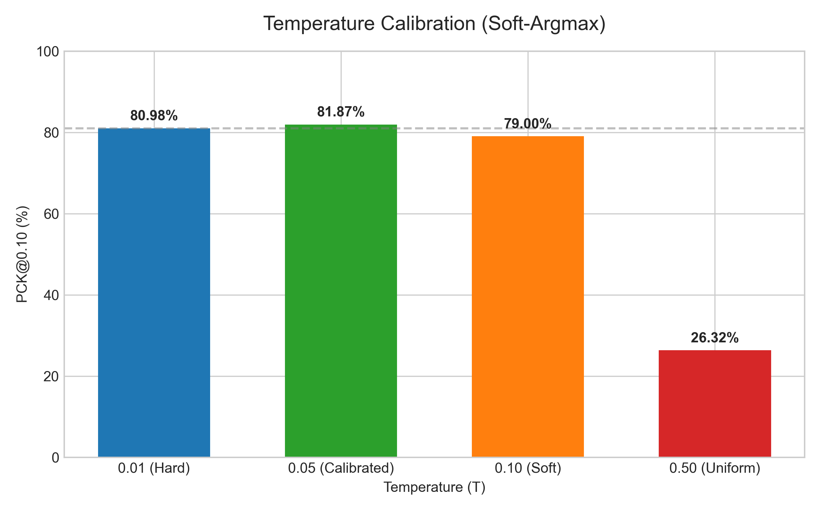
10. Temperature Calibration (Soft-Argmax)
- T=0.01 (blue) behaves like Hard-Argmax, losing sub-pixel smoothness. - T=0.05 (green) is the calibrated sweet-spot for local regularization. - T>=0.50 collapses the prediction into a uniform distribution.

Slide 12
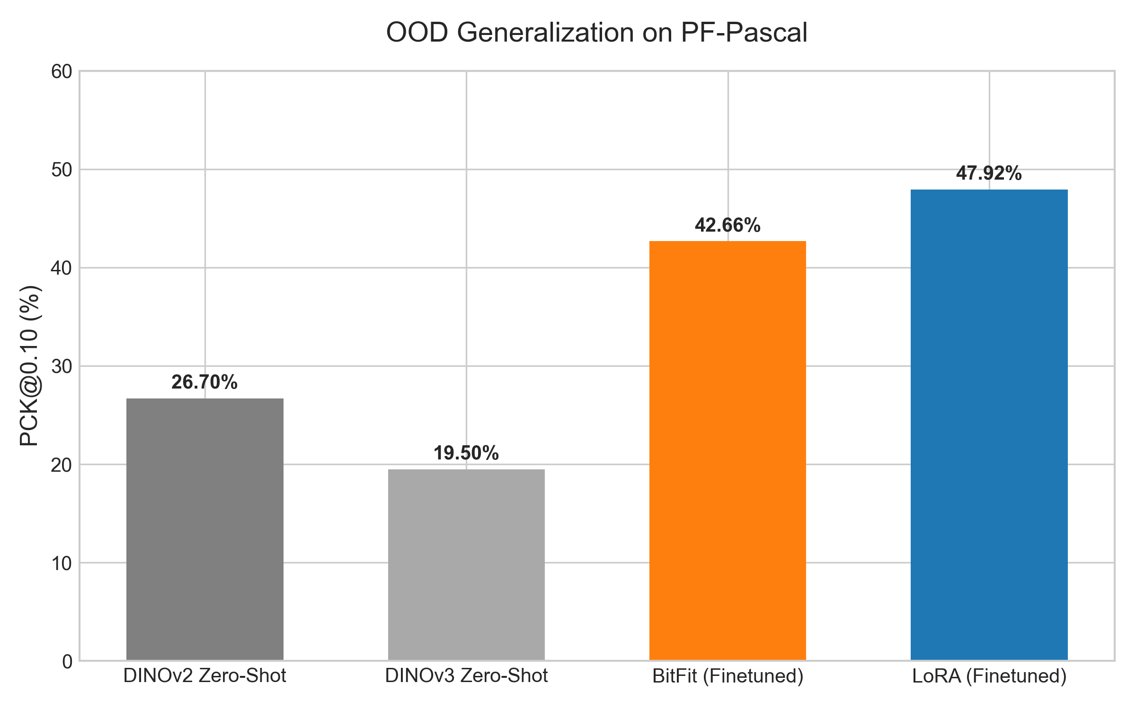
11. Out-of-Distribution Generalization
- Testing on PF-Pascal without any re-training. - The finetuned models retain a massive +20% gain over exactly equivalent frozen baselines, proving they learned 'how to match' rather than memorizing domain.

Slide 13
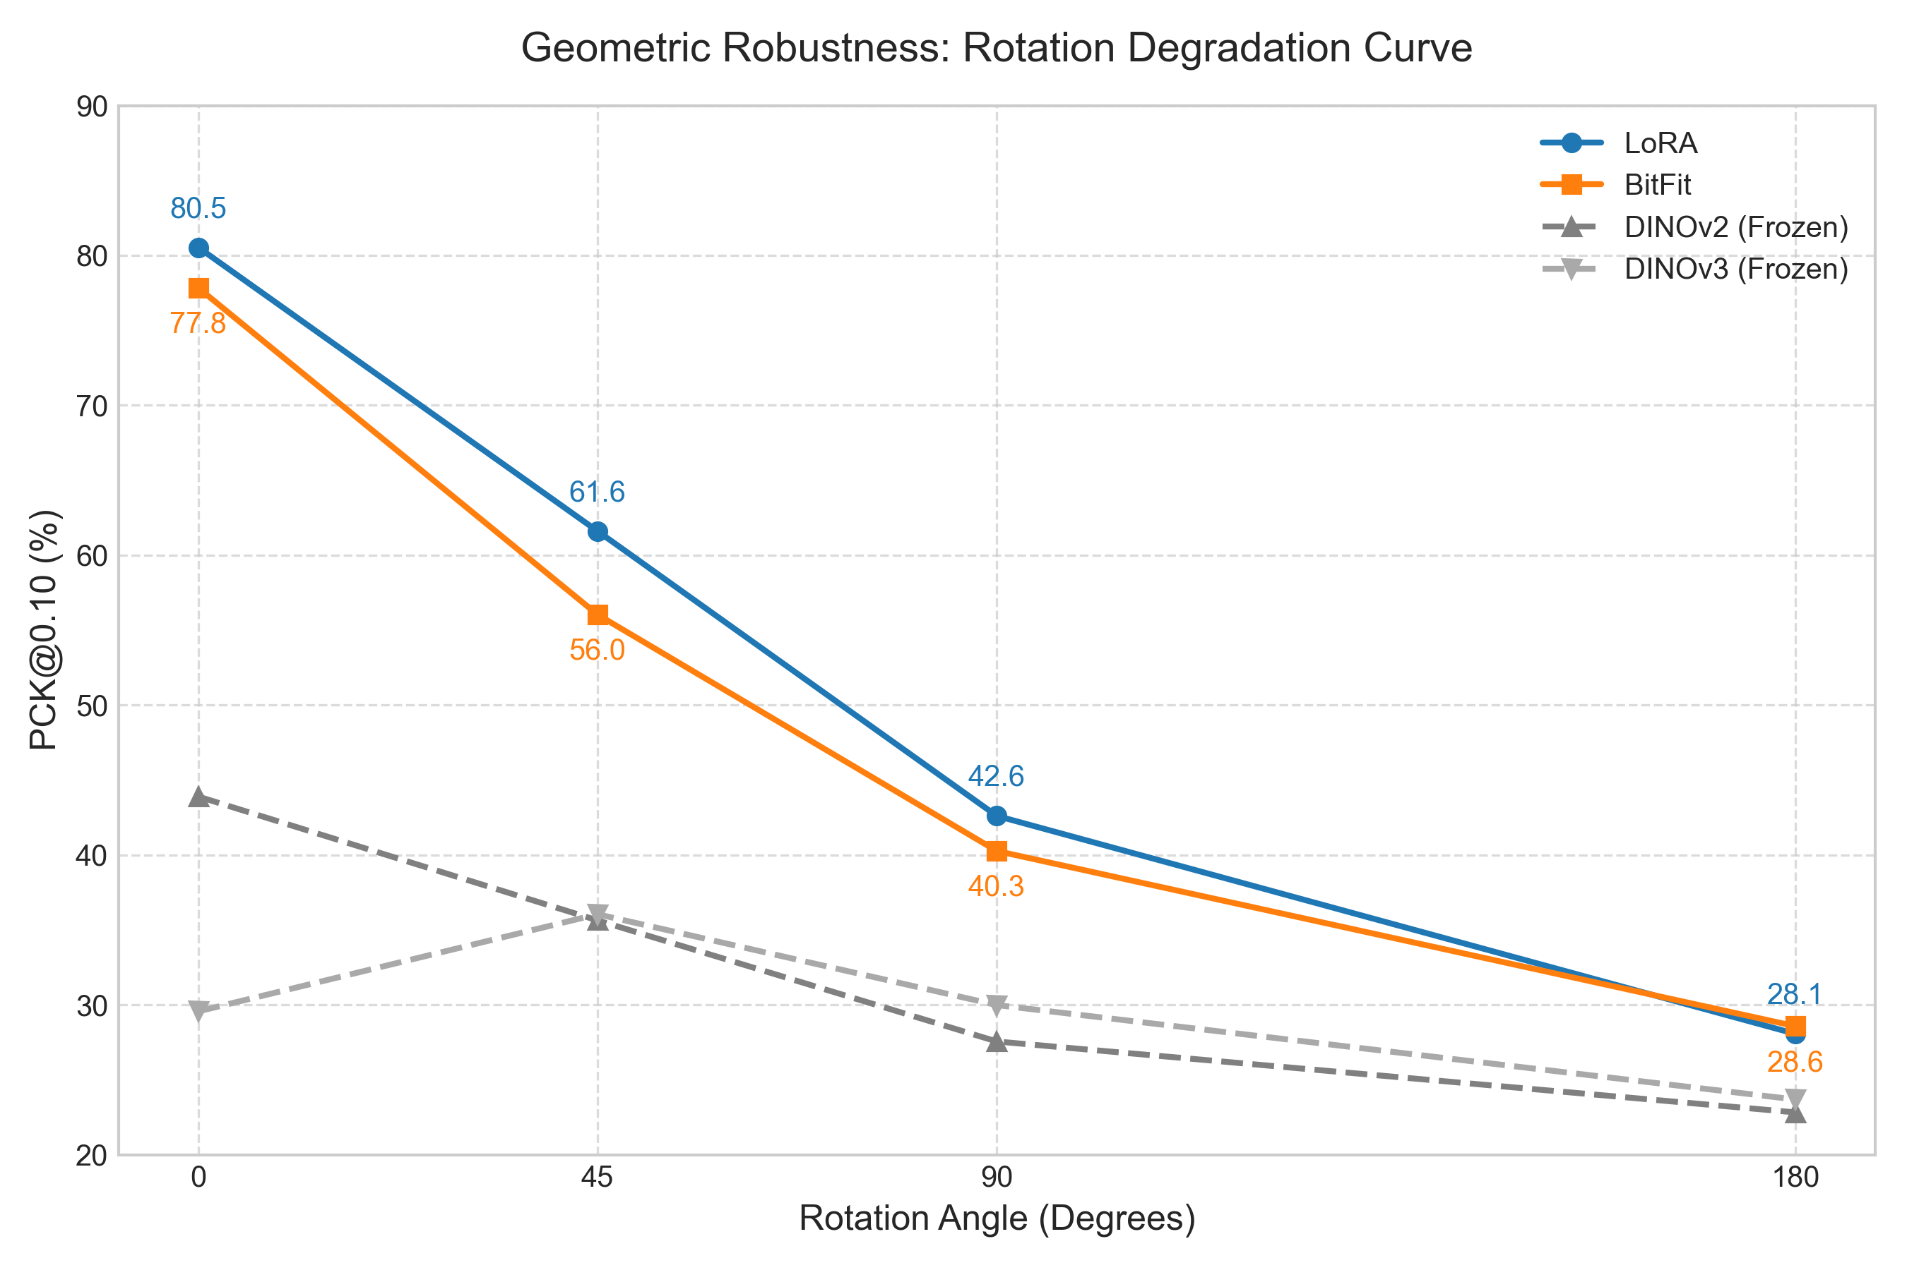
12. Geometric Robustness (Rotation)
- Models degrade gracefully up to 90 degrees. - DINOv3 shows unique resilience at 45 but structurally shares rotation vulnerability (Absolute Positional Encoding).

Slide 14
13. Conclusion & Future Work
Conclusions: - LoRA + Soft-Argmax is a highly effective pipeline for Semantic Corres. - Temperature scaling is essential for proper coordinate extraction. Future Work: - Integration of Inference-Time Augmentation (ITA) to solve rotation. - Exploration of multi-scale feature hierarchies for small scale matching.

