Slide 1
PAID PILOT STORY
RigSight AI turns test-run data into reviewed evidence.
A demo deck for engineering validation teams that need faster anomaly triage, cleaner review decisions, and customer-ready run reports.
CSV
Alerts
PDF
Import sanitized pilot telemetry
Explain what changed and why
Export a report from the run
RigSight AI sales demo
01
Notes:
Open by framing the buyer problem: test teams already have sensor data, but review and reporting are still manual.

Slide 2
PROBLEM
Validation teams lose time turning raw telemetry into decisions.
The demo should feel like a working review room, not a backend architecture tour.
Sensor CSVs are easy to collect but slow to interpret consistently.
Threshold checks are often scattered across scripts, spreadsheets, or tribal knowledge.
Reports are assembled after the fact, when the decision trail is already fading.
A pilot has to prove value without requiring proprietary data or enterprise auth first.
RigSight AI sales demo
02
Notes:
Keep this slide short. The audience should hear their current workflow in plain language.

Slide 3
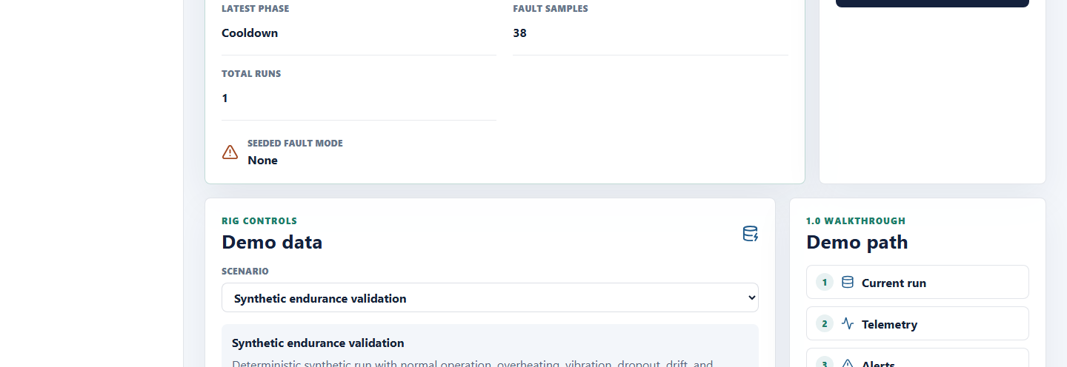
FIRST SCREEN
The run, not the backend, is the center of the workspace.
RigSight AI sales demo
03
Notes:
Start the live demo here. Point to action required, the active run, high alerts, and review backlog.

Slide 4
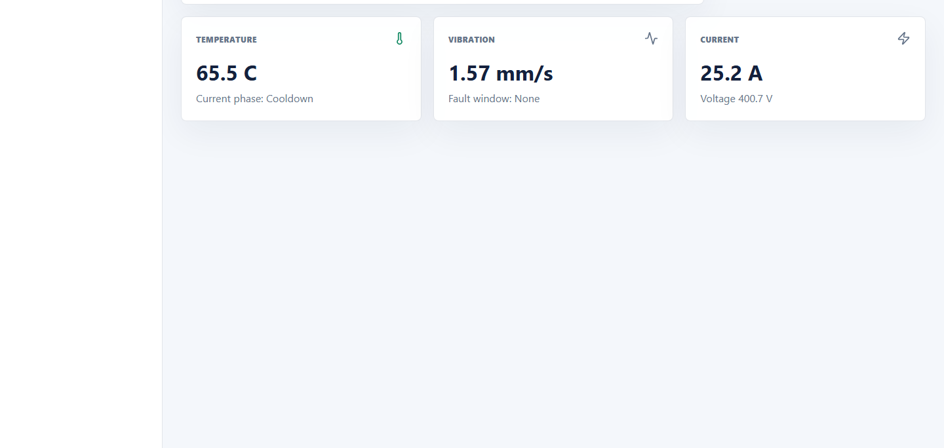
TELEMETRY
The investigation starts from sensor behavior, not a static list.
Talk track
Select the current run.
Show the metric trend and phase context.
Explain that thresholds and ML alerts attach back to these readings.
RigSight AI sales demo
04
Notes:
Use this as the transition from overview to detailed investigation.

Slide 5
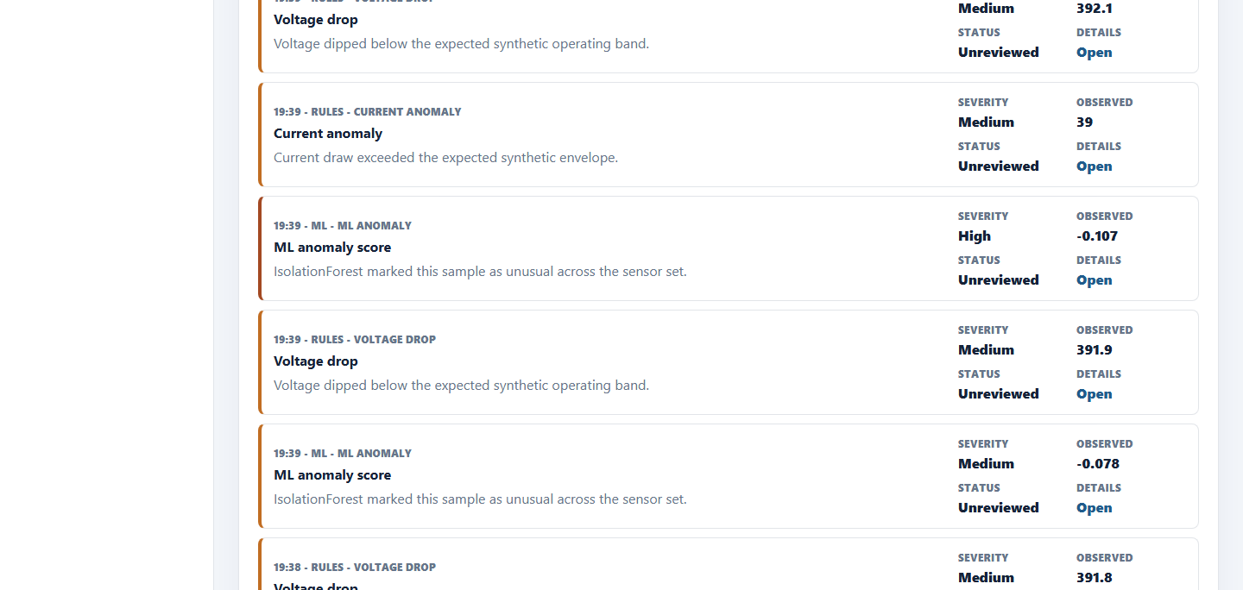
EXPLAINABILITY
Alerts need to say why they fired and what to do next.
Rules show configured range and observed value.
ML flags unusual cross-sensor behavior.
The recommendation is written for the test engineer reviewing the run.
RigSight AI sales demo
05
Notes:
Open one alert during the live demo and read the Why this fired section aloud.

Slide 6
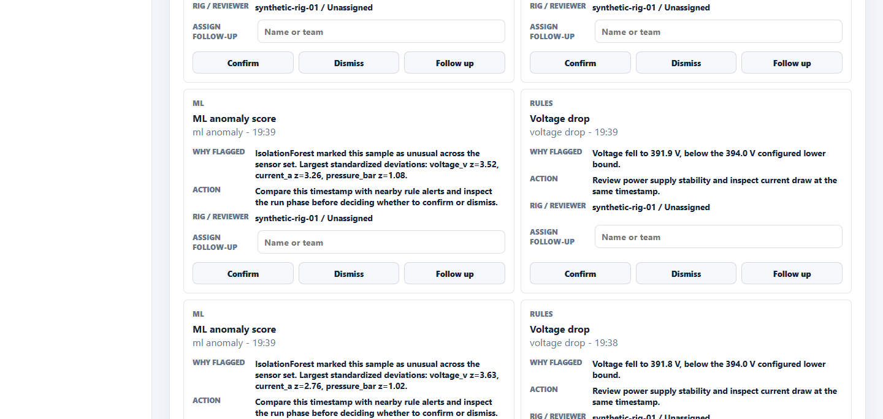
HUMAN REVIEW
The review queue creates a decision trail for the run.
Assign follow-up ownership.
Confirm, dismiss, or flag for follow-up.
Preserve the reviewer decision alongside the alert context.
RigSight AI sales demo
06
Notes:
This is where the product becomes an operational workflow rather than a chart viewer.

Slide 7
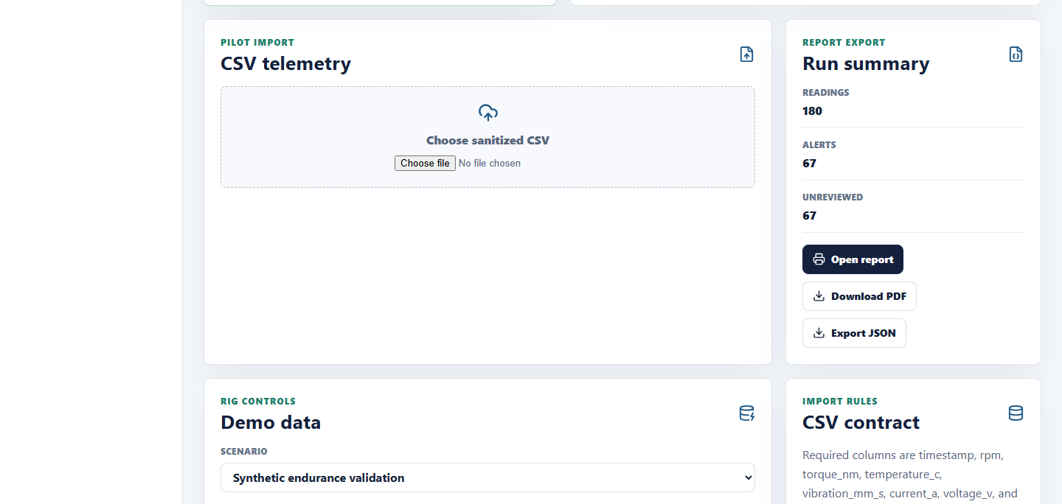
PILOT DATA
A prospect can try the workflow with sanitized CSV data.
Use the CSV template as the demo handoff.
Preview validation errors before upload.
Export the same run as JSON, HTML, or PDF.
RigSight AI sales demo
07
Notes:
Offer to run one of their sanitized CSVs through a paid pilot after the call.

Slide 8
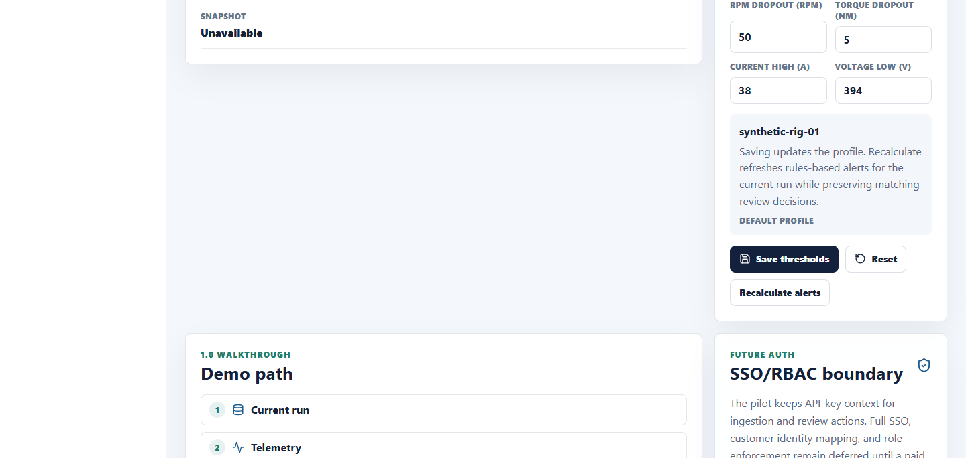
TUNING
Thresholds can match the test stand before adding enterprise auth.
Configure sensor limits per rig.
Recalculate rule alerts while preserving matching review state.
Keep SSO and RBAC out of scope until a customer asks for it.
RigSight AI sales demo
08
Notes:
This slide handles technical buyer questions without making infrastructure the main story.

Slide 9
PILOT PACKAGE
The sales motion is a short paid pilot with clear handoffs.
1. Bring data
2. Tune rules
3. Review alerts
4. Export proof
Customer shares sanitized CSV telemetry using the template.
Set sensor thresholds with the validation engineer.
Walk through rule and ML detections with recommendations.
Generate a branded run report and agree on success criteria.
RigSight AI sales demo
09
Notes:
Use this as the commercial close: a paid pilot, not broad SaaS procurement.

Slide 10
PUBLIC DEMO DEPLOYMENT
Host a private demo link before selling self-serve SaaS.
Frontend: deploy the Vite app to Vercel or Netlify with demo environment variables.
Goal
Backend: deploy FastAPI on Render, Fly.io, Railway, or Azure Container Apps.
A reliable link for discovery calls and pilot follow-up, without implying full enterprise readiness.
Database: use managed Postgres, run Alembic migrations, and seed clean demo data.
Controls: protect the demo with a shared password or basic auth, add uptime checks, and reset demo data nightly.
RigSight AI sales demo
10
Notes:
Make clear that the hosted demo is for guided sales and pilots, not open signup.

