Slide 1


BUSINESS PROPOSAL
NutriPill
Essential nutrients for busy lives
By Dani, Max, William & Miguel
Notes:
Good morning, everyone. We are Dani, Max, William and Miguel, and today we would like to present our business proposal: NutriPill, a product that brings essential nutrients to people with busy lives. Over the next few minutes, we will explain the problem we have identified, our solution, who it is for, and how we plan to turn this idea into a successful brand.

Slide 2
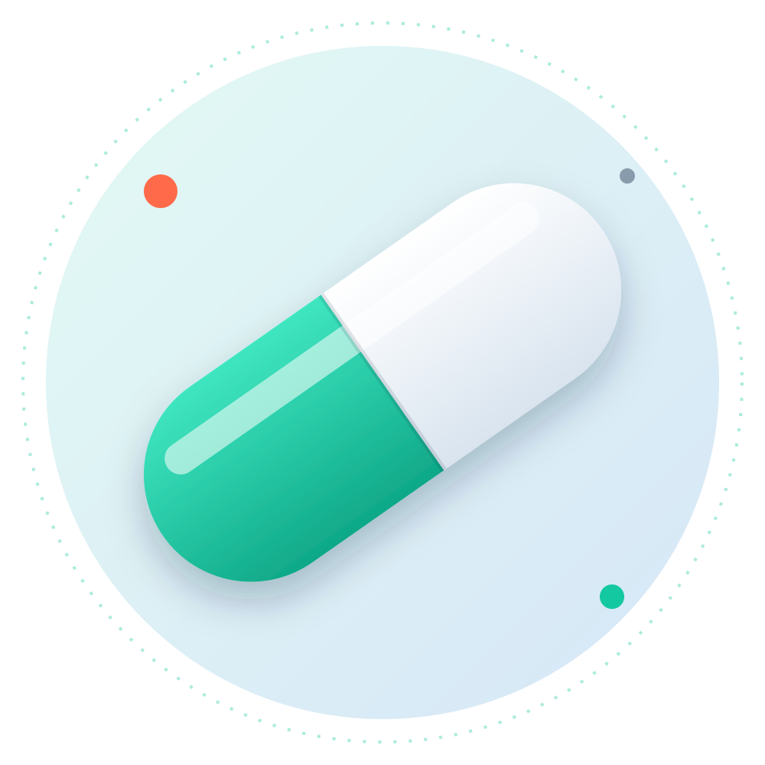

Introduction
01 / 08
Have you ever been so busy that you simply didn't have time to eat?
Imagine a pill that could give your body the essential nutrients it needs on those days when there is no time for a proper meal.
Meet NutriPill: a convenient way to get essential nutrients on the go. Small, simple, and designed to fit perfectly into your busy lifestyle.
Small
Simple
On the go
Notes:
Let's start with a simple question: have you ever been so busy that you simply didn't have time to eat? Most of us have experienced this at some point. Now, imagine a pill that could give your body the essential nutrients it needs on those days when there is no time for a proper meal. That is exactly what NutriPill is: a convenient way to get essential nutrients on the go. It is small, simple, and designed to fit perfectly into a busy lifestyle.

Slide 3



The Problem
02 / 08
Nowadays, many people have such busy schedules that they don't have enough time to prepare or eat proper meals. Students and workers, in particular, often skip meals because they are always in a hurry.
Low energy
Difficulty concentrating
Poor nutrition
Without regular meals, the body runs out of fuel long before the day is over.
Skipping meals makes it much harder to stay focused in class or at work.
Over time, the body misses out on the nutrients it needs to stay healthy.
What they need is a quick and convenient way to get essential nutrients when there is no time to eat.
Notes:
So, what is the problem? Nowadays, many people have such busy schedules that they don't have enough time to prepare or eat proper meals. Students and workers, in particular, often skip meals because they are always in a hurry. As a result, they suffer from low energy, they find it difficult to concentrate, and, over time, their nutrition becomes poor. Clearly, what these people need is a quick and convenient way to get essential nutrients when there is simply no time to eat.

Slide 4




Our Solution
03 / 08
Innovative
Small and easy to carry
A brand-new way of getting essential nutrients in seconds.
It fits easily into a pocket, backpack or bag.
Keeps your energy up
Perfect for busy people
It helps you maintain your energy throughout the day.
Ideal for students and workers with demanding schedules.
Please note: although NutriPill does not replace a complete meal, it offers a practical way to supplement your nutrition when life gets busy.
Notes:
This is where our solution comes in. NutriPill is an innovative and convenient pill designed to provide essential nutrients when people don't have time to eat. It is small, easy to carry, and perfect for busy students and workers. Our main goal is to help people maintain their energy and get extra nutrients throughout the day. However, we want to be honest: NutriPill does not replace a complete meal. Instead, it offers a practical way to supplement your nutrition when life gets busy.

Slide 5




Who Is Our Brand Directed To?
04 / 08
NutriPill is designed for busy people who don't always have time to eat properly, especially those who need a quick and convenient way to supplement their nutrition during a hectic day.
Students
Workers
Athletes
Hectic lifestyles
Long days of classes, exams and homework often leave little time for lunch.
Tight deadlines and back-to-back meetings mean meals are often skipped.
Intense training requires a steady supply of essential nutrients.
Anyone who is constantly on the move and short on time.
Notes:
But who exactly is our brand directed to? NutriPill is designed for busy people who don't always have time to eat properly. Our main target audience includes students, who spend long days in class and studying; workers, who often skip lunch because of tight deadlines and meetings; athletes, who need a steady supply of nutrients for their training; and, in general, anyone with a hectic lifestyle. It is especially useful for those who need a quick and convenient way to supplement their nutrition during a busy day.

Slide 6






Action Plan
05 / 08
Our business model is built on three key pillars:
01
02
03
Revenue
Channels
Pricing
We will generate income through direct sales of NutriPill, as well as experiences linked to the product.
We will build a strong presence on the main social networks, combined with face-to-face experiences.
Our prices will be affordable but with added value: a premium option that remains accessible to everyone.
Notes:
Now let's move on to our action plan. Our business model is built on three key pillars. Firstly, revenue: we will generate income through direct sales of NutriPill, as well as through experiences linked to the product. Secondly, channels: we will build a strong presence on the main social networks, combined with face-to-face experiences, so that people can get to know the brand in person. Finally, pricing: our prices will be affordable but with added value. In other words, NutriPill will be a premium option that remains accessible to everyone.

Slide 7




Growth Strategy
06 / 08
01
02
03
04
Create inspiring content
Work with local influencers
Create memorable experiences
Actively build a community
We will share content on social media that shows a real, everyday lifestyle.
We will partner with influencers who truly represent our brand's philosophy.
We will organise events, offer personalised kits and develop collaborations.
We will invite our customers to become a real part of the brand.
Notes:
Of course, having a good product is not enough; we also need a clear growth strategy. It consists of four steps. First of all, we will create inspiring content on social media that shows a real, everyday lifestyle. Next, we will work with local influencers who truly represent our brand's philosophy. After that, we will create memorable experiences, such as events, personalised kits and collaborations. Last but not least, we will actively build a community by inviting our customers to become a real part of the brand.

Slide 8


Our Proposal
07 / 08
WITH YOUR SUPPORT, WE CAN:
Develop joint products and experiences
We are looking for brands that want to grow with us.
Increase our reach through campaigns
What we propose is a strategic partnership in which you gain visibility, a stronger position among young consumers and a connection with new audiences.
Generate greater credibility and growth
Notes:
This brings us to our proposal. We are looking for brands that want to grow with us. What we propose is a strategic partnership in which our partners gain visibility, a stronger position among young consumers, and a connection with new audiences. With your support, we can develop joint products and experiences, increase our reach through advertising campaigns, and generate greater credibility and growth for both of us.

Slide 9



What We Expect to Achieve
08 / 08
In 6 months
Consolidate an active community around our brand.
In 12 months
Increase our digital reach and double our customer base.
In the long term
Establish ourselves as a leading brand in the local market, with expansion at a national level.
Notes:
Finally, we would like to share what we expect to achieve. In six months, we aim to consolidate an active community around our brand. In twelve months, we hope to increase our digital reach and double our customer base. And in the long term, our goal is to establish ourselves as a leading brand in the local market, with expansion at a national level. To sum up, NutriPill is a simple solution to a very common problem. Thank you very much for your attention. Do you have any questions?

