Slide 1
Anamoly detection for real time video surveillance

Slide 2
ABSTRACT
Video surveillance is one of the many ways available for monitoring crime or any unusual behaviour.
We attempted to create a model using convolutional neural networks to detect any anomalous activity or anomalies in the video for this purpose.
Our model will break down the input video into frames and look for anomalies.
The data is de-noised utilising the Gaussian blur feature to improve the model's efficiency. We're actively comparing and predicting various types of anomalies using the avenue dataset.

Slide 3
INTRODUCTION
Computer vision is the most rapidly developing section that collects information from all sorts of images and videos, which is termed to be the sequence of videos.
Our systems can distinguish things from digital photographs and respond appropriately to the images recognised by our system by combining deep learning models with computer vision.
Many recent events, such as terrorist attacks and a variety of other causes, have emphasised the urgent need for effective monitoring, and as a result, security and surveillance are the most critical issues in today's world, and we decided to conduct our research in this area. As a result, standard current surveillance systems, which use digital video (DVR) cameras with numerous channels, were deployed for surveillance. However, the most significant disadvantage of this paradigm is that it necessitates continual human monitoring, which causes human weariness and hence increases labour costs. We'll manually look through all of the video material to figure out when the anomaly occurred, which is exhausting, therefore we all need an automatic system that can detect it.

Slide 4
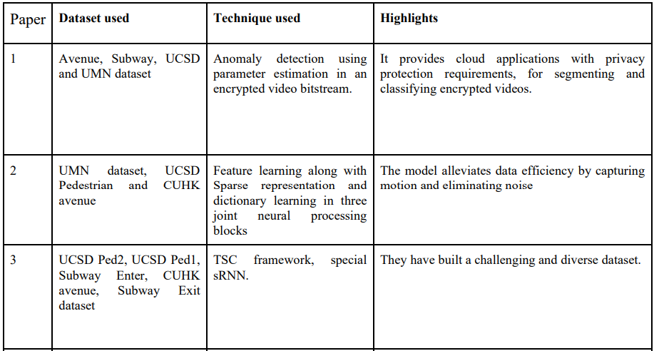
LITERATURE SURVEY

Slide 5
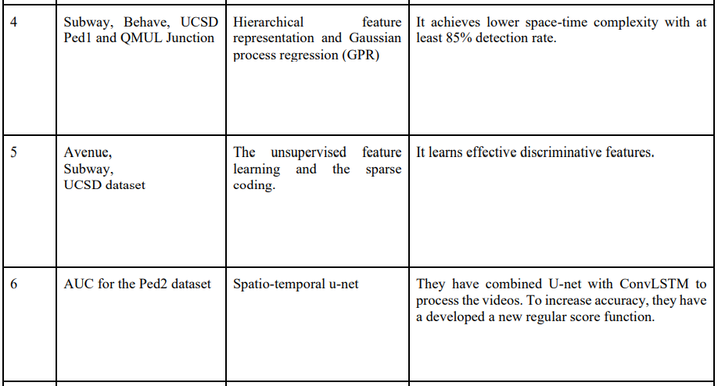
LITERATURE SURVEY

Slide 6
Dataset
Avenue Dataset -There are 16 training and 21 testing video clips. The training videos capture normal situations. We train the model with these videos and then use that model on test data to predict anomalies. The testing video clips contain 47 anomalous activities mostly by pedestrians which includes skating, throwing papers, people walking in the grass etc.

Slide 7
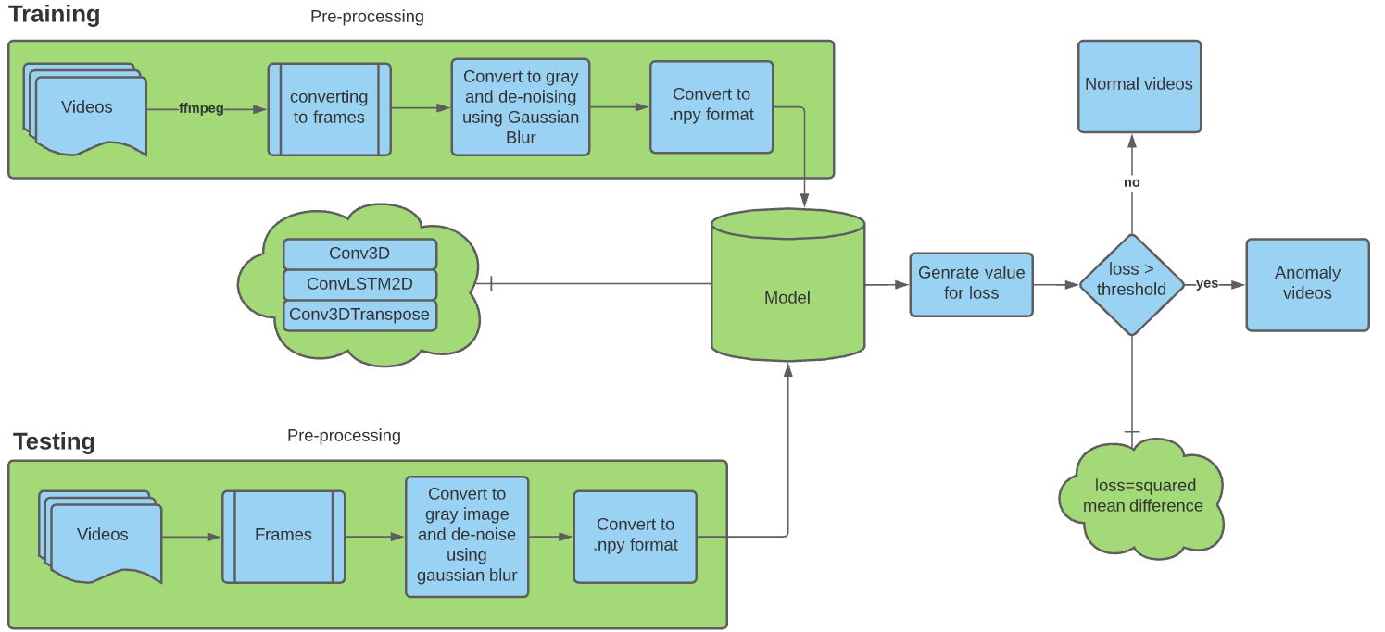
PROPOSED SYSTEM
personally monitoring all anomalies in crowded places is a highly exhausting task, we need to develop a system that can detect anomalies on its own, but with higher accuracy, better model building, and better pre-processing than prior works in the same idea.
The block diagram clearly shows that both the training and test sets are pre-processed in the same way. Both are converted into frames and grey images using the FFMPEG video extraction programme. The training set is then fed into a model with three sub models (Conv3D, ConvLSTM2D, Conv3DTranspose) and we train our model using that. Finally, the test set is fed into the model and a loss value is obtained that correlates to the video's behaviour. If the loss exceeds the threshold, it is referred to as an anomaly video; otherwise, it is considered a normal video.

Slide 8
SOFTWARE AND HARDWARE USED
Software – Google collab
Hardware - Nil
-

Slide 9
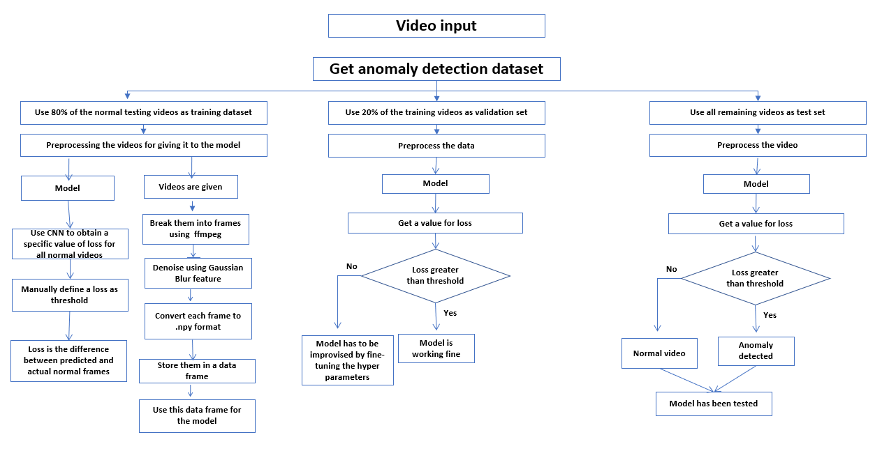
METHODOLOGY

Slide 10
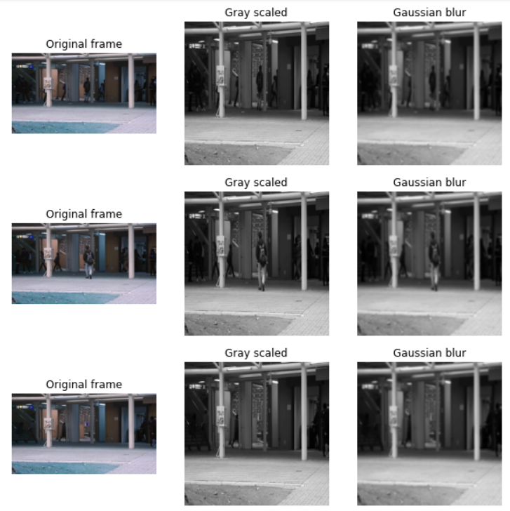
Sub-plots of the input frames

Slide 11
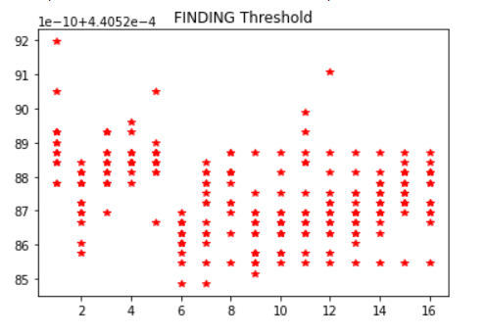
Plotting all the values which our model produces
Here, all the output values from the model of the normal videos are between 0.0004405285 to 0.0004405292
Thus values above 0.0004405292 are to be considered as a anomaly.

Slide 12
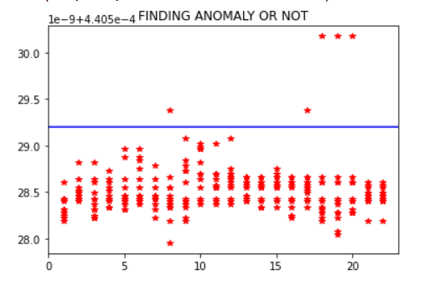
Finding Anomaly or not
Frames having a output values of above 0.0004405292 are considered as anomaly

Slide 13
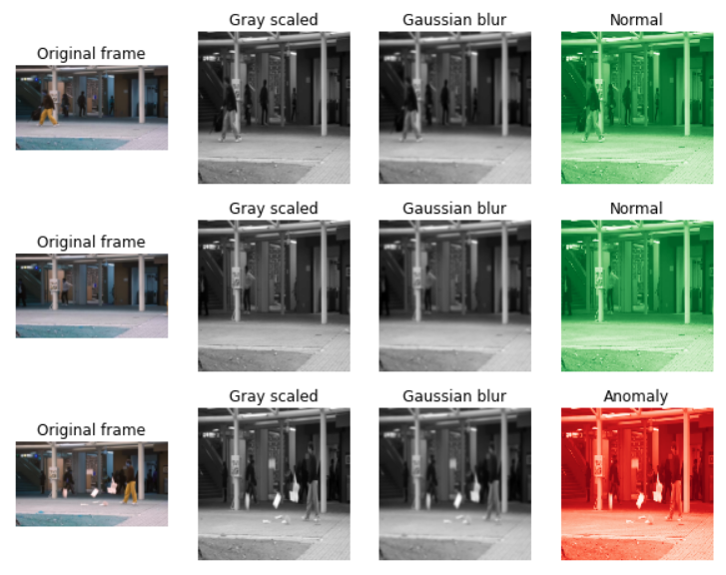
Sub-plots of the output

Slide 14
CONCLUSION
The main aspect is using gray and gaussian blur to denoise the frames. Denoising is that the technique of removing noise or distortions from a frame. there's an unlimited range of applications like blurred images that may be made clear. A grayscale image is one where all the colors present in it are purely shades of gray. the explanation for differentiating such images from the other type of color image is that less information has to be provided for every pixel. Fine-tuning the hyper-parameters like epochs, batch_size, patience, steps_per_epoch. From the table, we were ready to observe that because the epochs increased the accuracy was constant. Along with the epochs, and steps_per_epoch the accuracy has increased. But whereas the patience changing the patience doesn't have an excellent impact on increasing the accuracy of the model. So, these are the critical aspects of our work.
-

Slide 15
FUTURE SCOPE
Future work includes investigating other network architecture.
Dimensionality reduction can be done to improve accuracy. When we try to plot the training accuracy vs validation loss the curve descends indicating that the model is open to more training.
We plan to better the model by trying other techniques and finally applying our model to more complex situations and see how it performs
-

Slide 16
REFERENCES
[1] Guo, J., Zheng, P. and Huang, J., 2019. Efficient privacy-preserving anomaly detection and localization in bitstream video. IEEE Transactions on Circuits and Systems for Video Technology, 30(9), pp.3268-3281.
[2] Zhou, J.T., Du, J., Zhu, H., Peng, X., Liu, Y. and Goh, R.S.M., 2019. Anomalynet: An anomaly detection network for video surveillance. IEEE Transactions on Information Forensics and Security, 14(10), pp.2537-2550.
[3] Luo, W., Liu, W., Lian, D., Tang, J., Duan, L., Peng, X. and Gao, S., 2019. Video anomaly detection with sparse coding inspired deep neural networks. IEEE transactions on pattern analysis and machine intelligence.
[4] Cheng, K.W., Chen, Y.T. and Fang, W.H., 2015. Gaussian process regression-based video anomaly detection and localization with hierarchical feature representation. IEEE Transactions on Image Processing, 24(12), pp.5288-5301.
[5] Chu, W., Xue, H., Yao, C. and Cai, D., 2018. Sparse coding guided spatiotemporal feature learning for abnormal event detection in large videos. IEEE Transactions on Multimedia, 21(1), pp.246-255.
[6] Li, Y., Cai, Y., Liu, J., Lang, S. and Zhang, X., 2019. Spatio-temporal unity networking for video anomaly detection. IEEE Access, 7, pp.172425-172432.
[7] Leyva, R., Sanchez, V. and Li, C.T., 2017. Video anomaly detection with compact feature sets for online performance. IEEE Transactions on Image Processing, 26(7), pp.3463-3478.
[8] Ganokratanaa, T., Aramvith, S. and Sebe, N., 2020. Unsupervised anomaly detection and localization based on deep spatiotemporal translation network. IEEE Access, 8, pp.50312-50329.
-

