Slide 1
Mysql实战之
统计优化基础篇
快
帅
酷
刻意训练自己的技术套路
讲师：沈逸

Slide 2
使用PHP(swoole)进行基础手工分表（按年份）

Slide 3
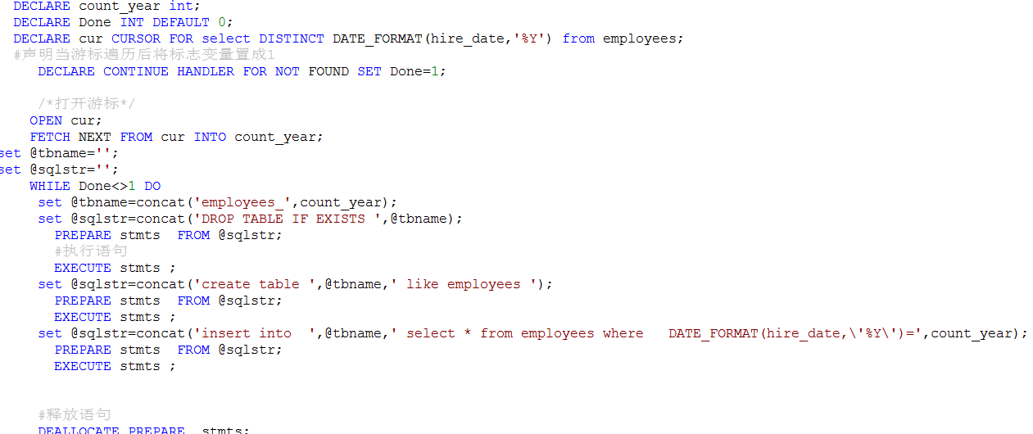
切割表

Slide 4
今天主要演示下程序切割
没啥太大技术含量，主要是“存储过程”实在不是很方便
第一步 ：获取所有 年份
define("AllYear","select DISTINCT DATE_FORMAT(hire_date,'%Y') as count_year from employees ");
function splittable(array $mysqlinfo){
$swoole_mysql = new Swoole\Coroutine\MySQL();
$swoole_mysql->connect($mysqlinfo);
$years = $swoole_mysql->query(AllYear);
foreach ($years as $row)
{
//打印出来看看
}

Slide 5
写协程执行过程
go(function() use($year,$mysqlinfo){
$mysql = new Swoole\Coroutine\MySQL();
$mysql->connect($mysqlinfo);
$tbName="employees_".$year;
$sql="DROP TABLE IF EXISTS $tbName;";
$stmt = $mysql->prepare($sql);
$stmt->execute();
$sql="create table $tbName like employees;";
$stmt = $mysql->prepare($sql);
$stmt->execute();
$sql= "insert into $tbName select * from employees where DATE_FORMAT(hire_date,'%Y')=$year";
$stmt = $mysql->prepare($sql);
$stmt->execute();
defer(function() use($mysql,$year){
$mysql->close();
echo "$year done ".PHP_EOL;
});
});

Slide 6
欢迎加入我们的QQ群
程序员在囧途教育QQ群
606976586

