Slide 1

Predicting Bitcoin’s Next Daily Close Price
Author: Jonathon Johnson

Slide 2
Problem/Issue
Can Bitcoin’s Daily Close Price be predicted and forecasted?
What variables are important and can be used in predicting this price?
Any financial indicators to aid in making trading decisions?

Slide 3

EDA: Basic Overview
BTC-USD: 2,309 rows BCH-USD: 1,269 rows
BNB-USD: 1,267 rows BSV-USD: 250 rows
EOS-USD: 1,291 rows ETH-USD: 1,985 rows
LTC-USD: 2,309 rows XRP-USD: 2,309 rows
XTZ-USD: 250 rows
Total rows: 13,239 rows
Column values/names: ‘Date’, ‘Open’, ‘High’, ‘Low’, ‘Close’, ‘Adj Close’, and ‘Volume’
All data retrieved from
Final rows of data used in modeling: 346 rows
Note: the few existing null values didn’t play a part in any modeling

Slide 4
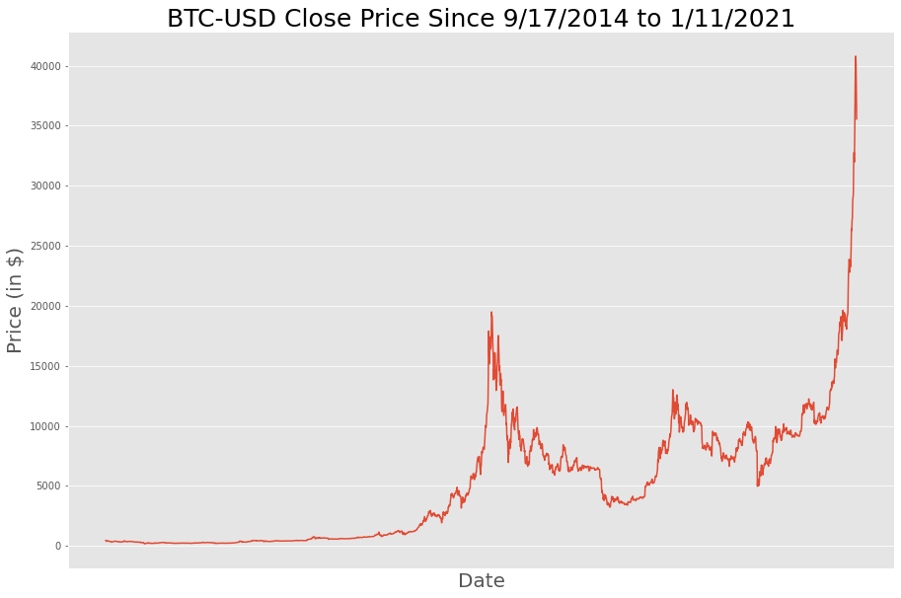
EDA: BTC-USD Over Time
*Near the end of 2018,
Bitcoin’s price crashed
*Another similar plunge
is quite possible in the
near future
*Extremely bullish
trend since
March 2020
*standard deviation:
$5,269.66
*max: $40,797.61
*min: $178.10

Slide 5
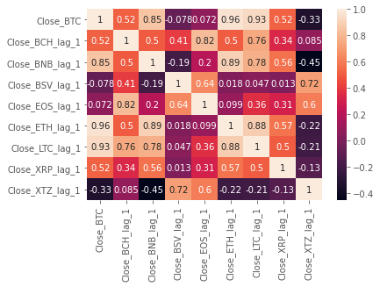
EDA: Correlation Plot
Highest correlation
between single-day
time-lagged ETH-USD,
LTC-USD, BNB-USD,
BCH-USD, and
XRP-USD with
BTC-USD

Slide 6
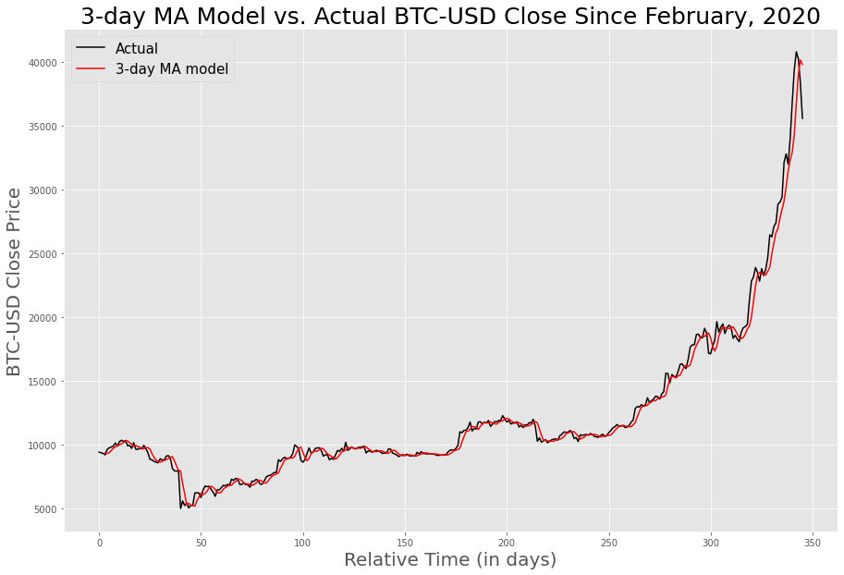
Baseline Model (3-day Moving Average)
Price(t) ~ [Price(t-1) + Price(t-2) + Price(t-3)]/3
RMSE: ~764.54
🖌

Slide 7
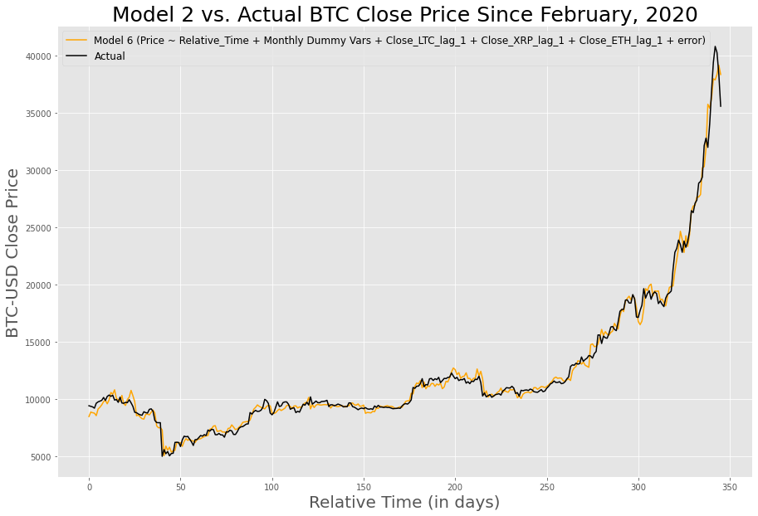
2nd Model (Multiple Linear Regressive Time Series)
Price ~ Relative_Time + Feb + Jun + Aug + Sep + Oct + Nov + Jan + Close_LTC_lag_1 + Close_XRP_lag_1 + Close_ETH_lag_1
RMSE: ~613.96
Improvement
over baseline
model, but more
improvement
can be made!

Slide 8
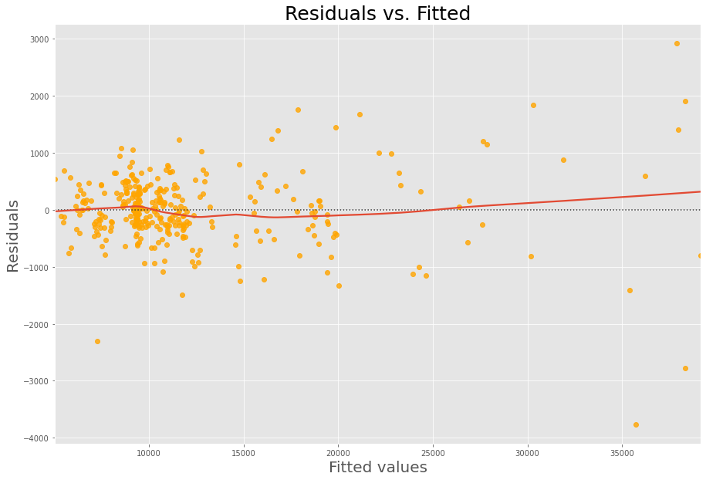
2nd Model (Residuals)

Slide 9
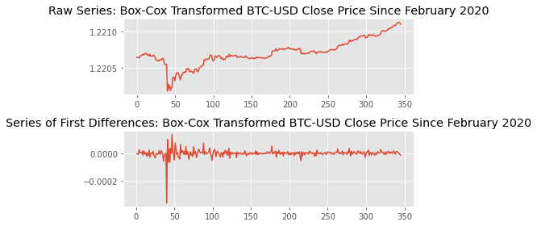
ARIMA: Achieving Stationarity
Box-Cox Transformation with first-order difference
ADF p-value ~ 3.12E-11 << 0.05

Slide 10
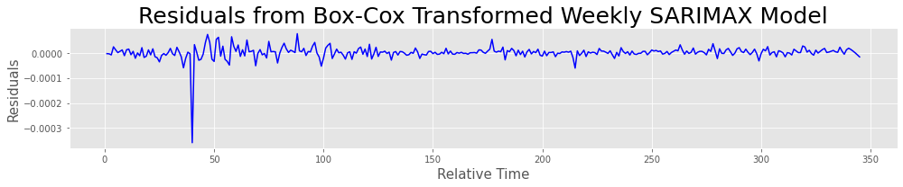
3rd Model (Seasonal ARIMA Time Series)
Lowest AIC
Order: p = 1, d = 1, q = 1
Seasonal_order: (1,0,[ ], 7)
RMSE: ~586.81
Further improvement made upon 2nd model

Slide 11
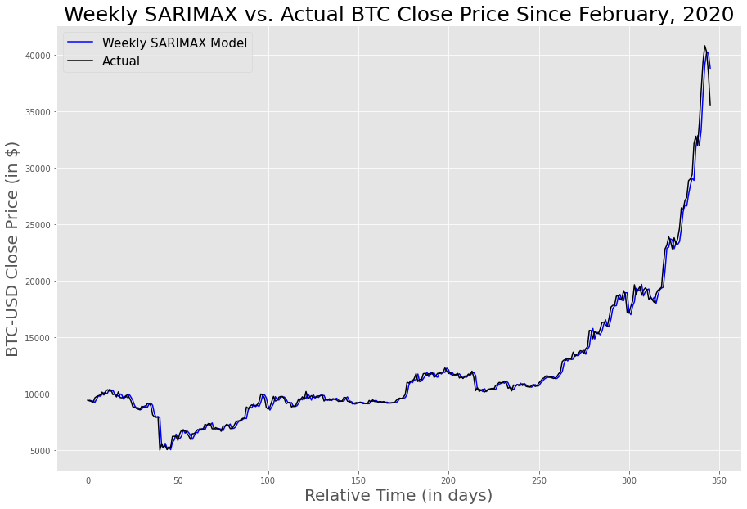
3rd Model (Seasonal ARIMA Time Series) Plot

Slide 12
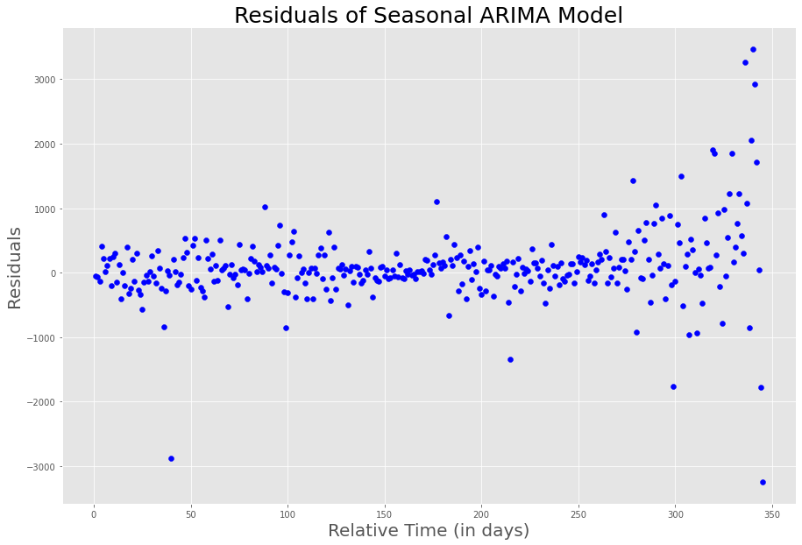
3rd Model (Residuals)

Slide 13
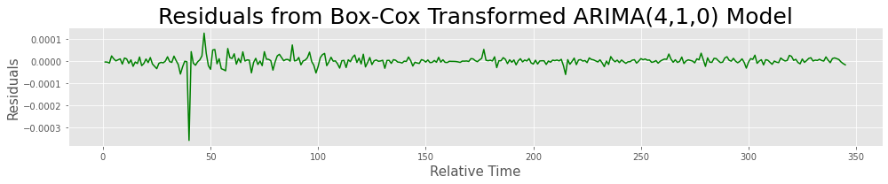
4th Model (ARIMA Time Series)
Highest Log Likelihood
Order: p = 4, d = 1, q = 0
RMSE: ~569.14
Best model thus far!

Slide 14
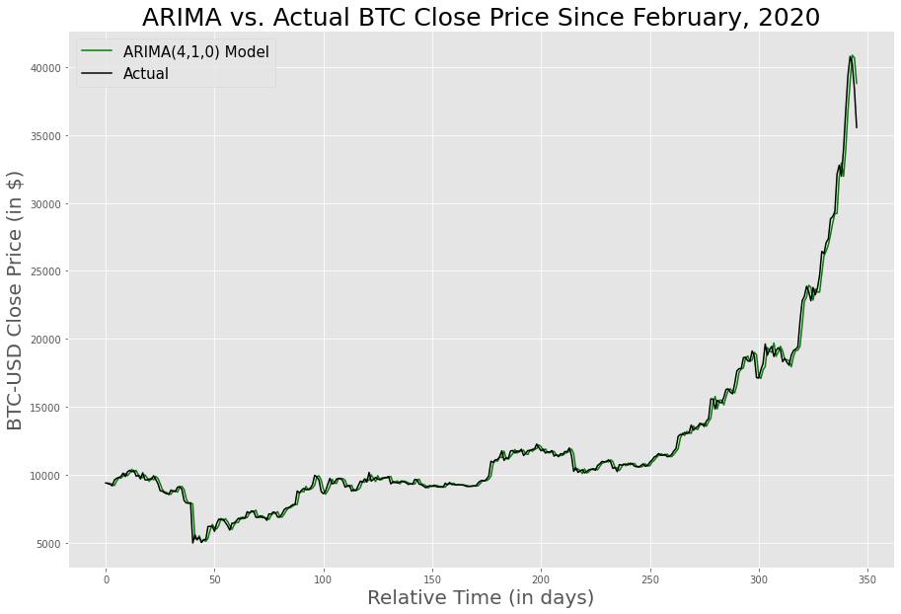
4th Model (ARIMA Time Series) Plot

Slide 15
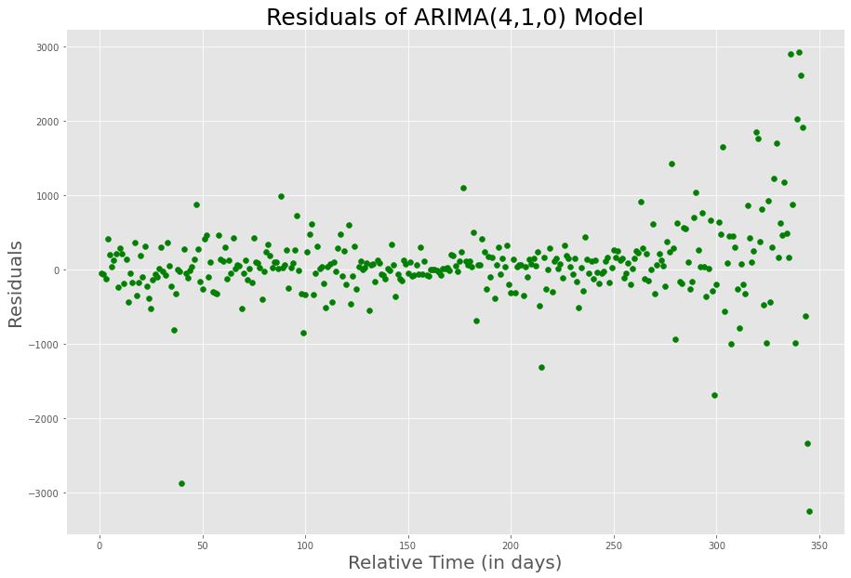
4th Model (Residuals)

Slide 16
Error of Best Model vs. 3-day MA Baseline Model
BTC_actual = $33,922.96
BTC_ARIMA_pred = $36,010.05
BTC_MA_pred = $38,059.21
The ARIMA(4,1,0) model had an error of ~6.15% vs. the 3-day MA model’s error of 12.19%!

Slide 17
VWAP vs. Close, MACD vs. Signal, RSI, and Predicted Price Algorithmic Output for 11JAN21
10-day VWAP is above Close Price and crossing above Close Price (SELL).
MACD is below Signal (SELL).
RSI is above 70 (SELL).
Today's predicted BTC-USD Close Price is $36010.05. Yesterday's BTC-USD Close Price was $35566.66.

Slide 18
Summary
ARIMA(4,1,0) was best model to predict the next day’s BTC-USD price (lowest RMSE)
ARIMA(4,1,0)’s predicted price of $36,010.05 vs. BTC-USD’s actual close price of $33,922.96 had an error of ~6.15%
Results of algorithm resulted in a trading decision to sell or wait for a better opportunity to buy Bitcoin for 11JAN21; this aligned with yesterday’s BTC price of $33,922.96 compared to the the previous day’s price of $35,566.66 (an overall ~4.6% loss)

Slide 19
Next Steps
With more granular data, complete LSTM modeling of BTC-USD and tune/re-adjust to get better RMSE score than the best ARIMA model.
Model other cryptocurrencies through similar pipeline and construct dynamic cryptocurrency investment portfolio.
Inclusion of macroeconomic factors such as exchange rate of USD (DXY index), GDP, unemployment rate, and overall time progression of the United States' debt, as well as results of sentiment analysis of the respective cryptocurrencies on popular cryptocurrency news websites.

Slide 20
Questions?
github.com/Johnson202/

