Slide 1

McDonald’s Corporation: Performance Management Plan (PMP) Proposal for McDonald’s Restaurants in US Market
Author: Jonathon Johnson

Slide 2
Background of McDonald’s Corporation
39,198 restaurants worldwide (WallStreetZen, 2022)
~80% are franchises (Vaujour, 2018)
Over a third of restaurants are in US (~34.9%) (WallStreetZen, 2022)
Primarily franchise-based business model (Altimetry, 2019)
Mission/Vision:
“[Serving] delicious food people feel good about eating, with convenient locations and hours and affordable prices, and [working] hard to offer the speed, choice, and personalization our customers expect,” according to McDonald’s (2022c).
To serve & integrity are some core values (McDonald’s, 2022c)
Investing in its’ people (McDonald’s, 2022d)
High quality of products/services (with variety) (McDonald’s, 2022a)
Notes:
The “concept of fast food, which eliminated the need for wait staff,” according to Downie (2021), has made McDonald’s one of the biggest names in the fast-food industry, much through its’ innovation, quick delivery of meals, and extensive recognition of its’ brand by customers (Downie, 2021). 39,198 restaurants worldwide represent McDonald’s Corporation (WallStreetZen, 2022), with approximately 80% being franchises (Vaujour, 2018) and over a third situated in the United States (~34.9% in total) (WallStreetZen, 2022). By converting most of its’ restaurants to franchises over the last several decades, it has improved its’ profitability significantly, much due to franchisees paying fees to set up and run the restaurant under the McDonald’s brand and taking on most of the cost and risk (responsible for majority of restaurant operations) (Altimetry, 2019). Therefore, McDonald’s Corporation generates much of its’ “revenues from the rent, royalties, and fees paid by the franchisees although it also earns from the restaurants it directly owns and operates,” according to Samson (2020). As for the mission and vision (strategies) of McDonald’s Corporation, the company generally focuses on “[serving] delicious food people feel good about eating, with convenient locations and hours and affordable prices, and [working] hard to offer the speed, choice, and personalization our customers expect,” according to McDonald’s (2022c). The backbone of the company’s brand consists of commitment to a set of five core values on how to run the business and restaurants, two primary ones being to serve, i.e., to put the customers and employees first, and integrity, i.e., always doing the right thing (McDonald’s, 2022c). According to McDonald’s (2022c), it is “committed to fostering a safe, respectful, and inclusive workplace,” thus providing quality jobs for its’ employees and investing in its’ people with top priority (McDonald’s, 2022d). McDonald’s Corporation “[puts] people, processes, and practices [in] place to make quality food,” is “dedicated to improving the way [it prepares its’] quality food and the ingredients that go into it,” according to McDonald’s (2022a). For example, McDonald’s Corporation uses 100% fresh beef for the Quarter Pounder patty, employs food experts (chefs, dieticians, & suppliers) to ensure the right food is served, keeps nutrition in mind when compiling properly balanced Happy Meals for kids, and provides a wide variety of choices in the food it offers (McDonald’s, 2022a). Most importantly and per the fast-food concept, effectiveness and efficiency is the key ingredient to McDonald’s operations, i.e., “the mass production and preparation of ready-to-eat food products to accommodate a large number of customers and thus, increase sales volume, improve operational effectiveness and efficiency, and promote convenience by reducing wait time,” according to Samson (2020).

Slide 3
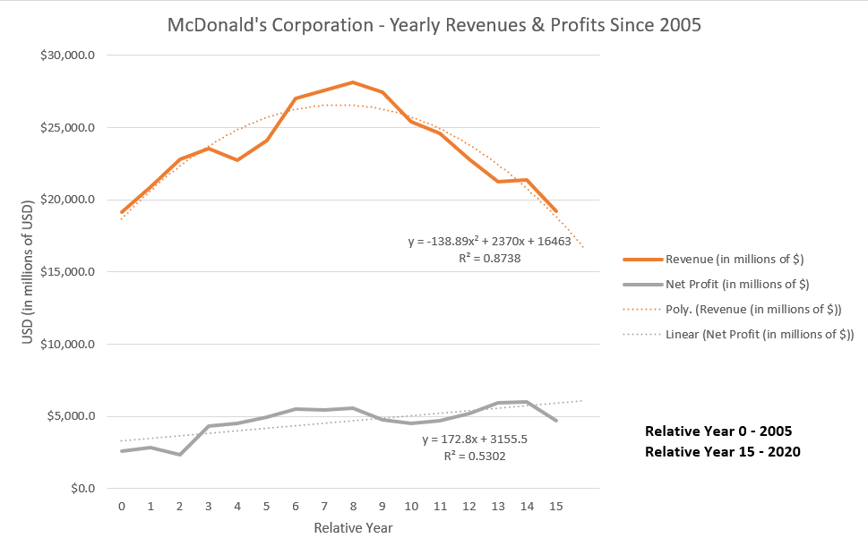
Overall Current Performance – Financially & Company-wide
Revenue peaked in 2013, steady decline since then
2020: revenue of $19.2078 billion & net profit of $5.9203 billion (net profit margin of ~30.8%) (Macrotrends, 2022)
Higher operating costs have plagued McDonald’s Corporation recently (Watrous, 2021)
Business Performance Issues:
Sexual harassment in workplace (Pratap, 2021)
Weaknesses inherent to franchise-based model (less control in employee management) (Pratap, 2021)
All-day breakfast menu halted (insufficient demand) (Pratap, 2021)
Notes:
Financial Performance
From a financial point-of-view, McDonald’s generated sales revenue peaked back in 2013 and has been on a steady decline since then. However, their net income/profit has been on a steady incline since 2005. Based on the most recent income statement made available by McDonald’s Corporation, the company raked in $19.2078 billion in sales revenue, with a net income of $5.9203 billion (a net profit margin of 30.8%) (Macrotrends, 2022). Projections for this past year’s (2021) revenue and net profit, based on second-degree and first-degree linear regression modeling respectively (refer to Figure above), were $18.827.2 billion and $5.9203 billion. 2020 was a rough year for McDonald’s Corporation in terms of sales, mainly due to the ongoing COVID-19 pandemic and resultant government restrictions (Watrous, 2021), but there was a “stronger operating performance in the US market,” according to Watrous (2021). “Higher selling, general and administrative expenses, higher restaurant closing costs, and lower gains on sales of restaurant businesses” are some of the major financial issues McDonald’s Corporation encountered and experienced in 2020 (Watrous, 2021). Other ones include higher labor and raw materials costs, higher costs incurred from supply chain operations and logistics, and technology-related costs (Pratap, 2021). At some point, McDonald’s Corporation will not be able to sustain increasing profits with decreasing revenues, so a plan needs to be put into action to resolve such a financial issue immediately.
Business Performance
As for McDonald’s Corporation’s most recent business performance, or how it’s been performing to reach its’ strategies, it has been both positive and negative. Positively, McDonald’s Corporation has continued to “[subject] its’ suppliers [to] strict standards . . . to promote quality across different branches,” according to Samson (2020). Moreover, it has worked to improve drive-thru service times by investing more in “staffing, positioning, and order assembly,” according to Watrous (2021). The fast-food restaurant’s “customers [still] feel extremely satisfied with the customer service,” according to Thomas (n.d.), and a bakery line was introduced into the McDonald’s restaurant business model most recently, with a plan to further improve its’ chicken sandwich menu items (Watrous, 2021). From a negative standpoint, McDonald’s Corporation has been experiencing a multitude of issues, e.g., customers feeling more emphasis should be put on offering more “high-quality food with healthier options,” according to Thomas (n.d.). Furthermore, innate issues lie within a franchise-based business model, such as employee management-related issues; this is due to the company have less control over franchisee-operated restaurants, which make up the bulk of its’ restaurants. More specifically, occurrences of sexual harassment in McDonald’s U.S.-based workplaces have surfaced in multiple reports, where 90% of McDonald’s restaurants in the U.S. are franchisee-operated (Pratap, 2021). This “damages the company’s reputation [while] the franchisees hardly bear any of the risk,” according to Pratap (2021). Lastly, the all-day breakfast feature of their food menu was halted in March 2020 (Pratap, 2021), much due to its’ lower demand during the COVID-19 pandemic and associated costs outweighing sales.

Slide 4
McDonald’s Corporation’s Product & Service Strategies
Product Strategies
Localization (Samson, 2020)
Cater to wide market with wide variety of products (Thomas, n.d.)
High-quality food with choice/personalization
Low prices (McDonald’s, 2022c)
Service Strategies
Fast service within minutes
Clean environment
Friendly staff (Thomas, n.d.)
Additional Support Data
MyMcDonald’s Rewards program/app (McDonald’s, 2022b)
Notes:
Product Strategies
A main component of McDonald’s Corporation’s product strategies is a focus on localization, i.e., “[developing] food products based on the culture of the locality to address the preferences of consumers in specific geographic markets,” according to Samson (2020). Therefore, menus vary from country to country and from region to region. However, a major part of the food menu is still uniform globally. Over time, McDonald’s Corporation has continued to add healthy food products to its’ food menu to attract more health-conscious customers (Thomas, n.d.). Another primary focus (of its’ product strategies) is to cater to “a wide target market . . . [by offering] a [wide] variety of products,” according to Thomas (n.d.), each with varying prices (but with low prices) (Thomas, n.d.). Since the performance of McDonald’s Corporation will be managed within only the U.S. market by this PMP, focus (in terms of product strategies) will instead be mainly placed on McDonald’s standard of serving high-quality food with choice and personalization, all with low prices and variety of product offerings in mind (McDonald’s, 2022c).
Service Strategies
As for how McDonald’s Corporation formulates its’ service strategies, the company strives to relatively quickly get the customer’s meal made and served within minutes of ordering (Thomas, n.d.), i.e., with “speedy service and friendly staff,” according to Thomas (n.d.). Maintaining a clean environment for customers to eat their food in (Thomas, n.d.) is another crucial component of McDonald’s service, as well as serving the food exactly how a customer orders since integrity, or doing the right thing, is a core value of McDonald’s Corporation (McDonald’s, 2022c).
Additional Support Data
In the U.S., McDonald’s Corporation maintains the MyMcDonald’s Rewards program on the McDonald’s app. Such a program provides many free offers to garner users, i.e., offering free large fries when downloading the app and joining MyMcdonald’s Rewards and a choice of free “Hash Browns, Vanilla Cone, McChicken, or a Cheeseburger,” after a first purchase is made, according to McDonald’s (2022b). Points are earned after each purchase, where rewards can be redeemed if the user has sufficient points available (depending on the reward) (McDonald’s, 2022b). Customer profile information stored within the application provides McDonald’s with a plethora of customer type/segmentation data, as well as purchasing information to tie the purchasing behavior of such customers to their respective customer type/segment.

Slide 5
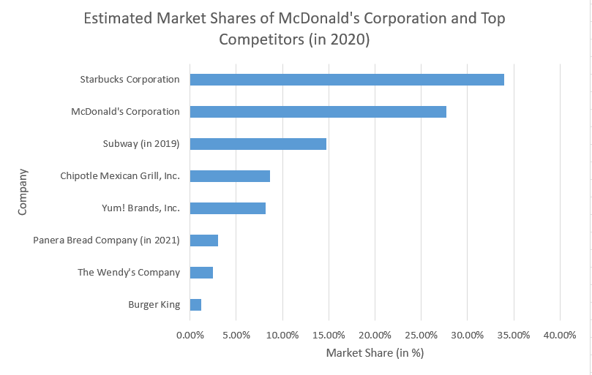
Market & Competitor Analysis
Target Market:
lower and middle-class (salary range of $48k-$65k)
males/females
ages 8-45
rural/urban areas (Thomas, n.d.)
Top Competitors
Estimated Market Share
Notes:
Target Market (of McDonald’s Corporation)
As for a general target market of McDonald’s Corporation, it is comprised of “lower and middle-class males and females between the ages of 8 and 45” in both rural and urban areas, with “both males and females [targeted] equally,” according to Thomas (n.d.). To capture the lower/middle-class customer types (salaries ranging from $48,000 to $65,000 per year), McDonald’s keeps prices low and affordable. McDonald’s provides Happy Meals with toys and sweet menu items to appeal to children customer types and offers free Wi-Fi services at store locations to appeal to young student customer types. Many of McDonald’s customers have a high degree of loyalty to the brand (Thomas, n.d.), which makes it possible for the company “to regain customers that were previously unhappy with the brand,” according to Thomas (n.d.). Moreover, some of McDonald’s customers are switchers, i.e., they eventually chose McDonald’s over other restaurants due to lower prices and better deals (Thomas, n.d.). This market is targeted by McDonald’s Corporation since these types of customers are most likely to eat and continue eating at McDonald’s, thus generating the most sales revenue for the company.
Top Competitors
However, McDonald’s has many major competitors, esp. within this target market, that take away significant market share, e.g., “by offering healthier food and different choices to [fast food],” according to Downie (2021). Such top competitors consist of the following: Burger King, “the most direct competitor for McDonald’s” due to its’ “Whopper challenging the Big Mac in the burger war,” according to Downie (2021); Wendy’s, a direct competitor that offers “burgers, fries, and other classic American food” much like McDonald’s, according to Downie (2021); Panera Bread Company, an indirect competitor; Yum! Brands, Inc. (namely consisting of Taco Bell, KFC, & Pizza Hut), an indirect competitor; Chipotle Mexican Grill (Downie, 2021), an indirect competitor that serves “tacos, burritos, bowls, and salads,” according to Downie (2021); Subway, an indirect competitor that sells sandwiches/salads (Downie, 2021) (but more geared towards the healthier side); and Starbucks, a major indirect competitor that serves “coffee, espresso, cappuccino, tea, pastries, sandwiches, and other foods,” with “some offerings that overlap with McDonald’s,” according to Downie (2021).
Estimated Market Share
By analyzing the financial performance, i.e., revenue, of McDonald’s Corporation’s and its’ major competitors, an estimated market share distribution for McDonald’s Corporation and its’ top competitors can be calculated for 2020. With Starbucks generating sales revenue of $23.518 billion (“Starbuck’s Corporation (SBUX) financials”, n.d.), McDonald’s Corporation $19.2078 billion (Macrotrends, 2022), Subway (in 2019) $10.2 billion (Lock, 2021a), Chipotle Mexican Grill $5.9846 billion (“Chipotle Mexican Grill, Inc. (CMG) financials”, n.d.), Yum! Brands, Inc. $5.652 billion 11 (“Yum! Brands, Inc. (YUM) financials”, n.d.), Panera Bread Company (in 2021) $2.1 billion (Macroaxis, 2021), Wendy’s $1.7338 billion (“The Wendy’s Company (WEN) financials”, n.d.), and Burger King $823 million (Lock, 2021b), McDonald’s estimated market share was ~27.75% in 2020, second to Starbucks’ market share of nearly 34% (refer to Figure above). This signals that McDonald’s is being outperformed by Starbucks and should take steps to regain the #1 spot, perhaps through re-vamping its’ food menu/prices to better cater to customers of Starbucks (perhaps to churn them to McDonald’s instead), but without losing its’ current customer base.

Slide 6
PMP Intended Results
Address issues recently experienced by McDonald’s Corporation (sexual harassment in workplace, high operating costs)
Maintain/improve performance of most important and relevant areas of mission/vision (with respect to restaurant operations) & product/service strategies:
Fast service with clean environment & friendly staff
High quality of products with wide variety & personalization
Invest in employees
Notes:
With respect to the four perspectives of the BSC, a range of intended results for the PMP apply. Within the learning & growth (employee perspective), employee management-related issues inherent to the franchise-based model of McDonald’s Corporation, as well as sexual harassment issues occurring in the workplace (Pratap, 2021), will be addressed by the PMP via assigned strategic objectives. As for the internal (business) processes and customer perspectives, McDonald’s Corporation caters to “a wide target market . . . [by offering] a [wide] variety of products,” according to Thomas (n.d.), each with varying low prices (Thomas, n.d.), as well as maintains high standards for serving high-quality food with “speed, choice, and personalization [the] customers expect,” according to McDonald’s (2022c). Moreover, with friendly service, a clean environment (Thomas, n.d.), and serving the food exactly as ordered (McDonald’s, 2022c) also in mind, the PMP will maintain these components of the business model with appropriately assigned strategic objectives in these perspectives. Another factor that should be addressed by the PMP within the customer perspective With specifically is customers’ opinion that more “high-quality food with healthier options” should be offered, according to Thomas (n.d.), as well as the customer profile information in the MyMcDonald’s Rewards program/app that can be leveraged to characterize customer types/segments with purchasing behavior. In terms of the financial perspective, “higher selling, general and administrative expenses, higher restaurant closing costs, and lower gains on sales of restaurant businesses” in 2020 (Watrous, 2021) should be addressed, as well as higher labor and raw materials costs, higher costs incurred from supply chain operations and logistics, and technology-related costs (Pratap, 2021). Decreasing revenues since 2013 is also a matter that must be addressed by the PMP with an appropriately assigned strategic objective within the financial perspective.

Slide 7
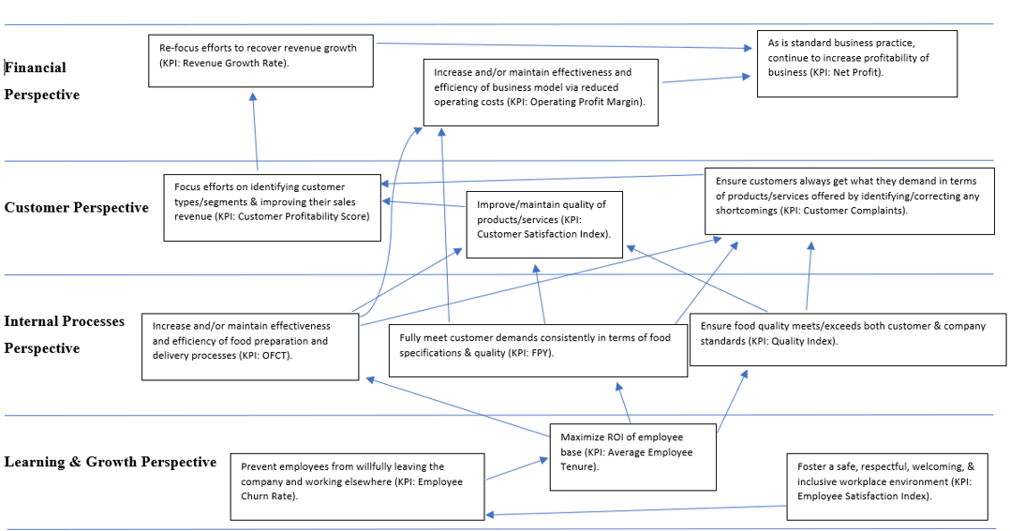
McDonald’s Corporation’s Strategy Map
Notes:
“A strategy map is a simple graphic that shows a logical cause-and-effect connection between strategic objectives,” where the “objectives in the lower perspectives drive the success of the higher ones,” according to Balanced Scorecard Institute (2021). Based on the current state of McDonald’s Corporation financially and in terms of business performance, as well as in alignment with its’ vision/mission (strategy) and product/service strategies, the strategy map of McDonald’s Corporation (specifically curtailed to its’ restaurant operations) will consist of the following key strategic objectives (within their appropriate BSC perspectives): within the learning & growth perspective, (1) foster a safe, respectful, welcoming, and inclusive workplace environment, (2) prevent employees from willfully leaving the company and working elsewhere, and (3) maximize ROI of employee base; within the internal (business) processes perspective, (4) ensure food quality meets/exceeds both customer and company standards, (5) fully meet customer demands consistently in terms of food specifications and quality, and (6) increase and/or maintain effectiveness and efficiency of food preparation and delivery processes; within the customer perspective, (7) ensure customers always get what they demand in terms of products/services offered by identifying/correcting any shortcomings, (8) improve/maintain quality of products/services, and (9) focus efforts on identifying customer types/segments and improving their sales revenue; within the financial perspective, (10) re-focus efforts to recover revenue growth, (11) increase and/or maintain effectiveness and efficiency of business model via reduced operating costs, and (12) as is standard business practice, continue to increase profitability of company. In terms of cause-effect relationships between these strategic objectives, (1) -> (2) since happier employees will more likely stay working for the company. (2) ->(3) because fewer employees leaving over time will lengthen the amount of time they stay working for the company (plus maximize ROI of any employee training). Furthermore, (3) -> (4, 5, 6), i.e., maximizing ROI of employees will raise food quality standards, enable meeting food specifications of customers (having long-term, trained staff provides seasoned experience in making/serving food properly and correctly), and increase efficiency of food preparation/delivery (having long-term, trained staff provides seasoned experience in faster making/serving of food). (4, 5, 6) -> (7, 8) since quality of products/services will be improved/maintained and shortcomings will be minimized through achievement of these causal internal business process strategic objectives. Moreover, (5, 6) -> (11) because of the following: fully meeting customer demands/food specification requests prevents re-work/subsequently reduces operating costs; and increasing/maintaining effectiveness/efficiency of food preparation and delivery methods will also reduce operating costs. Within the customer perspective, (7, 8) -> (9) since minimizing errors in customer service and keeping customers happy (by improving/maintaining quality of products/service) drastically increases the likelihood of customers remaining long-term customers and adding more value to the company. With additional insights from identifying the customer types/segments, the company can execute additional customer strategies to further retain these customers. (9) -> (10) because by improving customer sales (through customer type/segmentation identification), more revenue can be generated. Within the financial perspective, (10, 11) ->12 since generating more revenue and reducing operating costs leads to higher profitability.

Slide 8
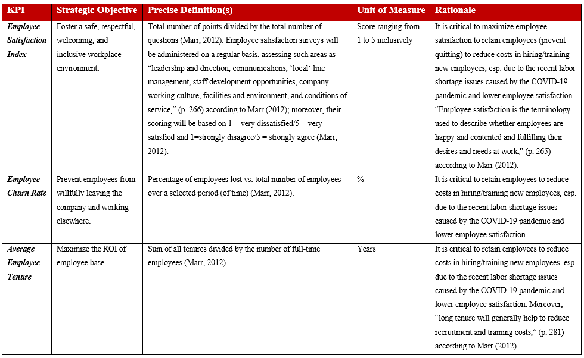
Defined & Documented Selected Measures – Learning & Growth Perspective

Slide 9
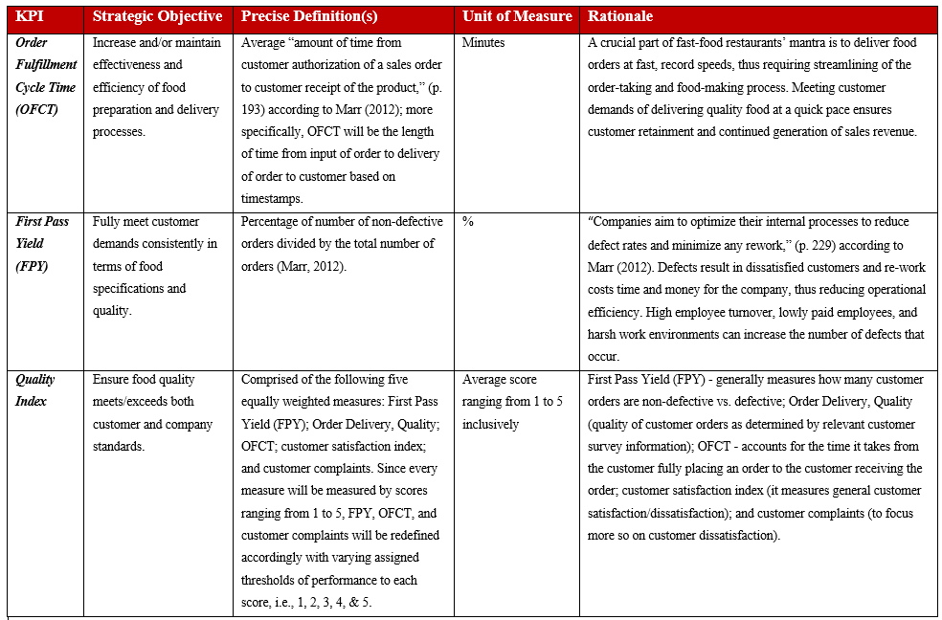
Defined & Documented Selected Measures – Internal (Business) Processes Perspective

Slide 10
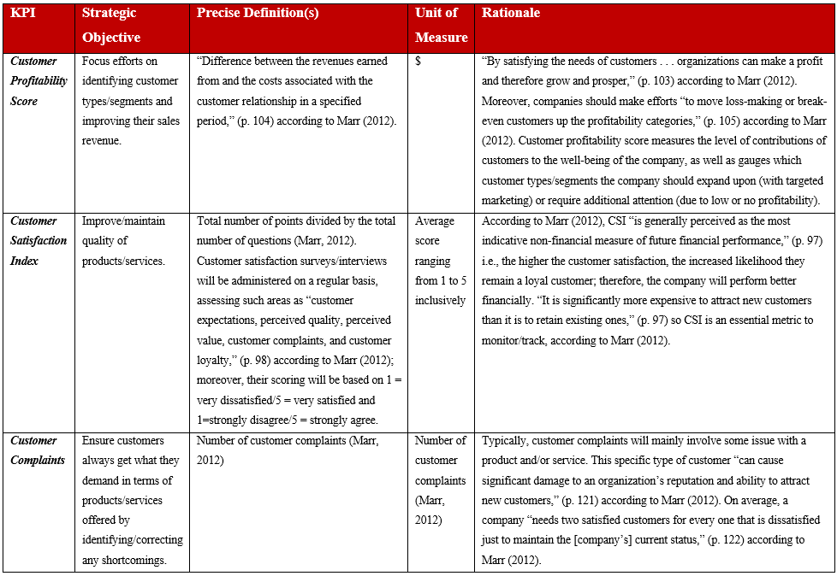
Defined & Documented Selected Measures – Customer Perspective

Slide 11
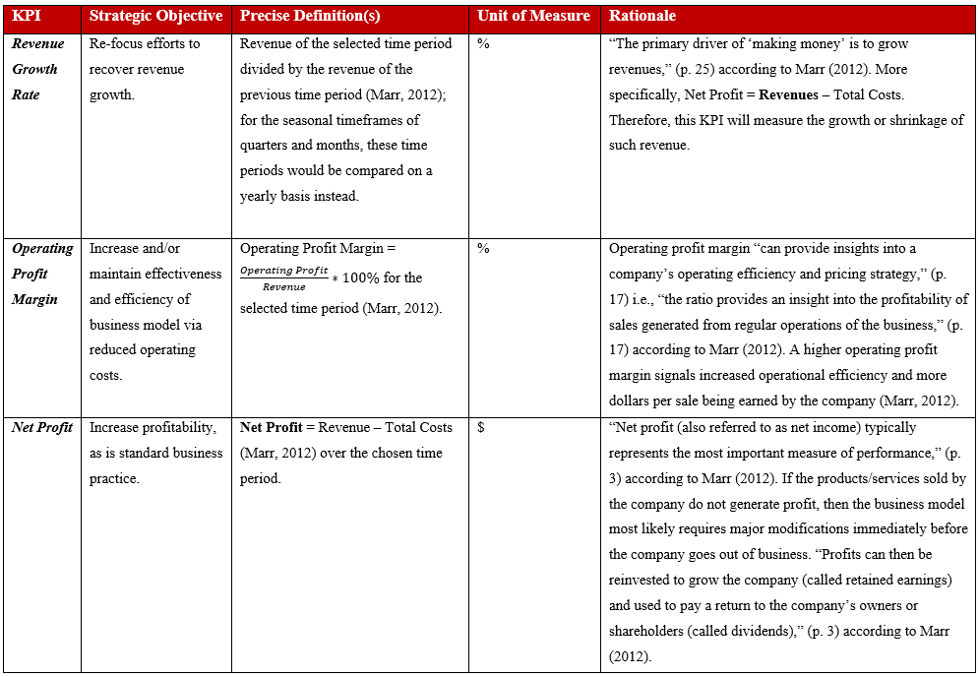
Defined & Documented Selected Measures – Financial Perspective

Slide 12
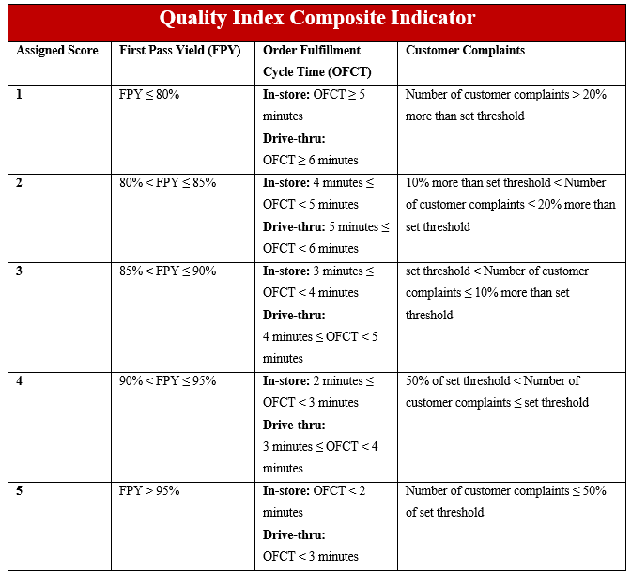
Defined Composite Indicator(s) – Quality Index
In general, performance
better than threshold yields
score of 4 & performance
better than target yields
score of 5; performance
worse than threshold scales
accordingly with scores
below 4.
Notes:
Notes: Customer Satisfaction Index is already rated as a score ranging from 1 to 5 inclusively, so no re-defining of the KPI measure is needed for the Quality Index composite indicator. The Order Delivery, Quality KPI score will be determined by the average score of all questions related to products/services of McDonald’s Corporation within customer surveys (random audits by McDonald’s management that assess quality of goods/services with additional survey questions of similar scoring method can also be included in the computation of this KPI – in such a case, the average score across both of these data sources for the chosen time period will be the overall score computed for this KPI). For OFCT, an average of the OFCT scores for in-store and the drive-thru would be calculated for an overall OFCT score (for use in the quality index).

Slide 13
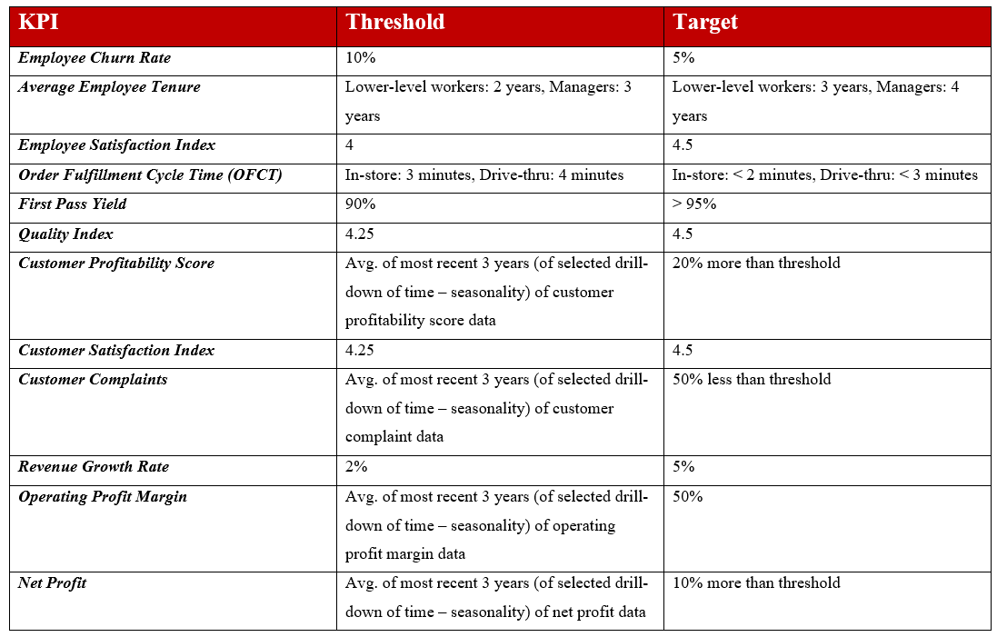
Established Targets & Thresholds

Slide 14
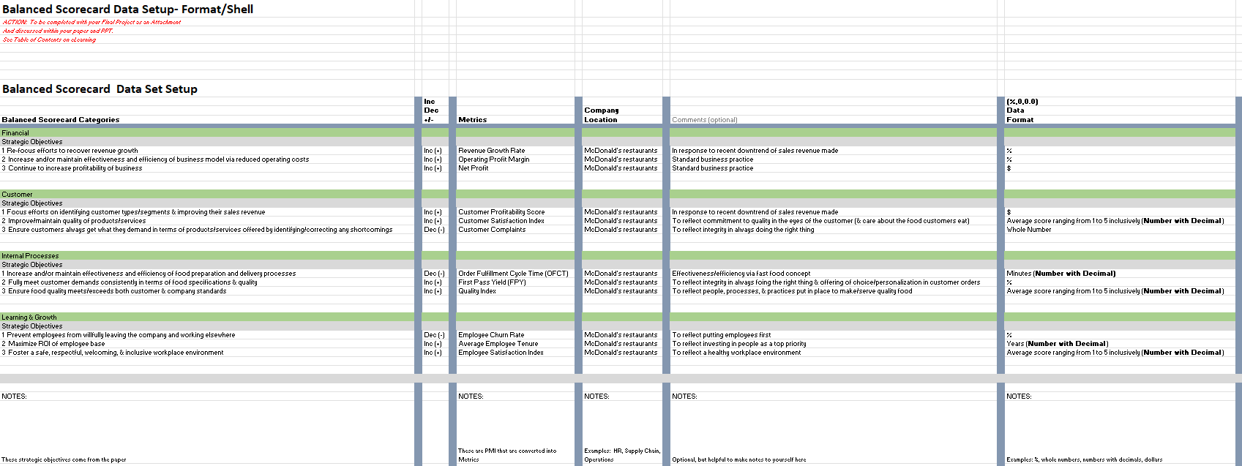
Mock-up BSC for McDonald’s Corporation
Notes:
Proposed Scorecard Overview
The proposed BSC will consist of the following columns: “Balanced Scorecard categories,” which will consist of the four categories of the BSC with assigned strategic objectives; “Inc/Dec (+/-)” to signify if positive or negative movement of the KPI is desired (for better performance); “Metrics” to indicate the KPI assigned to the respective strategic objective; “Company Location” to represent where the KPI measures performance within the company; “Comments (optional)” where the associated part of the company’s mission/vision (strategy) applicable to the strategic objective chosen/assigned will be displayed; “Data Format” to show the unit of measure of the KPI; any columns related to the data of the KPI, e.g., the months throughout the year from January to December, to display the KPI’s applicable data at the respective collection frequency/timing; and “Overall” to display the overall reading of the KPI (aggregated). To display other drill-down levels of the KPI, expansion of the BSC to dashboard format will enable this. This BSC will serve to measure performance in four key areas of the business, i.e., the learning & growth (employee), internal processes, customer, and financial perspectives, each with assigned strategic objectives that aim to improve the performance of McDonald’s Corporation’s restaurants.

Slide 15
Additional Scorecard Elements – Proposed Automation Tool
SQL database (ACID properties):
Atomicity
Consistency
Isolation
Durability (EssentialSQL, 2021)
MS Excel (for display of BSC & dashboards)
Notes:
Use of a SQL database would enable reliable automation of data collection and data computation/aggregation (with pre-programmed queries), much due to its’ inherent ACID properties (A – Atomicity, C – Consistency, I – Isolation, and D – Durable). Atomicity is described by its’ ability to enforce an “all or nothing” constraint on database transactions, i.e., a database will only save data if all of it is successfully written into the database (all transactions go through successfully) (EssentialSQL, 2021). Moreover, consistency is maintained since “saved data cannot violate the integrity of the database,” according to EssentialSQL (2021). A SQL database is isolative due to transactions not being able to interfere/affect other transactions taking place, dependent on the type of lock applied (only one transaction can take place on the same tables/data in question). Lastly, the durability of a SQL database is held since “system failures or restarts do not affect committed transactions,” according to EssentialSQL (2021). A way to automatically retrieve the data from all relevant data sources, i.e., the electronic employee surveys, electronic customer surveys, electronically recorded customer interviews, built-in POS system, electronic employee payroll records/HR system, and MyMcdonald’s Rewards/McDonald’s app, would need to be established with a correctly programmed, repeatable data pipeline. Data computations/aggregations using SQL can then be run in respective MS Excel cells to generate the required results of the BSC. Dashboards with constructed data visualizations can then be created within MS Excel to visualize the data, i.e., displaying varying aggregations of data across different time periods/granularities enables trend analysis.

Slide 16
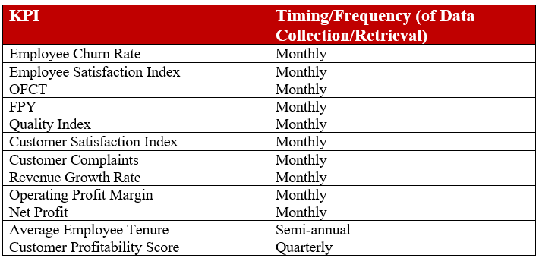
Additional Scorecard Elements – Collection & Monitoring Plan
Standardization of data format – CSV
Abnormal/lack of readings – indicates data input issues
SQL database is restrictive with data types
Notes:
As for the periodicity of data collection, this will depend on the KPI being measured. For Employee Churn Rate, Employee Satisfaction Index, OFCT, FPY, Quality Index, Customer Satisfaction Index, Customer Complaints, Revenue Growth Rate, Operating Profit Margin, and Net Profit, any data associated with these KPIs will be collected on a monthly basis. Average Employee Tenure data will be collected on a semi-annual basis, and Customer Profitability Score data will be collected on a quarterly basis. Collecting data in CSV format would enable standardization of subsequent processing of the data. Abnormal (much due to NULL values) or a lack of readings will indicate the data is not incoming correctly, Since a SQL database is very restrictive about what data types can be entered into respective columns of a table (these are established beforehand), any errors in data type within the data will prevent “write” operations from executing (in which case, closer inspection will be needed to pinpoint the issues in the data, then corrected accordingly).

Slide 17
Additional Scorecard Elements – Plan of Analysis of the Data
Reading KPI thresholds vs. targets
Pinpoint problem areas of business (take applicable managerial action(s)), as well as well-performing areas
Investigate why areas of business are performing well and disseminate to poorly performing areas of business (this will improve the business over time)
Abnormal/lack of readings – indicates data input issue & won’t be considered for use until fixed/accurate
Notes:
In general, if a KPI were to read below/above its’ established threshold (depending on if a + or – change in the indicator is desired respectively), managerial/procedural action(s) would be taken to resolve such poor performance (depending on the KPI being read). If a KPI were to read above/below its’ established target (depending on if a + or – change in the indicator is desired respectively), further investigation into why the KPI is showing such good performance could be initiated (the chosen level of drill-down would pinpoint where to investigate); management would then try to disseminate such findings to applicable poorly performing areas of the business to provide a means to improve their performance and recreate the exemplary performance. If readings are abnormal and/or not showing, further investigation into any issues with the data sources would be initiated (this is most likely origin since all SQL queries would be unalterable and pre-programmed).

Slide 18
Additional Scorecard Elements – Performance Improvement Plan
Incorporate ISR to maintain & continue to improve supply chain/logistics of McDonald’s Corporation – warehousing/distributing
ISR – “loss of products between the point where a product is produced or purchased and the point where it is sold,” (p. 201) according to Marr (2012)
Further expand PMP to manage performance of other regions/countries
Add procedural managerial action(s) to respond accordingly to KPI reading of respective strategic objective
Notes:
McDonald’s Corporation has “one of the world’s best supply chains,” according to Shrum (2018). Moreover, McDonald’s has strategically placed warehouses across the world to distribute its’ raw products to stores efficiently. To maintain this good performance, inclusion of Inventory Shrinkage Rate within the PMP should be included future revisions (it would be applied across the entire lifecycle of the products – starting with the supplier and ending at the store). “Inventory shrinkage refers to the loss of products between the point where a product is produced or purchased and the point where it is sold,” (p. 201) according to Marr (2012), thus unnecessary loss of products could be measured/monitored by this KPI. On the other hand, expanding the PMP to other regions of the globe where McDonald’s Corporation conducts business would be warranted to manage performance globally rather than just in the US market (though further financial, market & competitor analysis would need to be performed for each region to best design the PMP). Lastly, adding specific managerial procedural actions in response to each strategic objective/KPI and its’ readings/measures (above/below threshold or target) would be warranted.

Slide 19
Plan Recap/Request of Approval
Review McDonald’s Corporation’s Strategy Map (Slide 7)
Assigned strategic objectives address recent issues, both financial and business, as well as serve to maintain/improve current mission/vision
Approval sought to proceed with implementation of proposed PMP for McDonald’s Corporation restaurants in US market
Do I have your approval to proceed with this plan?
Notes:
Plan Recap
As per the proposed PMP, the following strategic objectives (derived from the mission/vision of McDonald’s Corporation and any pertinent issues in recent business performance) and respective KPIs are assigned to the four BSC perspectives accordingly: within the learning & growth perspective, (1) foster a safe, respectful, welcoming, and inclusive workplace environment (KPI: Employee Satisfaction Index), (2) prevent employees from willfully leaving the company and working elsewhere (KPI: Employee Churn Rate), and (3) maximize ROI of employee base (KPI: Average Employee Tenure); within the internal (business) processes perspective, (4) ensure food quality meets/exceeds both customer and company standards (KPI: Quality Index), (5) fully meet customer demands consistently in terms of food specifications and quality (KPI: FPY), and (6) increase and/or maintain effectiveness and efficiency of food preparation and delivery processes (KPI: OFCT); within the customer perspective, (7) ensure customers always get what they demand in terms of products/services offered by identifying/correcting any shortcomings (KPI: Customer Complaints), (8) improve/maintain quality of products/services (KPI: Customer Satisfaction Index), and (9) focus efforts on identifying customer 28 types/segments and improving their sales revenue (KPI: Customer Profitability Score); within the financial perspective, (10) re-focus efforts to recover revenue growth (KPI: Revenue Growth Rate), (11) increase and/or maintain effectiveness and efficiency of business model via reduced operating costs (KPI: Operating Profit Margin), and (12) as is standard business practice, continue to increase profitability of company (KPI: Net Profit). “Effective managers and decision-makers understand the performance of all key dimensions of their business by distilling them down into the critical KPIs,” (p. xxv) according to Marr (2012), and this PMP harnesses such an important concept of PM fully.
Request of Approval
This PMP would be helpful to McDonald’s Corporation for a myriad of reasons. Within the learning & growth (employee perspective), employee management-related issues inherent to the franchise-based model of McDonald’s Corporation, as well as sexual harassment issues occurring in the workplace (Pratap, 2021), are addressed by the PMP. As for the internal (business) processes and customer perspectives, McDonald’s Corporation caters to “a wide target market . . . [by offering] a [wide] variety of products,” according to Thomas (n.d.), each with varying low prices (Thomas, n.d.), as well as maintains high standards for serving high-quality food with “speed, choice, and personalization [the] customers expect,” according to McDonald’s (2022c). With friendly service, a clean environment (Thomas, n.d.), and serving the food exactly as ordered (McDonald’s, 2022c) also in mind, this PMP will maintain these components of the business model. Another factor that would be addressed by the PMP within the customer perspective specifically is customers’ opinion that more “high-quality food with healthier options” should be offered, according to Thomas (n.d.), as well as the customer profile information in the MyMcDonald’s Rewards program/app that can be leveraged to characterize customer types/segments with purchasing behavior. In terms of the financial perspective, “higher selling, general and administrative expenses, higher restaurant closing costs, and lower gains on sales of restaurant businesses” in 2020 (Watrous, 2021) are addressed by the PMP, as well as higher labor and raw materials costs, higher costs incurred from supply chain operations and logistics, and technology-related costs (Pratap, 2021). Decreasing revenues since 2013 is also a matter that is addressed by the PMP. To implement such a PMP, the first step will be to set up any data sources not already in place, e.g., creation of electronic customer/employee surveys and any features lacking in the current POS system (such as marking when order is defective or not). Following this step, any data storage capabilities not already in place would need to be incorporated, i.e., setting up a SQL database with proper data modeling and sufficient data storage volume. Thirdly, designing a correctly programmed, repeatable data pipeline to retrieve and store the data within the SQL database would be warranted. The fourth and subsequent step would be to code any SQL queries needed to compute/aggregate the chosen KPIs within the PMP’s BSC. 29 Lastly, programming of the thresholds/targets of the KPIs within the BSC would be needed to indicate poor/satisfactory/exemplary performance. In conclusion, approval is sought to immediately proceed with the incorporation of this proposed PMP into McDonald’s Corporation’s PM system for the US market only from now and into the future. Do I have your approval to proceed with this plan?

Slide 20
References
Altimetry (2019, October 22). McDonald’s can’t franchise away its problems. https://seekingalpha.com/article/4297817-mcdonalds-cant-franchise-away-problems
Balanced Scorecard Institute (2021). What is a strategy map? https://balancedscorecard.org/bsc-basics/what-is-a-strategy-map/
Chipotle Mexican Grill, Inc. (CMG) financials. (n.d.). Retrieved January 14, 2022 from https://finance.yahoo.com/quote/CMG/financials?p=CMG
Cokins, G. (2009). Performance management: Integrating strategy execution, methodologies, risk, and analytics. John Wiley & Sons, Inc.
Downie, R. (2021, September 27). Who are McDonald’s main competitors? https://www.investopedia.com/articles/markets/102815/who-are-mcdonalds-main-competitors.asp

Slide 21
References (cont.)
EssentialSQL (2021, October 24). SQL ACID database properties explained. EssentialSQL. https://www.essentialsql.com/sql-acid-database-properties-explained/
Lock, S. (2021a, April 22). Sales of Subway restaurants in the U.S. 2015-2019. https://www.statista.com/statistics/464277/subway-us-sales/
Lock, S. (2021b, November 29). Net income of Burger King worldwide 2014-2020. https://www.statista.com/statistics/222950/burger-king-net-income/#:~:text=World%20famous%20burger%20fast%20food%20chain%20Burger%20King,previous%20year%27s%20total%20of%20994%20million%20U.S.%20dollars.
Macroaxis. (2021). Panera financial statements from 2010-2022. https://www.macroaxis.com/financial-statements/PNRA

Slide 22
References (cont.)
Macrotrends. (2022). McDonald’s financial statements 2005-2020. https://www.macrotrends.net/stocks/charts/MCD/mcdonalds/financial-statements
Marr, B. (2012). Key performance indicators: The 75 measures every manager needs to know. Pearson Education Ltd.
McDonald’s. (2022a). About our food. https://www.mcdonalds.com/us/en-us/about-our-food.html
McDonald’s. (2022b). MyMcDonald’s Rewards. https://www.mcdonalds.com/us/en-us/mymcdonalds.html
McDonald’s. (2022c). Our mission and values. https://corporate.mcdonalds.com/corpmcd/our-company/who-we-are/our-values.html
McDonald’s. (2022d). Values in action. https://www.mcdonalds.com/us/en-us/about-us/values-in-action.html

Slide 23
References (cont.)
Pratap, A. (2021, November 28). McDonald’s SWOT Analysis 2021. Notesmatic. https://notesmatic.com/mcdonalds-swot-analysis-2021/
Samson, R. (2020, March 11). The business strategy of McDonald’s. https://www.profolus.com/topics/the-business-strategy-of-mcdonalds/
Shrum, A. (2018, April 18). An outline of McDonald’s wildly successful supply chain management. Dynamic Inventory. https://www.dynamicinventory.net/mcdonalds-best-supply-chain-management/
Starbuck’s Corporation (SBUX) financials. (n.d.). Retrieved January 14, 2022 from https://finance.yahoo.com/quote/SBUX/financials?p=SBUX
Thomas, M. (n.d.). McDonald’s target market (age, gender, salary + more). QuerySprout. https://querysprout.com/mcdonalds-target-market/

Slide 24
References (cont.)
Vaujour, G. (2018, February 26). McDonald’s logistics. The Blog of Logistics at MGEPS at UPV. https://logisticsmgepsupv.wordpress.com/2018/02/26/mcdonalds-logistics/
WallStreetZen. (2022). McDonald’s Corp. statistics and facts. https://www.wallstreetzen.com/stocks/us/nyse/mcd/statistics
Watrous, M. (2021, January 29). McDonald’s management lays out 2021 strategic priorities. https://www.foodbusinessnews.net/articles/17805-mcdonalds-management-lays-out-2021-strategic-priorities
The Wendy’s Company (WEN) financials. (n.d.). Retrieved January 14, 2022 from https://finance.yahoo.com/quote/WEN/financials?p=WEN
Yum! Brands, Inc. (YUM) financials. (n.d.). Retrieved January 14, 2022 from https://finance.yahoo.com/quote/YUM/financials?p=YUM

