Slide 1

Incognito
Miaozhi Chen & Rohini Machavolu

Slide 2
About Us
Target Audience
Why Incognito
App Description
Timeline

Slide 3
About Us

Slide 4

What is Incognito?
Incognito is an anonymous chat platform designed for users who value privacy and secure communication. Here are the main features of Incognito:
Topic-Based Timed Chat Rooms: chat rooms are created based on specific topics and hav time limit. Chat rooms will be closed once reach time limit.
Chat history will be destroyed: once a chat room is closed, all messages in it will be permanently erased.
Group Chat Only: Incognito does not support direct message. It only supports group chat.

Slide 5
Target Audience

Slide 6

Target Audience
Privacy-conscious users These individuals prioritize privacy and security in their communication. They want to ensure that their conversations are not saved or traceable, especially when sharing sensitive information.
Teens and young adults.
Users between the ages of 13 and 30 are likely to find the app appealing. They value anonymity, and the app’s ephemeral messaging allows them to express themselves freely without the fear of leaving a permanent record.
Users who want temporary chat
These users prefer temporary interactions with no need for maintaining long-term connections or archived conversations. Incognito serves as a platform for them to engage, get information, and move on without lingering chat histories.

Slide 7
Why Incognito

Slide 8

SlidesCarnival
Dark Minimalist
08/12/2024
Why we need Incognito
Incognito brings different values from it competitors. Below is a comparison between Yik Yak (the most popular anonymous chat app currently) and Incognito.
Yik Yak
Incognito
Group chat has no time restrictions
Users typically seek short-term casual conversations and may not want to be tied to a topic for an extended period.
Without time restrictions, inactive groups can dilute the user base by splitting attention across too many low-activity groups
Chat history will not be deleted
Knowing that the conversations will be saved indefinitely could cause concern, especially for those who value privacy or wish to have more control over the longevity of their messages
Student verification required
Student verification exposes users' privacy.
Student verification restricts access to non-student users, potentially limiting the platform's broader user base
Group chat has time restrictions
Users don't have to worry about being tied to a chat group long-term.
Time limits encourage users to actively participate in topics they are interested in.
Chat history will be deleted
Since chat history will be deleted, users don't need to worry about what they say.
Verification is not required
This is an app for everyone.
Requiring identity verification in an anonymous chat app is unnecessary. Such verification could become a barrier to users adopting the app.

Slide 9
APP Design

Slide 10
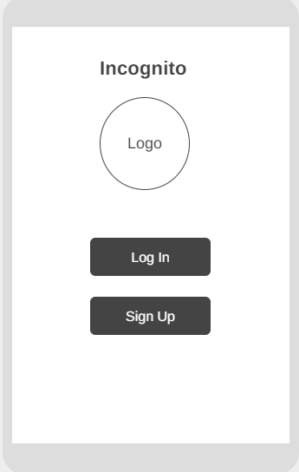
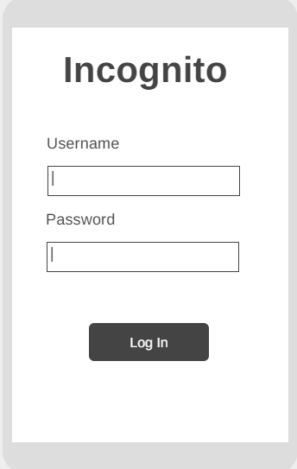
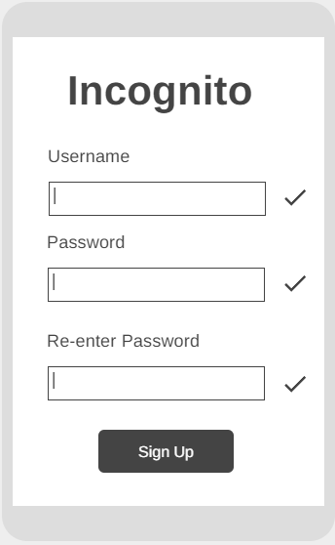
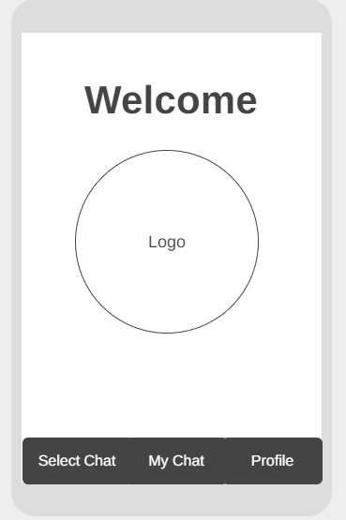
Landing Page + Login Page + Sign Up Page + Welcome Page

Slide 11
Landing Page + Login Page + Sign Up Page + Welcome Page
In the landing page, user is able to either sign up for a new account or log in with existing account. Click ‘Log in’ button will direct to log in page and click ‘Sign Up’ will direct to sign up page.
In log in page, user can log in with existing username and password.
In sign up page, user can sign up with username and password. The icon in the left of username indicate if the username is unique. The icon in the left of password indicates if the password meets requirements (e.g. contains letters and numbers). The icon in the left of re-renter password indicates if the re-entered password meets the original one. We don’t require information like email or phones. Besides, we don’t support ‘forget my password’ feature because for Incognito users, the experience of using a new account and using previous account is the same.
In the welcome page, there are three buttons, redirecting users to corresponding pages. We will talk about those pages in the next slide.

Slide 12
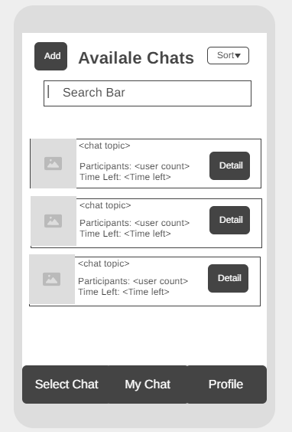
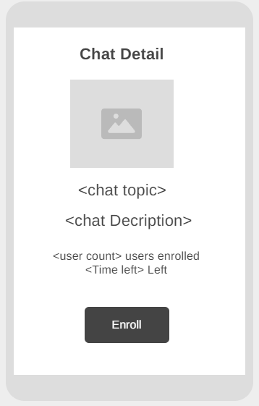
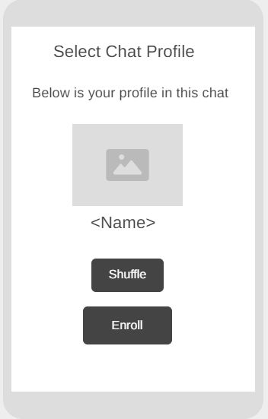
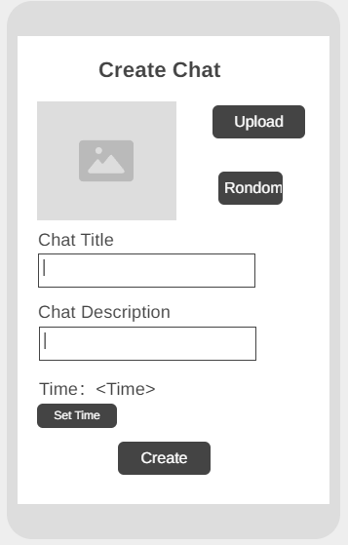
Select Chat Page+ Chat Detail Page + Set Chat Profile + Create Chat Page

Slide 13
Select Chat Page+ Chat Detail Page + Set Chat Profile + Create Chat Page
In the Select Chat Page, user is able to see, searh, create and enroll chats. Create button will direct user to the create chat page. Chat detail button will direct user to chat detail page. Search bar is for user to search chats based on chat name. Sort button allow user to sort chats based on enrolled user count.
In Chat Detail Page, user can see the detail info of the chat. Click the enroll button will direct user to set chat profile page.
In Set Chat Profile Page, user can set the profile pic and name for this chat. User can’t input pic or name. Instead, user can click shuffle button and get random pic and name. Click enroller will direct user to the chat page, which will be covered later.
In the Create Chat Page, user can create a new chat. Click upload will direct user to local album and user can upload a pic. Click random will generate a random pic. Click set time will pop up a time picker. Click create will create the chat and go back to the select chat page.

Slide 14
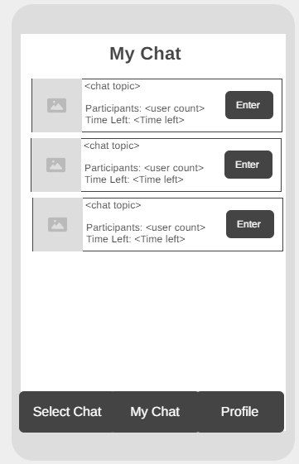
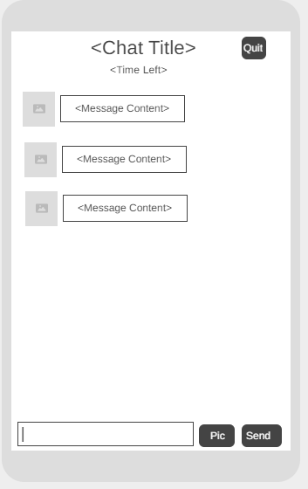
My Chat Page+ Chat Page

Slide 15
My Chat Page+ Chat Page
In the My Chat Page, user is able to see all enrolled chats and click enter button direct user to the chat page.
In the Chat Detail Page, user is able to chat with others. Clicking quit button will let user leave and direct user back to the My chat page. Click send will send message and click pic button allows user to upload a image from camera or from local album.

Slide 16
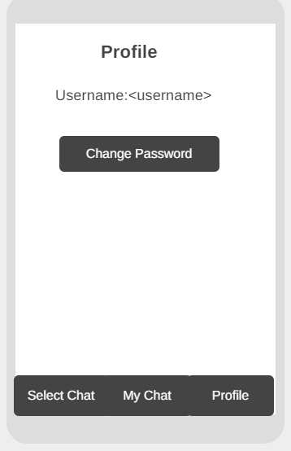
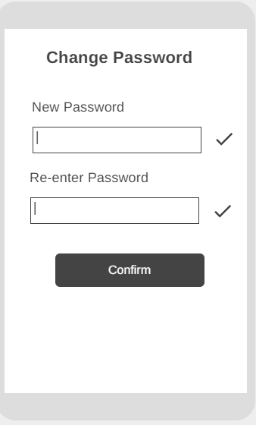
Profile Page + Change Password Page

Slide 17
Profile Page + Change Password Page
The Profile Page is very simple because we don’t need and want much profile info from user. We might add a membership feature here but right now it only has a change password button. Clicking change password button will direct user to the change password page.
In the Change Password Page, user is able to set a new password.The icon in the left of password indicates if the password meets requirements (e.g. contains letters and numbers). The icon in the left of re-renter password indicates if the re-entered password meets the previous one. Clicking confirm button will change password and direct user back to profile page.

Slide 18
Backend
Profile: We intend to implement user authentication using Google’s FirebaseAuthentication.
Database: We use Firebase Realtime Database to store user data.
Chat Feature: We intend to use Firebase UI oto implement the chat feature.

Slide 19
Sensors
We use camera and photo album to enable uploading pictures.
Although using location might seem suitable for an anonymous chat app, we believe it is unnecessary because it against the concept of being anonymous, and therefore will not implement it.

Slide 20
Timeline

Slide 21
Oct 25: Implement the login feature
Nov 7: Implement the select chat feature
Nov 21: Implement the chat feature
Nov 28: Implement the profile feature
Dec 4 : Finish project and upload

