Slide 1

INFX562
Interactive Information Visualization
Interactive Visualization of
Fatal Collisions
Across the States
Wang Chen
1627262

Slide 2
Schema of Data
State | US states names
Geotype | Every state has a geography category indicating which area the state belongs to. (cw – Central Western, ne – Northeastern, s – Southern, w – Western)
FatalPerBillionMiles | Number of fatal collisions per billion miles in that state
Speeding | Percentage Of Drivers Involved In Fatal Collisions Who Were Speeding
Alcohol-Impaired | Percentage Of Drivers Involved In Fatal Collisions Who Were Alcohol-Impaired
Distracted | Percentage Of Drivers Involved In Fatal Collisions Who Were Distracted
Car Insurance Premiums | How much the insurance company will pay ($)
Insurance Incurred per Driver | Losses incurred by insurance companies for collisions per insured driver ($)

Slide 3
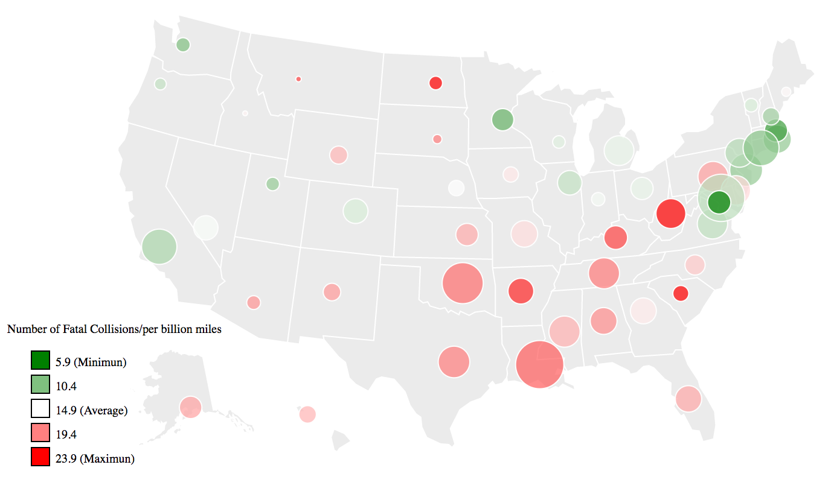
Interactive EDA
Overview of the dataset
Geographical distribution pattern
Dig deeper into details
Causes of fatal collisions
Regression Analysis
Insurance pricing policy

Slide 4
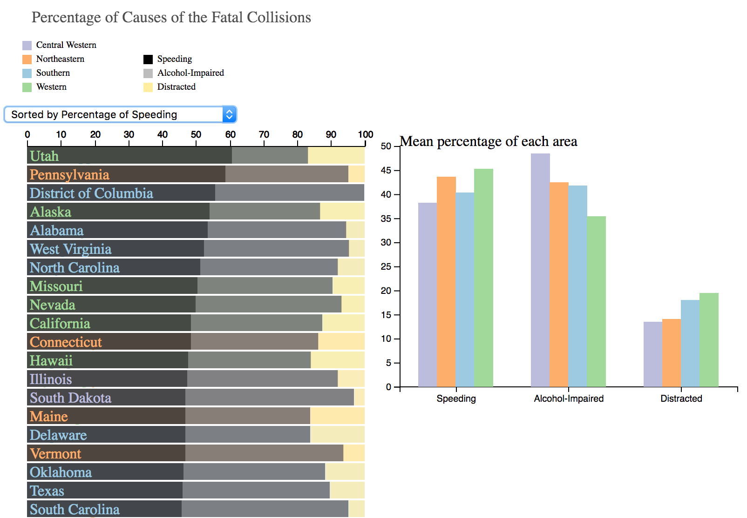
Interactive EDA
Overview of the dataset
Geographical distribution pattern
Dig deeper into details
Causes of fatal collisions
Regression Analysis
Insurance pricing policy

Slide 5
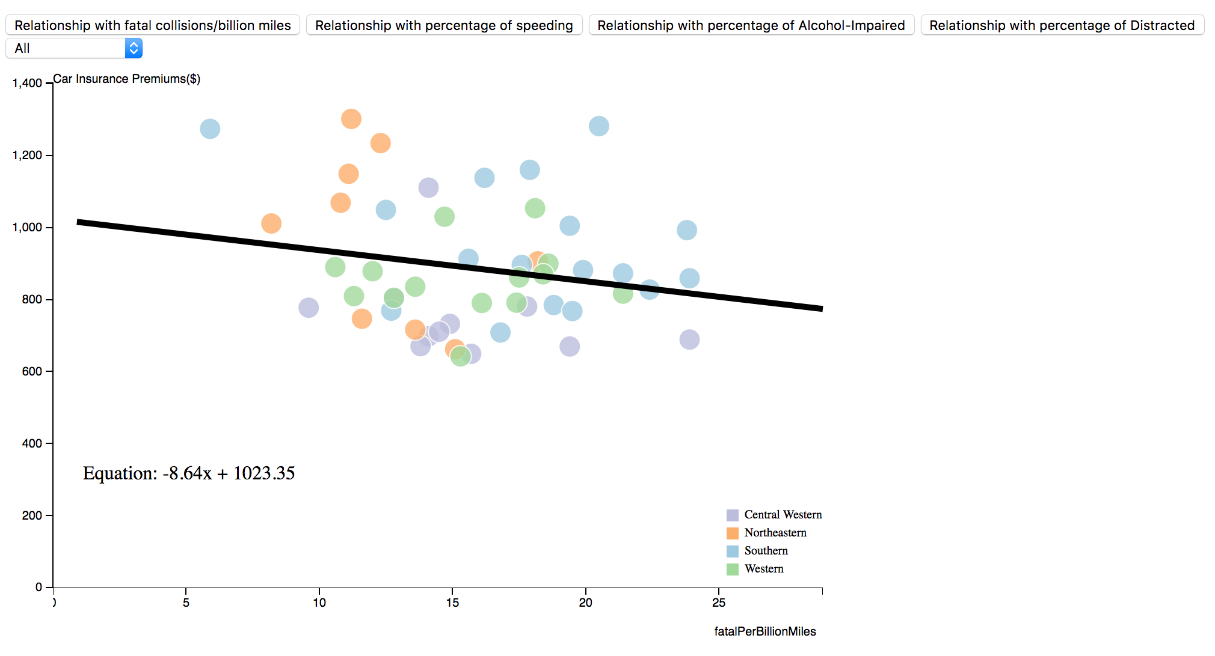
Interactive EDA
Overview of the dataset
Geographical distribution pattern
Dig deeper into details
Causes of fatal collisions
Regression Analysis
Insurance pricing policy

